Slide 1
26th Annual Conference
San Antonio, Texas
September 26-28

Slide 2
Addressing the Unique Employment Needs of Tribal Nations today & the foreseeable future
Paula Allen & Tyler Anderson

Slide 3
Presentation AGENDA
Statistics & Averages
Washington Tribal Results
Impact & Benefits
Immediate Adjustments
Front-Line Development
Measured Results to Expectations

Slide 4
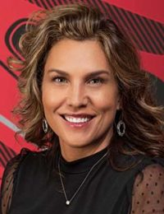
Presenting Team
17 Years of HR Leadership Experience
Responsible for creating one of the countries leading work environments at 7 Cedars
Recipient of multiple industry awards & recognition
Certified HR Trainer
Over 20 Years of leadership experience
17 years of Tribal experience
Active Member for 5 Tribal Boards across the U.S.
THRP, CRPS Certifications
Paula Allen
Tyler Anderson
Director of Leadership Development
Vice President U.S. Tribal Markets

Slide 5
Our why:
The essence of tribal sovereignty is the ability to govern and to protect and enhance the health, safety, and welfare of tribal citizens within tribal territory. Tribal governments maintain the power to determine their own governance structures and enforce laws through police departments and tribal courts. The governments exercise these inherent rights through the development of their distinct forms of government, determining citizenship; establishing civil and criminal laws for their nations; taxing, licensing, regulating, and maintaining and exercising the power to exclude wrongdoers from tribal lands.
In addition, tribal governments are responsible for a broad range of governmental activities on tribal lands, including education, law enforcement, judicial systems, health care, environmental protection, natural resource management, and the development and maintenance of basic infrastructure such as housing, roads, bridges, sewers, public buildings, telecommunications, broadband and electrical services, and solid waste treatment and disposal.
NCIA

Slide 6
What's AT STAKE?
Tribe:
Continued recruiting struggles
Increased employment expense
Lost opportunities for sustained & profitable growth
Employee:
Insecure job stability
Lack of engagement in position
Lack of commitment to advance in their career leading to missed opportunities for income and professional growth

Slide 7
The path to success
Current state of Tribes
How are we doing in comparison to our goal?
Immediate Tribal Citizen Needs
Where do we start? Where should the focus be?
Front-Line Development
Why is it important to invest in our front-line leadership
Develop Change Readiness
We need to be in the mindset of positive change.
Where does your organization start?
What are the first steps?

Slide 8
Example Washington State tribal stats
Where are we and how are we doing in relation to our Tribes Goals?

Slide 9
Retirement income disparity
Disparity in American Indian Retirement Income:
American Indian Alaska Natives $4,600 annual
African American (Black) $5,800 annual
Caucasian (White) $7,000 annual
*Results are from a 2009 study and released by the Social Security Administration 01-2015
52% Less!

Slide 10
Social security income disparity
Disparity in American Indian Social Security Income:
American Indian Alaska Natives $6,200 annual
African American (Black) $7,900 annual
Caucasian (White) $9,800 annual
*Results are from a 2009 study and released by the Social Security Administration 01-2015
58% Less!

Slide 11
Support & Education Disparity
Factors that Impact Retirement:
Access to Industry Professionals
Access to Money Management and Investment Vehicles
Access to Tools and Resources to Properly Plan
Consistency of Access to Previously Mentioned

Slide 12
WIGA Stats 2020
Jobs
37,371 jobs generated
54,000 jobs traced back to tribes
72% non-Indian employees

Slide 13
The way to get started is to quit talking and begin doing.
Walt Disney

Slide 14
Indian Socioeconomic Status lags
Income per person
Unemployment
College Attainment
All persons in WA $39,401
American Indians $18,683
All persons in WA 4.9%
American Indians 15.8%
All persons in WA 36%
American Indians 9.7%

Slide 15
The Immediate Needs of our Tribal Citizens
Immediate Actionable Plans need to be in place in order to turn this statistic around Fast!

Slide 16
Importance of Tribal Youth & Tribal Citizens
Small Changes make a big impact
We need to develop future tribal leaders
Focus on three areas
Tribal Youth
Tribal Citizens
Tribal History

Slide 17
Put your plan together
Tribal Youth
Tribal Citizen
Tribal History
Children’s Programs
Youth Leadership/Mentors
Teen Career Development
College Team
Employment Coaches
Meet one-on-one with Executive Team
Connect with Employment Coach
Leadership/Self-Development Skills
Actively work on next step
Create an education module that explains the unique needs of tribal organizations. Explain where we are, how we got here and where we are going so every team member agrees to this unique relationship

Slide 18
The importance of Front-Line Development
Who are the front line employees?
What are the risks if we don’t?

Slide 19
Engage your Senior Leadership Team
Take inventory
Focus on these areas
Morale
Cost
Productivity
Quality

Slide 20
Leadership Development
Self-Development
Leading Others
Leading Teams
Enneagram
Assess health, finance
Plan & Prioritize
Create Support System
Learn techniques of developing strong professional relationships
Create Development Plans for their team members
Create Communication systems
Establish Team Purpose and gain Clarity
Create Team Priorities and Scoreboards

Slide 21
SUMMARY Benefits of addressing vs status quo:
vs
Implementation Success?
Reduced turnover
Increased employee moral
Improved Customer Satisfaction
More productive & driven employees
Increased sales revenue & profit
Engaged & devoted employees
Reduced stress on Leadership & Council
Not Addressing?
Employee retention struggles
Costly employee turnover
Consistent recruiting needs
Low employee moral
Customer satisfaction suffers
Lost revenue
Decreased profits
Consistent strain on: Employees, Leadership, & Tribal Council

Slide 22
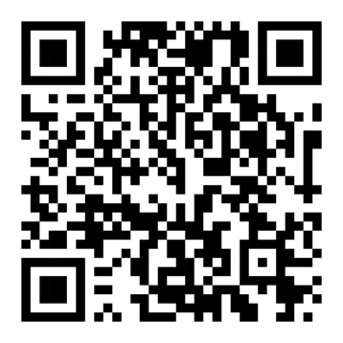
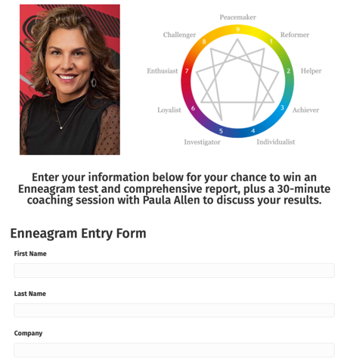
Enter to Win a Free Enneagram Test
+ Coaching Session!
SCAN TO ENTER!
BetRavingKnows.com/Enneagram-Giveaway/
Scan the QR Code to enter to win a free enneagram test and 30-minute debriefing with Paula Allen on your report!

Slide 23
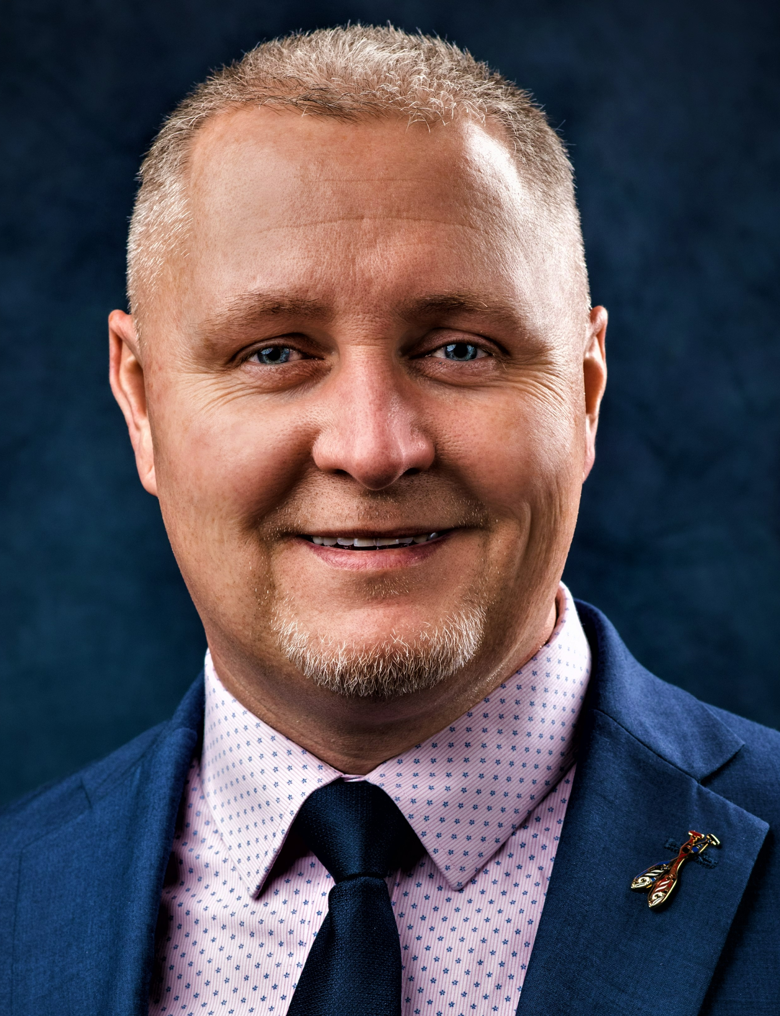
THANK YOU!
We hope you were able to identify a few ideas to take back to Benefit your Tribe!
Paula Allen
(360) ###-####
Paulaallen@7cedars.com
Tyler Anderson
(425) 563-0858
Tyler.Anderson@mutualofamerica.com
Reach out with any questions to:

