Slide 1
Advancing Tribal HR Departments into Strategic Partners
Tonia Leaureaux, Frank Tecumseh, Skye Skinner
Notes:
Welcome!
Thank you for joining us today. We are going to be talking about Advancing Tribal HR departments into Strategic Partners

Slide 2
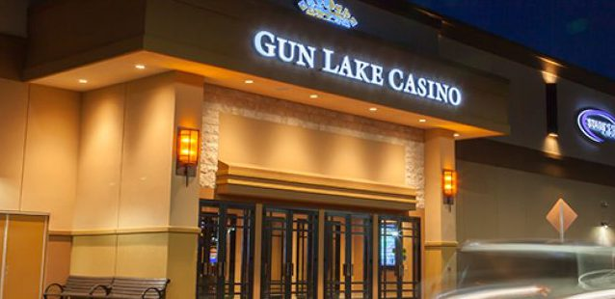
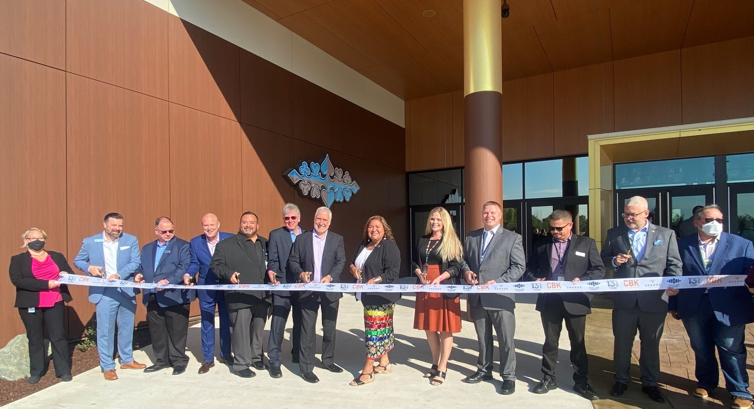
Skye Skinner, THRP|SHRM-SCP|PHR
Founder of HR Development & Innovation, LLC

Slide 3
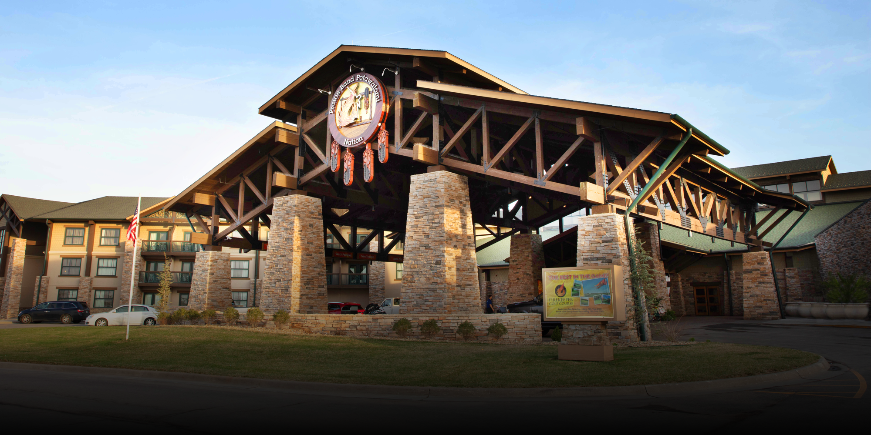
Frank Tecumseh – Vice President of Human Resources & Chair of the Prairie Band Potawatomi Entertainment Corporation

Slide 4
Tonia Leaureaux, SPHR, SHRM – SCP
Human Resources Director at Station Casinos

Slide 5
Advancing Tribal HR Departments into Strategic Partners
What is Strategic HR?
and
Why is it important?

Slide 6
Advancing Tribal HR Departments into Strategic Partners
What role does HR play in the success of your business?

Slide 7
Advancing Tribal HR Departments into Strategic Partners
What steps do you take to develop or refine a strategic HR plan?

Slide 8
Advancing Tribal HR Departments into Strategic Partners
What are some questions that HR professionals should be asking to evaluate alignment between the HR department and the organization as a whole?

Slide 9
Advancing Tribal HR Departments into Strategic Partners
How have you established credibility with your property peers/executives?

Slide 10
Advancing Tribal HR Departments into Strategic Partners
How have you used gap analysis to ensure that present capability aligns with future needs?

Slide 11
Advancing Tribal HR Departments into Strategic Partners
How can we leverage HR information to become more proactive?

Slide 12
Advancing Tribal HR Departments into Strategic Partners
How can we measure our success?

Slide 13
Advancing Tribal HR Departments into Strategic Partners
Questions?

Slide 14
THANK YOU
Skye Skinner, PHR|SHRM-SCP|THRP
HR Development & Innovation, LLC
www.hrdiconsulting.net (269) 830-3415
Frank Tecumseh
Vice President of Human Resources
franktea@hotmail.com
(269) 660-5647
Tonia Leaureaux, SPHR|SHRM-SCP
Human Resources Director
Tonia.Leaureaux@StationCasinos.com
(702) 617.7683

