Slide 1
Calm In The Chaos
The Directors Cut

Slide 3
Topics
Chaos in MY Indian Country
SHRM: Body of Applied Skills and Knowledge
Applying SHRM BASK during a crises – Establishing best practices from lessons learned
SHRM Mental Health Ally Certification: What is it and why is it so important
Practical Applications

Slide 4
The Flood – May 2019
200,000+ cubic square feet of water per second to keep Keystone Dam from failing
Army Corps of Engineers warn of major flooding Do we misplace thousands to save hundreds of thousands?
Do we pay employees if they’re not working?
New communication systems for teams/departments
Implemented a pre-planned emergency communication paradigm

Slide 5
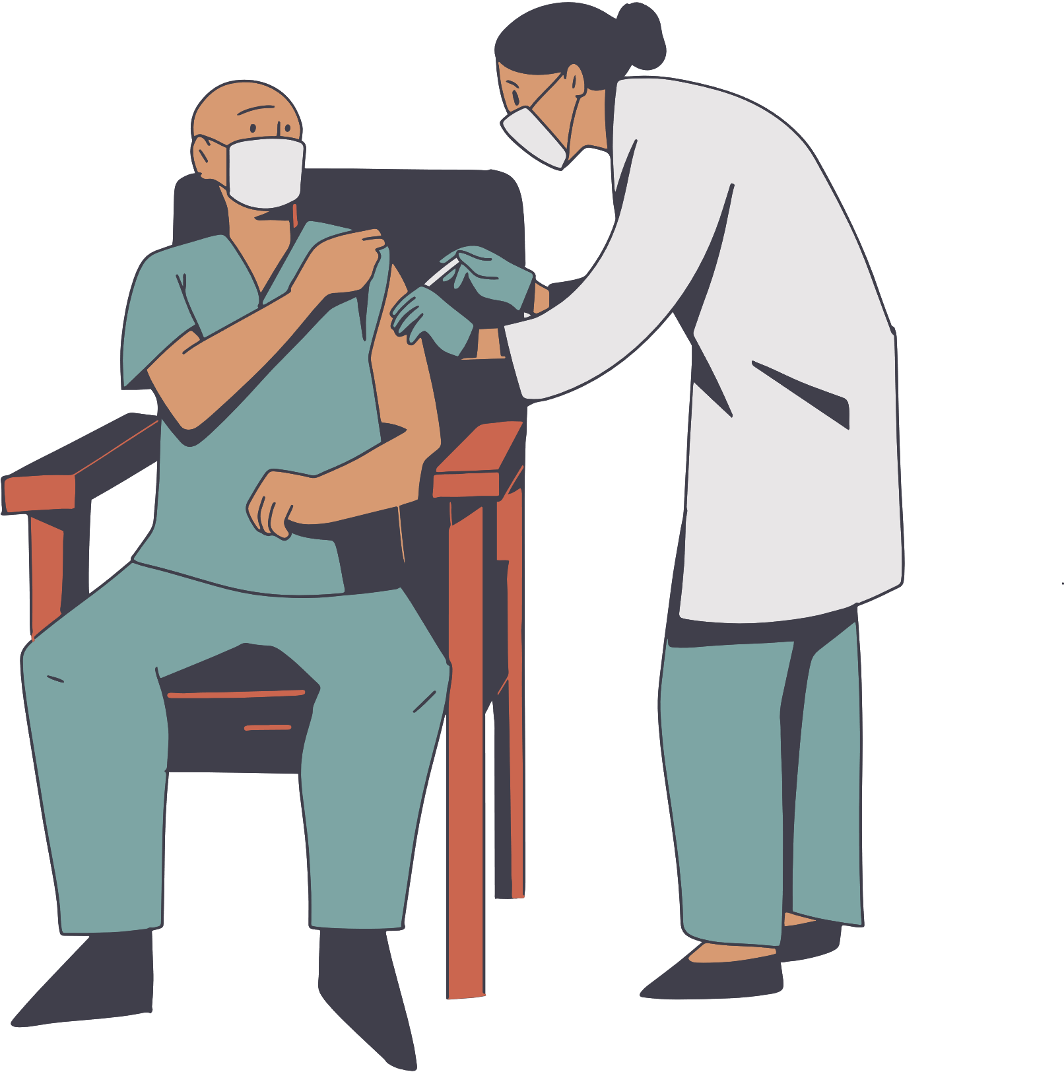
Covid 19 – March 2020
Closed for the flood not 10 months earlier, we were ready
The major tribes closed their casinos individually
We paid employees, again
The major tribes came together to discuss reopening
Even more new processes and training
Covid Testing
Contact Tracing
Covid Leave
Vaccines
Masks
Remote work

Slide 6
28
SHRM: BODY OF APPLIED SKILLS AND KNOWLEDGE

Slide 7
Knowledge + Behavior = Success
Success stems not only from what you know (knowledge) but also what you do (behavior). Neither is sufficient in isolation.
SHRM’s use of behavioral and technical skills in their models and exams shows that a smart mindset of HR success is a function of knowledge and behavior.

Slide 8
Leadership
1

Slide 9
Key Concepts - Leadership
Practical Applications – Leadership
Pay, benefits, hazard pay, vaccine incentives
Motivational theories (e.g., goal-setting theory, expectancy theory, attribution theory, self determination theory).
People management techniques (i.e. directing, coaching, supporting and delegating)
Establish call center, surveys for screening, no penalty for seasonal illnesses
Knowledge, skills, abilities, and other characteristics needed to navigate the organization and accomplish HR Goals
Influence and persuasion techniques (e.g., personal appeal, forming coalitions, leading by example, rational persuasion.)
HR on site, extending hours, partnering with MCNC Health Department, Employee Assistance Program
At the beginning of the pandemic, we were faced with many challenges, as a result HR had to quickly regroup and establish new goals, plans, policies, procedures and best practices.
Building rapport with employees
Trust- and relationship building techniques (e.g., emotional and social intelligence).

Slide 10
Interpersonal
2

Slide 11
Interpersonal
There are three behavioral competencies in the Interpersonal cluster:
Relationship Management
Knowledge, skills, abilities needed to create and maintain a network of professional contacts within and outside of the organization
Communication
Global & Cultural Effectiveness

Slide 12
Communication

Slide 13
Practical Applications– Communication
Key Concepts– Communication
This competency describes the behavior and knowledge needed for effective two-way communication.
Respond!
General Communication Techniques (eg. Planning communications, active listening)
Communications Committee to streamline communications and maintain legal compliance
Knowledge, skills, and abilities needed to effectively craft and deliver informative communications and address the concerns of others.
Communication Techniques for Specialist Situations (eg. Giving feedback, facilitating focus groups, facilitating staff meetings)
Enterprise meetings, call in updates, staff tracking reports
Communication is comprised of three sub competencies:
Delivering messages
Exchanging organizational information
Listening
Communications via Media (eg. Phone, email, face to face, report, presentation, social media)
Choose communication to match workforce (eg. Text, chat, Facebook messenger)

Slide 14
Business Acumen
3

Slide 15
Business
HR Leaders must:
Be able to understand the organizations business as a whole and recognize what unique roles HR can play in organizational success
Effective Leaders must:
Have a well developed proficiency in business acumen. They understand the core functions of the business, including how it operates and how HR practices contribute to those operations.

Slide 16
HR Expertise
Technical

Slide 17
HR Expertise
Principles, practices and functions of effective HR management
HR Expertise is grouped into three knowledge Domains:
People – HR Strategy, Talent Acquisition, Employee Engagement & Retention, Learning & Development & Total Rewards
Organization – Structure of HR Function, Organizational effectiveness & Development, Workforce Management, Employee & Labor Relations, Technology Management
Workplace- Global Workforce, Risk Management, Corporate Social Responsibility and US Employment Law & Regulations.
Successful HR Professionals must understand the behavioral components of HR practice in addition to being in command of technical HR knowledge.

Slide 18
Photo Collage
IRON MAN

Slide 19
Workplace Mental Health Ally
Eight Module Course designed to eliminate the stigma of mental health
Culture where mental health can be discussed openly
Common Mental Health Conditions
Substance Abuse
Suicide
Safety Planning
Diversity
Bias
Communication Skills

Slide 20
Mental Health in the Workplace
CDC Statistics
1 in 5 adults have a mental illness
1 in 20 adults have what is considered a serious mental illness
Depression & Anxiety cost the economy $1 trillion each year in lost productivity
12.2 million adults seriously thought about suicide
3.2 million adults made a plan
1.2 million attempt suicide
50,000 die each year to suicide
Non-Hispanic American Indian/Alaska Native is racial/ethnic group with highest suicide rate

Slide 21
Personal Connections
How to Help
Express concern
Be calm, respectful, compassionate
Listen
Offer affirmations
How Not to Help
“It could always be worse”
“Everyone feels like that sometimes”
Avoid blaming statements or using sarcasm

Slide 22
Mental Health Resources
Muscogee (Creek) Nation Department of Health
918-758-1910
National Suicide Prevention
1 (800) 273-TALK
Suicidepreventionlifeline.org – chat feature on website
also resources en Espanol and for Deaf and hard of hearing
National Suicide & Crisis LIFELINE
988
Crisis Text Line
Text “HOME” to 741741
Veterans Crisis Line
1 (800) 273-8255
Veterancrisisline.net
The Trevor Project Support Center
1 (866) 488-7386 thetrevorproject.org – For LGBTQ+ Youth

