Slide 1

COMPENSATION 101
Presented by
Karla S. Bylund, MS-IOP, SHRM-SCP

Slide 2

Introduction
Compensation is a tool used by management for a variety of purpose.
Compensation may be adjusted according to the business needs, goals, and available resources.

Slide 3

Purpose of Compensation
Compensation may be used to:
recruit and retain qualified employees.
increase or maintain morale/satisfaction.
reward and encourage peak performance.
achieve internal and external equity.
reduce turnover and encourage company loyalty.

Slide 4
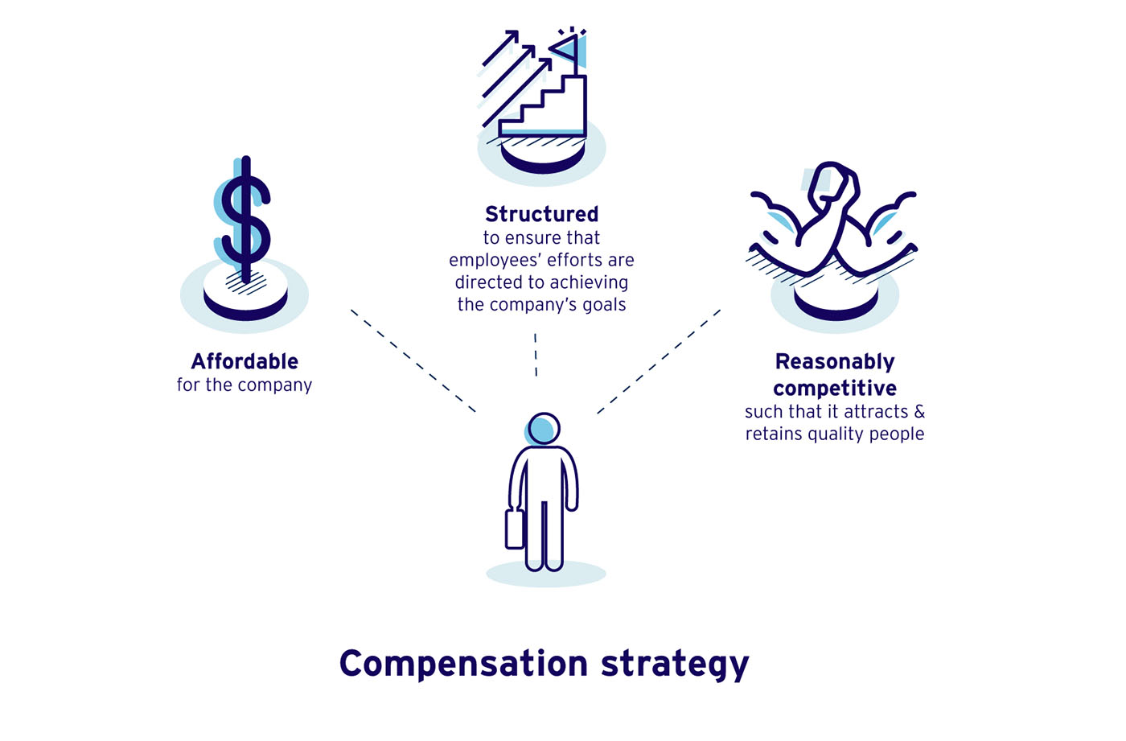

Slide 5
Types of Compensation
(total compensation)
Base Pay
Commissions
Overtime Pay
Bonuses, Profit Sharing, Merit Pay
Hazard Pay, shift differentials
Travel/Meal/Housing Allowance
Benefits: Insurances, paid leave, retirement, taxes...

Slide 6

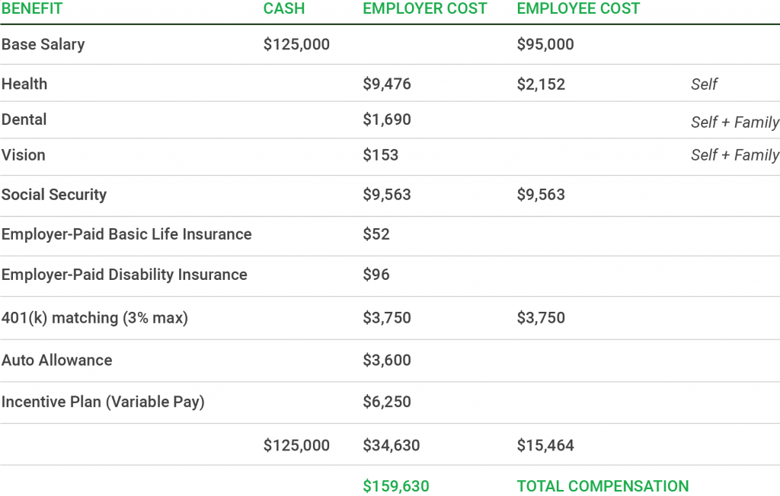
Total Compensation

Slide 7
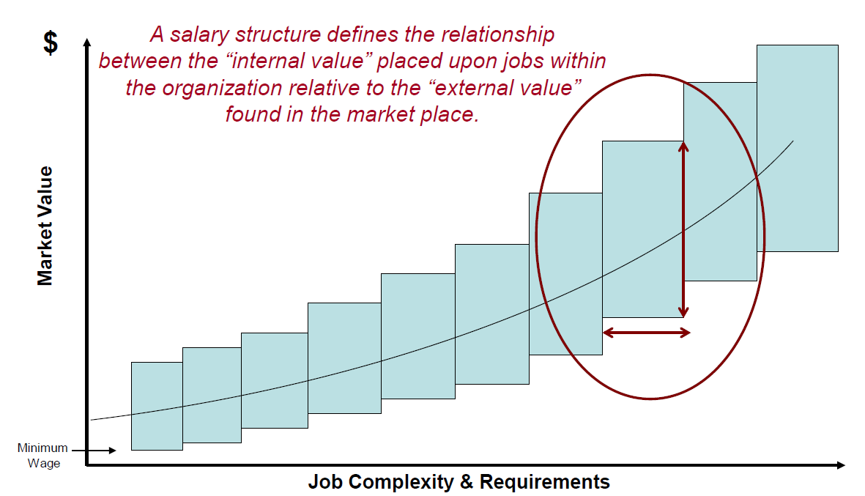
Salary/Pay Structure

Slide 8
Developing a Salary/Pay Structure
Step 1. Identify “Benchmark” Jobs
Requirements for good benchmark jobs include the following.
Very common to organizations within your industry
The work performed is very standardized from one employer to another as well as performed under similar working conditions
The incumbent job requirements such as knowledge education skills experience abilities etc. are also very standardized from one employer to another
There is a rich supply of reliable market data for the job

Slide 9
Common sources of “Benchmark” data
Government
Bureau of Labor Statistics
State and Municipal surveys
Published surveys (purchased for a fee)
Sibson
Hewitt
Wyatt
REDW
WageWatch
Online Subscription Surveys
Salary.com
Payscale.com
Business & Legal Resources (BLR)

Slide 10
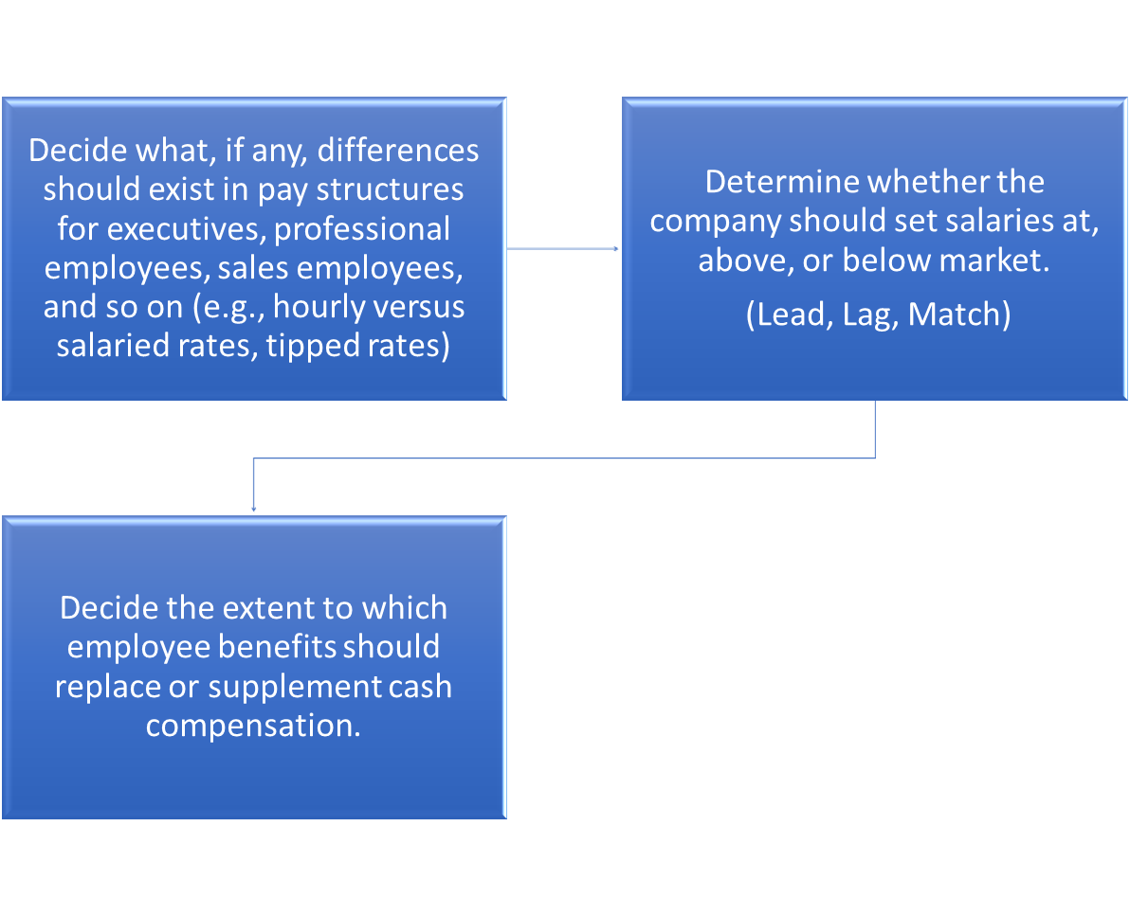
Developing a Salary/Pay Structure
Step 2. Develop a compensation philosophy.

Slide 11
Developing a Salary/Pay Structure
Step 3. Conduct a job analysis
Job analysis is the foundation for all compensation, assessment and selection decisions.
Job analysis provides a way to develop this understanding by examining the tasks performed in a job the competencies required to perform those tasks and connection between the tasks and competencies

Slide 12
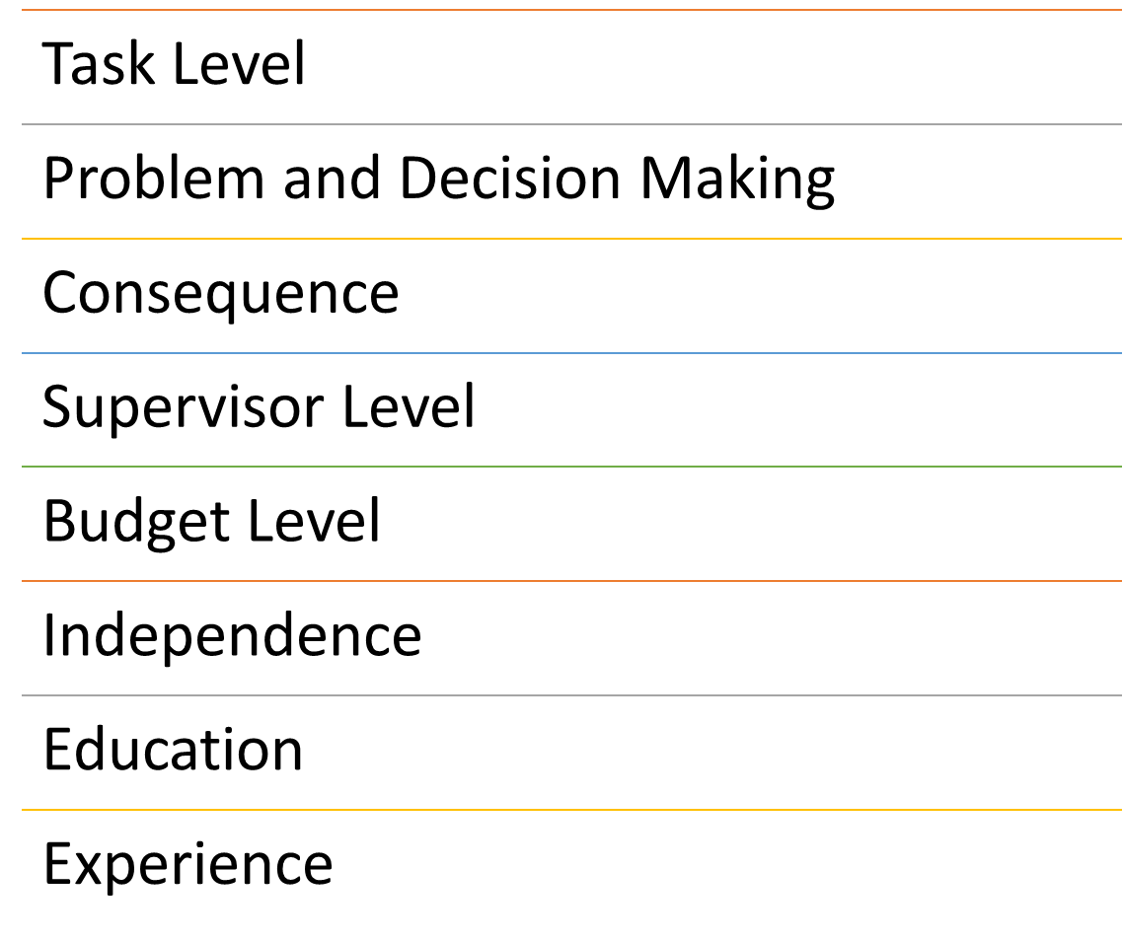
JOB ANALYSIS CRITERIA

Slide 13
Steps in a Job Analysis
Conduct a general task analysis. What tasks must be accomplished by whom?
Get input from senior executives and department heads to determine the organizational structure and primary functions of each.
Interview department managers and key employees, as necessary, to determine their specific job functions.
Develop model job descriptions for exempt and nonexempt positions
Develop a final draft of job descriptions.
Meet with department managers, as necessary, to review job descriptions.
Finalize and document all job descriptions.

Slide 14
Developing a Salary/Pay Structure
Step 4. Evaluate the Job
1
Rank the jobs
Verify ranking by comparing it to industry market data concerning the ranking and adjust if necessary.

Slide 15
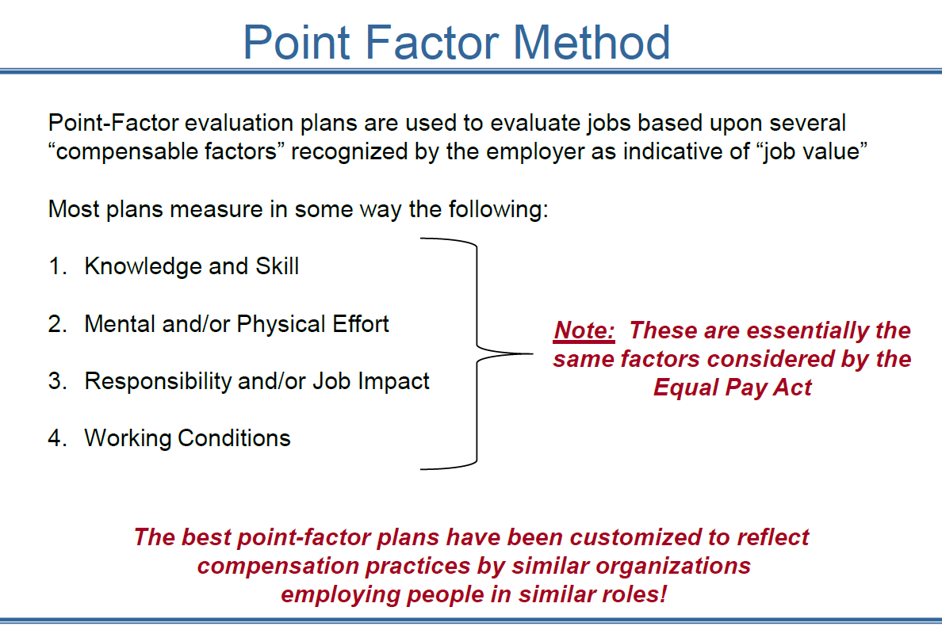

Slide 16
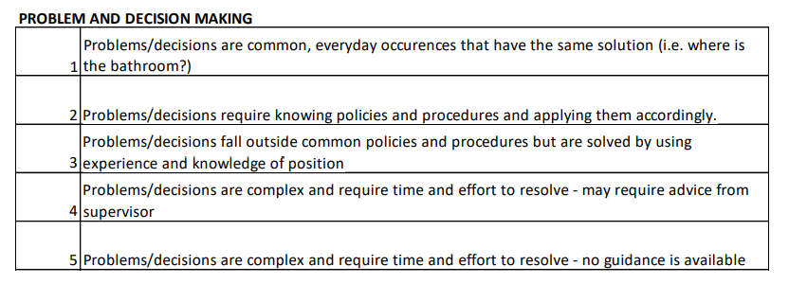
Ranking Guideline
EXAMPLE

Slide 17
EXAMPLE

Slide 18
Developing a Salary/Pay Structure
Step 5. Determine the Grades
Determine the number of pay grades for each pay scale (Salary, hourly, tipped …)
Establish benchmark (key) jobs.
Review the market price of benchmark jobs within the industry.
Assign Positions to Grades

Slide 19
Developing a Salary/Pay Structure
Step 6 Determine Salary Structure
Pay scales are calculated by the number of grades within the scales, the grade spread (width of the range) and midpoint differential (difference between the grades).
Pay scales have Minimum (min), Midpoint (mid) and Maximum (max) points on the scale.
Best pay practices encourage organizations to define the criteria for each of these points on the scale and set a policy on progression from range minimum to midpoint.

Slide 20
Minimum:
Represents the lowest rate on each pay grade. Typically, this is the pay that is offered at recruitment.
The employee is newly hired and in the orientation phase of their employment.
The employee just meets the minimum hiring requirements for the position.
Midpoint:
Considered the competitive market rate for the job.
The employee competently performs each job task associated with their role (typically 4-8 years after hire).
The employee is typically in good standing with the organization
Maximum:
Represents the highest rate an organization is willing to pay for the job. Reasons to pay an employee close to the maximum of the range include:
Employee has mastered all the competencies of this position.
The employee has been identified as a high performer or has high potential within the organization.
The employee has long service and/or tenure with the organization

Slide 21
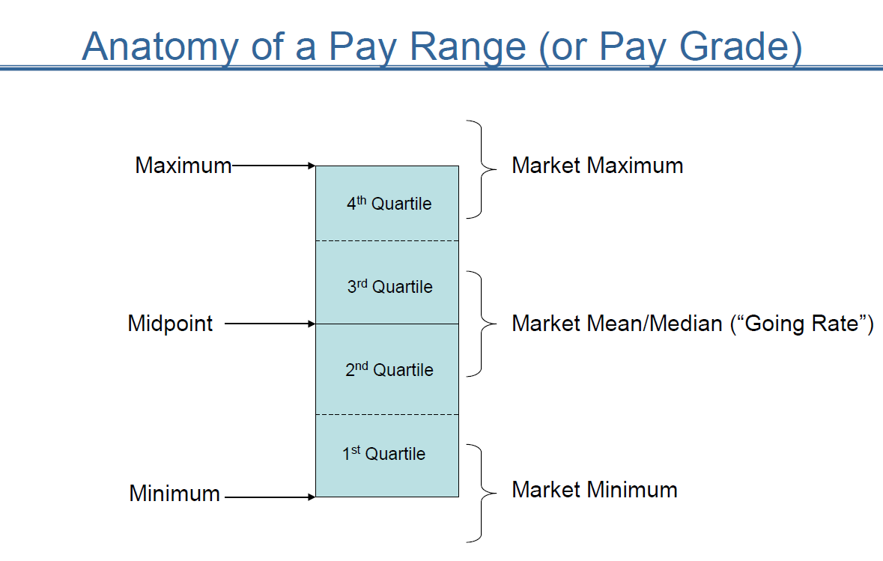

Slide 22
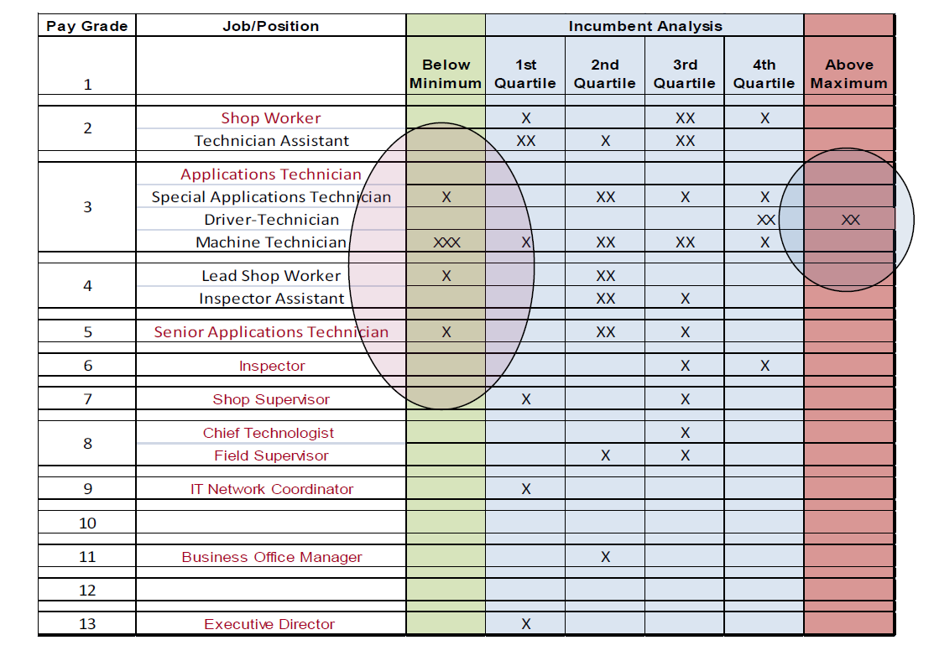
Developing a Salary/Pay Structure
Step 7. Analyze the Impact

Slide 23

Develop a Salary Administration Policy
Develop and document the general company policy.
Develop and document Strategies and Procedures for:
  Hiring above the minimum
  Merit raises
  Cost-of-living adjustments
  Bonuses
  Annual reviews
  Promotions.
  Maximum pay
  Temporary positions

Slide 24
Maintain the Salary/Pay Structure
PERIOD | ACTIVITY
ANNUAL | Adjust pay ranges based upon forecasts what other employers will be doing during the next year Adjust the ranges based on changes in tribal minimum wage Establish and implement salary increase budget based on forecasts
Every 3 to 5 Years | Conduct full wage survey to re-align internal and external factors

Slide 25

QUESTIONS?

