Slide 1
26th Annual Conference
San Antonio, Texas
September 26-28

Slide 2
Fraud in HR How to Spot it & Stop it
AmyAnn Taylor
Training Consultant

Slide 3
AGENDA
WHAT is fraud?
WHO commits fraud and WHY do they do it?
WHERE are we seeing fraud in 2022?
Fraud Risk Assessment
HOW do we stop the fraud?
WHEN fraud is discovered what do we do?
Topic one
Topic two
Topic three
Topic four

Slide 4
WHAT is fraud, Anyway?
“Fraud” is any activity that relies on deception in order to achieve a gain. Fraud becomes a crime when it is a “knowing misrepresentation of the truth or concealment of a material fact to induce another to act to his or her detriment.” (Black’s Law Dictionary)
In other words, if you lie in order to deprive a person or organization of their money or property, you’re committing fraud.

Slide 5
WHO commits fraud and why are they doing it?

Slide 6
Why do People Commit Fraud?
The most widely accepted explanation for why some people commit fraud is known as the Fraud Triangle. The Fraud Triangle was developed by Dr. Donald Cressey, a criminologist whose research on embezzlers produced the term “trust violators.”

Slide 7
Why do People Commit Fraud?
The Fraud Triangle hypothesizes that if all three components are present — unshareable financial need, perceived opportunity and rationalization — a person is highly likely to pursue fraudulent activities.

Slide 9
“When the trust violators were asked to explain why they refrained from violation of other positions of trust they might have held at previous times, or why they had not violated the subject position at an earlier time, those who had an opinion expressed the equivalent of one or more of the following quotations: (a) ‘There was no need for it like there was this time.’ (b) ‘The idea never entered my head.’ (c) ‘I thought it was dishonest then, but this time it did not seem dishonest at first.”

Slide 10
WHAT is fraud?
REVISITED

Slide 11
Categories of Fraud
Unfortunately, fraud is so common that it can be categorized in countless ways. But fundamentally, every type of fraud is either organizational or individual. Let’s look at some key characteristics of each.
AGAINST INDIVIDUALS
This is when a single person is targeted by a fraudster — including identity theft, phishing scams and “advance-fee” schemes. Perhaps one of the most noteworthy and devastating individual frauds is the Ponzi scheme.
INTERNAL ORGANIZATIONAL FRAUD
Sometimes called “occupational fraud,” this is when an employee, manager or executive of an organization deceives the organization itself. Think embezzlement, cheating on taxes, and lying to supervisors or leadership.
EXTERNAL ORGANIZATIONAL FRAUD
This includes fraud committed against an organization from the outside, such as vendors who lie about the work they did, demand bribes from employees and rig costs. But customers sometimes defraud organizations, such as when they submit bad checks or try to return knock-off or stolen products. And increasingly, technology threatens organizations with theft of intellectual property or customer information.

Slide 12
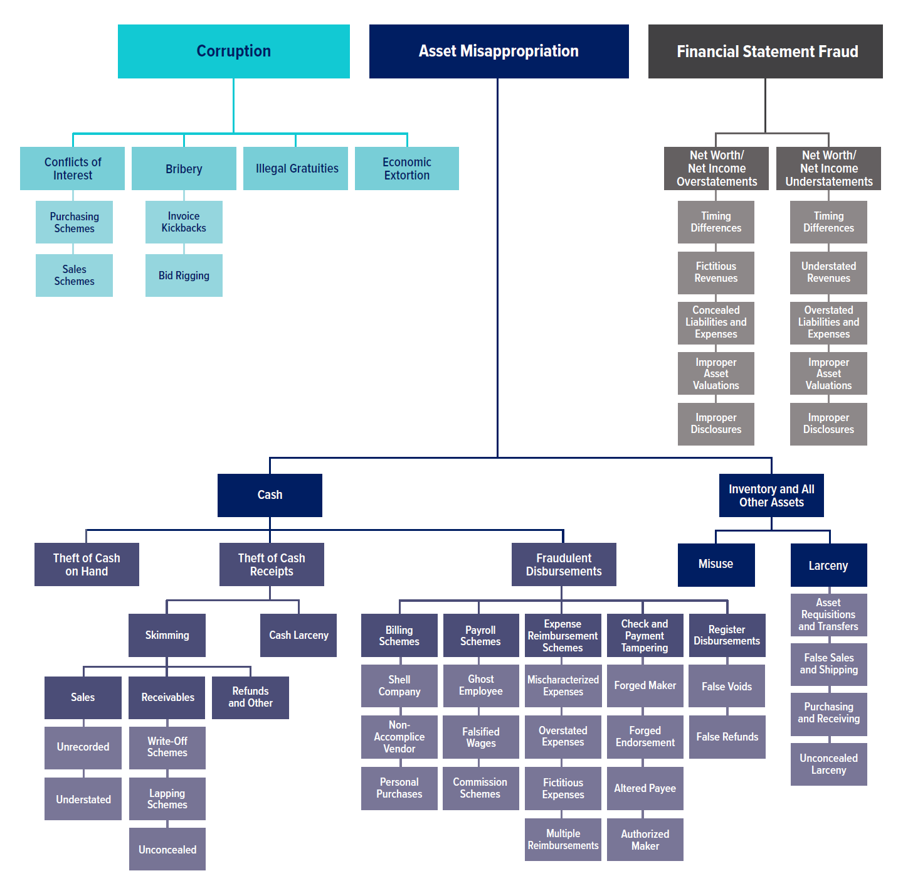

Slide 13
Fraud in HR
Ghost Employees
Falsified Wages – often collusion with supervisor (split overage)
Payroll Tax Fraud
Sick leave fraud
Additional Beneficiaries/Spouses/Partners
Time and Expenses Fraud
Expense fraud - Fake purchases, or inflate expense claim.
Misuse of Company Assets – use company asset for personal use
Procurement Fraud – employee overpurchases and then uses for own use

Slide 14
FRAUD IN HR CONTINUED…
Theft of Personally Identifiable Information
HR impersonation schemes over social media – trying to get personal information and/or payment
Executive or IRS/Immigration impersonation schemes – asking for W-2, I-9 or payroll access
Fraudulent change in wages or direct deposit location (usually urgent email) ***Recent Scan***
• William.White@company.com
• Wil1iam.White@company.com

Slide 15
WHERE are we seeing fraud in 2022?

Slide 16
ACFE Report to the Nations
12th Edition of the largest global study on occupational fraud
Based on 2,110 real cases of occupational fraud
Data from 133 countries
23 major industry categories included
Explores the costs, scheme, victims and perpetrators of fraud

Slide 17
ACFE Report to the Nations

Slide 18
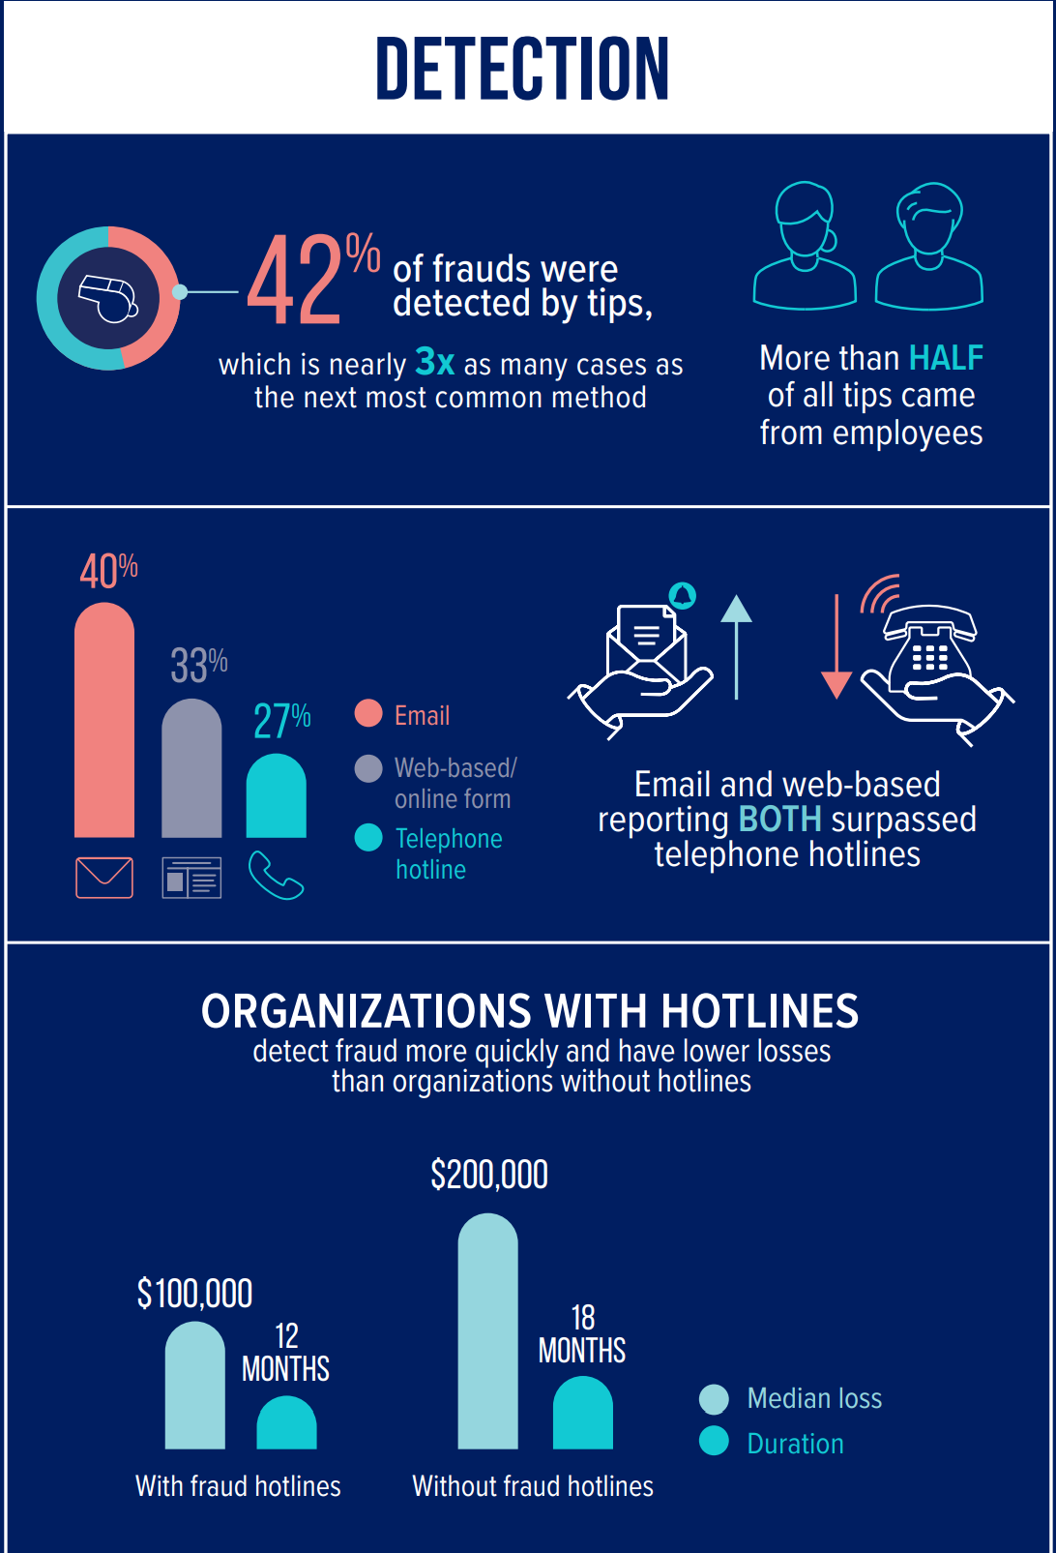
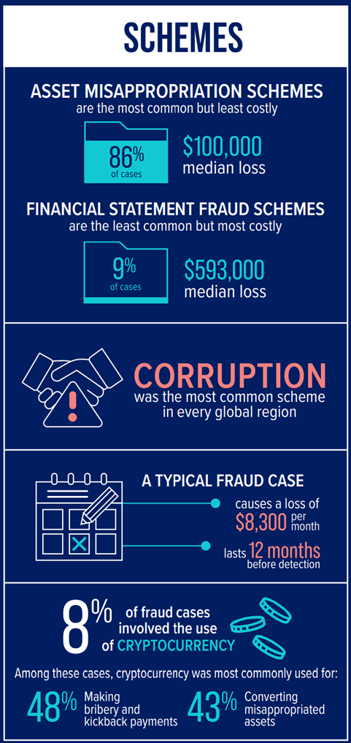

Slide 19
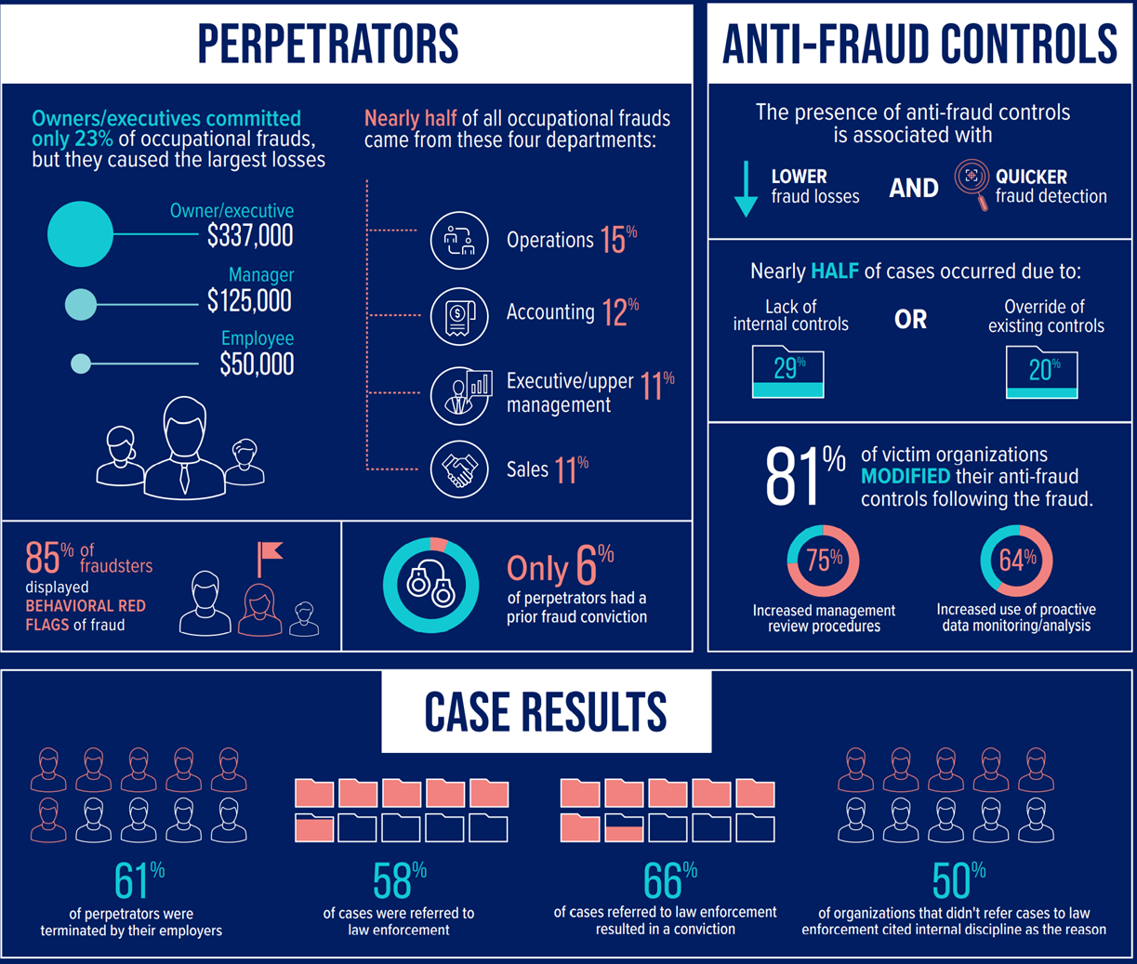

Slide 20
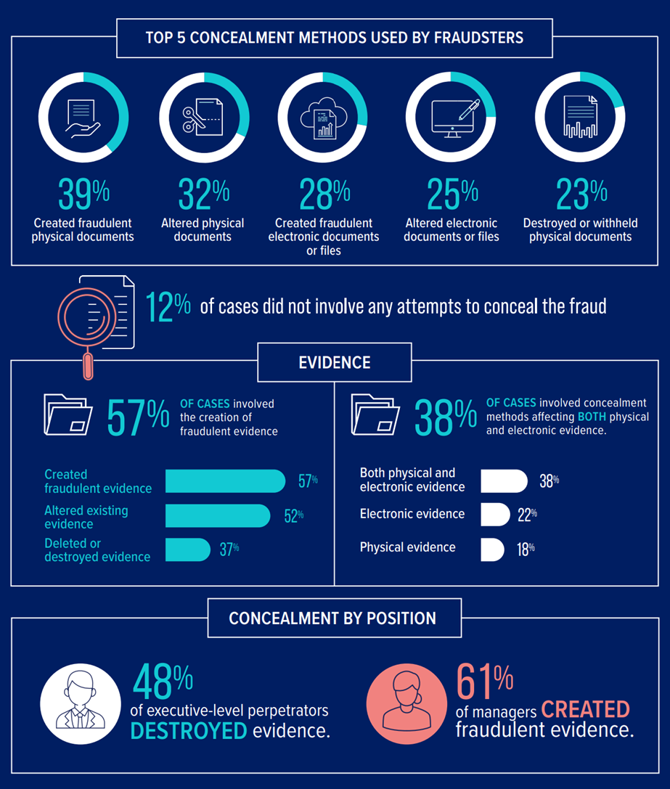

Slide 21
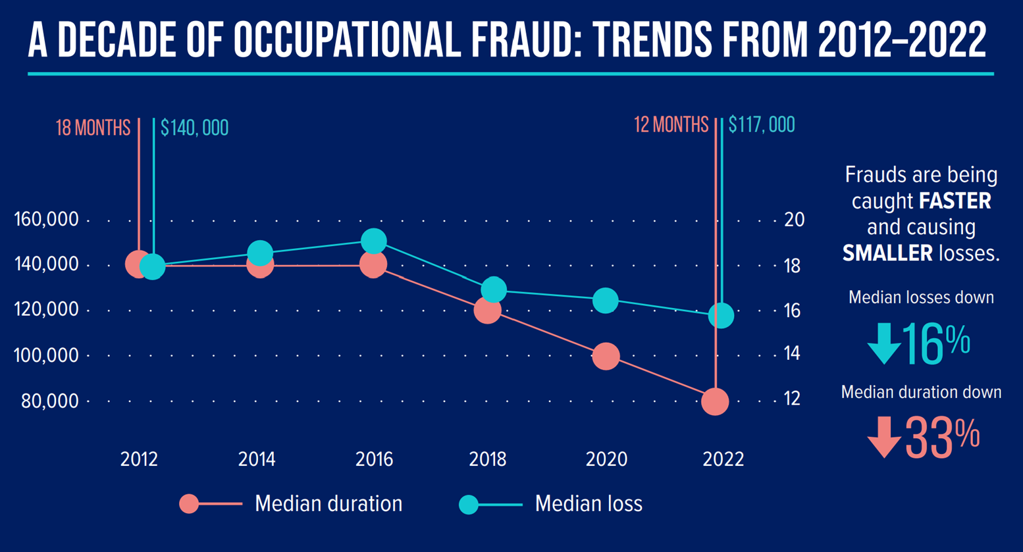
ACFE Report to the Nations

Slide 22
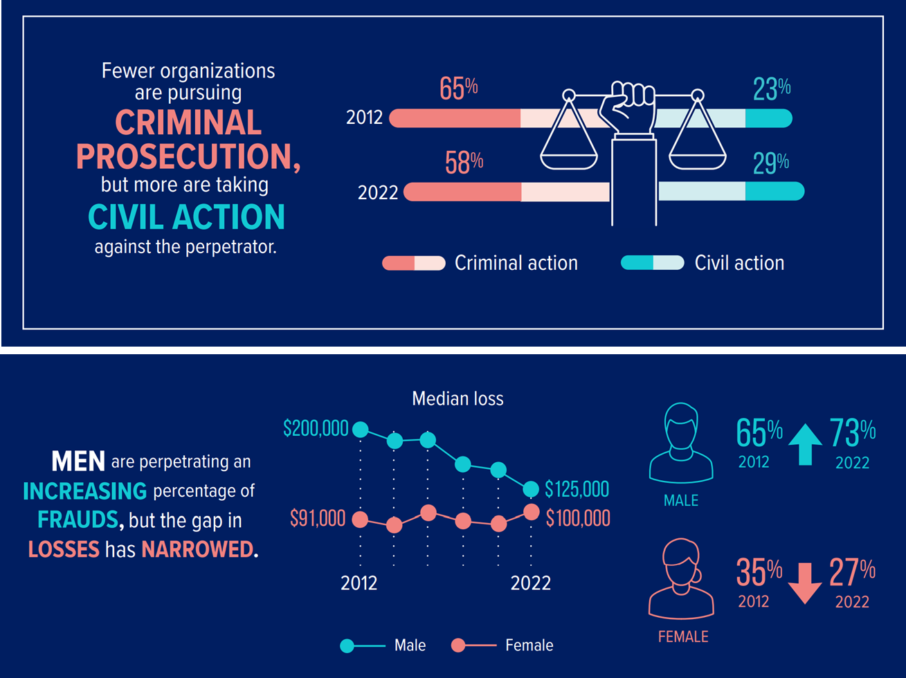

Slide 24
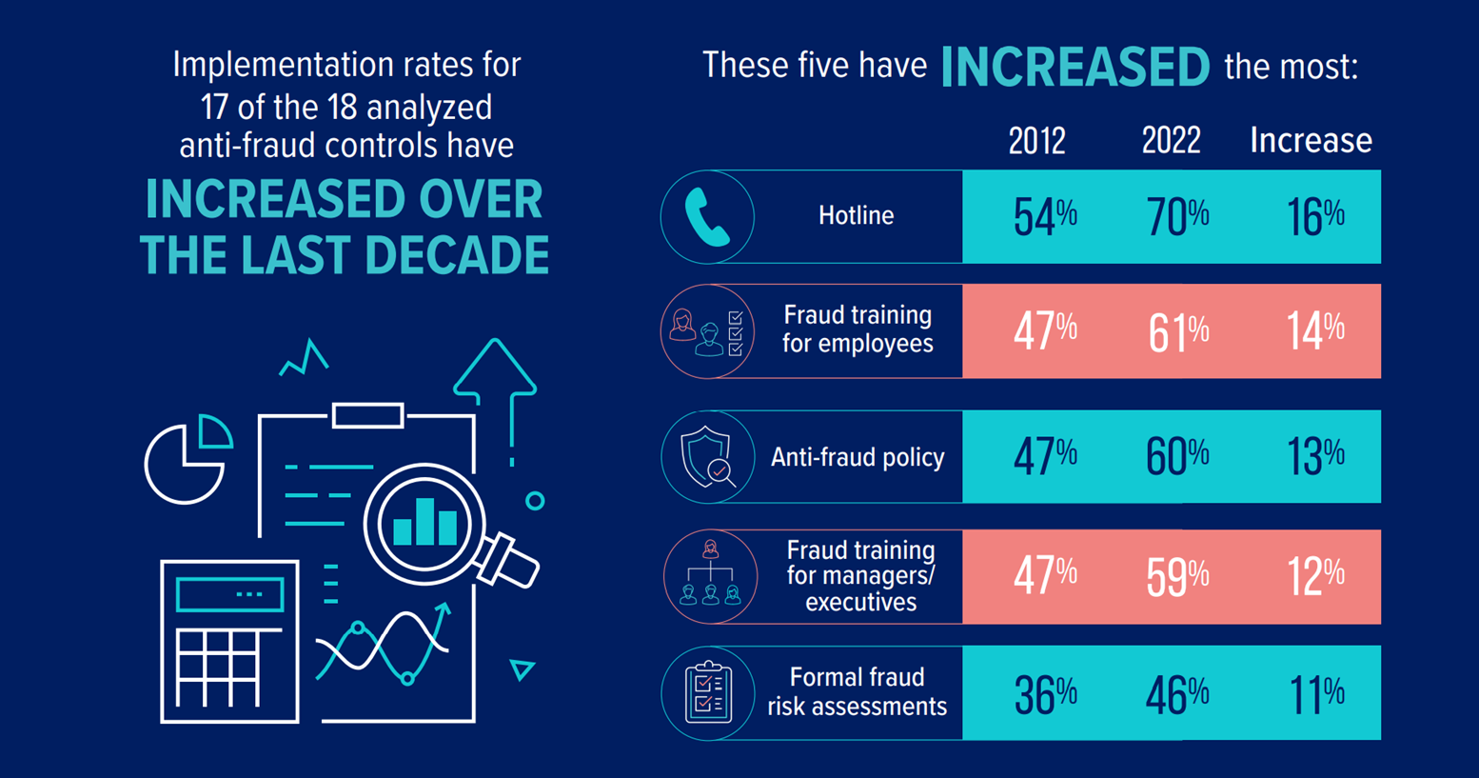
ACFE Report to the Nations

Slide 25
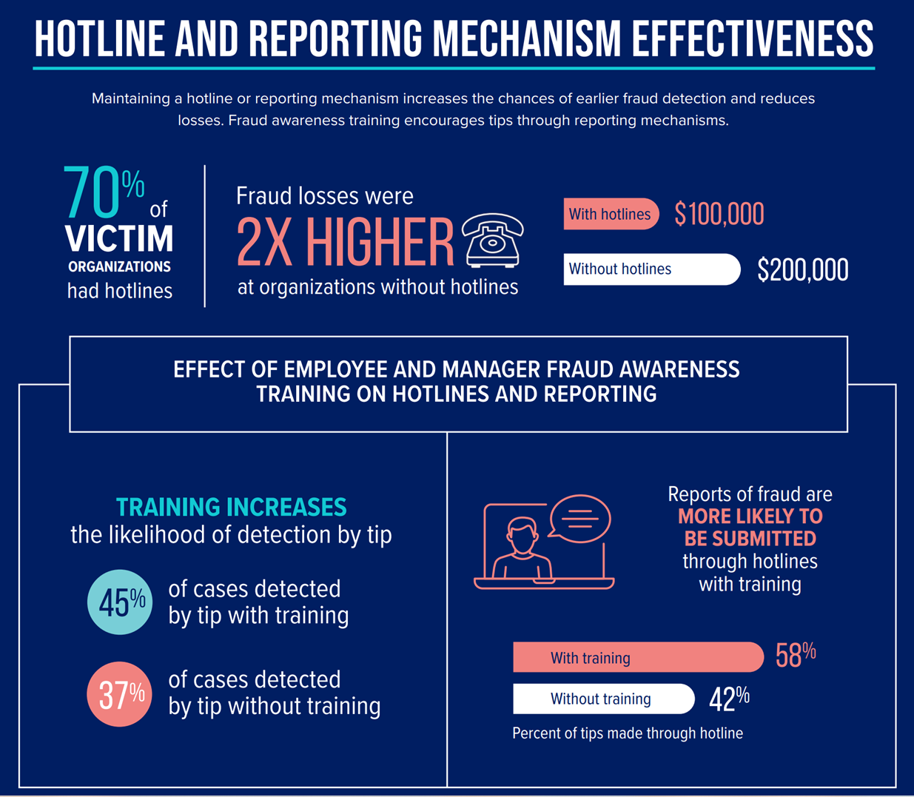

Slide 26
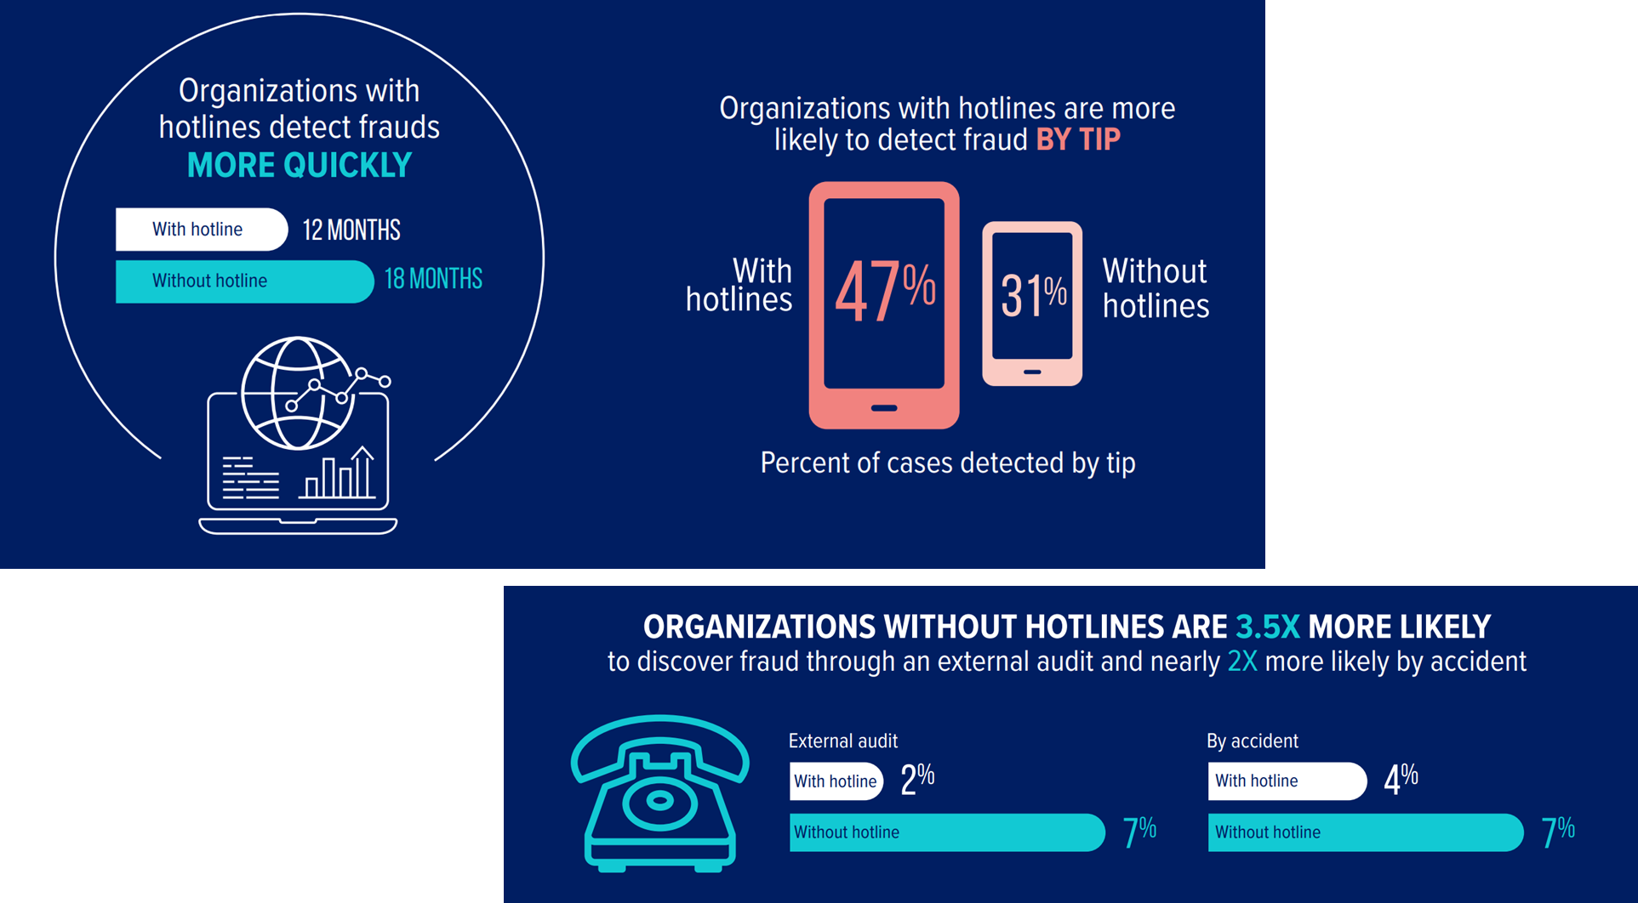

Slide 27
ACFE Report to the Nations

Slide 28
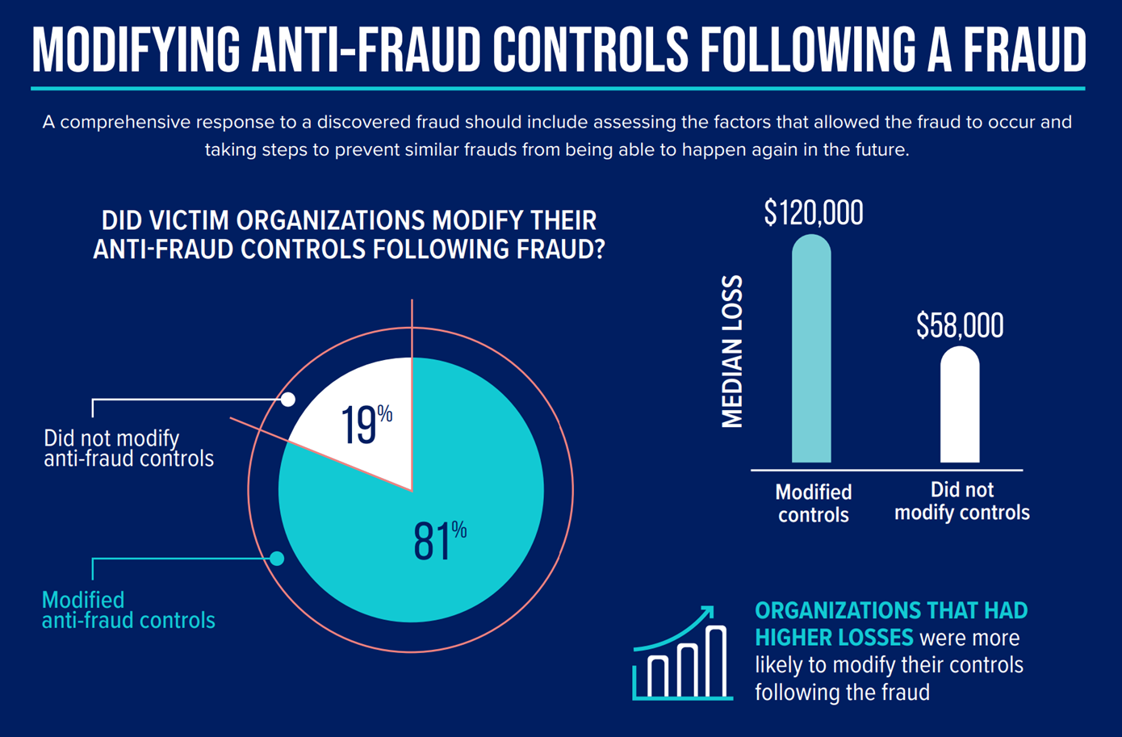
ACFE Report to the Nations

Slide 29
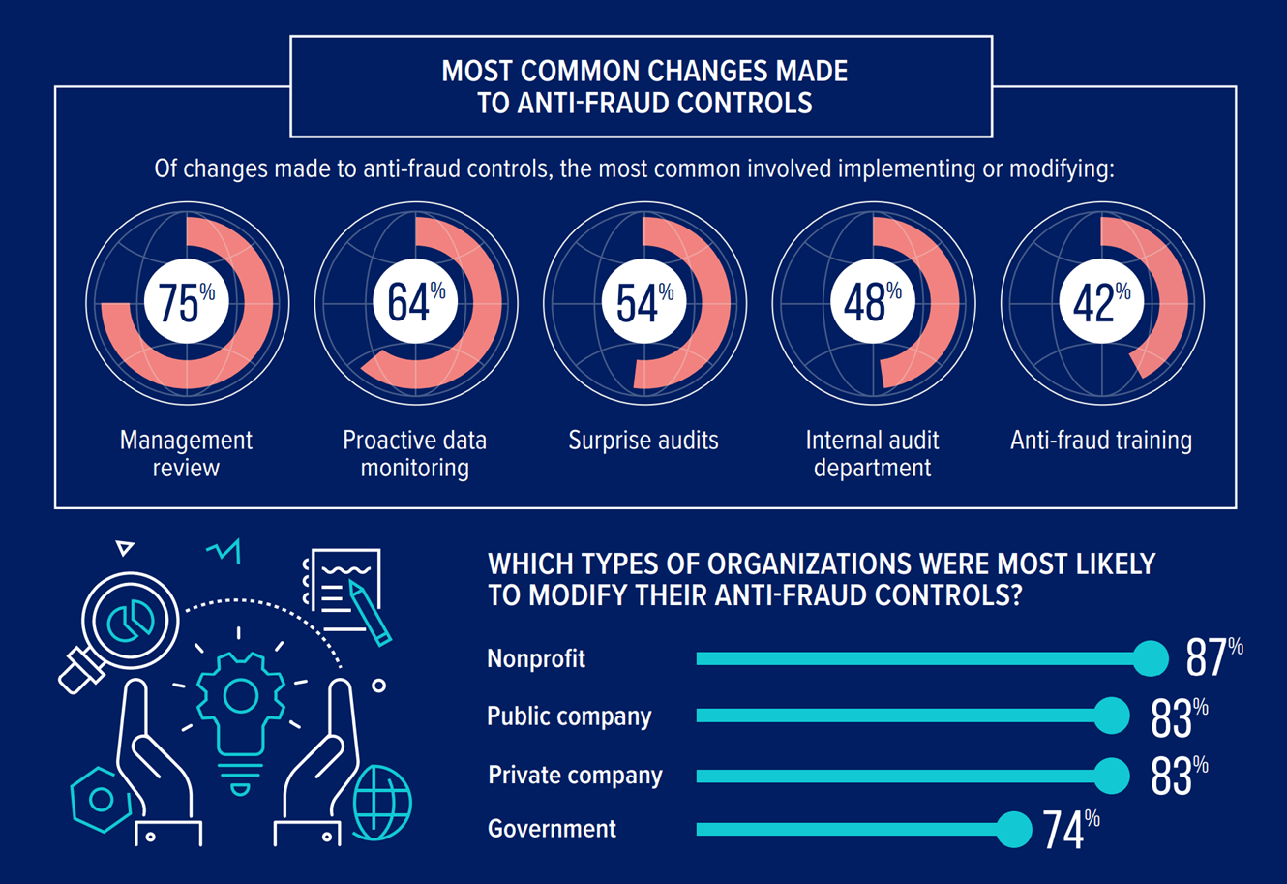
ACFE Report to the Nations

Slide 30
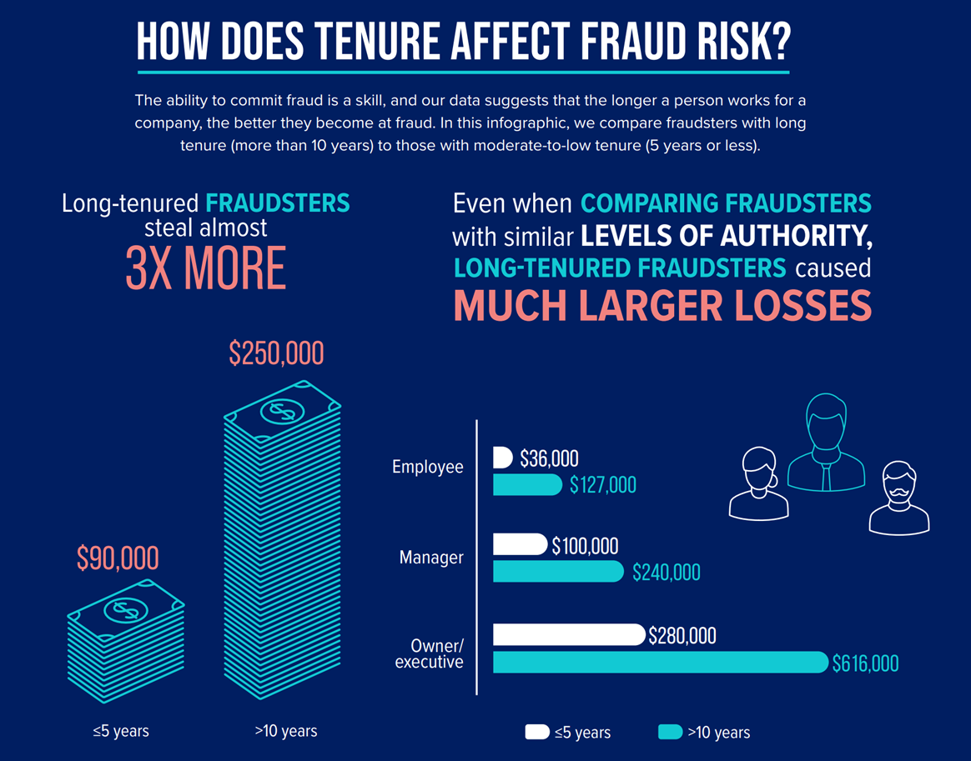
ACFE Report to the Nations

Slide 32
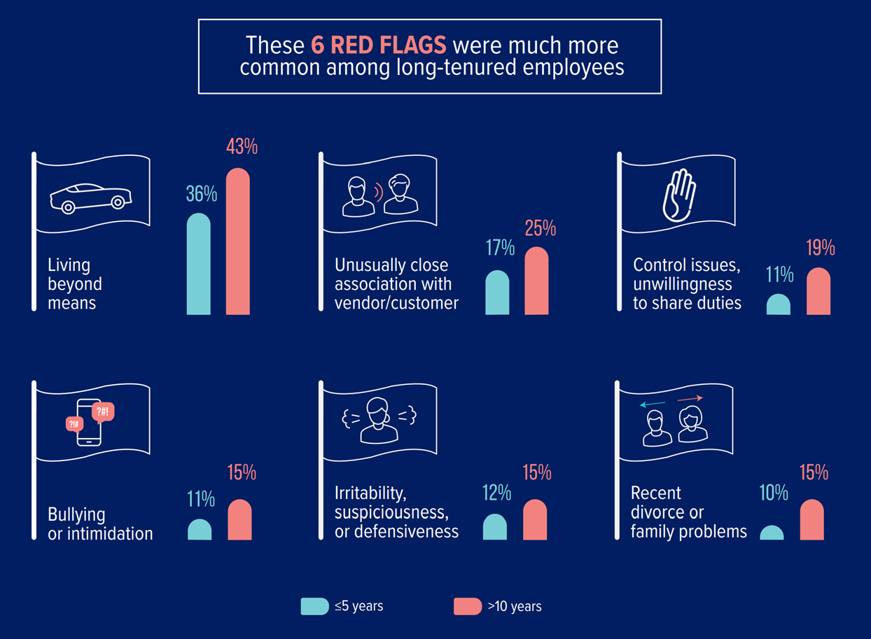

Slide 33
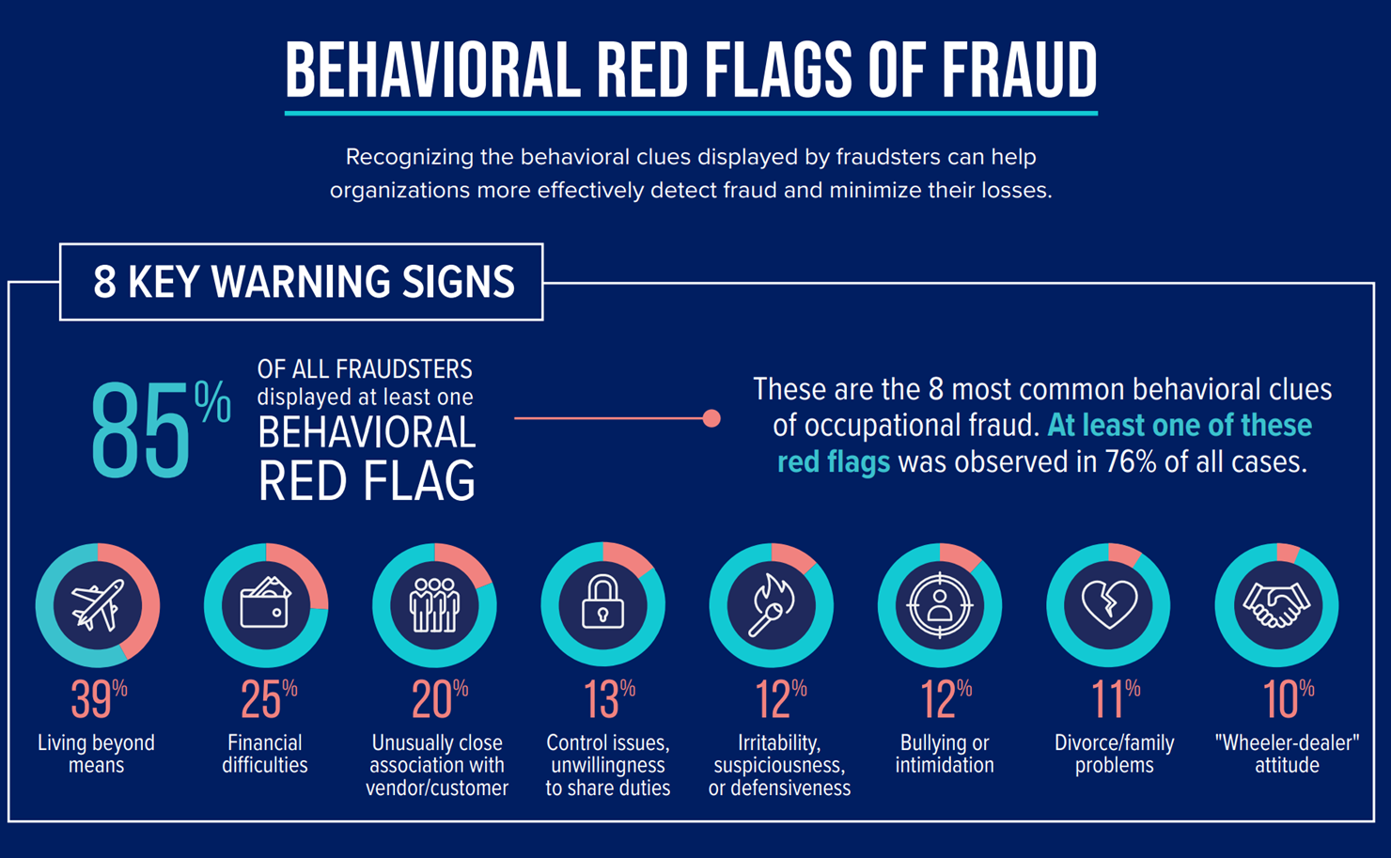

Slide 34
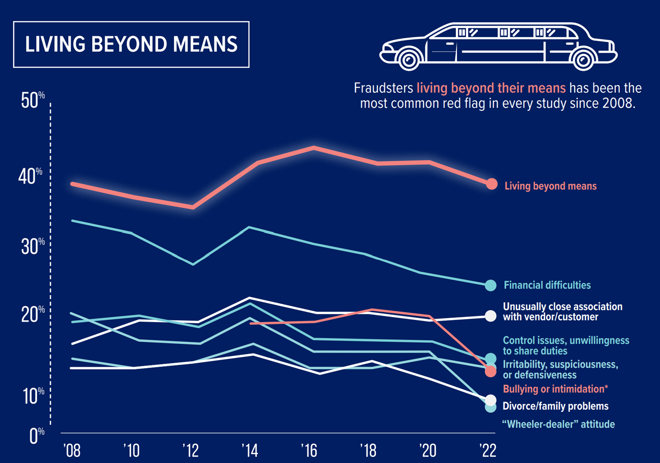

Slide 35
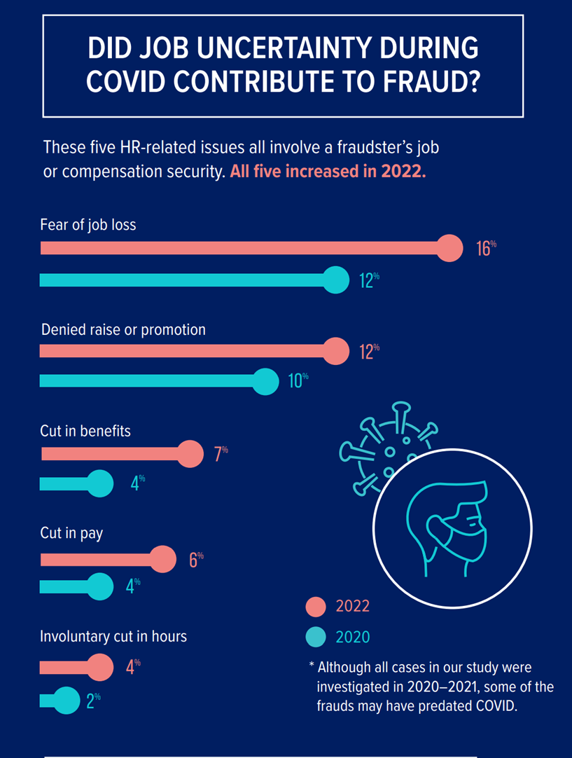

Slide 36
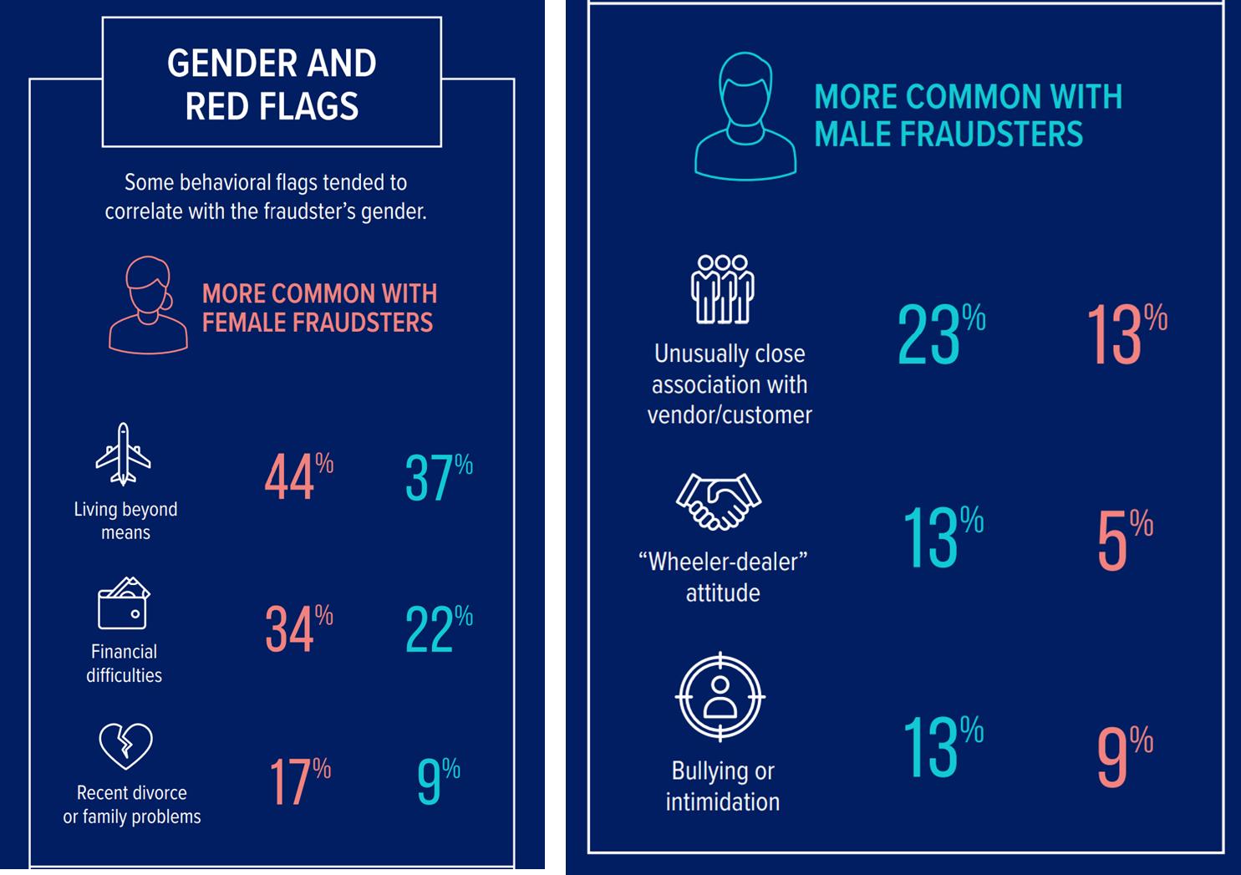

Slide 37
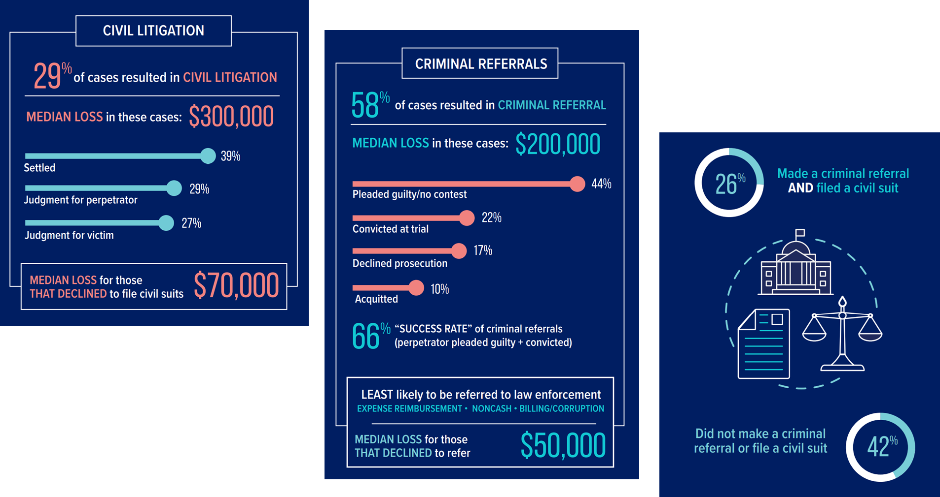

Slide 38
Fraud Risk Assessment

Slide 39
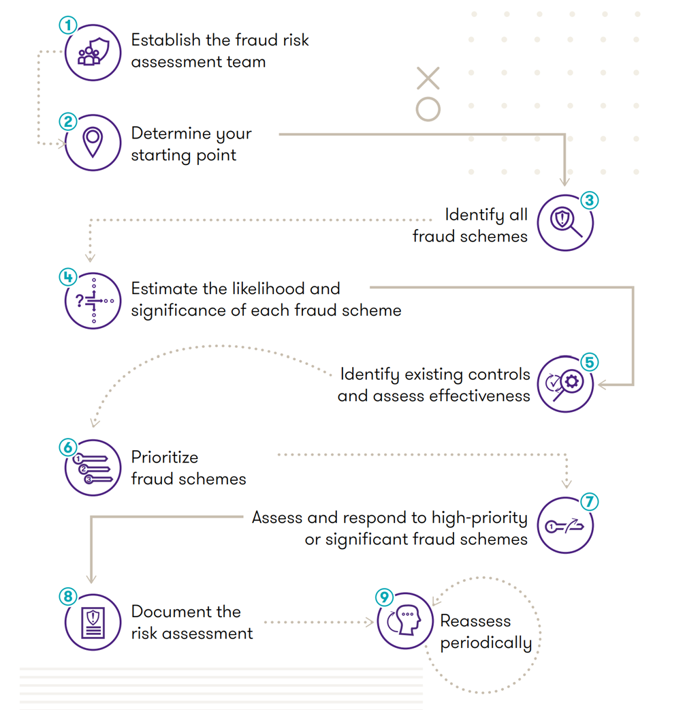
Fraud Risk Assessment

Slide 41
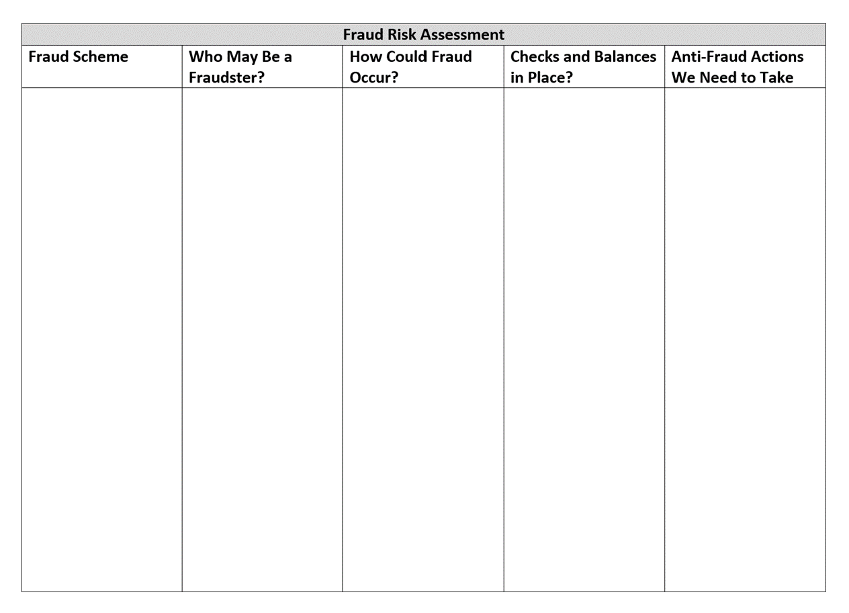

Slide 42
Questions to ask …
What fraud schemes are the Tribe susceptible to?
Both internal or external
What are the weaknesses in our systems?
How could a perpetrator override or circumvent controls?
Who might have motive or incentive to commit fraud?
What type of fraud has occurred in the past?
What other data do we know about our organization that could be relevant?
Any possible non-financial fraud schemes the Tribe may be vulnerable to?
What did we learn from the Report to the Nations that might be applicable?

Slide 44
HOW do we stop the fraud?

Slide 45
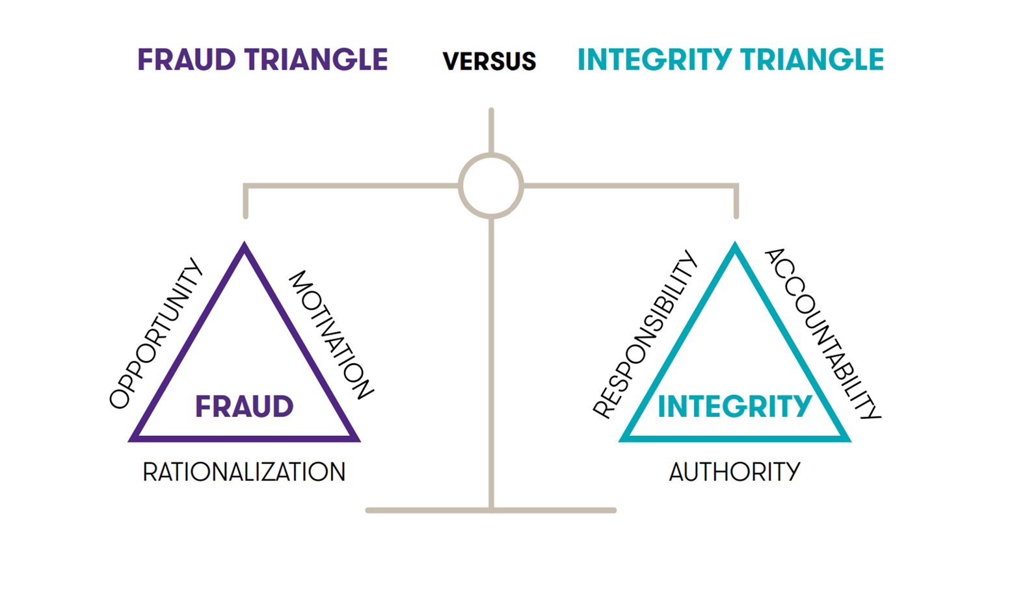
HOW do we stop the fraud?
Responsibility to their organization
Accountable to its mission
Authority to effect positive change

Slide 46
HOW do we stop the fraud?
Awareness
Integrity Triangle
Mandatory periodic training
On threat of fraud, cost of fraud and capacity to combat it
On Fraud Policy
Do employees know where to seek help regarding fraud?
Fraud Reporting Mechanism
Does it exist?
Do employees know how to use it? Is it advertised?
Do employees trust it – that it will be used and that it will be free from reprisal?
Does it include vendors, tribal members, and other outside parties?

Slide 47
HOW do we stop the fraud?
Fraud Policy
Zero Tolerance? (what is the Tribe’s fraud risk appetite)
What actions constitute fraud – list examples (including, but not limited to)
What position should individuals contact if concerned about fraud?
Who is responsible for investigating fraud (what team) and what authorizations do they have (free and unrestricted to all information)?
Confidentiality
Reporting procedures
All reporters must be acting in good faith and consequences for malicious allegations
Whistleblower Protection
Who makes the decision to terminate individuals?
Who is responsible to administer the policy?

Slide 48
HOW do we stop the fraud?
Implement Anti-Fraud Controls
Proper Separation of Duties
Use of Authorizations
Physical Safeguards
Job Rotations
Mandatory Vacations
Assess Tribe’s Fraud Risk Appetite
Develop Formal Investigation Process
Implement Mechanism for Individuals (including contractors and employees) to disclose actual or potential conflicts of interest
Implement P&Ps for how to handle conflicts of interest

Slide 49
HOW do we stop the fraud?
Fraudulent Conduct Dealt with Aggressively
Surprise Fraud Audits
Data Analytic Techniques Used
Managers Actively Review Controls
Consider Doing Deeper Proactive Fraud Risk Assessment
Fraud Team Regularly Review Fraud Risk Assessment (Annually at a minimum)
Employee Surveys to Determine Extent to Which they Believe Leaders Act with Honesty and Integrity
Implement the Integrity Triangle from Top Down
Incorporate Fraud Prevention Goals into Performance Evaluations

Slide 50
HOW do we stop the fraud?
Regularly Change External Auditors
Provide Internal Audit with Staff/Resources Needed
Hiring Policy Requirements – background checks, educational checks
Implement Employee Support Programs to assist employees struggling with addiction, mental/emotional health, family, or financial problems
Implement Employee Open-door Policy
Allow employees to speak about pressures and allow management opportunity to alleviate pressures before they become a problem
Reasonable Performance Goals
Regular, Anonymous Surveys Conducted to Assess Employee Morale

Slide 51
HOW do we stop the fraud?
HR Specific:
Review employee register for similar names
Run missing data analytics report – look for profiles missing information
Look for employees that have no voluntary deducations
Review payee addresses for duplicates
Review direct deposit accounts for duplicates
Review overtime and who approved
Review employee tax deductions
Know who your employees are
Periodically request tax transcripts

Slide 52
HOW do we stop the fraud?
HR Specific:
Watch for frequent or excessive ordering of supplies, consistently exceeding department budget, missing or fraudulent expense reports or receipts
Employees that live above their means, refuse to let other HR team members help with their job, work long or odd hours, and never take days off
Implement internal controls
Emphasize ethics
Conduct internal audit or spot audits
Cross check personnel records with payroll records
Check all email addresses – make sure they are exactly from someone in the company
Create standard for email design and structure

Slide 53
WHEN fraud is discovered what do we do?

Slide 54
When fraud is discovered …what do we do?
Alert Tribal Attorneys/General Counsel – preserve legal protections from communications
Follow written investigation process
Confirm validity of allegation – assign individual or team to investigate
Define severity of allegation - does it violate policies, law, rules, etc.?
Consult other Departments as needed
Consider hiring outside investigator – Certified Fraud Examiner or Computer Forensic Secure evidence -pull any video or files as needed
Put freeze on files – both hard and electronic – or make a copy of them when fraud is discovered
Escalate Issue or Investigation as Appropriate
Alert Leadership as needed
Alert Law Enforcement as decided by policy/leadership

Slide 55
When fraud is discovered …what do we do?
Alert Federal Program if grant funds involved/FBI
Put involved employees on admin leave and shut off all access to department/Finance both physically and electronically, unless working with Law Enforcement for conviction
Interview any possible involved party (least likely to most likely)
List information that should remain confidential
Define how investigation will be documented and document it!
Determine how to alert employees of action taken
Insurance claim?
Re-evaluate anti-fraud mechanisms in place

Slide 56
Ask me at least one question about fraud?

Slide 57
THANK YOU
AmyAnn Taylor
ataylor@kosostrategies.com
(916) 919-2573

