Slide 1
26th Annual Conference
San Antonio, Texas
September 26-28

Slide 2
How Changing Medical and Recreational Marijuana Laws Require a Reexamination of Tribal Laws and Policies for the Workplace
Corey Hinton, Attorney mchinton@dwmlaw.com

Slide 3
Introduction
“Among the most difficult and challenging problems in Indian country is the problem of drug and alcohol abuse. Virtually every Indian tribe—small or large, wealthy or destitute, landed or landless—must deal with this problem”
Matthew Fletcher, “The Drug War on Tribal Government Employees: Adopting the Ways of the Conqueror”, Columbia Human Rights Law Review (2003)
This workshop focuses on how tribal government employers respond to these dynamics amid changing social policy and asks the following questions:
How do drug testing policies address and help curb drug abuse?
Do our policies make sense in light of changing marijuana policies around the country?
How do we manage work spaces where marijuana is accommodated to varying degrees (although not on the job)?

Slide 4
Marijuana and the War on Drugs
Controlled Substances Act, which lists marijuana as a schedule one illegal drug is signed into law in 1970
1971: Nixon declares a “War on Drugs”, stating that drug abuse was “public enemy number one”
Quote from Nixon aide, John Ehrlichman:
“You want to know what this was really all about. The Nixon campaign in 1968, and the Nixon White House after that, had two enemies: the antiwar left and black people. You understand what I’m saying. We knew we couldn’t make it illegal to be either against the war or black, but by getting the public to associate the hippies with marijuana and blacks with heroin, and then criminalizing both heavily, we could disrupt those communities. We could arrest their leaders, raid their homes, break up their meetings, and vilify them night after night on the evening news. Did we know we were lying about the drugs? Of course we did.”

Slide 5
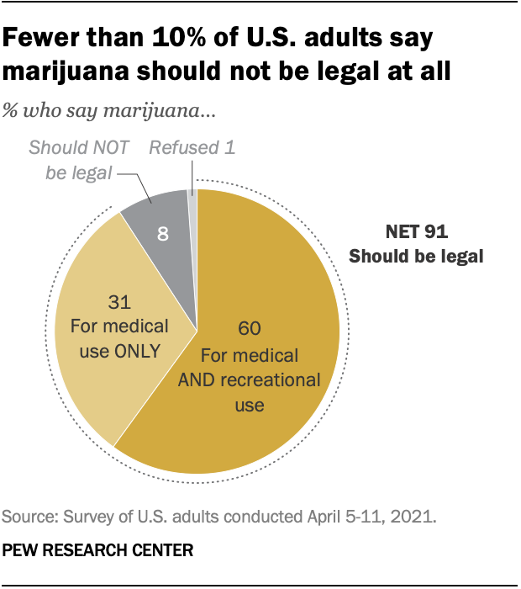
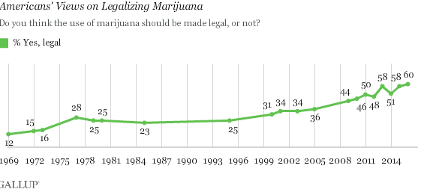
Changing Public Opinion
National support of legalization 60% in 2021

Slide 6
State and Federal Disconnect
Marijuana is a Schedule I substance under the US Controlled Substances Act
Production, processing and sale of marijuana is completely illegal under federal law;
Everyone producing, processing and selling marijuana - - even in a state where it’s legal for medical or recreational purposes - - is committing a federal crime
State and tribal efforts to legalize are still occurring around the country
Today, cannabis is recreationally legal for adult use in 18 states; 39 states permit marijuana for medical use

Slide 7
Tribal and Federal Disconnect
Tribal Nation’s ability to preempt federal regulations or prohibitions
U.S. v. Smiskin, 487 F.3d 1260 (9th Cir. 2007) (holding that the prosecution of Yakama tribal citizens under the federal Contraband Cigarette Trafficking Act would violate Yakama treaty rights);
Makah Indian Tribe v. Quileute Indian Tribe et al., 873 F.3d 1157 (9th Cir. 2007) (acknowledging a tribal treaty right to harvest whales and seals despite such activities being unlawful under the federal Endangered Species Act).

Slide 8
Laws Applicable to Employees
Public Sector Employment Law Issues in the Age of Marijuana

Slide 9
Sample Legalization Act Provisions
No effect on employment policies
Act “may not be construed to require an employer to permit or accommodate the use, consumption, possession, trade, display, transportation, sale or growing of cannabis in the workplace. [Act] does not affect the ability of employers to enact and enforce workplace policies restricting the use of marijuana by employees or to discipline employees who are under the influence of marijuana in the workplace.”
Anti-discrimination:
“[E]mployer … may not refuse to … employ or … or otherwise penalize a person 21 years of age or older solely for that person's consuming marijuana outside of the … employer’s … property.”

Slide 10
Laws Applicable to Drug Testing
First and Fourteen Amendments are generally considered to bar federal and state gov’t employers from conducting random, suspicion-less drug testing
Fourth Amendment:
“The right of the people to be secure in their persons, houses, papers, and effects, against unreasonable searches and seizures, shall not be violated, and no Warrants shall issue, but upon probable cause, supported by Oath or affirmation, and particularly describing the place to be searched, and the persons or things to be seized.”

Slide 11
Other Major Rules Under Federal Law
Skinner v. Railway Labor Executives’ Ass’n, 489 U.S. 602 (1989): upholding post-accident testing of railroad employees due to safety-concerns
National Treasury Employee v. Von Raab, 489 U.S. 656 (1989): upholding pre-employment drug testing required for hiring by the US Customs and Border Protection agency, safety concerns considered
Chandler v. Miller, 520 U.S. 305 (1997): striking down a Georgia law that required drug testing as a pre-condition to being eligible to run for an elected office, no safety concerns found

Slide 12
Applicability of the Fourth Amendment to Indian Country
In general, federal law permits the testing of public employees in “safety-sensitive” type positions
Bill of Rights only applies to state and federal governments (not tribal governments or the private sector)
Indian Civil Rights Act of 1968: includes the Fourth Amendment and extends its protections to Indian country
Santa Clara Pueblo v. Martinez, 533 U.S. 353 (2001), confirmed that tribal courts can exercise jurisdiction over ICRA claims, but only if tribal governments waive sovereign immunity

Slide 13
Applicable Tribal Laws
Constitutions, if they exist
Laws, codes, ordinances
Regulations or administrative guidance/policy
Tribal court decisions

Slide 14
Practical Questions about Marijuana in the Indian Country Work Place
Practical implications/what’s happening around you?
Hiring employees in tribal and-non tribal regional markets where marijuana use is legal
Legal Implications:
If I allow off-duty marijuana use, will it jeopardize federal grants or contracts?
Indian Civil Rights Act
Marijuana business ownership in Indian country

Slide 15
Tribal Drug Testing Policies:
Creating or Revising Policy—Where do we start?
Does your employer have a policy?
When do you want testing to occur?
Are there particular “Safety-sensitive” or other jobs where testing is particularly important?

Slide 16
Fact Gathering Before Policymaking
Why is the Tribe testing applicants for employment and employees for drugs and/or alcohol use? What is the Tribe’s motivation?
Why would the Tribe test pre-employment (and what does it tell us)?
Why would the Tribe test randomly during employment (and what does it tell us)?
Why would the Tribe test if an individual appears under the influence of drugs/alcohol (and what does it tell us?) On-duty? Off-Duty?
Why would the Tribe test post-accident, with reason to believe drugs/alcohol were involved?
Why would the Tribe test post-accident, if there is no reason to believe drugs/alcohol were involved?
Taking into consideration the Tribe’s motivation for testing, which categories of, or specific, positions, should be tested? Safety-sensitive? Non-safety-sensitive? Others?
Is there an evidence-based concern that alcohol and/or drug use by non-safety-sensitive positions poses a danger to the Tribe and tribal members?

Slide 17
Policy Decisions To Be Made
When will testing occur? (Pre-employment, at random, upon reasonable suspicion, off duty, post accident)
Who is going to be tested?
All employees
Elected leaders
Safety-sensitive positions only
What are you testing for?
Standard list covered under federal guidelines include marijuana, cocaine, opioids, amphetamines, and phencyclidine
How are you going to treat recreational and medical marijuana?

Slide 18
Practical Problems with Marijuana Testing
A positive result for marijuana is not, alone, evidence that an employee is currently impaired by marijuana.
Overall testing issues with accuracy, precision, sensitivity, ability of people to obstruct accuracy of tests, in general
Significant differences in type of product, potency, and method of ingestion can lead to variation in the the duration of how long effects last and how traces of marijuana use will be detected in the system

Slide 19
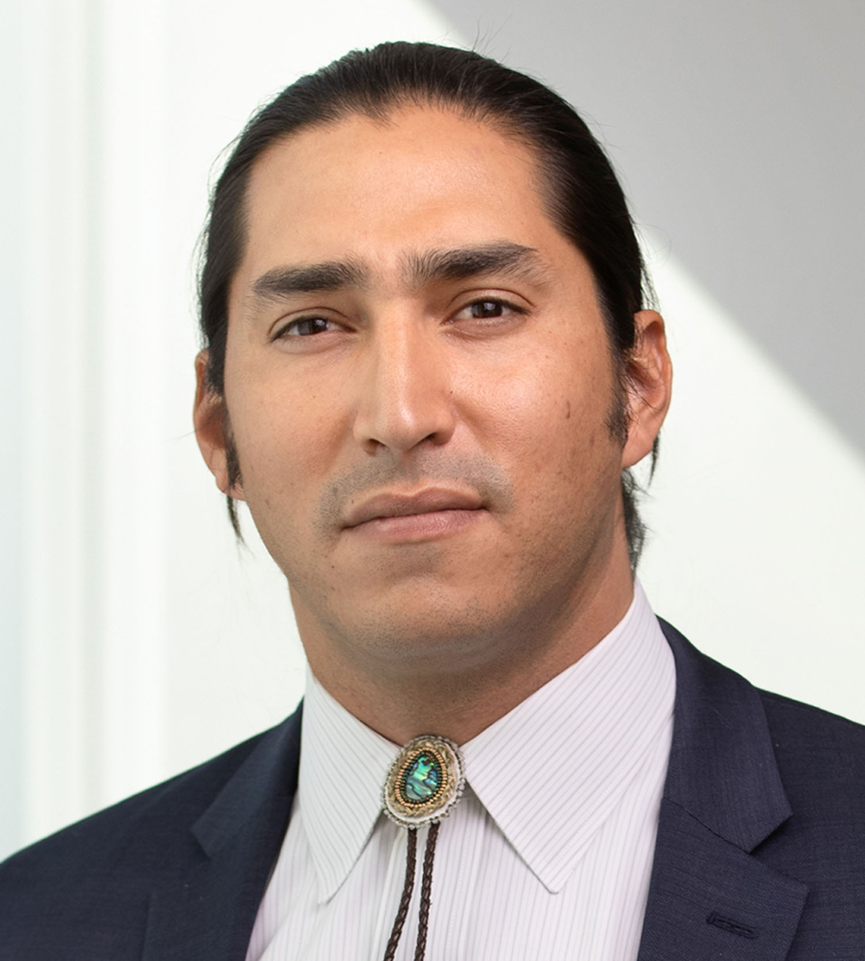
THANK YOU
Corey Hinton
mchinton@dwmlaw.com
www.dwmlaw.com

