Slide 1
26th Annual Conference
San Antonio, Texas
September 26-28

Slide 2
How Digital Advertising is Reshaping the Recruitment Landscape
Lynn Maurer
Director of Digital Strategy & Technology

Slide 3
AGENDA
Topic one
Topic two
Topic three
Topic four
What Is Out There for HR
What Other HR Execs Look For
Digital Products
HR Case Study

Slide 4
OUR BRAND POSITION
InnoVision refutes the “traditional agency” stigma by putting service and value first and believing that a “Just Say Yes” attitude will lead not only to guaranteed client satisfaction, but to more creative thinking, new innovations and complex ideation. Years of experience coupled with passion for the profession and a client-first approach have encouraged the rapid growth of InnoVision with a highly positive, passionate and diverse culture that serves as the foundation for the development of proven strategies. We prioritize precision and always ensure that our clients’ expectations are not only met, but exceeded by achieving their objectives accurately, meeting all deadlines and staying within all determined budgets.
Headquartered in sunny San Diego, InnoVision encompasses the best of both coasts with clients based throughout the United States including Washington, Florida, Arizona, New York and throughout California.
InnoVision Marketing Group is a brand-centric agency dedicated to providing the highest level of service. Plus, our 24/7 availability, accessibility and flexibility coupled with outstanding work are what make us the country’s only anti-agency® with results that continually exceed client expectations. Modeled after a New York agency in style, scope and intensity, InnoVision is defined by its unique culture of free-flowing ideas, transparency and positivity.
Our team’s personal interest in Huey Magoo’s success combined with a
hands-on, sales-oriented approach has garnered the brand huge results.

Slide 5
Team
Name
Name
Name
Name
Title
Title
Title
Title

Slide 6
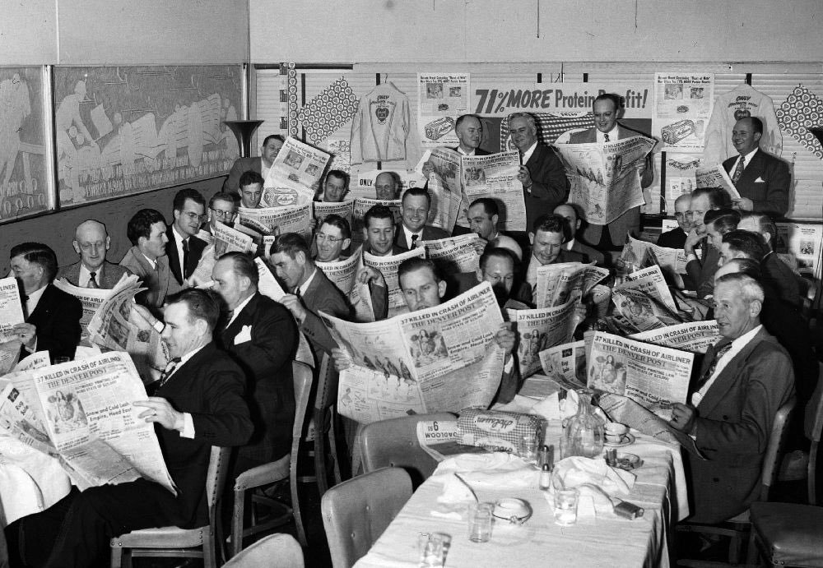
Memories...
Notes:
Ahhh…memories. When you could sell, recruit, offer – basically do anything in one place and 90% of the town would see it.
Running an ad in the paper worked so well for a long time –why? Because everyone read the paper. It’s where you got your news, sports, entertainment – everything was in the paper. Anyone looking for a job, knew the only place to find one – was through the classifieds. The days of want ads, and job posting signs have not technically disappeared, just where they run may look a bit different now a days

Slide 7
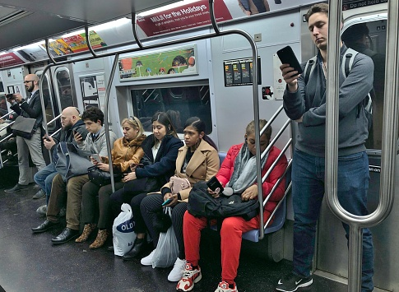
TODAY'S reality
Notes:
So imagine if there was a different paper for each section and each article. And you would have to place that wanted ad in every single paper in order to reach the same people that you used to reach with just one ad in one paper.
This is the landscape of the world we live in now. Everyone on their phone, everyone having completely different experiences but inches from each other. Unlike the picture before, everyone in this picture is reading something completely different, even if they are reading about the same topic, they would all be reading from different sources.

Slide 8
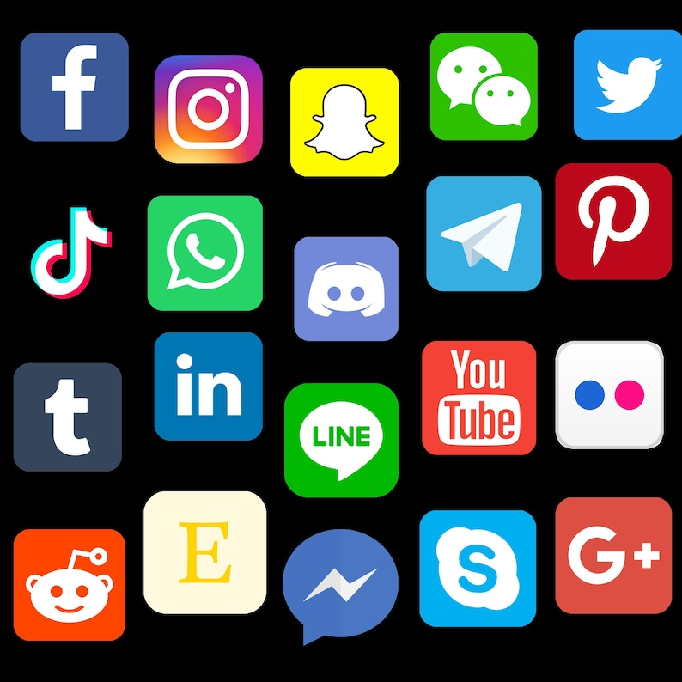
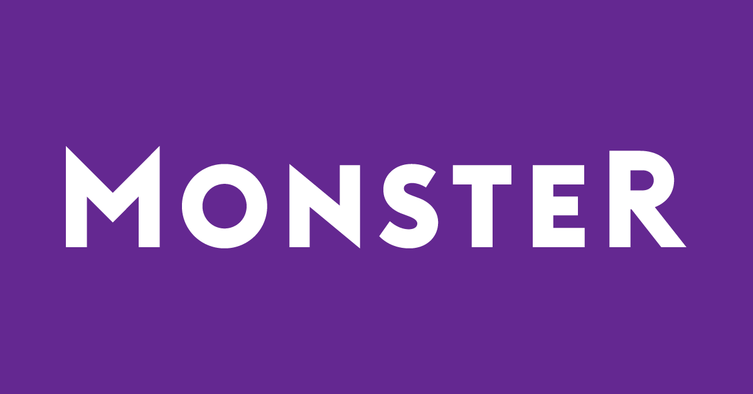
Social media / Job boards
Notes:
There are also so many sites for jobs: Linkedin, Indeed, Monster, Yahoo, Google Search, Facebook Jobs, Craigslist, even your own website. Jobs are listed everywhere. So how can you stand out, and how can you reach the right applicant?
There are millions of websites, information is everywhere – and there is no one source of information that people use anymore. So, how do you not only figure out how to reach them with job opportunities, but then convince them to take the time and effort to fill out YOUR application. ?
This is where all of the digital pieces can come together to build both earned and paid placements for your job listings.

Slide 9
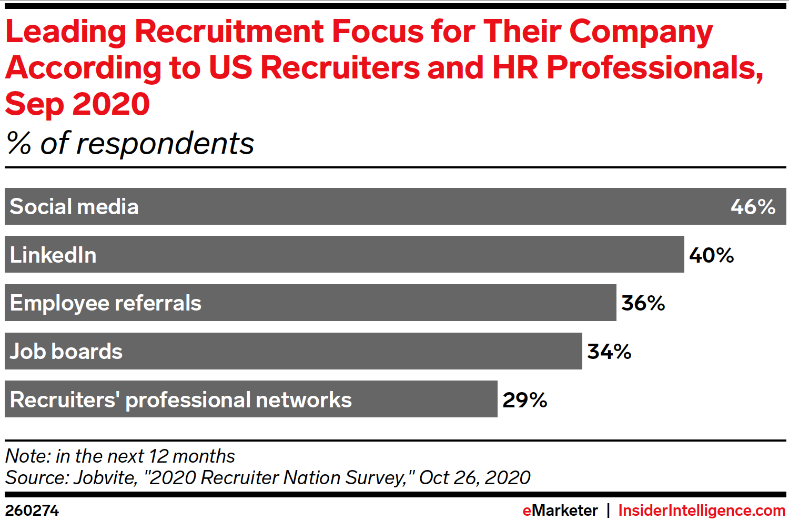
How are others recruiting
Notes:
So today we can get into the how, where and why’s of what is available to you.
Let’s begin with what others are saying about the landscape – 46% of HR professionals plan to use social media as a recruiting tactic (this is Facebook, Instagram, TikTok, and Snapchat) –

Slide 10
TikTok
Notes:
Looking for younger applicants? Try TikTok! Some young adulusers ts are starting to post TikTok resumes- a new service that TikTok is beta testing with brands such as Target, Chipotle and Shopify, although many more brands have joined the site to promote their job openings.

Slide 11
Yes, This is real
https://newsroom.tiktok.com/en-us/find-a-job-with-tiktok-resumes

Slide 12
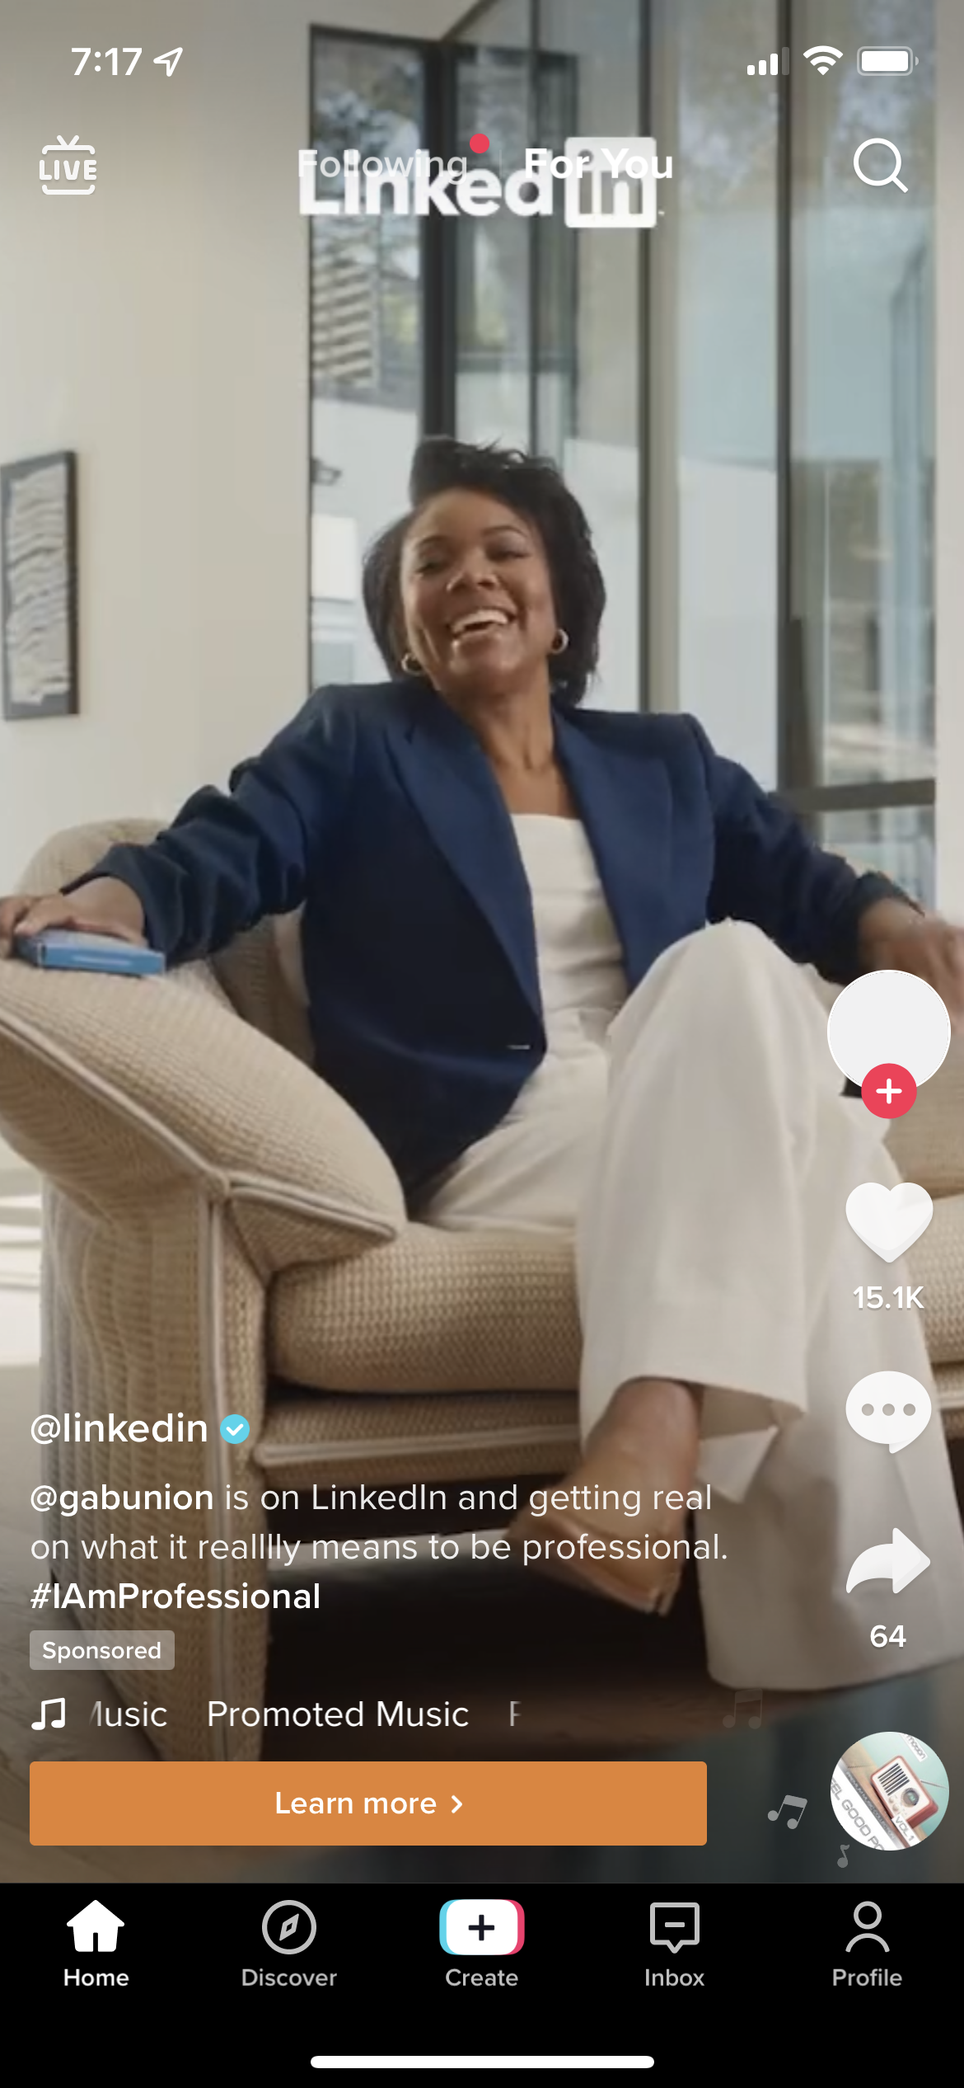
Even Linkedin jumped onboard
Notes:
This just adds another way that employees want to be found and recruited. Even Linkedin jumped on board the TikTok wagon – they are promoting on TikTok all the time!

Slide 13
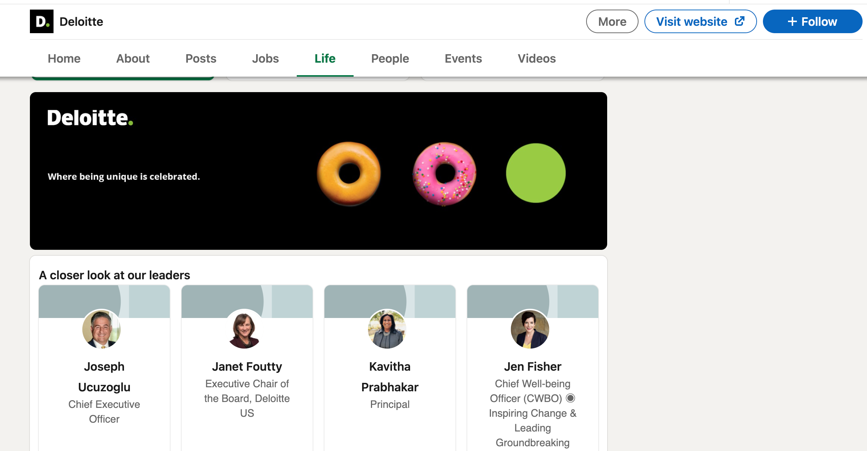
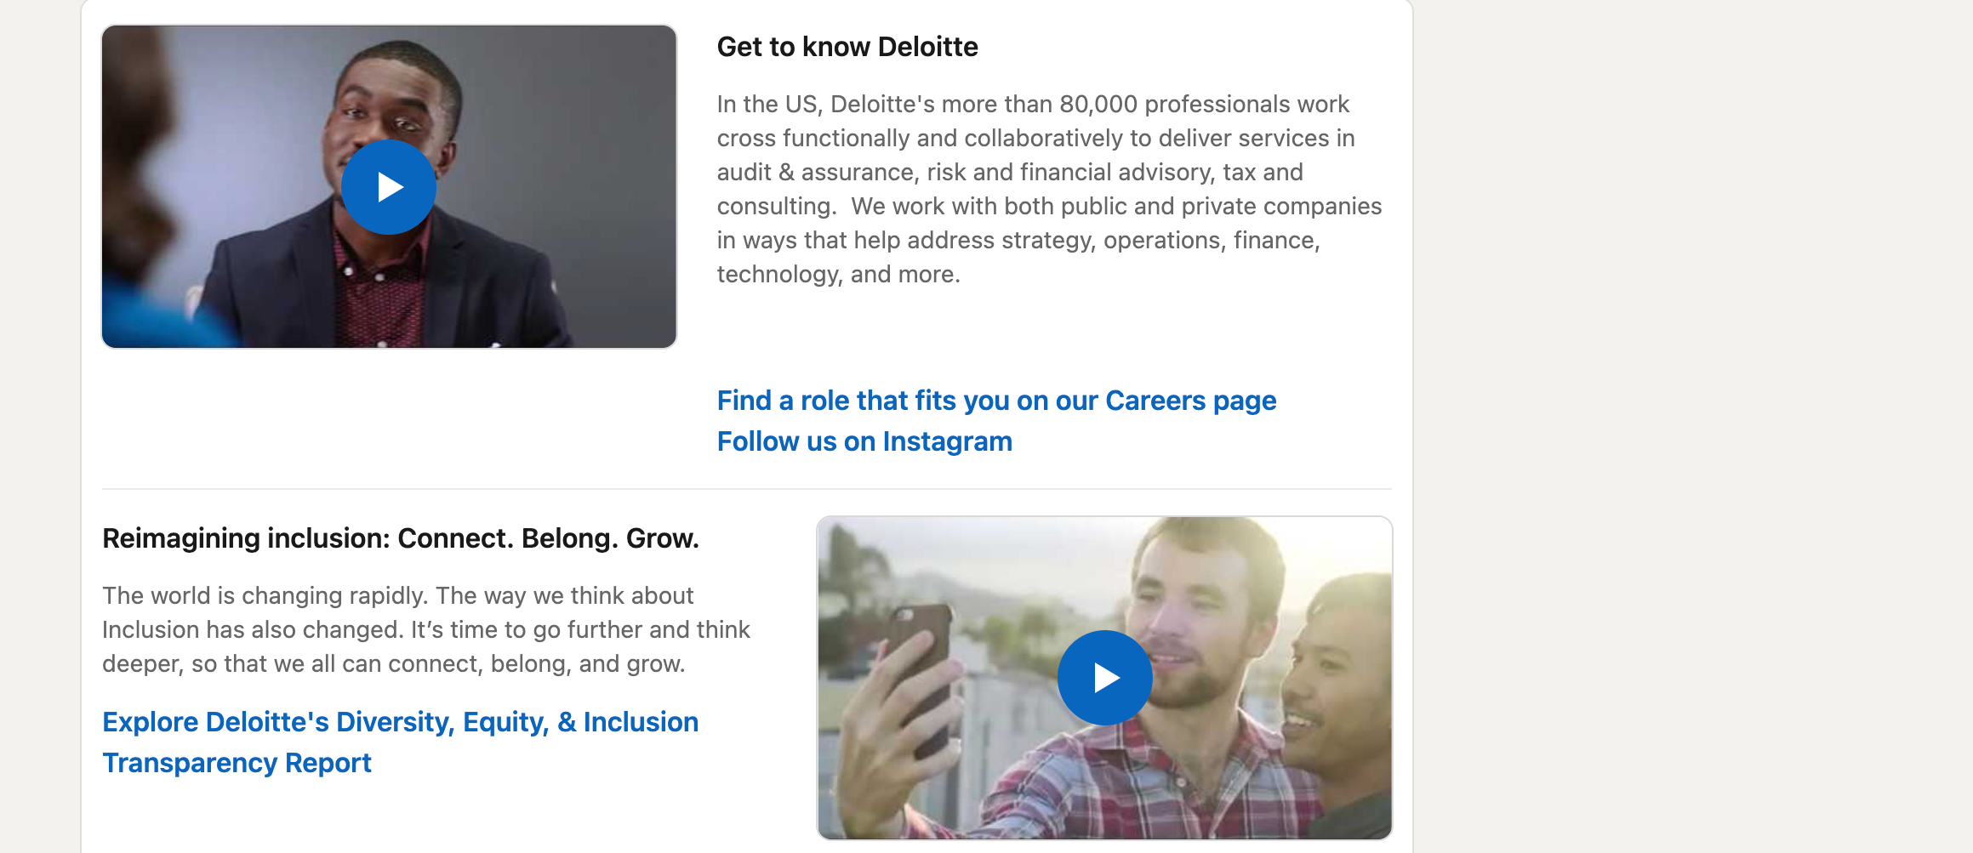
Linkedin
Be mindful and up-to-date on your company LinkedIn page
Notes:
Speaking of LinkedIn - 40% of those HR respondents pointed to LinkedIn directly as a lead source for recruitment. So let’s jump into that platform.
When recruiting through LinkedIn – one of the most important things to keep in mind is that applicants are going to look at your business profile and another research piece talks about what applicants are most interested in, and employee experience tops the list. So keeping your business profile on LinkedIn up to- date and full of content, including employee experience content is going to be extremely important and a factor that applicants will look at before deciding that you fit their mold. Take a look at your “Life” section on your business page – is it active? Do you have great content for prospects to learn about your company? Do you even have a Life section??
Showing prospects about your company is vital in winning great applicants over your competitors. How can you make this happen? It’s all about content and consistency. First, you need to create content that shows workers, highlights the company and the environment that they will be working in, and make sure it’s FUN! You can also have employees help write content that shows the jobs and the greatness that is your company – then you can run paid social campaigns using that employee’s content to specific applicants!

Slide 14
Linkedin
Be mindful and up-to-date on your company LinkedIn page

Slide 15
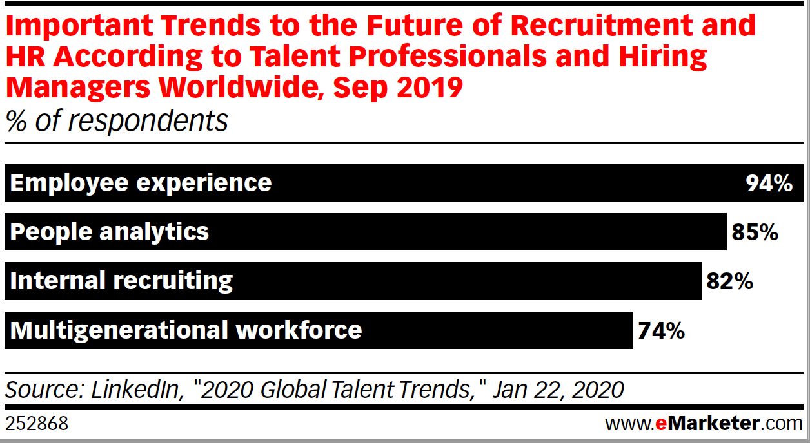
What to post

Slide 16
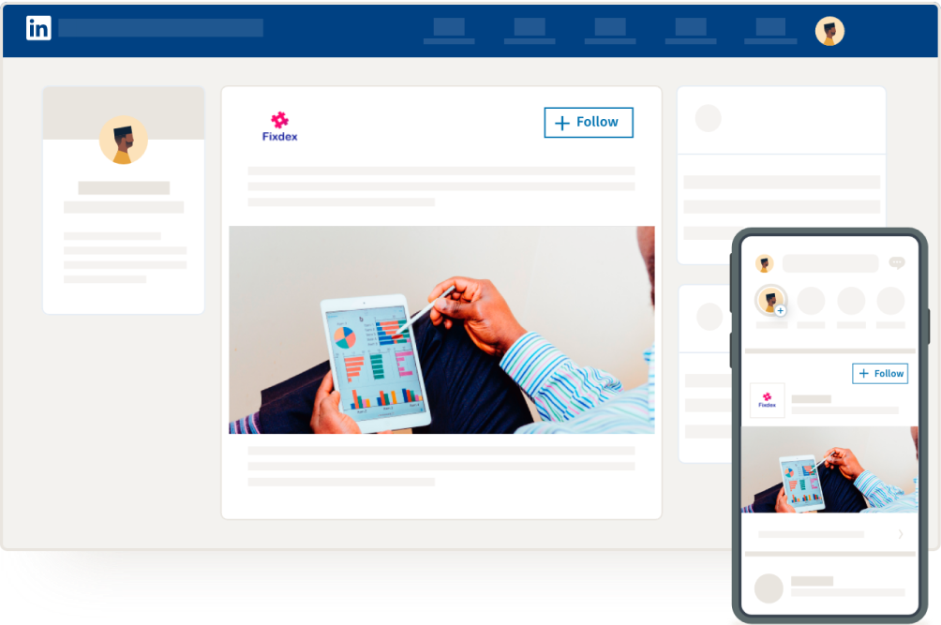
Linkedin targeting options
Can Include:
Location
Company Name
Company Size
Job Title
Job Experience
Skill Sets

Slide 17
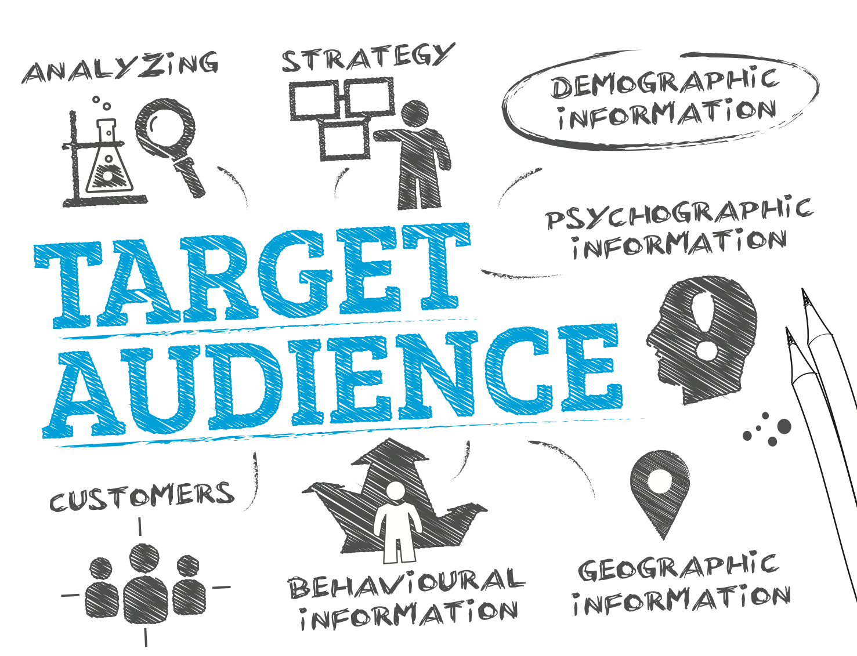
Digital targeting
Notes:
Now let’s talk technology and different types of messaging options and platforms. Digital marketing has changed so much in the last few years, and will continue to do so as new technology becomes available and current platforms advance.
There’s a lot of data out there for you to use – and so many options to outreach to the right person. You have the ability to seek out applicants, instead of waiting. You can use data to target people that are searching for specific job titles, industries as well as those people that are already working in a specific industry.

Slide 18
Build the target
Who are we looking to reach?
Where are they?
How do we want to speak to them?
Notes:
Once we know who you are looking for, then we start to layer in other data such as location or proximity to your location, and any other demographic that we feel would be best for our campaign. Then the magic starts – our campaign ads start to show to those people that fit these descriptions and data targets.
These ads can run on all different platforms and websites. These ads can be static images, they can have animation and they can also be video and audio.
You can target people on everything they do online. If a potential applicant is watching YouTube, or watching the latest episode of ‘This is Us’ on the NBC app, your ad can be shown to that person while they are watching.
If they are listening to their favorite podcast, or getting a run in while listening to Spotify – as long as they fit our target – your ad can be heard!
Finding the right target, can also mean looking into places they’ve visited….

Slide 19
DISPLAY AD EXAMPLE

Slide 20
DISPLAY AD EXAMPLE

Slide 21
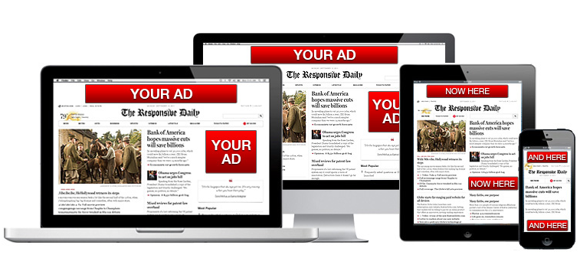
Display placement

Slide 22
Location targeting
Notes:
Have you ever hosted a job fair and wished you could stay in touch with everyone that attended? T

Slide 23
Location targeting: How does it work?
We build an invisible fence around a specific location, or multiple locations
We decide what dates we want to pull mobile devices from – was it a one-day job fair? Or devices that are going to a specific school?
We gather the devices and build our audience from those devices which can then be served ads to their phone across multiple platforms!
Their device gives us lots of information as well – think demographics, psychographics, household information
Let’s see that info!
Notes:
It’s called Polygonal Targeting and Attribution (or PTA for short). This technology allows us to look at any location in the US, and pull devices that were active at that location up to a year in the past. We can also look at that location over very specific dates (like a day longdaylong or weekend long job fair).
Once we capture the devices from that location, we can then create what becomes a 1st party custom audience. This audience can be used to run banner ads, social ads, video ads as well as streaming audio ads. We can target any location whether it be where a job fair has been held, a competitor location or your own location as well.

Slide 24
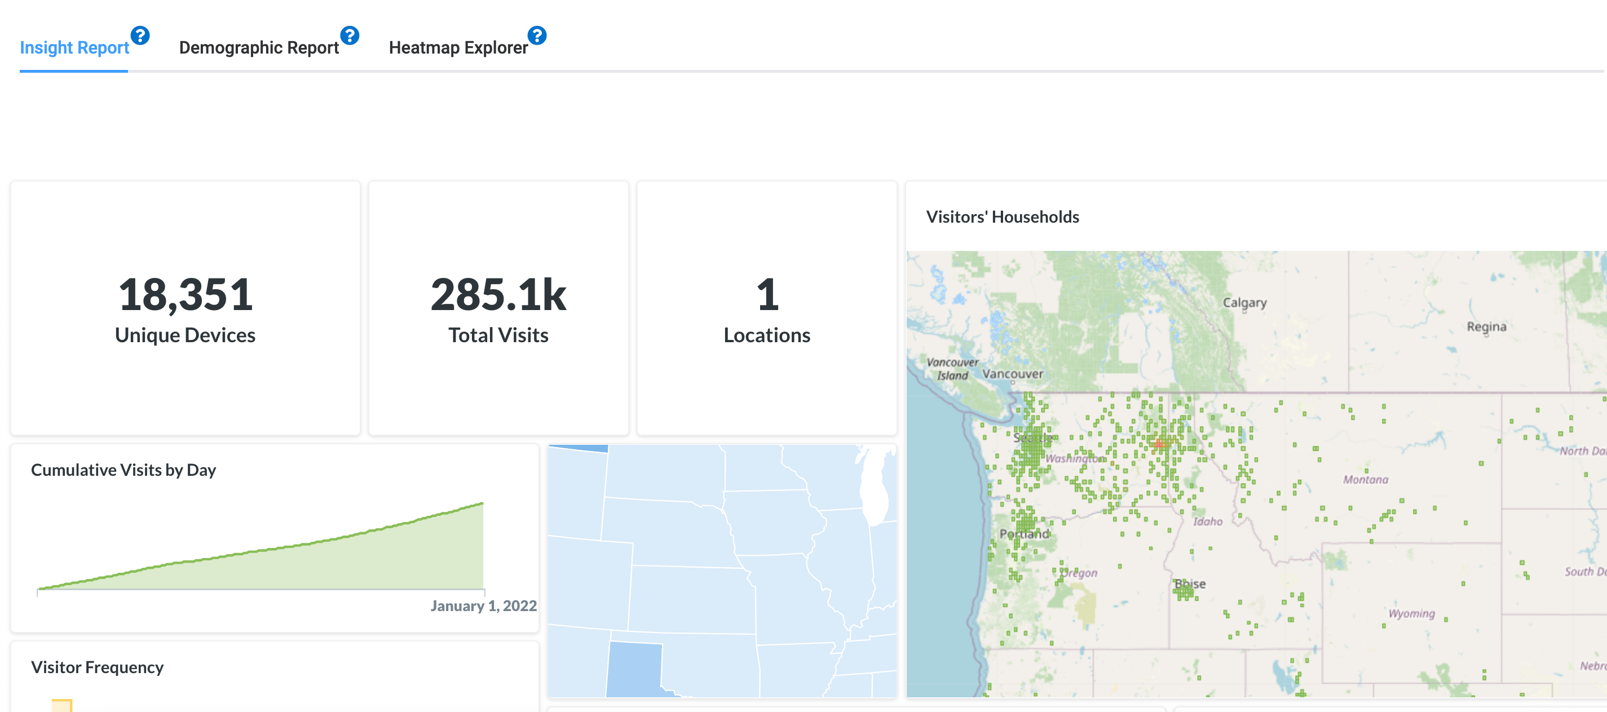
Polygonal targeting and attribution

Slide 25
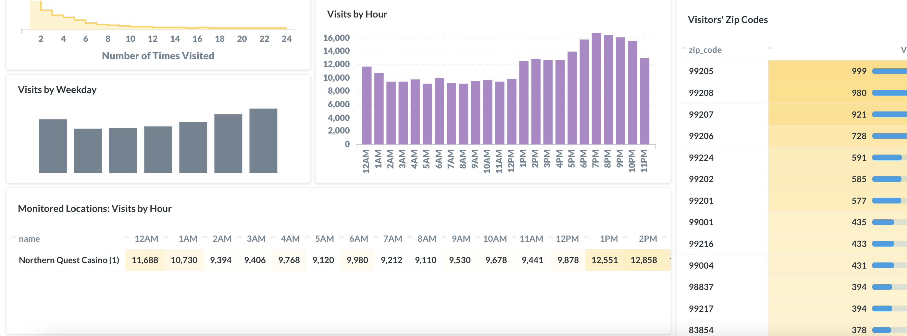
Polygonal targeting and attribution

Slide 26
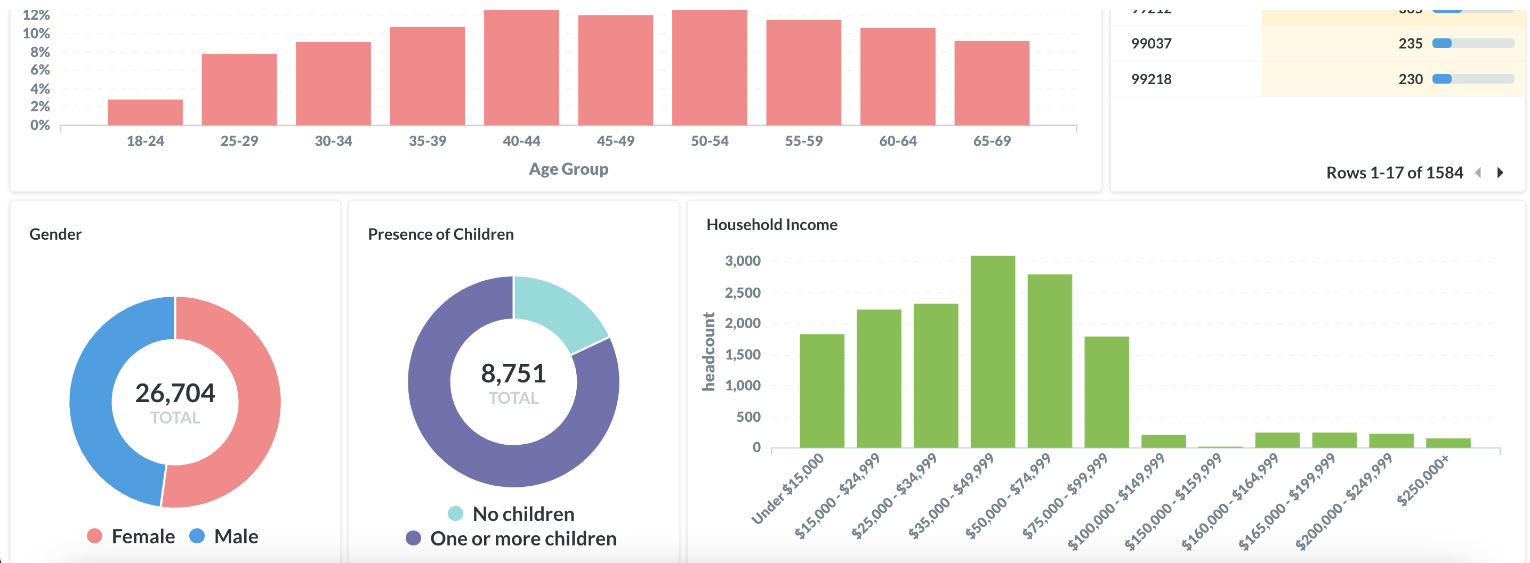
Polygonal targeting and attribution

Slide 27
Case study – valley view casino and hotel
Valley View Casino and Hotel needed to drive more applications for all position types including:
Kitchen
Janitorial
Dealers
Restaurant Staff
VVCH was open to different options to reach their prospects, including running Spanish language advertising
Notes:
The reality of life is that people use the internet all day long – and these strategies and platforms allow you to reach your potential applicants consistently throughout their internet day. By keeping your name, your brand and your openings top of mind – that is what will give you an edge over other companies wi

Slide 28
VVCH Strategy
Target specific job titles, keywords, those looking for employment
Target Spanish-language users that are looking for employment
Utilize paid Facebook options for placement to specific targets and job titles

Slide 29
VVCH RESULTS
Campaign-Specific Results
Double industry standard click-thru rates
Three times industry standard on social ads
High engagement on social including shares, comments and clicks
Our client saw an increase of 50% Spanish applicants and close to 50% for English applicants!
While other companies were struggling to find workers, VVCH was receiving consistent applications for all levels of jobs.

Slide 30
TAKEAWAYS
PLATFORMS
technology
CREative
One platform won’t do it all – be everywhere!
Update and post consistently.
Fill out the “Life” portion on LinkedIn and make sure it has personality!
Location-based targeting allows you to find people based on where they have been up to a year in the past.
Always look for new options to tell your company’s story!
Drive interest with what sets you apart.
Talk about benefits, employee success and job title openings.

Slide 31
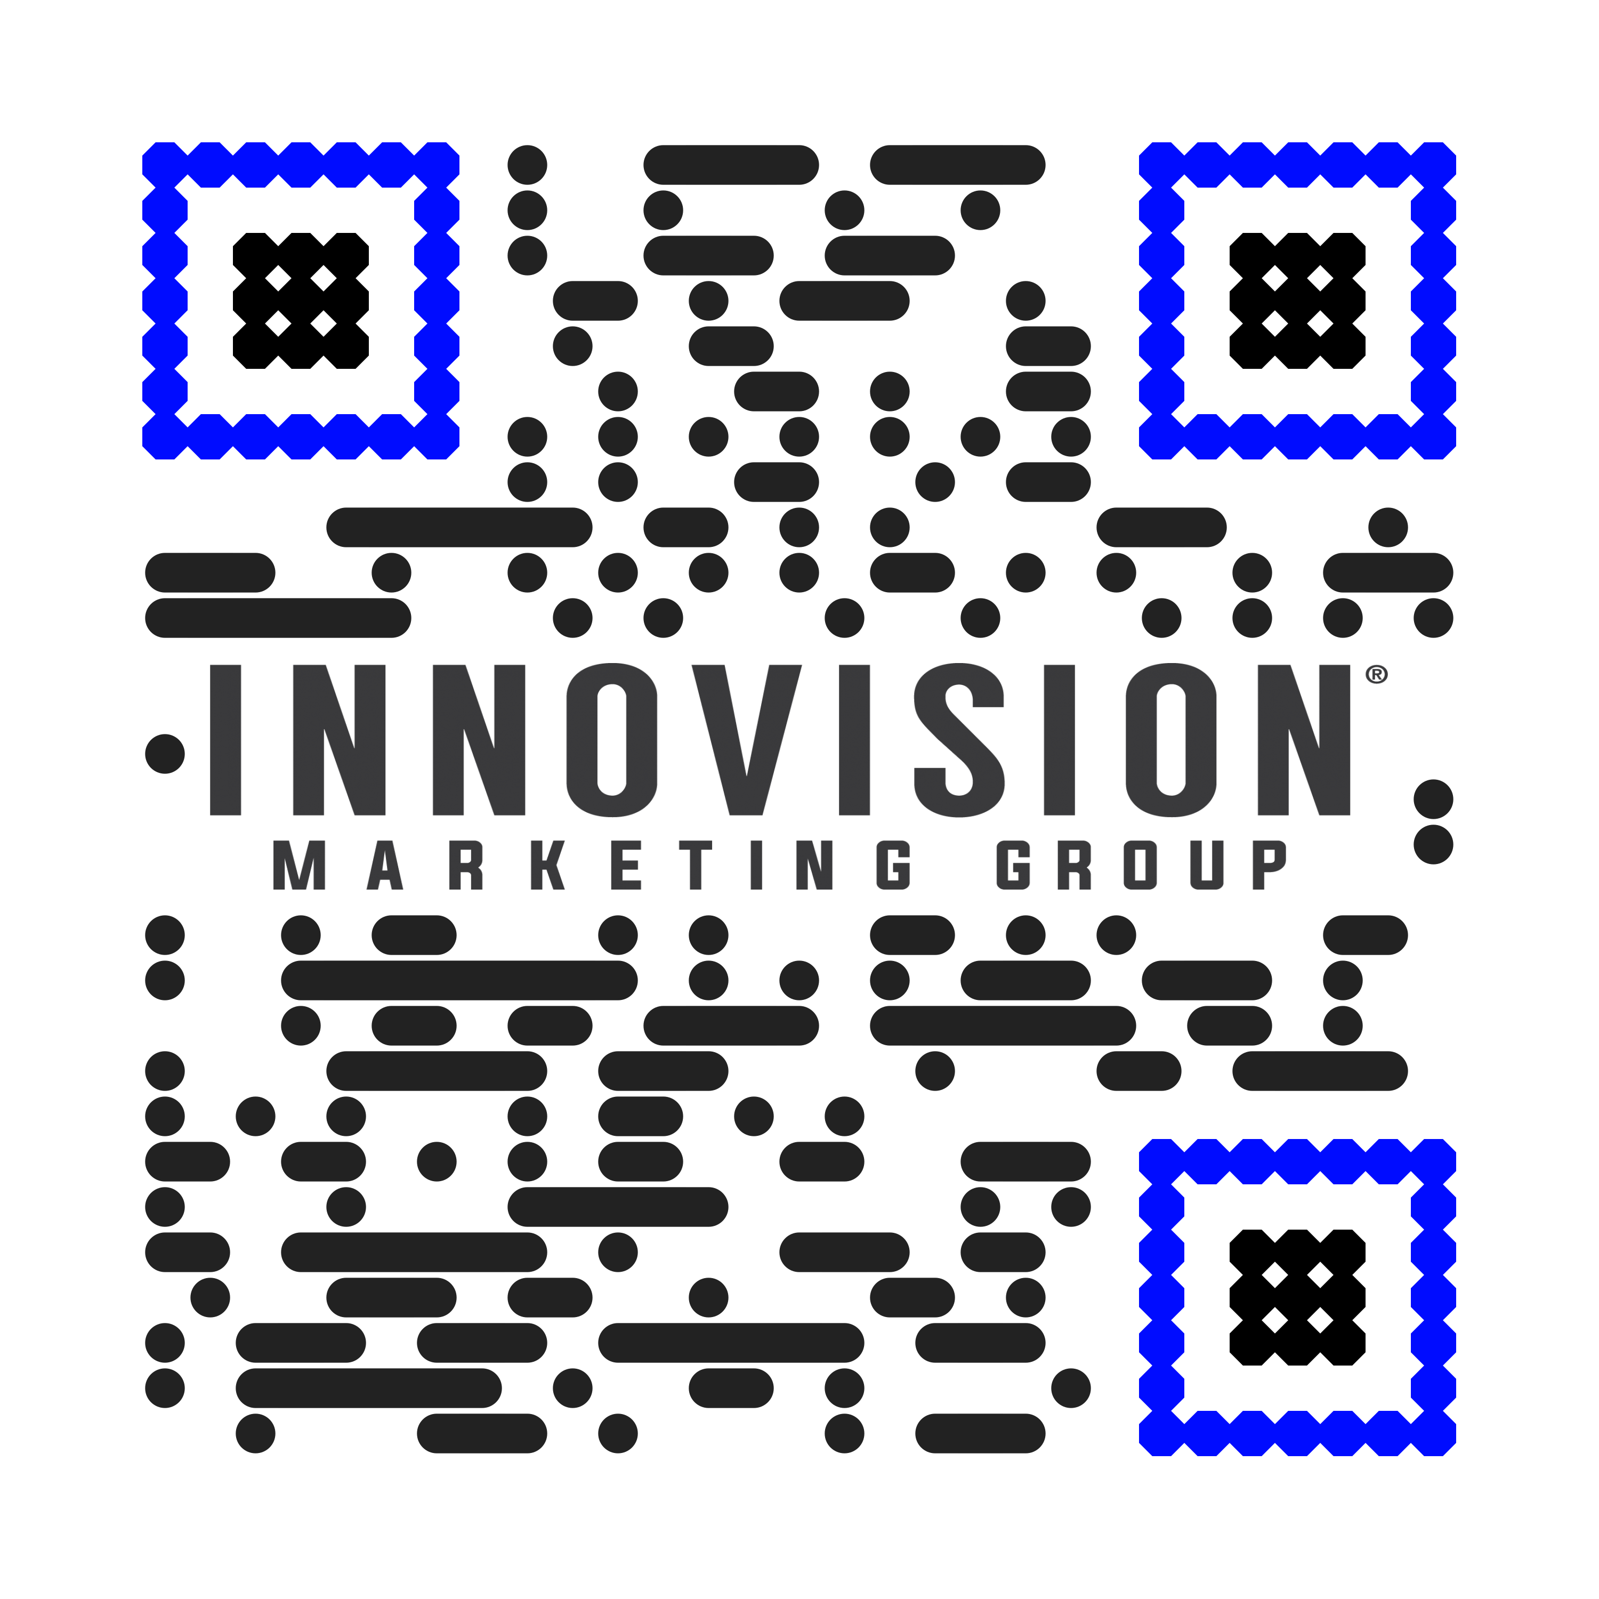
THANK YOU
Lynn Maurer
lynnm@teaminnovision.com
TeamInnoVision.com

