Slide 1
26th Annual Conference
San Antonio, Texas
September 26-28

Slide 2
I-9: Everything You Need To Know (but Didn’t know to ask)
Pamela Fagan, THRP, SPHR

Slide 3
Presenter
Audit Business Services, Inc.
In business for over 35 years offering services to companies regarding employment law, labor law and payroll tax law compliance audits. Specialist in Tribal sovereignty for over 6 years. Worked with NAFOA, NCAI, and multiple tribes in the Pacific Northwest, Arizona and Minnesota. Honorary member of the Mendota Mdewakanton Dakota Community in Minnesota.
Ms. Fagan is certified: SPHR, CPP, THRP, TFMC and certified in both United States and Canada.
Pamela Fagan
Owner
©Audit Business Services, Inc. – 07/2022 – all rights reserved

Slide 4
introduction
Today’s presentation will address the complex issues regarding properly preparing, auditing and recordkeeping for I-9’s to survive an ICE (US Immigration and Customs Enforcement) audit.
At the end of this session you will know:
Steps for conducting an effective internal I-9 audit
How to properly correct I-9 Forms
Keys to avoiding penalties following an ICE audit
Keys to stay off ICE’s radar
Employers must monitor DHS’ and ICE’s Workforce Enforcement announcements about when the extensions end and normal operations resume.

Slide 5
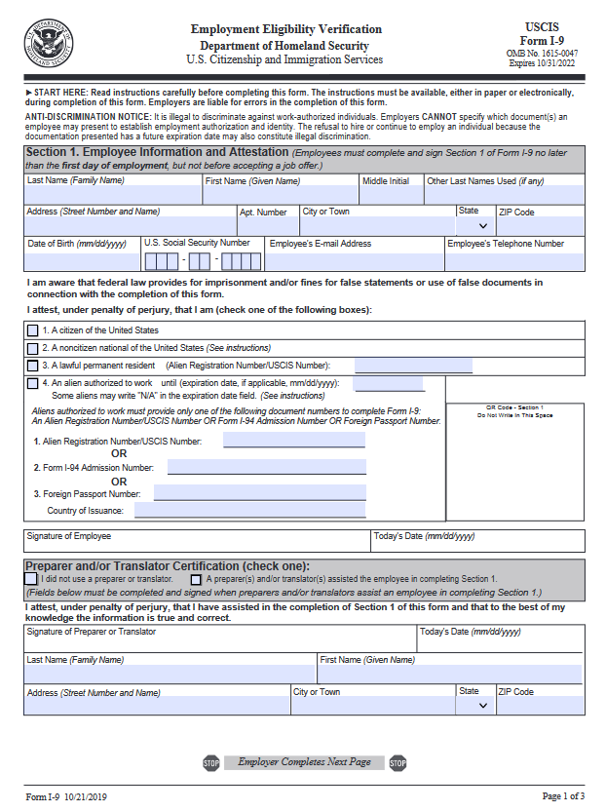
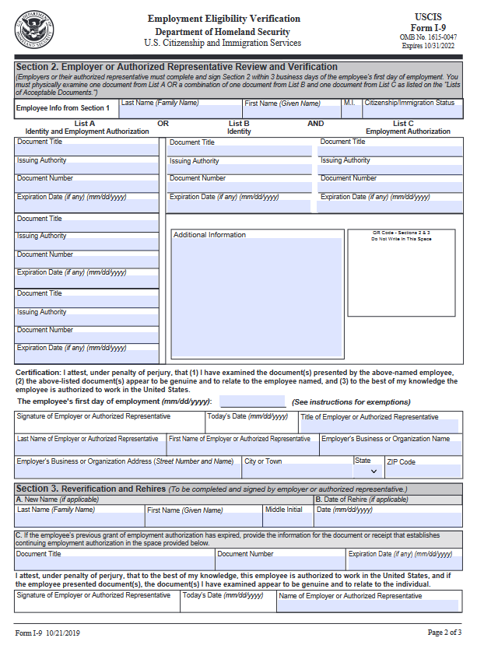
AGENDA
Latest I-9 Form Updates: Guidelines for Total Compliance
Effective Self-Audits: Bulletproof Your I-9 Policies & Avoid ICE Audits
I-9 and Legal Liability: Best Solutions to Minimize Costly Mistakes
Q & A Session
©Audit Business Services, Inc. – 07/2022 – all rights reserved

Slide 6
Latest I-9 Form Updates: Guidelines for Total Compliance
Section 1

Slide 7
I-9: Flexibility Announcement
Initial announcement (3/20/2020) - Extended
REMOTE issues
The Department of Homeland Security (DHS), U.S. Immigration and Customs Enforcement (ICE), announced an extension of the Form I-9 flexibilities first announced in March 2020 and updated in March 2021.
COVID-19 pandemic (“COVID-19”). Due to the continued safety precautions related to COVID-19, DHS will extend the updated flexibilities until October 31, 2022.
Employers may be unable to timely inspect and verify, in-person, the Form I-9 supporting documents of employee(s) hired since March 20, 2020, in case-by-case situations.
In such cases, employers may memorialize the reason(s) for this inability in a memorandum retained with each affected employee’s Form I-9.
Any such reason(s) will be evaluated, on a case-by-case basis, by DHS ICE in the event of a Form I-9 audit.
https://www.ice.gov/news/releases/ice-announces-extension-i-9-compliance-flexibility-3
©Audit Business Services, Inc. – 07/2022 – all rights reserved

Slide 8
Temporary Policy for List B Identity Documents Ended
DHS ended the COVID 19 Temporary Policy for List B Identity Documents.
Beginning May 1, 2022 - Employers will no longer be able to accept expired List B documents.
Starting May 1, 2022 - employers must only accept unexpired List B documents.
If an employee presented an expired List B document between
May 1, 2020, and April 30, 2022, employers are required to update their Forms I-9 by July 31, 2022.

Slide 9
I-9: Flexibility Announcement - REMOTE
Hired on or after 4/1/2021:
Employers are temporarily exempt from the physical inspection requirements associated with Form I-9 until: they undertake non-remote employment on a regular, consistent, or predictable basis, or the extension of the flexibilities related to such requirements is terminated, whichever is earlier.
Policy only applies to employers and workplaces that are operating remotely.
If employees physically present at a work location, no exceptions are being implemented at this time for in-person verification of identity and employment eligibility documentation.

Slide 10
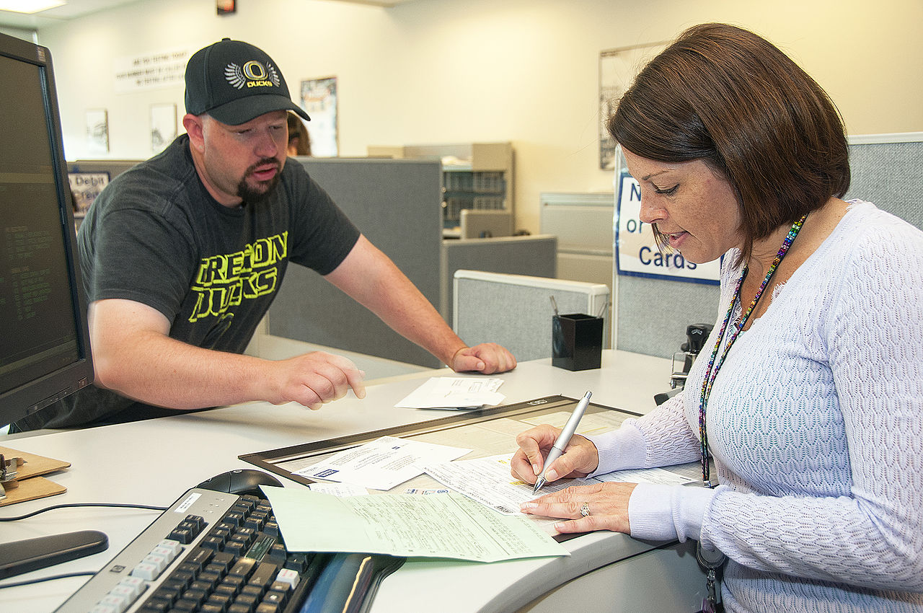
I-9: Flexibility Rules Remote
Once normal operations resume, all employees who were onboarded using remote verification, must report to their employer within three business days for in-person verification of identity and employment eligibility documentation.

Slide 11
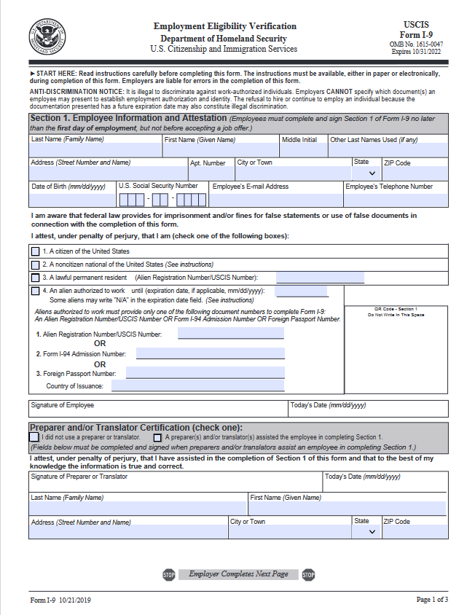
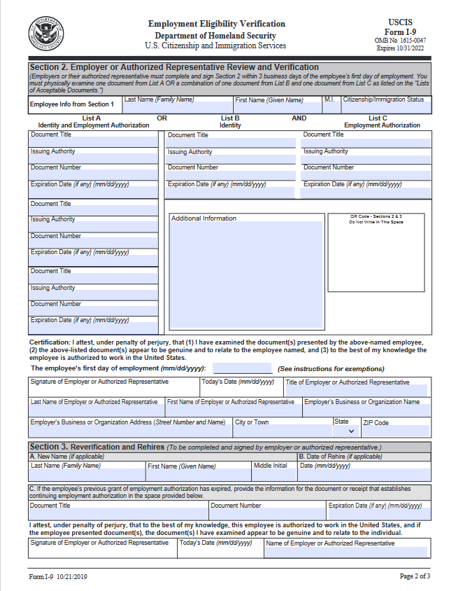
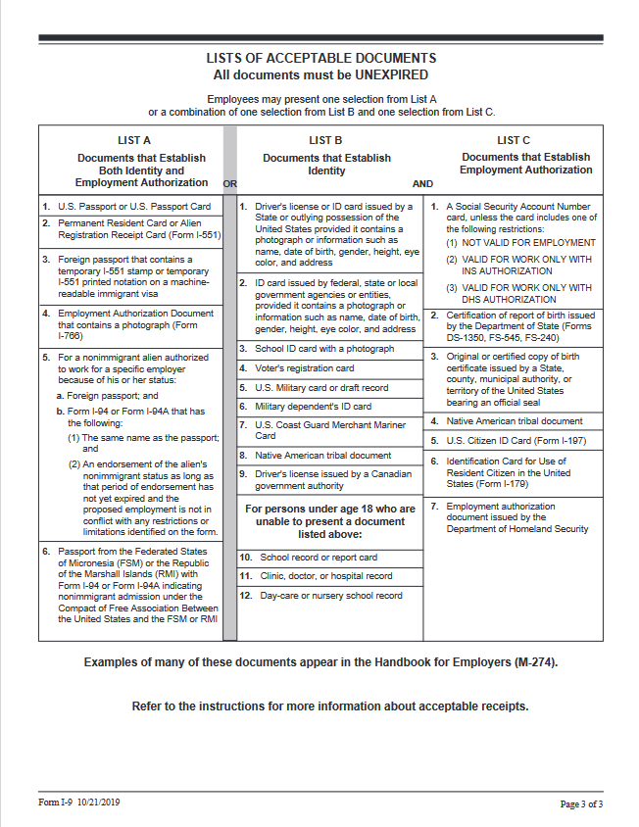
Correct Form To Use

Slide 12
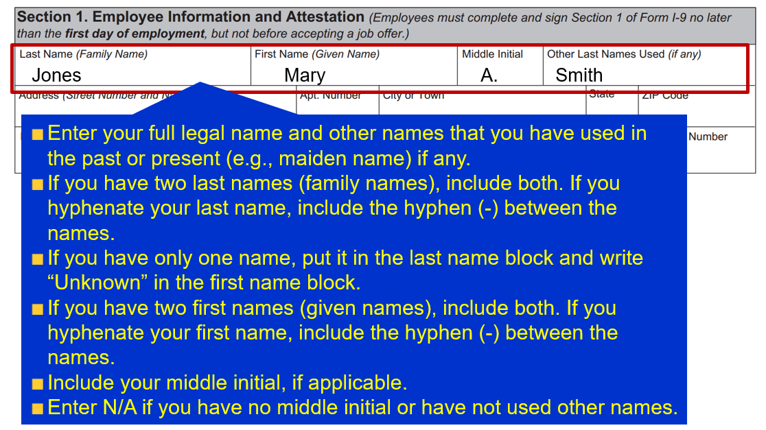
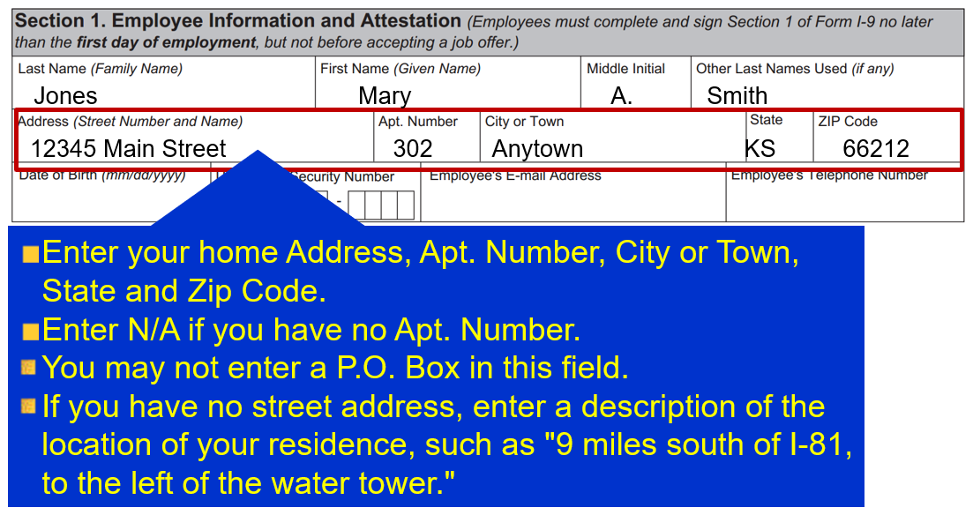
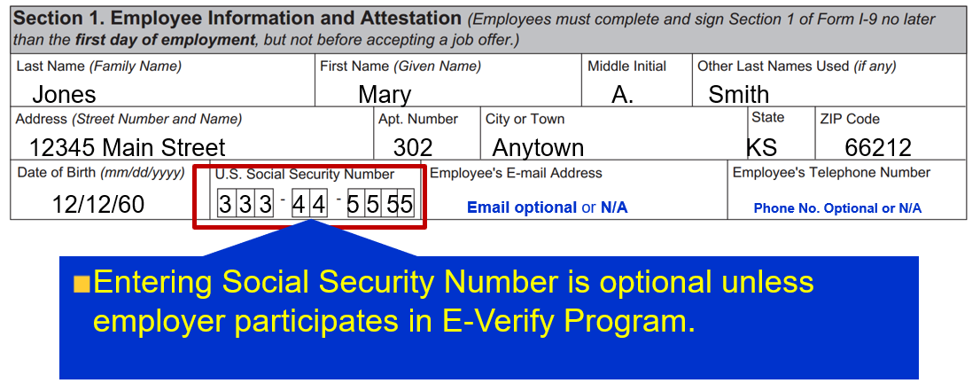
Create a Tutorial for Your Staff

Slide 13
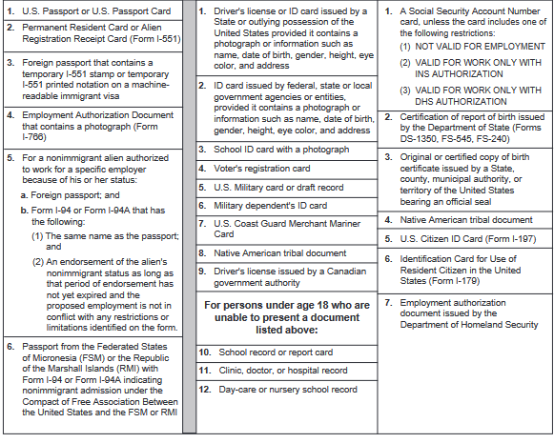
Allowed Identity Documentation
Tribal employees may use documentation from sections B and C to prove their status. Examples:
Native American tribal document and
Social Security card or birth certificate or driver’s license

Slide 14
Hiring Employees In Other States
I-9’s can be completed in their home state
Authorized representative is necessary to confirm documentation
Helps if they are a notary
Photocopy of original documents must be sent to home office by designee

Slide 15
Appointing an Authorized Representative
May designate an authorized representative to act on your behalf to complete Section 2.
Any person may be designated to complete and sign Form 1-9 on employer’s behalf.
Employer liable for any violations in connection with the form or the verification process committed by the designee.
An HRMorning Workshop
15

Slide 16
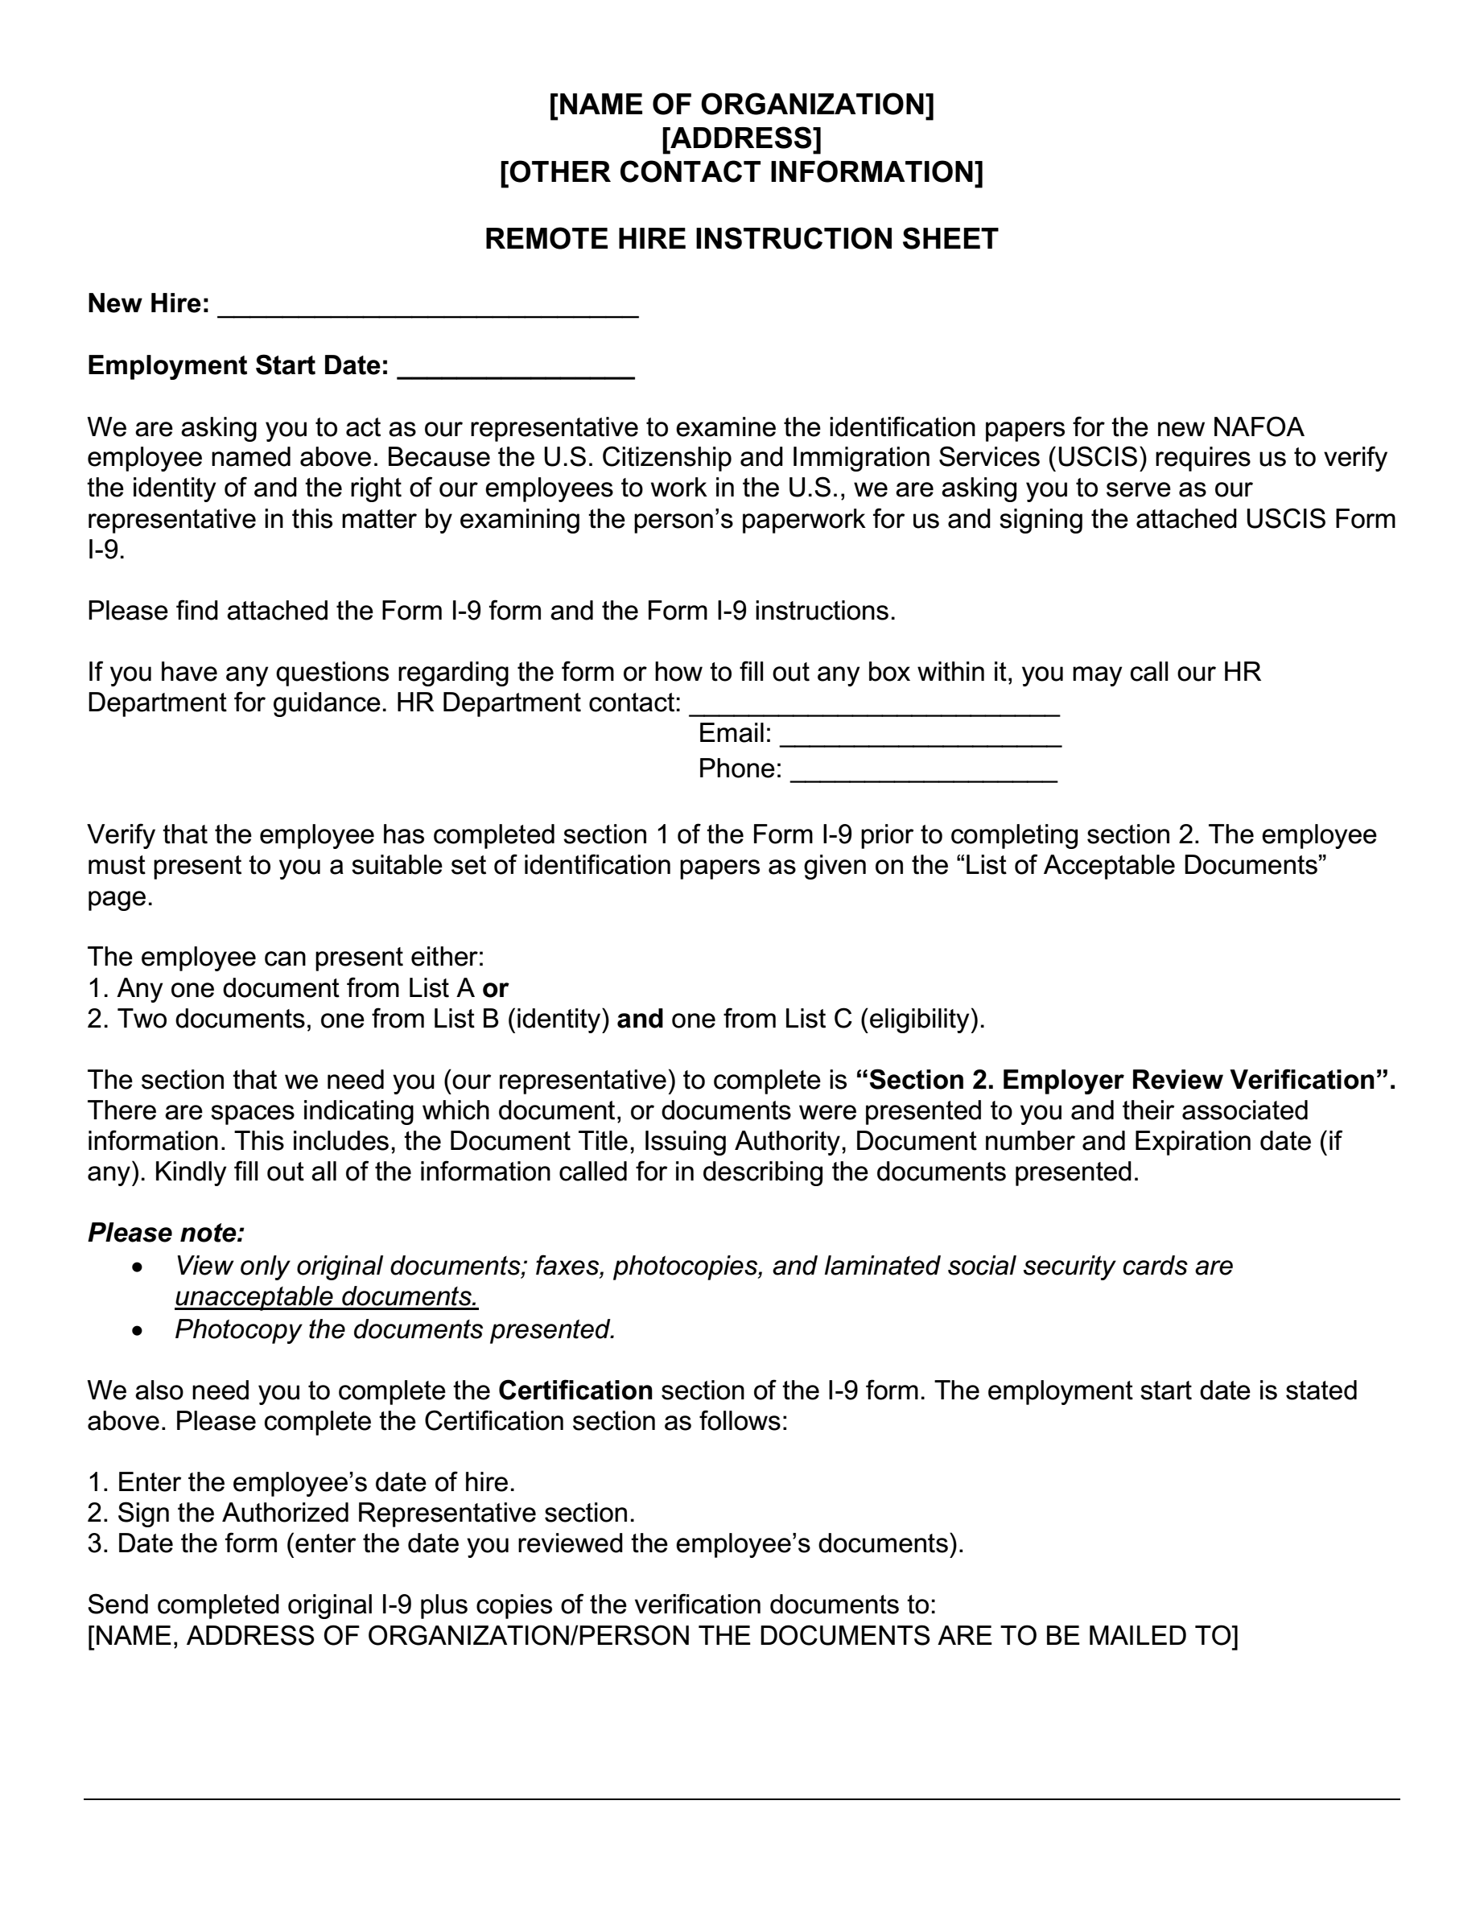
Designation Documents

Slide 17
Inspecting Documents Remotely
Inspect over video link, fax or email, etc. and obtain, inspect, and retain copies of the documents, within three business days for purposes of completing Section 2.
Employers who avail themselves of this option must provide written documentation of their remote onboarding and telework policy for each employee.
© 2020 Max Muller & Associates. All rights reserved.
An HRMorning Workshop
17

Slide 18
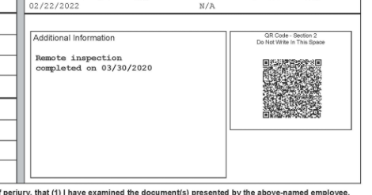
Inspecting Documents Remotely
NOTE: There will be notations added to the “Additional Information” box once normal operations resume and the documents are examined in the presence of the employee.
© 2020 Max Muller & Associates. All rights reserved.
An HRMorning Workshop
18

Slide 19
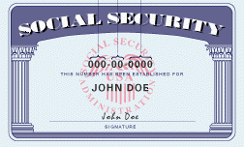
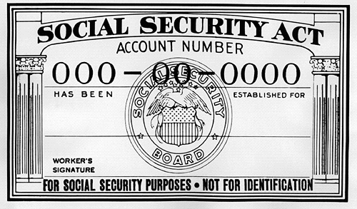
Join E-Verify – Important!
www.uscis.gov/E-Verify
Employer - Voluntary
Federal Contractors - Mandatory
State Law Requirements (some)

Slide 20
How E-Verify Works

Slide 21
How E-Verify Works – Step-by-step
The E-Verify process includes the following steps:
The employer enters the employee's information from Form I-9 into E-Verify and submits the information to create a case.
E-Verify compares the information to records available to the U.S. Department of Homeland Security and the Social Security Administration, including:
U.S. passport and visa information.
Immigration and naturalization records.
State-issued driver's licenses and identity document information.
Social Security Administration records.

Slide 22
How E-Verify Works – Step-by-step
E-Verify sometimes displays a photo for the employer to compare to the photo on the employee's document to ensure that the document photo has not been altered.
E-Verify provides one of the following case results:
Employment Authorized - The employee's information matched records available to SSA and/or DHS.
Verification In Process - This case was referred to DHS for further verification.
Tentative Nonconfirmation - Information did not match records available to SSA and/or DHS. Additional action is required.
Case in Continuance - The employee has visited an SSA field office or contacted DHS, but more time is needed to determine a final case result.
Close Case and Resubmit - SSA or DHS requires that you close the case and create a new case for this employee. This result may be issued when the employee's U.S. passport, passport card or driver's license information is incorrect.

Slide 23
How E-Verify Works – Step-by-step
If the E-Verify system issues a Tentative Nonconfirmation (TNC) in response to a query, the employer must provide the employee with a notice generated by E-Verify, as well as information on how to contest the TNC.
If the employee elects to challenge the TNC, the employer is required to provide the employee with a referral letter issued by E-Verify containing instructions and contact information.
The employee is allowed eight federal government workdays to contact the appropriate federal agency.
An employer is not allowed to terminate or take any adverse action against the employee until it receives a Final Nonconfirmation or a notice that the employee has decided not to contest the TNC.

Slide 24
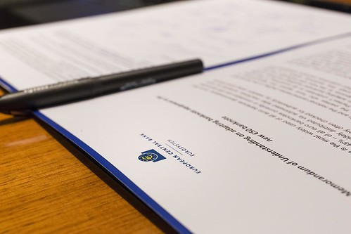
Memorandum of Understanding (MOU)
Initiate a query 3 business days after completion of Form I-9
Agree to verify ALL new hires
CANNOT use E-Verify for re-verification of previously hired employees
CANNOT use E-Verify for screening prior to hire
Agree to allow DHS and SSA to make periodic visits for the purpose of reviewing E-Verify related records
Agree to allow DHS and SSA to interview employer's agents and employees with issues concerning E-Verify

Slide 25
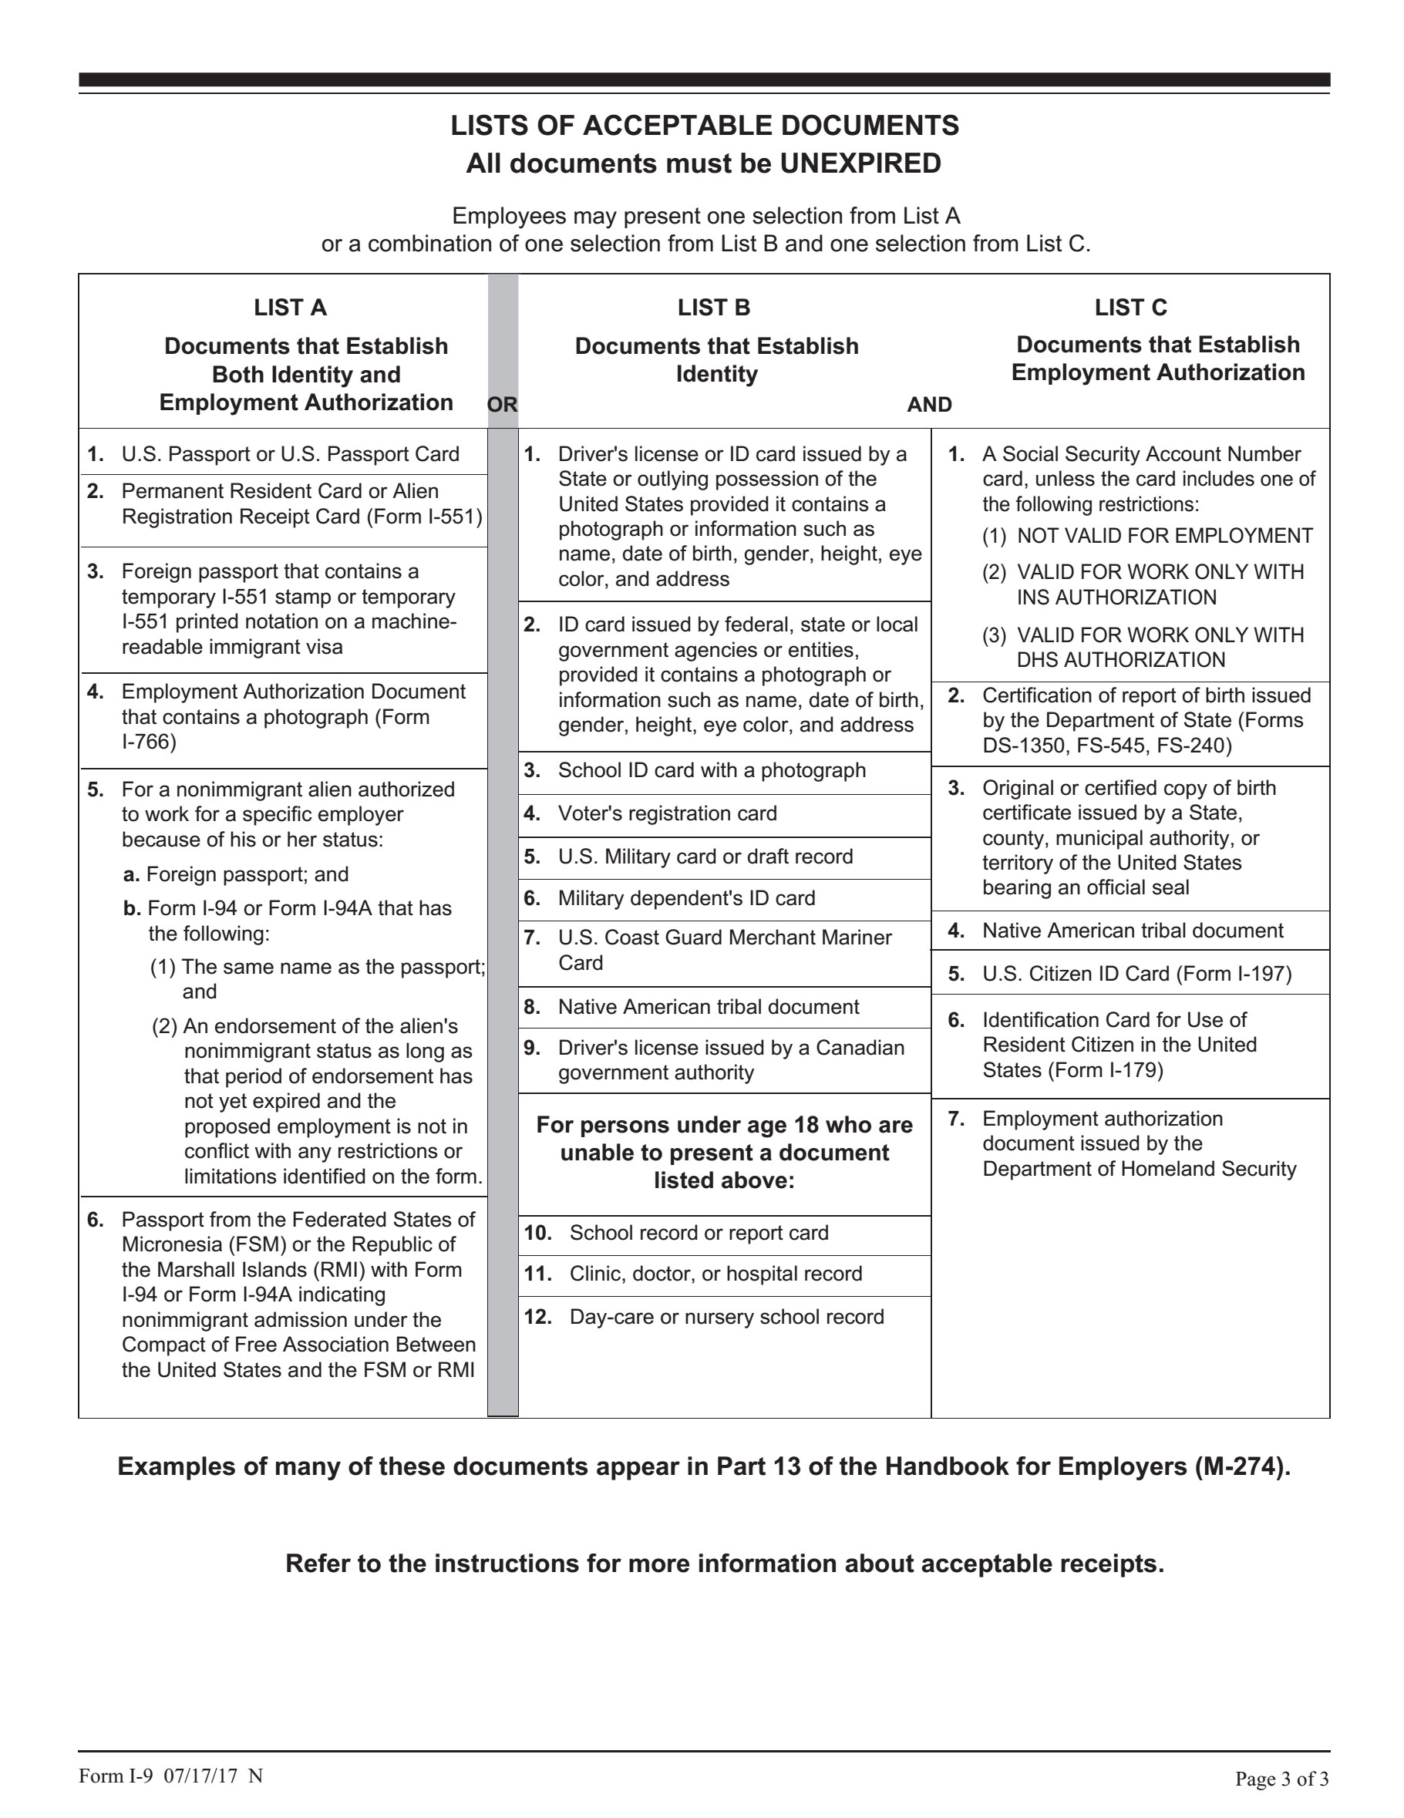
Photocopying Verification Documents
See attached
See attached
See attached
Must photocopy documents if participating in E-Verify
May photocopy documents if not participating in E-Verify
If photocopying, must photocopy for all
Must keep photocopies with I-9

Slide 26
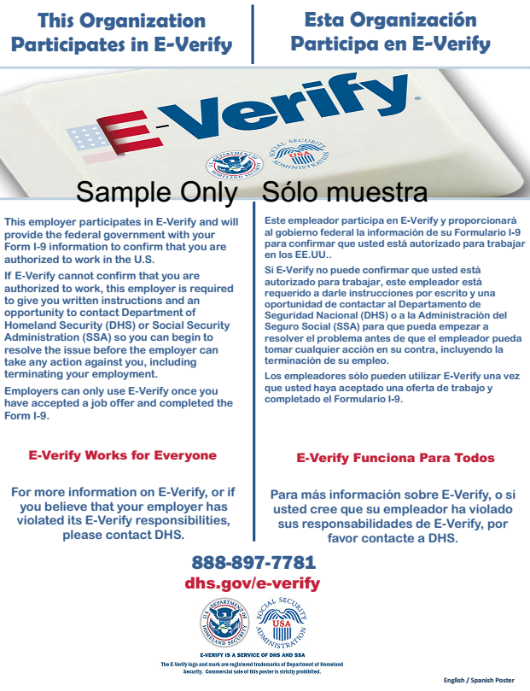
E-Verify Posters

Slide 27
Avoid Penalties – Start with the Basics
Forms, Instructions and more available at: www.uscis.gov
Covered employers – 4+ employees
I-9 for all new hires after November 6, 1986
Retain for 3 years from time of hire or
one year from the date of separation, whichever is longer
Electronic Recordkeeping

Slide 28
Effective Self-Audits: Bulletproof Your I-9 Policies & Avoid ICE Audits
Section 2

Slide 29
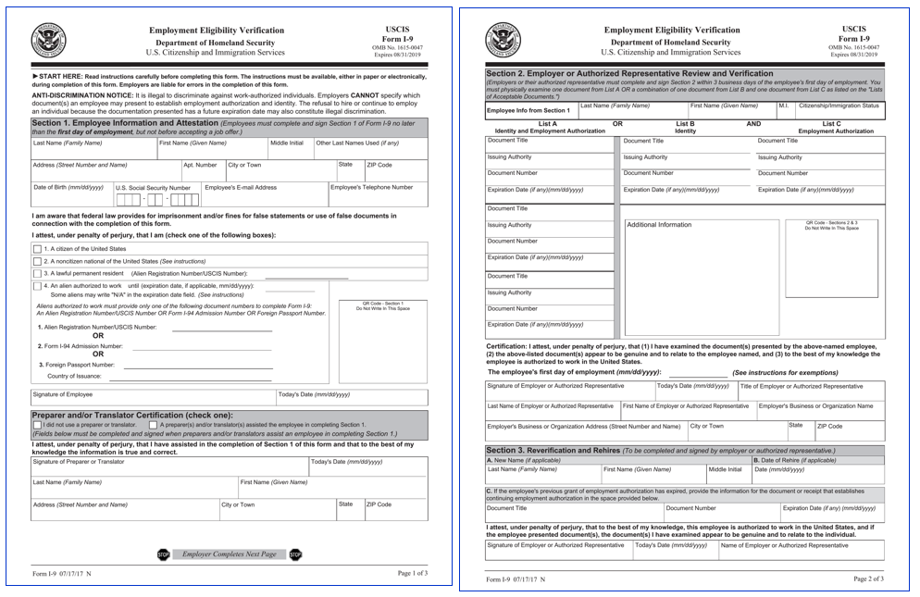
Internal Audit FOCUS
Auditing & Correcting
NOT Completing

Slide 30
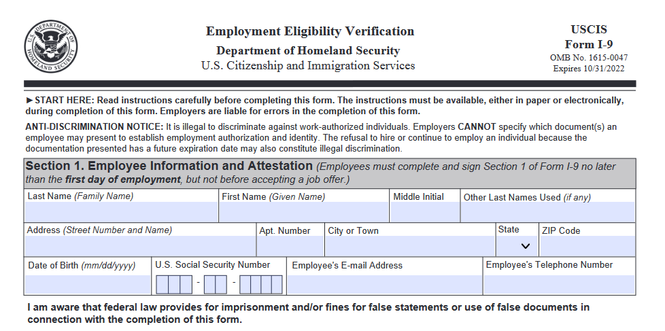
I-9 Audit Survival Kit – What to look for – section 1
No employee printed name, maiden name (if applicable), address or date of birth.
Any blank fields – write/type “n/a”
If no middle initial – write/type “n/a”
If no apt. number – write/type “n/a”

Slide 31
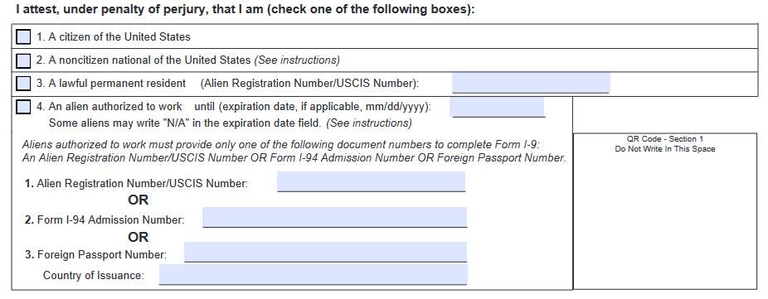
I-9 Audit Survival Kit – What to look for – section 1
Not checking a box to indicate whether the employee is attesting to be a citizen or national of the United States, a lawful permanent resident, or an alien authorized to work until a specified date—or checking multiple boxes attesting to more than one of the above.

Slide 32
I-9 Audit Survival Kit – What to look for – section 1
No “ARN/USCIS” number for an employee who selects “A Lawful Permanent Resident.”
No “ARN/USCIS” number or “admission number” for an employee who selects “An alien authorized to work until.”

Slide 33
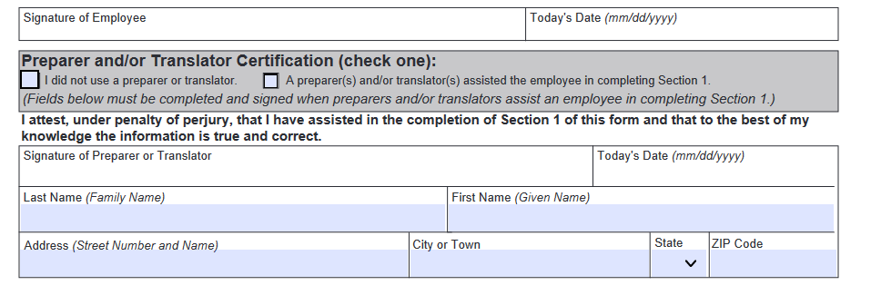
I-9 Audit Survival Kit – What to look for – section 1
No employee signature or attestation date.
Not completing Section 1 by the time the employee began work for pay.
Preparer and/or Translator Certification not marked
If Preparer or Translator is used: must fill in last section
Otherwise – leave blank

Slide 34
I-9 Audit Survival Kit – What to look for – section 1
No preparer and/or translator name, address or signature (if applicable).
No date in the preparer and/or translator certification box (if applicable).

Slide 35
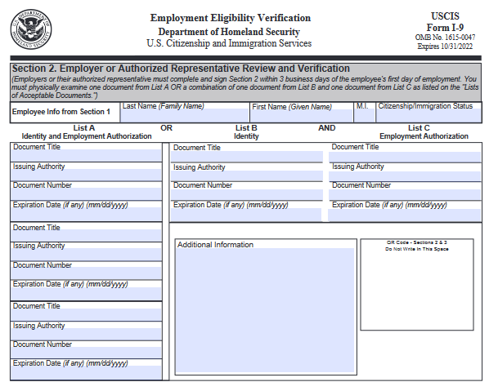
I-9 Audit Survival Kit – What to look for – section 2
No Employee Information from Section 1
Must match section 1 information EXACTLY
No acceptable List A document or acceptable List B and List C documents recorded on the form.
No document title, issuing authority, number(s) or expiration date for the documentation presented.

Slide 36
I-9 Audit Survival Kit – What to look for – section 2
No date for when employment began.
No employer signature, printed name or attestation date.
No business title, name or address.
Not completing Section 2 by the third business day after the date the employee started work for pay, or, if the employee is hired for three business days or less, at the time the employee started work for pay.

Slide 37
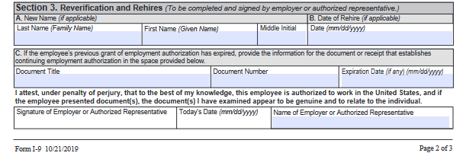
I-9 Audit Survival Kit – What to look for – section 3
No document title, number or expiration date for the acceptable documentation presented.
No date of rehire, if applicable.
No new name, if applicable.
No employer signature or date.
Completing section 3 after the employee’s work authorization expired.

Slide 38
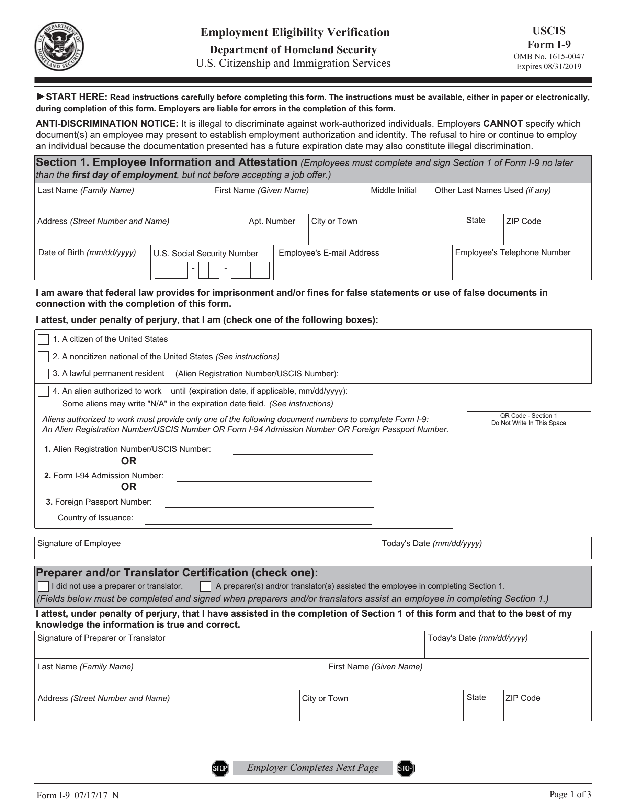
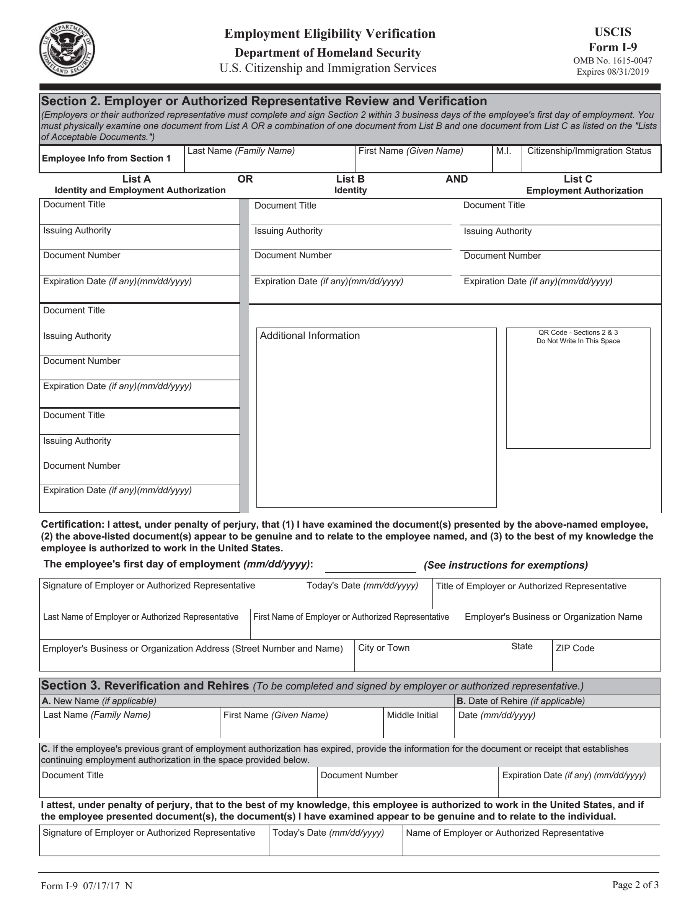
Reverification Correct Form
Only use the most current form and instructions
IMPORTANT: In situations where there is an original I-9 that must be updated because of a verification, e.g., a Section 3 reverification or a Section 2 reverification of a remote original verification due to COVID-19, and a new version of the I-9 form has gone into effect, use Page 2 of the new form for the reverification(s); and attach it to the original document.
After April 30, 2020 – Only use
© 2020 Max Muller & Associates. All rights reserved.
An HRMorning Workshop
38

Slide 39
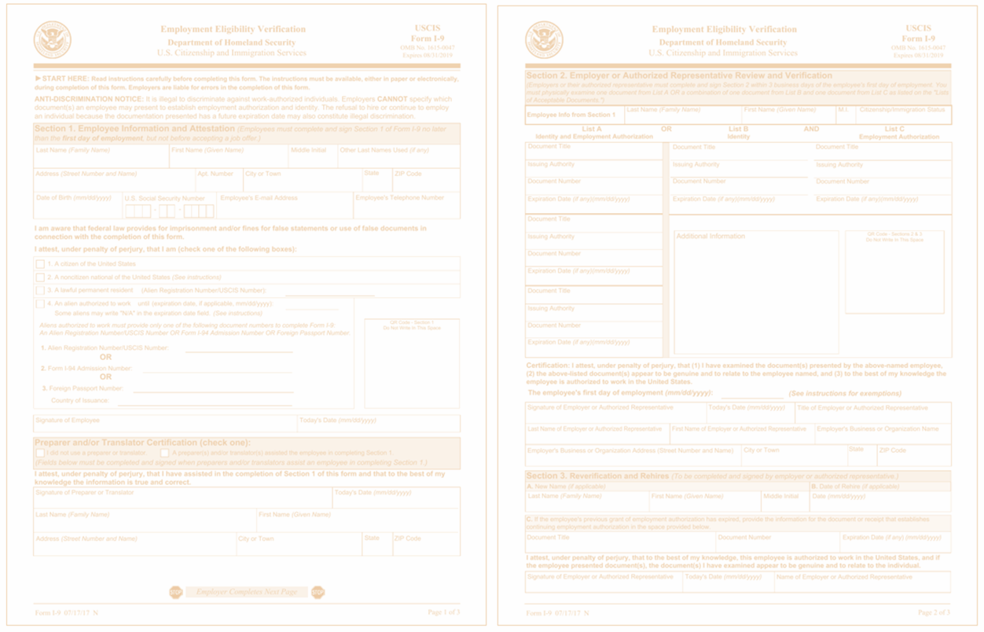
Form I-9 Never Completed or Missing
Complete current version of Form I-9 as soon as possible.
If an original Form I-9 exists but either Section 1 or Section 2 was never completed, the employee (for Section 1) or the employer (for Section 2) should complete the section as soon as possible.
DO NOT BACKDATE the form.
Clearly state the actual date employment began in the certification portion of Section 2.
Attach a signed and dated explanation of the corrective action taken.

Slide 40
If Correction Is Needed…
Best practice:
Draw a line through the incorrect information;
Enter the correct or omitted information; and
Initial and date the correction or omitted information.
Do not conceal any changes, e.g., Erasing text; using correction fluid.
Do not backdate anything.

Slide 41
Omissions in Section 1
Employer may not correct errors or omissions in Section 1.
Ask the employee to correct the error or omission.
Omission:
(Employee) Enter the omitted information.
Initial and date near the newly entered information.
Employer should attach a written explanation of what happened. [Not mandatory]
If employment has terminated, employer should attach a written explanation to the
Form I-9 explaining the error and place in the employee’s file.

Slide 42
Errors in Section 1
✓ Employer may not correct errors or omissions in Section 1.
✓ Ask the employee to correct the error or omission.
Error:
Best practice - have the employee:
Draw a line through the incorrect information;
Enter the correct or omitted information; and
Initial and date the correction or omitted information.

Slide 43
Section 1 Errors/Omissions – Employee No Longer Employed
Employer - attach to the existing form a signed and dated statement identifying the error or omission and explain why corrections could not be made (e.g., because the employee no longer works for the employer).

Slide 44
Multiple Errors – Sections 2 and 3
May redo the section(s) containing the errors on a new Form I-9, [Use most current form]
attach to the previously completed form,
attach an explanation of the changes made to an existing form I-9 or the reason a new form I-9 was completed, and
sign and date the explanation.

Slide 45
Corrections: Preparer or Translator
If original Preparer or Translator
draw a line through the incorrect information and enter the correct information or note the omitted information;
have the employee initial and date the correction or omitted information if able; and
initial and date the correction or omitted information next to the employee’s initials.

Slide 46
Corrections: Preparer or Translator
If different Preparer or Translator
Preparer and/or translator certification should: complete the certification block; or
If the certification block was previously completed by a different preparer and/or translator:  draw a line through the previous preparer and/or translator information; and  enter the new preparer and/or translator information and indicate “for corrections”.

Slide 47
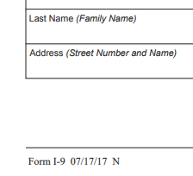
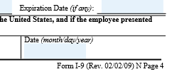
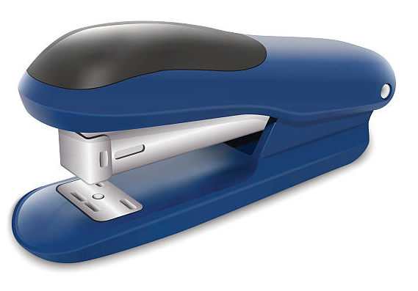
Wrong Version of Form I-9 Used
Draft an explanation and attach it to the outdated completed Form I-9 explaining that the wrong form was filled out correctly and in good faith.
- Or -
If Form I-9 documentation presented was acceptable under the rules current at time of hire:
Staple the outdated completed form to a blank current version, and
Sign the current blank version noting why the current blank version is attached (e.g., wrong edition was used at time of hire).

Slide 48
I-9 and Legal Liability: Best Solutions to Minimize Costly Mistakes
Section 3

Slide 49
SCOPE of audit
Communicate!
Document!
Use Neutral Selection Criteria
Avoid Discrimination!
Audit All
Audit Sampling

Slide 50
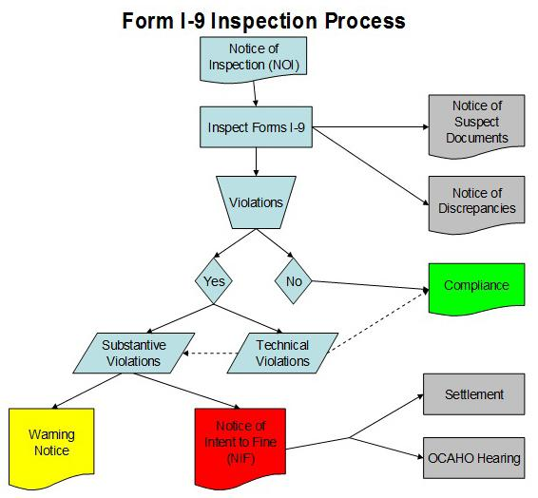
Flowchart Source: https://www.ice.gov/factsheets/i9-inspection

Slide 51
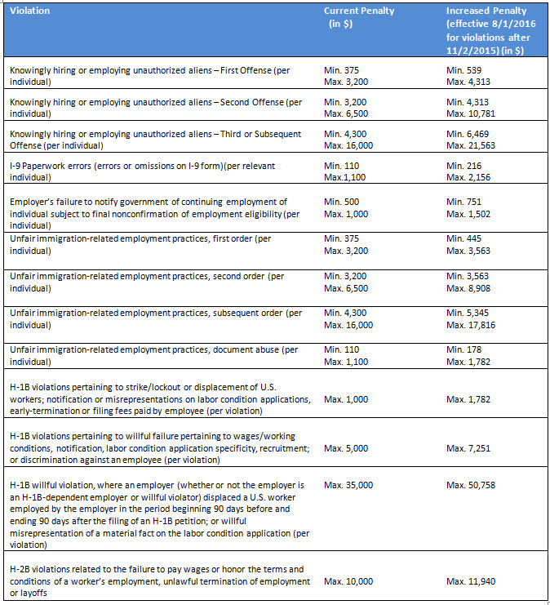
Penalties
Min. $216
Max. $2,156

Slide 52
Determining Penalty Amounts
ICE considers five factors:
the size of the business,
good faith effort to comply,
seriousness of violation,
whether the violation involved unauthorized workers, and
history of previous violations.

Slide 53
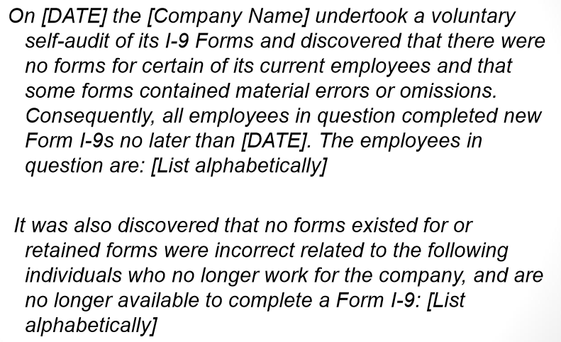
Corrective Action Memos

Slide 54
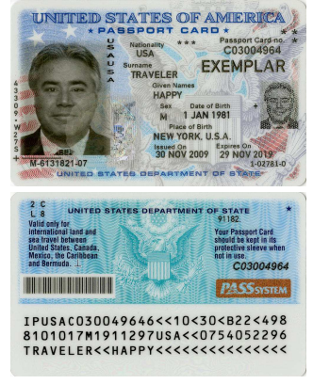
E-Verify Users: Be Sure to Make Copies of Photo-Matching Documents Correctly
If a new employee presents a document for their Form I-9 that triggers photo matching in E-Verify, employers must make a copy of that document to use when creating the E-Verify case, and must retain it with the employee’s Form I-9.
If an employee presents a U.S. passport card, Permanent Resident Card (Form I-551), or Employment Authorization Document (Form I-766), you must copy the front and back of these cards. If an employee presents a U.S. passport, you must copy both the front page and the back barcode page.
Form I-551

Slide 55
10 Most Common Mistakes Checklist
Not completing I-9 on time
Backdating forms
Requesting “specific” proof of documentation of identity from employee
Using the wrong I-9 form
Forgetting to re-verify when required

Slide 56
10 Most Common Mistakes Checklist
Not using “authorized representative” for remote employees
Improper document retention
Not conducting internal audits
Not using E-verify
Not making the difference between Form I-9 and the E-verify system
A written policy and procedure manual and internal checklist can save you from making these common mistakes

Slide 57
SUMMARY
Knowing what to look for is half the battle.
Having written policies and procedures with examples and on-going training of HR personnel are the best way to be prepared in advance of an audit.
Self-auditing on a regular schedule designed by the number of employees and turnover your company experiences is a good measure of being ready for an external audit.
©Audit Business Services, Inc. – 07/2022 – all rights reserved

Slide 58
Q&A

Slide 59
THANK YOU (Pidamaya)
Pamela Fagan
absinc.pfagan@gmail.com
https://www.absinc2000.com/
©Audit Business Services, Inc. – 07/2022 – all rights reserved

