Slide 1
26th Annual Conference
San Antonio, Texas
September 26-28

Slide 2
IMPORTANT STEPS TO BRING Financial Wellness to the workplace
Brahm Rossiter, Marcus Sasaki, Jake Taylor

Slide 3
Team
Brahm Rossiter
Marcus Sasaki
Jake Taylor
Rebecca Reynolds
Desiree Jacobs
Financial Consultant
Financial Consultant
Financial Consultant
Account Coordinator
Executive Assistant

Slide 4
PROMOTING RETIREMENT PLAN Goals
RWM Financial Group can lead the way toward retirement readiness for pre-retirees and new generations of employees. Their success comes from your plan’s success.
Combining professional dedication, cutting-edge tools and high-impact education with a commitment to service.
RWM Financial Group’s process sets a clear direction toward retirement for your valued employees and balances the needs of the employer.

Slide 5
Recent Focus on health and wellness
Employers have learned a lot about the benefits of helping employees change the behaviors that impact physical and emotional health.
Notes:
Employees living paycheck to paycheck
Tapping into retirement savings prior to retirement
Financial stress draining productivity and engagement

Slide 6
employers are often a trusted source of Financial information
TRUST AND ACCESS TO EMPLOYEES
Notes:
employers have a unique opportunity to
provide education, interventions, and programs to
improve individuals’ financial literacy and wellness.

Slide 7
Employees report
24%
29%
47%
61%
Notes:
Let’s take a look at these percentages.
Read each percentage and expand.
Are you comfortable with 24% of your work force being distracted? Or, 29% of your work force missing work to deal with finances?

Slide 8
SIX Steps to creating your Financial wellness coaching strategy
1
2
3
4
5
6
DEFINE
FINANCIAL WELLNESS
FOR YOUR ORGANIZATION
EXPLORE
ESTABLISHED
AND
EMERGING
SOLUTIONS
UNDERSTAND
THE FINANCIAL LANDSCAPE
LEAN ON
BEST
PRACTICES
BUILD
BUSINESS
CASES
OVERCOME CHALLENGES

Slide 9
Step 1 Understand the financial landscape
Working Life
Personal Life
Economic Life
Wages
Taxes
Healthcare
Retirement
Bonuses
Childcare
Lifestyle
Habits
Household structure
Stress
Commitments
Entertainment
Income
Housing
Basic goods
Insurance
Education
Savings
Debt
What role does your business aspire to play?
What is the business impact of making a bigger investment of financial wellness?
Notes:
Let’s breakdown the financial landscape into 3 sections. Work, Personal and Economic.
How can a financial wellness program help provide a positive impact?
Work life: Each are important, but which topic causes the most confusion for your employees? Taxes, healthcare, retirement!!!!
Personal life: Providing tools can help highlight financial lifestyle, habits (spending). Which can provide education to help stabilize/improve households, stress.
Economic life: Prioritizing income, appropriate housing, providing the basics, enough or not enough insurance, savings and debit levels. What is enough?
Read the questions from the slide.

Slide 10
Step 2 Define financial wellness for your organization
DEFINING FINANCIAL WELLNESS MEANS MEETING PEOPLE WHERE THEY ARE:
INCOME STRUGGLES
SPENDING CHALLENGES
BUILDING SAVINGS
EXTRA INCOME
FINANCIALLY SECURE
SELF-ACTUALIZATION
Financially secure
ESTEEM
Building for the Future
PHYSIOLOGICAL
Stress, Worry,
Anxiety, Fear
SAFETY/SOCIAL
Building Stability
Notes:
Income struggles: lower paid group of work force, lives paycheck to paycheck, needs budget help, financial literacy
Provide: budget/savings tools
Spending Challenges: doesn’t manage cash flow, thinks they are financial literate, poor credit, has credit card debt, lacks savings
Provide: budget/savings tools, credit/debt counseling, emergency savings education, retirement planning
Building Savings: has savings cushion, needs help to fine tune a budget, tax planning, additional financial literacy needs
Provide: budget/savings tools, home buying support, retirement planning
Extra income: good income, financial literate, owns a home, thinks about retirement savings
Provide: tax planning, wealth preservation strategies, long term financial planning resources
Financially Secure: well compensated, wants to maximize tax benefits, wants financial planning, has prepared legal docs (will, trust,..), Max out retirement contributions
Provide: advanced financial education, estate planning, legacy planning, wealth preservation, tax planning
Each employee type can get great value from an employer sponsored financial coaching/wellness program

Slide 11
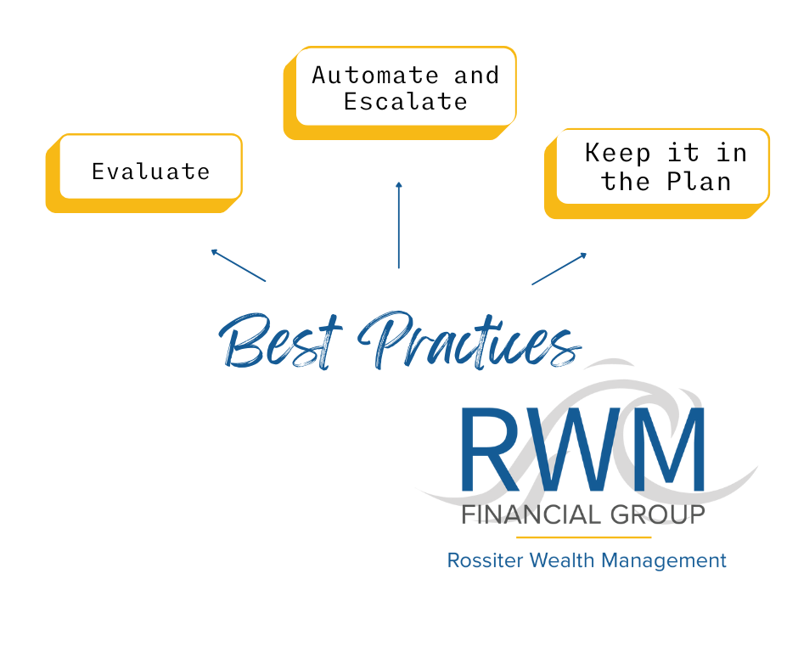
Step 3 Lean on Best practices
MUST HAVES
Flexibility
Ease of use and flexibility
Educational components
EVALUATE AND ALIGN BENEFITS
Understand your audience
Keep it simple
Measure and adjust
DESIGN TIPS
Accessibility for All
Consolidation options
Segment programs/communications
Year-round Communication
Notes:
Introduce the bullet points for each heading.
Evaluate: use plan data to get better understanding of your employees.
Look at: participation rates, allocation as an indicator of financial understanding (target date funds, do it for me)
Automate & Escalate: auto enrollment and auto savings to nudge employees into better savings habits
Keep it in the plan: Risk of allowing employees to have easy access to with drawing funds from the plan. Communicate the drawbacks of cashing out and make it more difficult. Provide education to help avoid bad decisions.

Slide 12
Step 4 explore, establish and emerging solutions
Lean on your vendors and your call centers
Financial Diagnosis
Counseling
Emergency saving
Emergency loans
Cash flow management/analysis
Budgeting tools, Simpler investing
Investment education
Leverage existing benefit tools
Credit/debit counseling and consolidation
Make sure they know about and understand the resources available to your employees.
Notes:
All Tools:
Online
In-person
Apps
Leverage Technology

Slide 13
Step 5 overcome challenges
Employees don’t pay attention to communications
Start small
Promote what have
Leverage vendors
Utilize HR program for
delivery to employees
Mandatory training
Year-round communications
Do something different
Tie into annual enrollment
How to work with limited Resources
How NAVIGATE COMPLEX PROGRAMS
Build awareness
Vendor summits
One website
Notes:
Read slide
Make the experience easy for employees is critical for changing behaviors
Make benefits education part of mandatory training

Slide 14
Step 6 build a Business case
To get Leadership
to buy into a
Wellness Program
RESULTS:
Decreased absenteeism
Increased productivity
Increased usage of the retirement program
WHAT TO MEASURE TO TACK AND BUILD YOUR CASE:
Presenteeism
Absenteeism
Turnover
Job performance
Medical claims
Employee satisfaction with their work and personal environments
In 2012, the International Foundation of Employee Benefits reported, the health and wellness programs have saved $1 for every $3 dollars spent.
Notes:
Leadership will ask:
What will this do for the company?
How much will this cost?
Read the Slides
Results: All leadership will appreciate each result. Especially decreased absenteeism and increased productivity.
Employees will appreciate having financial confidence.

Slide 15
Bringing it all together
What is your organization’s vision for financial wellness/coaching?
What are the objectives?
How will we measure success?
How will we tie those measurements to business goals and results?
What resources are needed to create the program, manage it overtime and communicate it frequently?
Notes:
Read the slide

Slide 16
Work with your Vendors to develop what you need, when you need it now and in the Future
Maximize the Power of Words
Make it Relevant
Connect Problems to Solutions
Focus your Efforts
Make all Income Welcome
Link to Life Events
Engage
Notes:
Wrapping it up!
Press your vendors to see what programs they already have to offer.
Most have them at no or little cost.
Read slide: emphasize the bullet points and the importance of linking each to their employees.
Power of words with no financial jargon
All income welcome: high earners can have the most financial problems
Life events: before you get married classes, before you have a child, divorce support
Engage: no one time education classes, the best results and biggest impact are focused education topics over time
Leverage all your vendors
Retirement
Health
Supplemental
All benefits
Commercial Insurance

Slide 17
THANK YOU
The financial consultants at RWM Financial Group are registered representatives with, and securities and advisory services are offered through, LPL Financial, a registered investment advisor, member FINRA/SIPC. This information was developed as a general guide to educate plan sponsors, but it is not intended as authoritative guidance or tax or legal advice. Each plan has unique requirements, and you should consult your attorney or tax advisor for guidance on your specific situation. In no way does advisor assure that, by using the information provided, plan sponsor will be in compliance ERISA regulations.

Slide 18
Connect with us
866-702-3276
BRAHM ROSSITER
brahm@rwmfinancialgroup.com
MARCUS SASAKI
marcus@rwmfinancialgroup.com
JAKE TAYLOR
jake@rwmfinancialgroup.com

