Slide 1

26th Annual Conference
San Antonio, Texas
September 26-28

Slide 2

Setting Up Your Recruitment Team For Success: KPI’S Matter
Clint Rosser
Chief Operating Officer
crosser@practicematch.com

Slide 3
AGENDA
Discuss KPIs
SMART Goals
Effective Goal Setting
Common Goal Setting Pitfalls
Steps to take when goal setting
Where to begin

Slide 4
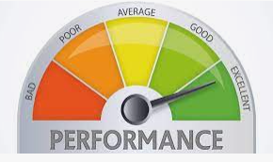
Performance
Why is measuring performance important
What goals should you set as a Director/VP (leader), Recruiter, Sourcer, etc.
Setting key performance indicators (KPI)
  Do your goals help achieve your KPI’s?
Setting smart goals (specific, measurable, attainable, realistic, time-bound)
Notes:
1: Because it allows you to understand trends and determine if you need to make changes.
2: This is not for me to determine but to help guide. Each organization is different, if team is set-up different and responsibilities vary but if you are able to determine what you want them to be it will help with results
3: KPI’s have been used at PracticeMatch even prior to me coming to the company. They are a great way to look at yourself or staff and determine how things are going. Remember that you want your goals to help you achieve your KPI’s.
4: Setting Smart Goals will be critical as you begin this process.

Slide 5

Key Performance Indicator (KPI)
Definition: KPI stands for key performance indicator, a quantifiable measure of performance over time for a specific objective. KPIs provide targets for teams to shoot for, milestones to gauge progress, and insights that help people across the organization make better decisions.
DO NOT OVERCOMPLICATE
THIS PROCESS.
Notes:
At PracticeMatch we use KPI’s for all employees. Some have more than others based on their role but we use them to look at how the department is performing. The key is to ensure they are measuring the right area and items that keep your organization heading in the right direction
Organizations use KPIs at multiple levels to evaluate their success at reaching targets. High-level KPIs may focus on the overall performance of the business, while low-level KPIs may focus on processes.

Slide 6
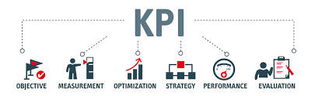
Why Create KPI’s?
Organizations use KPI’s to help individuals at all levels focus their work towards achieving a common goal. KPI’s also help businesses understand whether they're spending utilizing their time, and budget and talent on the right strategies, tasks and tools in order to achieve its goals.
Notes:
Employee often ask "Why do we need KPIs?" or "Why use KPIs?" or "Why are KPIs important" or even "What are KPIs?" as they think their way of doing things isn't broken. This is not to call out or punish employees!! Effective KPIs are important metrics to make sure that you can accomplish any business objective.
The importance of KPIs can't be understated.
Also remember that KPIs are more than numbers you report out weekly - they enable you to understand the performance and health of your organization and department so that you can make critical adjustments in your execution to achieve strategic goals. Knowing and measuring the right KPIs will help you achieve results faster.
Remember that A Key Performance Indicator is a measurable metric that demonstrates how well a company is performing against its key business objectives and priorities

Slide 7
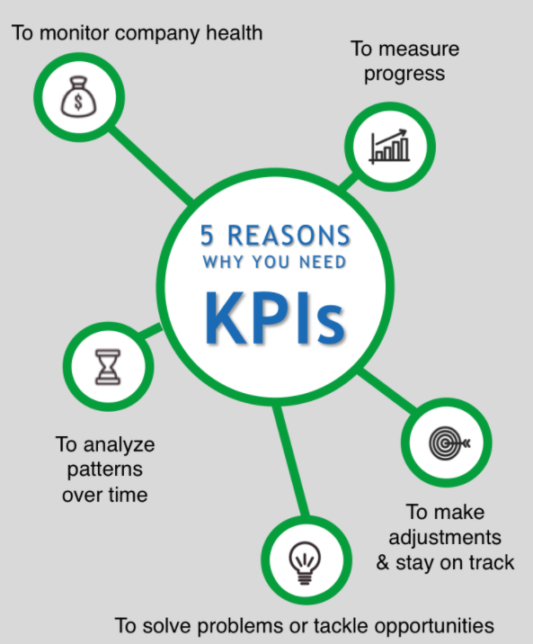
The Importance of KPI’s
To monitor company / department
/ individual health
To measure progress over time
To make adjustments & stay on track
To problem solve / tackle problems
To analyze patterns over time
Notes:
To monitor company health. KPIs are a scorecard for company/Department health. You only need a handful of KPIs to monitor your company's vital signs. Only measure what you want to move so you can put energy where you want to effect change. We’ve found that it is important to measure a few KPIs in each of certain categories: Customers, Processes, employees and our renewals. These fall under the disciplines of customer satisfaction, business processes, business strategy and many more. First make sure you choose the right KPIs for your business, then worry about who is accountable for them (leadership accountability.)
To measure progress over time. Track key results indicators like usage, sourced candidates, etc… Set targets at the beginning of each year and each quarter and use KPIs weekly to measure your progress toward those goals. Setting the right KPIs help you measure your progress towards your long-term goals and organiztions strategy.
To make adjustments & stay on track. In addition to your results, you also need leading indicators to let you know when you’re in danger of missing those targets before it’s too late. Leading indicator KPIs help you predict what will happen in the future and your future results. They let you know if you are on track to achieve the results you want. Leading indicators have two characteristics: they are measurable, and you can directly influence them. They are good KPIs to have on your dashboard to keep your projects on track.
To solve problems or tackle opportunities. Use a combination of KPIs in a dashboard so that you have the right information at your fingertips to solve problems or tackle opportunities. Let’s say you are in a recruitment slump. Identify a handful of KPIs that can help you turn the tide (maybe it is # of outbound calls, # of site visits kept, # of career fairs attended). Put them on a dashboard and track them weekly to see if you’ve found the right lever that helps you generate more predictable provider signings.
To analyze patterns over time. If you measure the same KPIs quarter over quarter, you can begin to detect patterns in your numbers. There are countless ways these patterns can help you in your business. Maybe you can predict when your slowest recruitment quarter will be and use that time to train your recruitment team. Maybe you take this information and work with your partners to see how you can change the pattern? Maybe you use this time to do additional events to increase your future pipeline? Maybe you can see that you’ve got some team members who are habitually under-performing or over-performing on their KPIs and can use this data to talk about consequences, bad or good.

Slide 8
Getting Started
Apply a Balanced Approach
  Are your employees engaged, productive, delivering results and excited about the future?
  Do your customers (Providers) love, appreciate and refer you?
  Do you have healthy operations and disciplines that you can scale for the future?
  Do you have the right offerings and do all you marketing strategies support your current and future goals?
Notes:
There are four critical areas of business every company must consistently maintain and nurture in order to reach its full potential. These areas are Employees, Customers, Processes and Revenue. It’s easy to become so laser-focused on solving an urgent problem in one critical area that you actually begin to lose ground in another critical area of the business.
In order to avoid this pitfall, you need to identify the few KPIs in each area that give you good insight into whether or not you’re on track to achieve your targets. Here are four questions you can use to prompt your thinking:
1 Are your employees engaged, productive, delivering results and excited about the future?
2 Do your customers (Providers) love, appreciate and refer you?
3 Do you have healthy operations and disciplines that you can scale for the future?
4 Do you have the right offerings and marketing strategies support your current and revenue goals?
No matter how your gut tells you to answer these questions, the next question you must ask is “How do I know?” Focusing on how you can know the answers to these questions will help you determine the specific and measurable ongoing operational results you should continuously measure, monitor and adjust. This will give you a good set of balanced KPIs to help you maintain a healthy organization

Slide 9
Getting Started
Good KPIs (Performance Measures):
Provide objective evidence of progress on achieving a strategic objective or goal
Measure what is intended to be measured, to help inform better decision making
Offer a comparison that gauges the degree of performance change over time
Track organization progress – organizations efficiency and effectiveness. Quality, timeliness, safety and security, governance, compliance, behaviors, economics, project performance, personnel performance, and resource utilization
Are they valid, verifiable and balanced between leading and lagging indicators
Notes:
Creating KPIs that matter
Select a business result, priority or problem you want to improve.
Determine what activities in your business influence the outcome, and find a way to measure them.
Set Red-Yellow-Green success criteria for each.
Determine specific actions required to achieve the Green success criteria, and get to work.
Start with just one or two priorities or problems you want to work on and set up KPIs that measure your progress on the activities that influence the results.

Slide 10
Getting Started
Creating KPIs That Matter
  Select a business result, priority or problem you want to improve.
  Determine what activities in your business influence the outcome and find a way to measure them.
  Set Red-Yellow-Green success criteria for each.
  Determine specific actions required to achieve success and get to work.
  Start with just one or two priorities or problems you want to work on and set up KPIs that measure your progress on the activities that influence the results.
Don’t overcomplicate this process!
Notes:
Creating KPIs that matter
Select a business result, priority or problem you want to improve.
Determine what activities in your business influence the outcome, and find a way to measure them.
Set Red-Yellow-Green success criteria for each.
Determine specific actions required to achieve the Green success criteria, and get to work.
Start with just one or two priorities or problems you want to work on and set up KPIs that measure your progress on the activities that influence the results.

Slide 11
Measuring / Auditing
Over time, as you add strategic KPIs, remember to keep your dashboard as simple and impactful as possible. So here are some suggestions on how to determine your list
  Does everyone understand the purpose and importance of this KPI?
  Does this KPI prompt action if not performing?
  Are your success indicators realistic?
  Does each KPI spark the right discussions in meetings?
  Is the data that supports this KPI valid and clearly understood by all?
Don’t overcomplicate this process!
Notes:
You want to be able to see in one quick glance if there’s an area in the business that needs your attention. The way to do this is to make sure that everything on your dashboard is relevant and drives action. Here are a few questions to help you determine what should be in and what should be out:

Slide 12
Example of Recruitment KPI’s
Sourcing channel cost
Conversion time (time to hire)
Fill rate
Application conversion
  Applies to phone interview
  Phone interview to site visit
  Site visit to hire
Offer acceptance rate
Qualified candidates per opening
Referrals equal “X” amount
Don’t overcomplicate this process!

Slide 13
Final Thoughts
Meet with your team and talk about the process and involve them
Remember your milestone measures are and should be strategic
This is not about micromanaging or counting things
Research
Most meaningful KPI’s will not be found in a book but come from you and your employees
Do not overcomplicate

Slide 14

Questions?

Slide 15
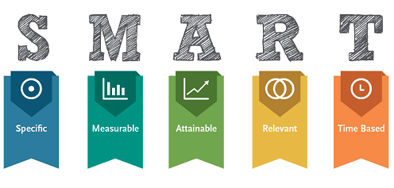

Slide 16





SMART Goals
SPECIFIC
MEASURABLE
ACHIEVABLE
RELEVANT
TIME-BOUND
State what you’ll do
Use action words
Provide a way to evaluate
Use metrics or data targets
Within your scope
Possible to accomplish, attainable
Makes sense within your job function
Improves the business in some way
State when you’ll get it done
Be specific on date or time frame
{[””“[[
Notes:
Definition of Goal: A goal is an idea of the future or desired result that a person or a group of people envision, plan and commit to achieve
Definition of SMART
Specific Goals – If goals are not clear this will make it extremely hard setting and measuring KPI’s
Measurable Goals – You need to define how to measure your progress for each goal. With adding your measure, this is where goal setting and KPI start to become one
Attainable Goals – This is a critical step because if not done correct, it will discourage yourself or your team. The goal needs to be ambitious enough to motivate your team and push them
Relevant Goals – Goals not matter if they are long or short term should be relevant to the greater end-goal. So evaluating goals along your journey is critical and do not be afraid to temporarily or permanently remove goals if they no longer fit
Time-Specific Goals – Goals should have time’s set to Goals help measure success and will help you prioritize any action needed

Slide 17
SMART Goals
Effective & clear goal setting helps leadership with:
Retention
Strategy
Performance Management
Better Decisions
Succession
Target critical talent for development and retention
Execute strategy by prioritizing and aligning goals and objectives
Improve performance of groups and individuals
Make better decisions based on performance and desired results
Identify top performers to develop a succession plan and development opportunities

Slide 18
SMART Goals
GOAL SETTING
Draft goals. Work with your employees to identify 4-6 goals to work towards achieving in the upcoming year/quarter.
Goals should be split between:
Goals that support Organization/Department/unit goals
Goal that support ongoing job responsibilities
Goals that support professional development
Remember: Goal setting involves the development of an action plan designed to motivate and guide a person toward a goal and is integral to successful Organizations.

Slide 19
SMART Goals
AVOID COMMON PITFALLS
Too many or too few goals
Limit the number of goals to 4-6 to ensure focus on the most important results
Unclear expected results or measurements
Clearly agree on the qualities or measures of the expected results to reduce ambiguity
Accountability problems
Clarify who is accountable for achieving the goal—especially important in teams or where work is highly interrelated
Unrealistic goals
Ensure that the distance between where employee is now and what you want them to achieve is so great that they feel completely overwhelmed by how to even begin.

Slide 20
SMART Goals
Example of SMART Goals
“X” number of Marketing emails sent each week
“X” number of Search's within each recruitment tool each week for each open position
“X” number of calls placed into your candidate pool each week/month
“X” number of successfully contacts per week/month
Host “X” number of resident outreach events each year
Host “X” number of education sessions for Providers each quarter
Update job posting monthly

Slide 21
questions?

Slide 22
Where To Start
Remember:
Review your goals for your Recruitment team
Are they Smart?
Are the obtainable?
Are you tracking?
How do you know your team or yourself are successful?
Do your goals role into your KPI’s?
If you have KPI’s are they being monitored actively?
Set KPI’s for department
Example: Neuro takes 4 months to fill from opening
Averages 5 site visits for an accepted offer
Averages 3 phone interviews for a site visit
Averages 4 responses for a phone interview
Typically receive 1 response per 300 emails
Now work backwards…
Evaluate historical data to help with future goals
Notes:
Are you tracking your goals and tracking your progress? It is important that you are able to look back. Talk to the account manager.

Slide 23
Where To Start
• Leaders:
  Do you have KPI’s created?
    If not, create them
    If you do, review to ensure they still meet your organizational goals
  Review your team goals, are they SMART
• Recruiters:
  Do you know what your KPI or smart goals are? If not ask.
  If your organization does not have established goals, create your own
Ask
Yourself
• Reset! Remember goals need to reviewed as your organization changes or
your role changes
• Do not over complicate
• Ask questions
Notes:
1: Because it allows you to understand trends and determine if you need to make changes.
2: This is not for me to determine but to help guide. Each organization is different, if team is set-up different and responsibilities vary but if you are able to determine what you want them to be it will help with results
3: Setting Smart Goals will be critical as you begin this process.
4: KPI’s have been used at PracticeMatch even prior to me coming to the company. They are a great way to look at yourself or staff and determine how things are going. Remember that you want your goals to help you achieve your KPI’s.

Slide 24
Where To Start
Set Goals KPIs for Your Partners
Have you communicated with your Partners what you expect with ROI?
Have you communicated your goals?
Are you partnering with them to ensure each of you know how things are going?

Slide 25
In Conclusion
What do I need to do differently now?
Get started with setting goals and measuring your team or yourself
Am I leveraging all resources available to ensure you are successful?
Do my current tools support this new or changing strategy? If not, want do I need to change?
What part of our recruitment strategy is going to change moving forward?
Notes:
What do you need to do differently now?
If you haven’t already, get started with setting your goals, either for yourself or your team.
If you already have measurable goals and KPI’s set, take a look and see if anything needs to be adjusted.
Are you leveraging all resources you have to ensure your success? We mentioned our Client Support Specialist team, which is available as a complimentary service, as just one example. Can they even assist with maybe sending an email for you, which can hopefully help you achieve one of your goals!
Do the current tools you have in your arsenal support your strategy? If not, what will?

Slide 26

THANK YOU
Clint Rosser | Chief Operating Officer
crosser@practicematch.com

