Slide 1








26TH ANNUAL CONFERENCE
San Antonio, Texas
September 26-28

Slide 2


Successful Hiring for Tribal Employers:
Is it an Art or a Science?
Is it Even Possible Anymore?
Jeff Yates
S3 Management Group

Slide 3
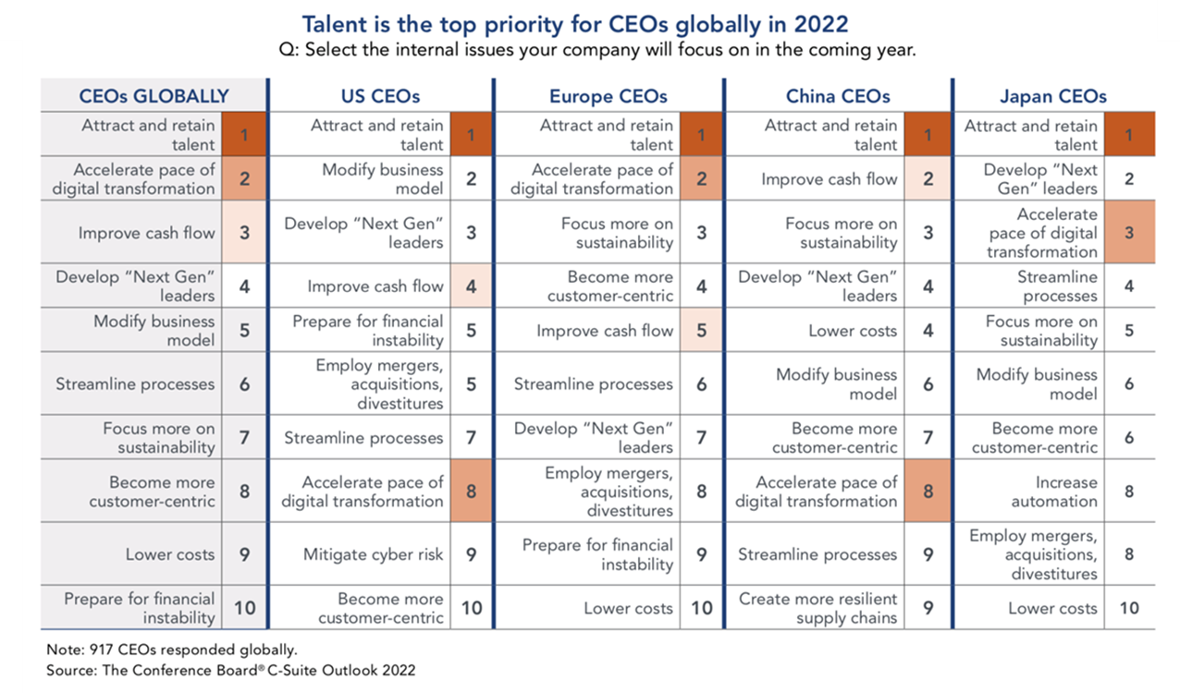

Top Challenges Heading Into 2022

Slide 4
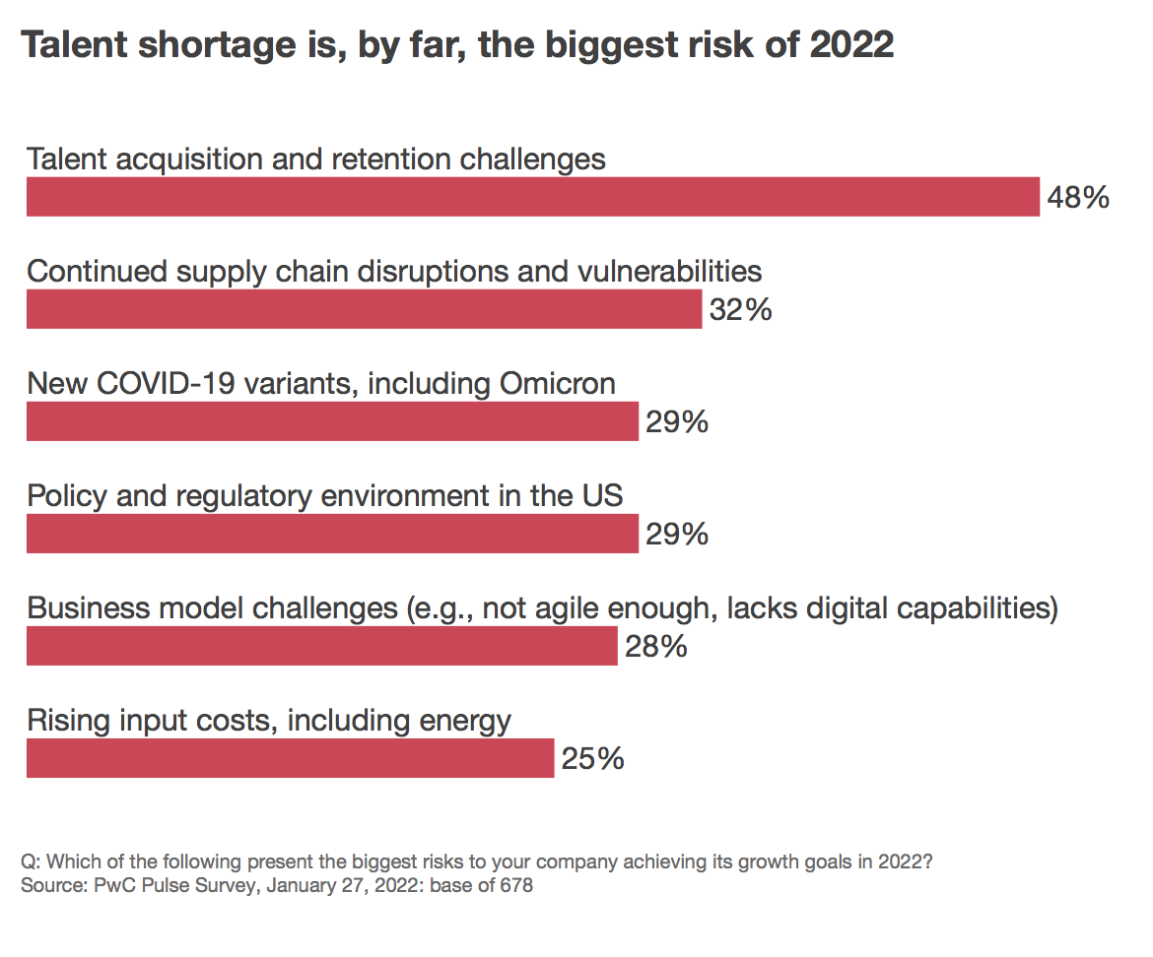

Top Business Risks of 2022

Slide 5

HR-Related Employee Risk Related To Hiring
Why it matters for you…
Employees are your greatest asset
Employees are your greatest risk
…and the landscape has drastically changed!
Job seekers are better equipped
Companies face rapid hiring pressures
HR is stretched with more responsibilities than ever before

Slide 6

Top Business Risks of 2022

Slide 7

Top Business Risks of 2022

Slide 8
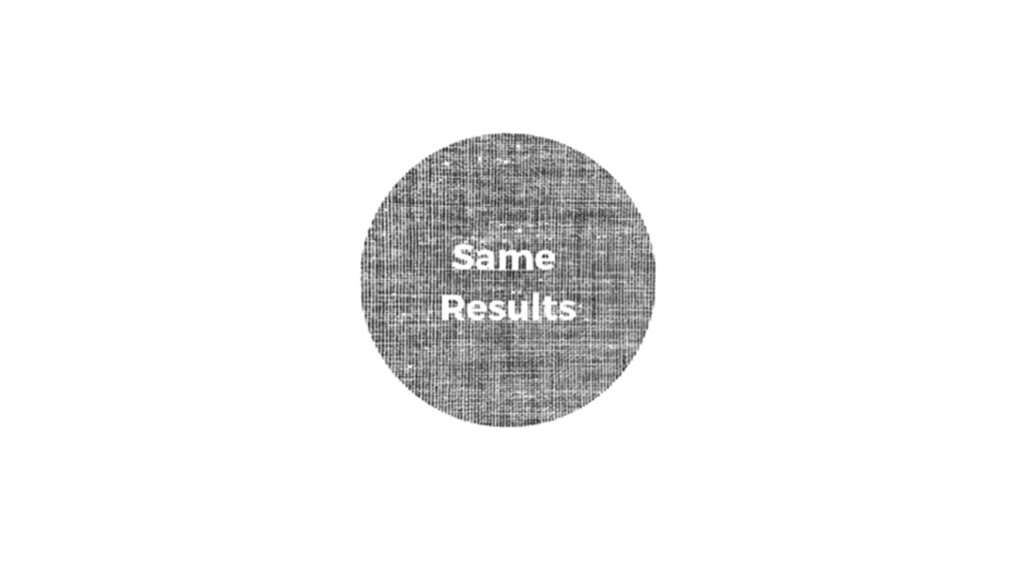
Top Business Risks of 2022

Slide 9

By Definition:
Subjective (adjective):
based on or influenced by personal feelings, tastes, or opinions.
Objective (adjective):
(of a person or their judgment) not influenced by personal feelings or opinions in considering and representing facts.
What is the difference between Subjective and Objective?

Slide 10
Subjective Hiring
The Way We’ve Always Done It

Slide 11
Components of Subjective Hiring
Applicant Tracking Systems (ATS)
Job Boards
Resumes
Personality Tests
Interviews

Slide 12
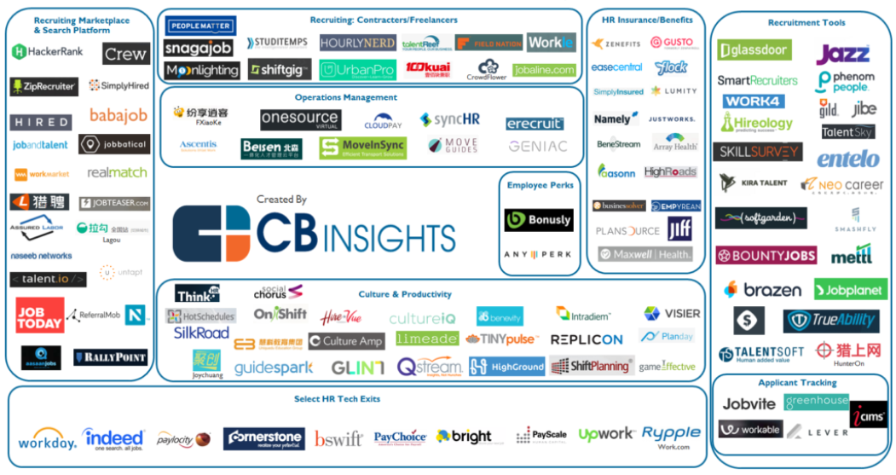

Applicant Tracking Systems - ATS
ATS Flaws - Harvard Business School this year suggested that flaws in automated resume-screening tech are causing millions of workers to be overlooked during the hiring process. The software focused on specific skills listed in the job description instead of what a person could bring to the role.

Slide 13









Posting Jobs On Job Boards

Slide 14
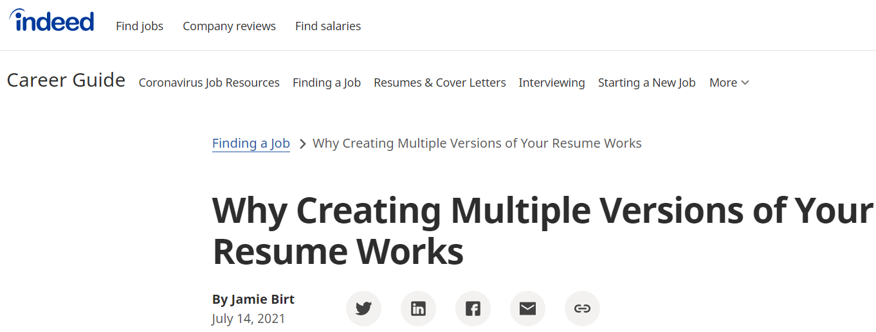

Resumes
The first documented resume was created by Leonardo da Vinci in 1482
A 540-year-old hiring tradition
- If you type “How to write the perfect resume” in the search bar, you’ll get more than 4 Billion options in less than one second
Resumes might contain false information – estimated that 40% contain errors
Resumes leave too much room for bias – various factors can create “first impression” bias, based on certain criteria listed on the resume. This bias is one of the leading causes of hiring mistakes.

Slide 15
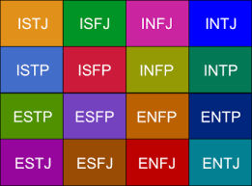
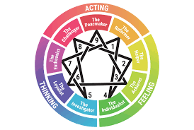
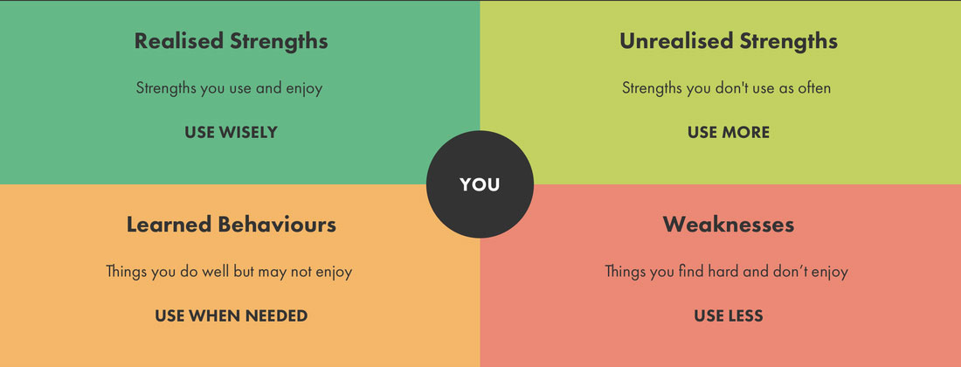
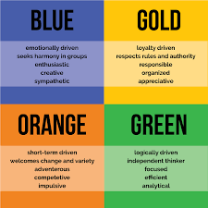
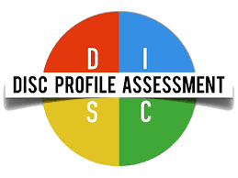

Behavioral Testing

Slide 16

CAT

Slide 17

DOG

Slide 18
The Risk Of Subjective Hiring
DOG & CAT - Simple words = wide range of interpretations
Hiring is far more complex and offers much greater challenges
Recent survey by HireVue demonstrated:
      - 38% of hiring is done based on “gut instinct”
        - 31% of hiring is done based on personal connection
        Organizations state that they are good at interviewing, using behavioral questions and resumes combined with their instincts, yet applicant flow struggles continue, and turnover remains at all time highs. And it’s costly $$$!

Slide 19
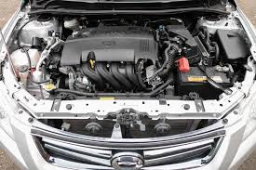
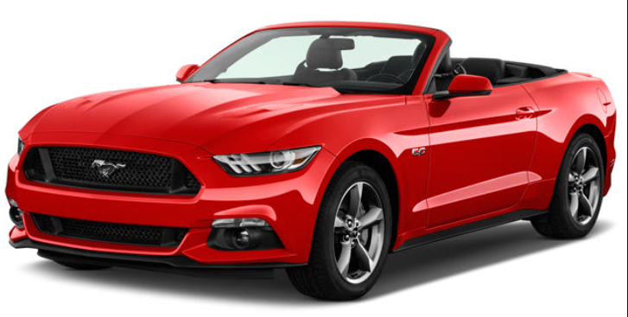
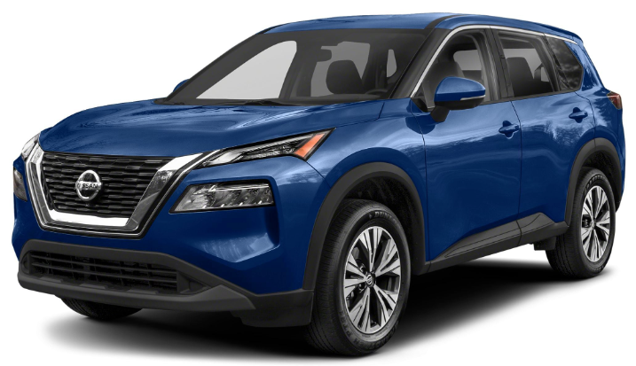
How It Applies To Hiring…
Subjective Hiring – hiring decisions made based on resume, interview, and application process. Applicant paints a picture of themselves that they want you to see.
Objective Hiring – hiring decisions made based on whether or not a candidate is internally wired for a position. Applicant’s hard wiring (that never changes) is what is seen first.
Think of it like a car:
Applicants that are wired for the job train faster and stay longer

Slide 20
Objective Hiring
Identify Applicants Truly Wired For Success In a Particular Job

Slide 21


What Are Objective Traits
Realistic
Enterprising
Social
Investigating
Artistic
Conventional

Slide 22

Realistic
Stable, Practical, Determined, Focused, Independent, Persistent, Genuine.
Continuously thinks or asks “why?” either internally or verbally depending on Behavioral Profile.
Usually take longer to train as they need the chance to ask why and understand the subject.
Once the “why” is clear they are very loyal to the mission and organization.
Need to understand every aspect of an assignment, issue or product to support it.
Often like working with their hands because they can clearly see the “why” and the results.
Knowing an applicant is realistic is critical to their success!

Slide 23
Realistic
Strengths – determined, hands-on, focused, loyal, independent
May struggle with – over-questioning, confinement, vagueness, creativity
Needed Support – Social, Artistic, Investigative
Stable, Practical, Determined, Focused
Continuously asks why
Will take longer to train
Must be given the chance to ask why and understand
Once they get the “why”, they will be your most loyal people
Interview Questions
Tell me about a time when you found a better way of doing something which proved to be an improvement on the existing system.
What is your approach to managing important projects? When you need to create a list of job tasks that need to be completed, how do you decide which task has priority?

Slide 24

Enterprising
Ambitious, Energetic, Risk-taker, Assertive, Sociable, Confident, Optimistic
Prefers to make things happen right now.
Will adventurously move forward without knowing exactly how to get there.
May occasionally go so fast they might overlook the details.
Do not particularly like structure and realize they often need it to excel.
Big picture thinker who focuses on the endless possibilities.
Enjoys influencing others and might exhibit dominance in doing so.
Enterprising is different than “competitiveness” externally

Slide 25
Enterprising
Strengths – leadership, driven, energetic, visionary, risk-taker
May struggle with – following, details, relaxing, mundane tasks
Needed Support – Investigative, Conventional, Artistic
Ambitious, Adventurous, Energetic, Risk-taker
Like to make things happen right now
Will go without knowing how to get there
Will go so fast they overlook the details
Do not like structure and often need it to excell
Interview Questions
Have you had an experience where you realized that you had to be more positive and persuasive when selling your ideas to others?
What did you learn from this experience? What steps do you take to promote a business idea to your manager?

Slide 26

Social
Friendly, Inspiring, Kind, Empathetic, Caring
Knows how to engage well with people as they genuinely care.
Great at building relationships.
Willing to ask for and accept help as they feel teamwork is valuable and beneficial.
Sensitive and empathetic to the needs of others and genuinely concerned.
Tactful in their approach to others in problem solving and addressing tasks.
Often make informative teachers, counselors and trainers.
Social is different than “communicator” externally

Slide 27
Social
Strengths – empathetic, relational, teaching, inspiring, tactful
May struggle with – compliance enforcement, focus on task, data analysis, implementation
Needed Support – Conventional, Investigative, Realistic
Cooperative, Friendly, Humanistic, Inspiring
Know how to engage well with people
Are typically good teachers and mentors
Willing to ask for and accept help
Feel teamwork is valuable and beneficial
Interview Questions
Have you ever volunteered for a community cause or a special project at your place of employment? If so, why?
Do you prefer to work by yourself or on teams?
Have you ever had a disagreement with a co-worker? How was this resolved?

Slide 28

Artistic
Expressive, Creative, Spontaneous, Intuitive, Imaginative, Visual
Creative thinker and problem solver.
Seeks out ways to be self-expressive at work.
Clearly sees the big picture in full color and not necessarily the details.
Thrives in an environment where you are supported by a detail person to map out the processes.
Constantly looking for a new way.
Great at developing new approaches, sometimes to excess.

Slide 29
Artistic
Strengths – big picture thinker, creative, seeks new ways, expressive
May struggle with – details, mundane tasks, over-creativity, data analysis
Needed Support – Investigative, Conventional, Realistic
Expressive, Creative, Spontaneous, Intuitive
These are creative thinkers and problem solvers
Will volunteer to write on the whiteboard when planning
They see the big picture but not necessarily the details
Support them with a detailed person to map the processes
Interview Questions
Can you tell me about a situation where you used your imaginative skills to solve a very difficult problem?
Can you tell me about a time when you tried to solve a problem with methods that had not been tried before?
When do rules & regulations promote more creativity in employees, rather than less?

Slide 30

Investigative
Scholarly, Intellectual, Critical, Curious, Mathematical, Systematic, Analytical
Excels at identifying exact steps to accomplish the ideas you hear from the team.
Crucial in helping the big picture thinkers drill down to the details.
Essential to every organization to establish the “how”.
Generally good at mathematics and solving for missing variables.
Highly analytical and scientific in their approach to work.
Employs analytical and scientific processes in problem solving.
Investigative is different than “being a coordinator” externally

Slide 31
Investigative
Strengths – detailed, systematic, mathematical, analytical, curious
May struggle with – creativity, self-expression, leading, vision
Needed Support – Artistic, Social,
Enterprising
Scholarly, Intellectual, Critical, Curious
Will identify exact steps to accomplish the ideas they hear from the team
Will help the big picture thinkers drill down to the details
Critical to every organization to establish the “how”
In the absence of these people, big dreams remain big dreams
Interview Questions
When a logical approach to a problem is ineffective, how do you arrive at an effective solution to solve the issue?
How can you determine that enough analysis has been done, and a course of action must be taken? Please describe an example from your experience.

Slide 32

Conventional
Stable, Efficient, Dependable, Controlled, Careful, Conforming, Conservative
Traditional thinker and typically resistant to change.
Excels in a support role and is comfortable with consistent and repetitive work.
Gladly follows a set of procedures and routines.
Prefer working with accurate data and detail, rather than with ideas.
Values others who are orderly, self-controlled, and follow a structured plan.
Works best when the lines of authority are established and clear.

Slide 33
Conventional
Strengths – implementer, consistent, process driven, controlled approach
May struggle with – social engagement, taking risks, spontaneity, creativity
Needed Support – Enterprising, Social, Artistic
Efficient, Stable, Dependable, Controlled
Traditional thinker and resistant to change
Believe round pegs go in round holes
They like consistency and doing a process over and over
Often support staff that is comfortable with repetitive work
Interview Questions
How do you accommodate last minute changes that have to be incorporated into your work?
Tell me about a time when you worked with others, but felt they were too sloppy in their work. What, specifically, was the problem: Too much wasted time? Too little attention to detail? How did you handle the situation?

Slide 34
Objective Hiring – Step 1 – The Job Description
Job Summary:
The Accountant will prepare financial reports to track the organizations assets, liabilities, profit and loss, tax liabilities, and other related financial activities.
Supervisory Responsibilities:
None.
Duties/Responsibilities:
Performs general cost accounting and other related duties in the accounting department.
Prepares periodic (monthly) balance sheets, income statements, and profit and loss statements.
Maintains the general ledger.
Codes invoices, sets up new accounts, reconciles accounts, and closes the monthly books.
Reconciles bank accounts at least monthly, verifies deposits, and addresses inquiries from banks.
Reconciles customer accounts and manages accounts receivable collections.
Verifies payment of invoices associated with accounts payable and ensures payments are charged to the appropriate accounts.
Provides outside auditors with assistance; gathers necessary account information and documents to perform annual audit.
Files required tax forms with federal, state, and local government agencies.
As appropriate, coordinates with software vendor to maintain accounting software system; recommends updates to enhance the accounting software.
Performs other related duties as assigned.
Required Skills/Abilities:
Extensive knowledge of general financial accounting and cost accounting.
Understanding of and ability to adhere to generally accepted accounting principles.
Highly proficient with accounting software.
Excellent organizational skills and attention to detail.
Excellent written and verbal communication skills.
Proficient in Microsoft Office Suite or similar software.
Key Traits
Investigative: math, analytical, systematic
Realistic:
practical, stable, focused
Social:
friendly, kind, caring

Slide 35
Objective Hiring – Step 2 – Interview Questions
Interview Question – Investigative
When a logical approach to a problem is ineffective, how do you arrive at an effective solution to solve the issue?
Applicant #1 Applicant #2
While logic is helpful, I prefer to take a problem and dissect it. I prefer to create a plan of action that defines the outcome expected, and then I work backward to create each step in the process. The outcome drives the process, and the process must be tested to ensure that no flaws exist
I would prefer to use logic, and my ideal hope is that there is already a structure in place so that I don’t have to create a new process from scratch. I’d prefer to manage a well-defined process versus create a new solution

Slide 36
Objective Hiring – Step 2 – Interview Questions
Interview Question – Realistic
When you need to create a list of job tasks that need to be completed, how do you decide which task has priority?
Applicant #1 Applicant #2
I tend to tackle the items that will be accomplished most quickly. I feel it’s best to knock out tasks as fast as possible, so if I get those done first, I feel a sense of accomplishment.
I look at all the tasks, and then I process from a tactical approach. I continuously ask questions related to what is most important, what makes the biggest impact, what is most critical. As I define where each task fits best within the process, then I rank them based on priority.

Slide 37
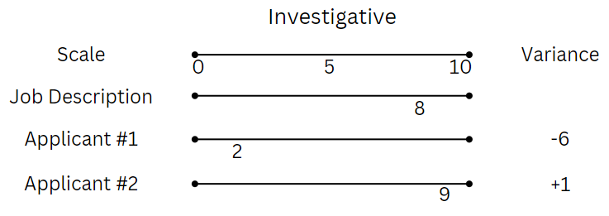
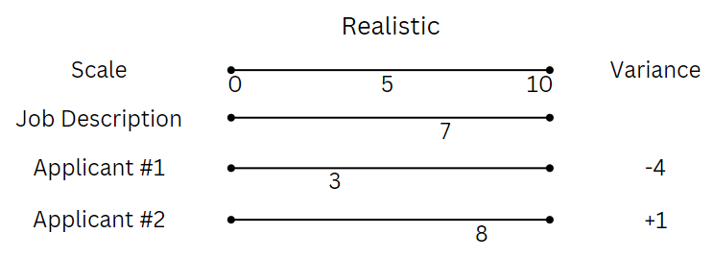
Objective Hiring – Step 3 – Ranking Results
Applicant 1 Applicant 2
Realistic - 6 +1
Social +2 - 2
Enterprising +1 0
Artistic +3 - 1
Investigative - 6 +1
Conventional - 2 0
Total Variance - 8 - 1
Applicant 2 demonstrates the objective traits that are most closely aligned with the job description for the accounting position.
Applicant 2 would be the person that should be intentionally engaged with to continue the application process for the job.

Slide 38
How to Hire Objectively
Clearly define your requirements in the job description – especially consider things such as degree requirements and previous experience
Use a standard set of objective interview questions with each candidate – ensuring that every applicant is treated fairly and similarly during the process
Intentionally focus on the applicant’s actions during the interview, keeping the objective traits in mind. They will demonstrate these traits in how they respond.
Explore unique assessment tools that identify the internal traits of an applicant. Often these tools can compare applicants to current top performers as well.
Indeed SVP: “We encourage hiring tools that use objective screening, such as skills assessments or screener questions, as these technologies make it easy to identify candidates based on their ability to do the job vs. what is listed solely on their resumes”

Slide 39
Something To Think About…
If you aim at nothing, you will hit it every time! – Zig Ziglar
The definition of insanity is doing the same thing over and over and expecting a different result

Slide 40


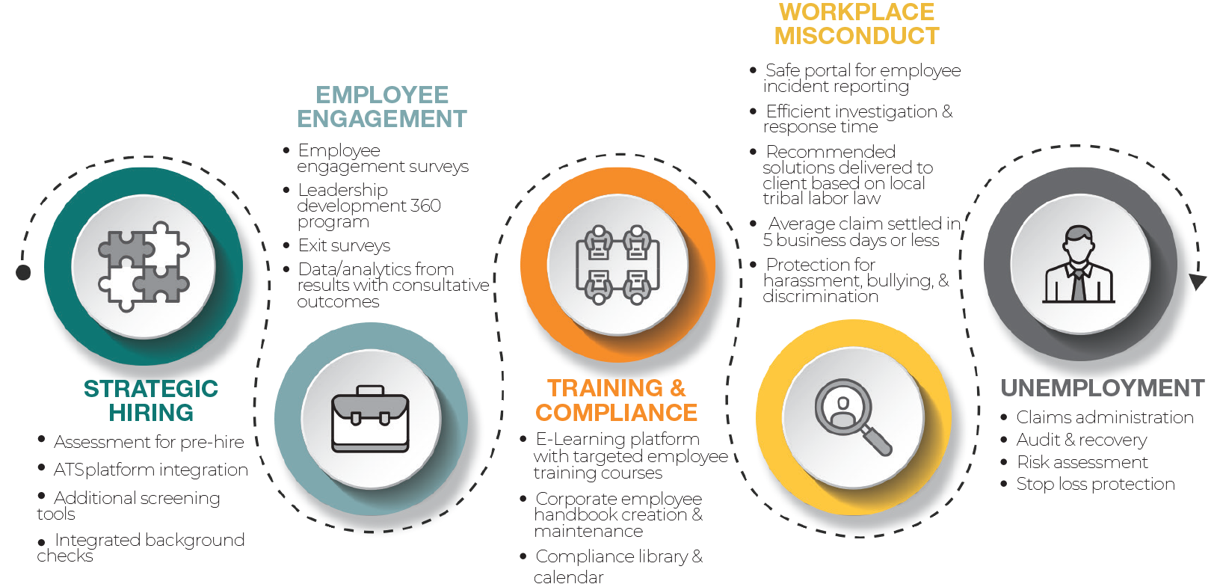
THANK YOU
S3 Management Group has been serving Indian Country for more than a decade. It was founded with an industry-changing belief that human capital risk is not simply a burden to be tolerated. Instead, we see it as an opportunity to make a difference – for employers and their people!
The S3 Sentinel

