Slide 1
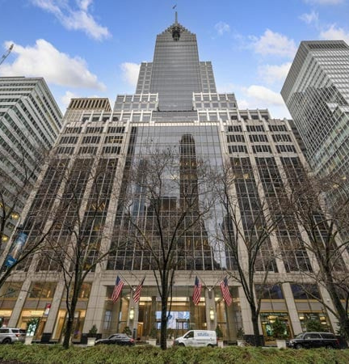
2024
Compensation
&
Benefits
Summit

Slide 2
Compensation & Benefits Summit
Providing NNAHRA Members With Valuable Market Competitive Data
Safe Harbor Guidelines
Salary and Benefits Surveys Offered

Slide 3
Meet the Team
Steve Rosenberg
NNAHRA Compensation Survey Administrator
Virtual Compensation

Slide 4
Compensation & Benefits Summit
Safe Harbor Salary Survey Guidelines
Managed by a third-party (i.e. independent consultant)
Data more than three months old
At least 5 participants offering data
No participant should represent more than 25%
Participants data sufficiently aggregated
Individual participant data not identifiable

Slide 5
Compensation & Benefits Summit
NNAHRA Tribal Gaming Salary & Benefits Survey
Salary & Incentive Data - 217 Job Titles
General Data - Participant Profiles; Salary Budgets; Pay Differentials; Turnover Rates; Various Pay Practices
Benefits Data - 20+ Key Employee Benefit Areas
Member Participant Cost - $880

Slide 6
Compensation & Benefits Summit
NNAHRA Tribal Government Salary & Benefits Survey
Salary & Incentive Data - 340 Job Titles
General Data - Participant Profiles; Salary Budgets; Pay Differentials; Turnover Rates; Various Pay Practices
Benefits Data - 20+ Key Employee Benefit Areas
Member Participant Cost - $1,130

Slide 7
Compensation & Benefits Summit
NNAHRA Executive Compensation Survey
Salary & Incentive Data - 57 Job Titles
Participant Demographics
Executive Pay & Design Practices - Incentive Plan Severance Plan; Executive Perquisites
Gaming; Tribal Government; Corporate/Holding Company; Federal Contracting; Cultural & Economic Development
Member Participant Cost - $1,000
`

Slide 8
Compensation & Benefits Summit
Annual Survey Participation Timing
First Quarter - California Tribal Gaming
Second Quarter - National Executive
Third Quarter - National Tribal Gaming
Fourth Quarter – National Tribal Government
- End -

Slide 9
Get in Touch
Contact us to get more info
compsurvey@nnahra.com
XXXXXX
619.309.9434
nnhra.com

