Slide 1




2024
Compensation
&
Benefits
Summit

Slide 2


Compensation & Benefits Summit
Objectives
Types of Salary Structures
Compensation Strategy
Building a Salary Structure

Slide 3



Meet the Team
Karla Bylund
Julie Boyd
Korey Keen
CEO & Founder
Compensation Manger
Compensation Specialist

Slide 4




Meet the Team
Shannon
Rick
Nadia
Abby
Name
Name
Name
Manager
Owner
Leader

Slide 5

Purpose of Compensation
recruit and retain qualified employees.
increase or maintain morale/satisfaction.
reward and encourage peak performance.
achieve internal and external equity.
reduce turnover and encourage company loyalty
recognize each job’s value to the organization

Slide 6
Risks of not Structuring a Compensation System:
Lose or not attract talented employees
Overpay for certain positions
Liable for pay discrimination
Bias in pay decisions
Low morale
Notes:
Without a structured system, it’s all too easy to fall on bias or subjective, inequitable standards to set your pay ranges, like using the employee filling the role to set the pay range for it. This kind of approach puts you at risk in a number of ways, including:
You could end up offering wages that aren’t competitive and lose talented employees.
Similarly, you won’t be able to attract good candidates with out of date wages.
You could end up overpaying for certain positions.
You could be liable for pay discrimination.
Market-based pay ranges help you ensure pay equity across salary decisions and help your organization stand out as an employer that cares about fair and equitable pay:
You’ll be more conscientious and consistent in how you approach wages.
You can reduce bias in salary decisions.
You’re better equipped to help employees understand how and why they’re compensated the way they are.
With data-backed, fair pay as the foundation of your compensation strategy, your organization can also navigate difficult decisions, like adjusting salaries in response to inflation.

Slide 7

Most Common Types of Pay Structures
Traditional
Broadband
Step-Grade

Slide 8
Traditional / Market Based

Slide 9
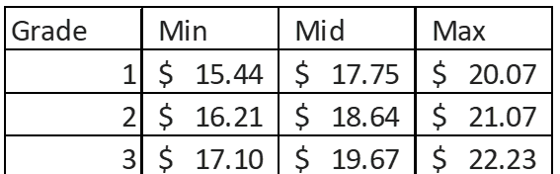
Traditional / Market Based
Divided into different pay grades.
The jumps between pay grades are relatively small.
Market-based structures are based on what other employers pay employees.
Have established ways or requirements for employees to move up a pay level. (performance, length of employment)
This type of salary structure makes it so that employees do not cap out their salaries too quickly.
Notes:
To implement this structure
Decide what an employee needs to do to move onto the next pay grade. You may use a variety of metrics to determine a pay raise, such as performance and length of employment.
Set the minimum and maximum salary range for each employee or employee group. Then, determine the number of pay grades within the structure.

Slide 10
Broadband

Slide 11
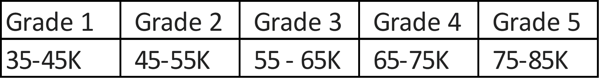
Broadband
A broadband pay structure divides employees into types or categories rather than a specific position.
These types or categories could be labeled as administrative jobs, executive jobs, or other department jobs.
Broadband salary structures have fewer pay grades than a traditional salary structure, but the grades typically have a wider salary range.
Pay raises under this structure are more flexible but this can also lead to employees reaching their salary cap quickly.

Slide 12
Step Pay
Step pay structures are one of the simplest salary structure systems.
A clearly defined pay structure or progression is set at the start of the employee’s time with the company.
Pay increases may come from pre-determined time increments with the company or adequate performance.
Government agencies often use step pay structures.

Slide 13
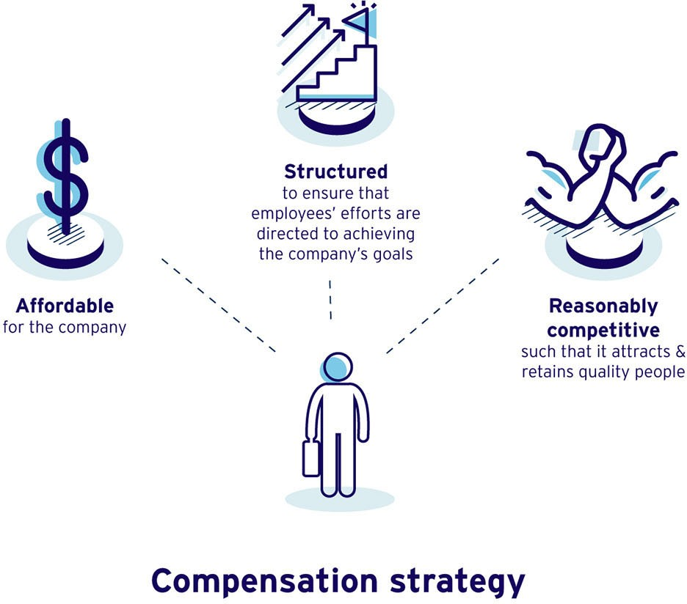
Compensation Strategy
Notes:
A good compensation strategy is affordable, structured and reasonably competitive

Slide 14

Equity: Fairness Is the Ultimate Goal
Notes:
We have already heard about market wages and compensation studies
safest bet is to use reliable market data to find the minimum, median, and maximum pay for comparable roles.

Slide 15

Market-based pay ranges help you ensure EXTERNAL pay equity across salary decisions

Slide 16

Analyzing positions within the organization and assigning pay ranges to similar positions across the organization ensures that you are maintaining an INTERNAL equity.

Slide 17
Building a salary structure
Notes:
Now that you have determined your pay structure and comp philosophy, it is time to build your salary structure

Slide 18
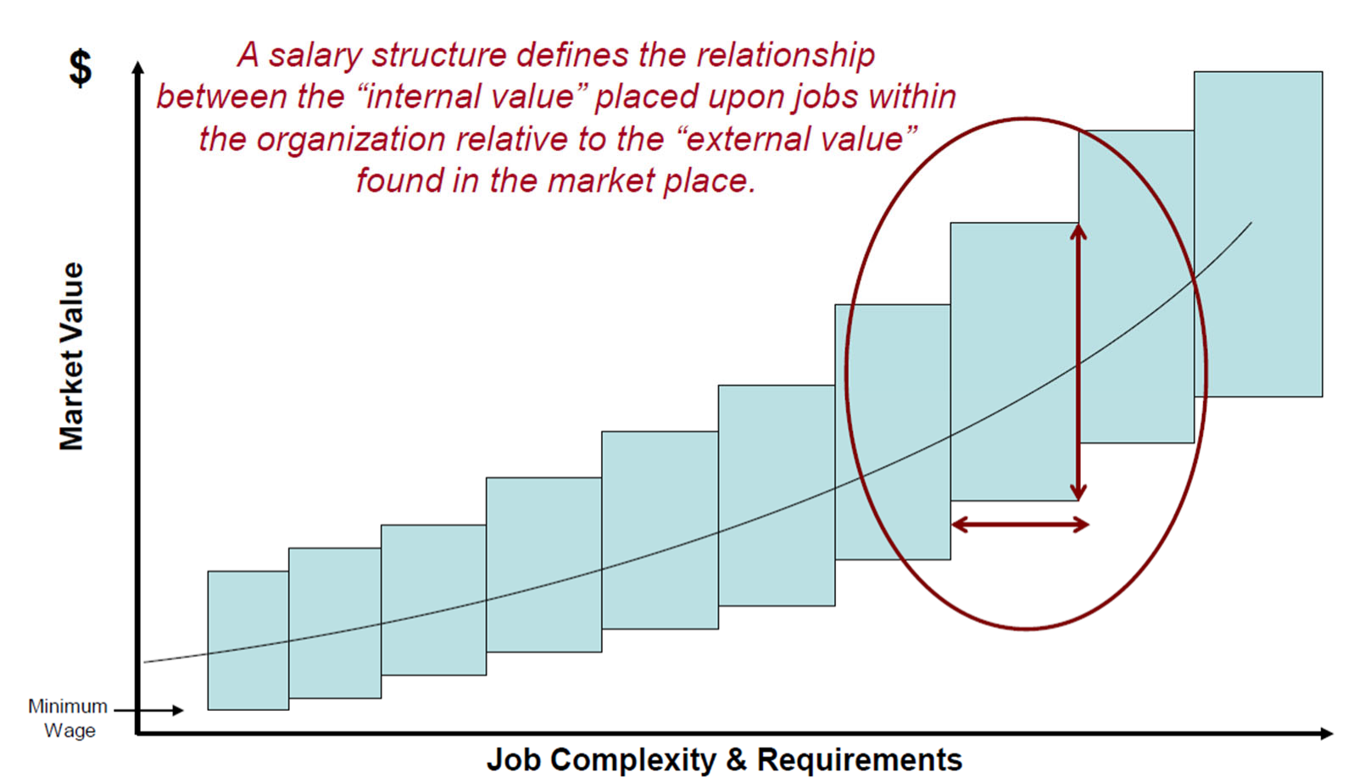
Salary/Pay Structure

Slide 19



Step 1.
Identify “Benchmark” Jobs
Developing a Salary/Pay Structure
Requirements for good benchmark jobs include the following.
Very common to organizations within your industry
The work performed is very standardized from one employer to another as well as performed under similar working conditions
The incumbent job requirements such as knowledge education skills experience abilities etc. are also very standardized from one employer to another
There is a rich supply of reliable market data for the job

Slide 20

Benchmarking against the Market
Use 3 or more surveys
Review for outliers
  Throw out extreme highs or lows
Adjust as necessary
  Adjust for geography
  Adjust for age of data
  Adjust for hard to fill positions
Notes:
Benchmarking positions against the market is not an easy task. However, by keeping the following points in mind, the process can be
effective, efficient and accurate, and yield an effective base pay system for the organization.
Review for outliers. After pulling the various market data points, review the salary data for outliers (extreme data points on
either end), and remove as appropriate. If the data show extreme highs or lows from one year to the next or if one data point
seems high or low, check to see if the number of organizations or number of incumbents changed from a prior year's report.
Rejecting a data point is appropriate if it does not appear valid, but do not automatically exclude data because they are the
lowest or highest—especially when using multiple surveys.
Adjust as necessary. Use three or more surveys to lessen variability in data from one year to the next. Adjust data as needed,
including the following common data adjustments:
Create a market composite for each benchmark position. Combine data points from several surveys either by simple
average, employee-weighted or organization-weighted data to develop composite market data. Most surveys report 25th, 50th
and 75th percentile data points for base salary, bonus targets, actual bonus payouts and total cash compensation. When using
surveys, be aware that the 25th and 75th percentile data points have less reliability and can fluctuate more year to year.
Averaging the individual 50th percentile data points from each survey creates the market composite 50th percentile value.
Sometimes, however, an organization values the data in a specific survey more than in others. As such, that survey's data can
be double or triple weighted in the calculation to emphasize its importance. In addition, HR should be careful of weighting
survey sources equally, especially if one survey has a larger sample size. HR professionals should use judgment in reviewing
the data to determine the best approach. There is no right answer, but with consistency, the results will be internally accurate.
Review current pay rates against market data. Review each benchmark's current employee average pay rates against the
target market data. Pay particular attention to those positions with a 20 percent difference above or below the market. Be sure
that the matches accurately reflect the duties in the benchmark position, and make changes as needed.
The composite market data points not only provide the tools necessary to create the pay structures but also allow comparison
between the market and the organization's compensation philosophy. Reviewing the market data can confirm that the
organization has selected an appropriate compensation philosophy for its talent management needs, strategic plan goals and
fiscal realities. Reviewing with senior management the high-level composite market data against the compensation philosophy
also affords the opportunity to obtain further buy-in and any necessary modification to the compensation philosophy.

Slide 21


Developing a Salary/Pay Structure
Step 2.
Develop a compensation philosophy
Decide what, if any, differences should exist in pay structures for executives, professional employees, line level employees, retail etc.
Decide the extent to which employee benefits should supplement cash compensation
Determine whether salaries should be set to LEAD, LAG or MATCH the market

Slide 22

Compensation Philosophy
Lead
Lag
Match
Notes:
Matching the market. To target the 50th percentile means that an organization wants to pay in the middle of all organizations
that have a similar position.
Market leader. If an organization chooses to focus on the 75th percentile and take a "market leader" position, it will pay higher
than 75 percent of other organizations with similar positions. Organizations competing for employees with specialized skill sets
Market lag. If an organization chooses to focus on the 25th percentile and take a "market lag" position, it will pay higher than
only 25 percent of other organizations with similar positions. Organizations with strong variable compensation or benefits
programs, or those encountering financial difficulties, may opt for a market lag position.

Slide 23

Developing a Salary/Pay Structure
Step 3.
Conduct a job analysis
Job analysis is the foundation for all compensation, assessment and selection decisions.
Job analysis provides a way to develop this understanding by examining the tasks performed in a job the competencies required to perform those tasks and connection between the tasks and competencies

Slide 24
Steps in a Job Analysis
Get input from senior executives and department heads to determine the organizational structure and primary functions of each department.
Interview department managers and key employees, as necessary, to determine their specific job functions.
Conduct desk audits if needed.
Conduct a general task analysis. What tasks must be accomplished by whom?
Draft job descriptions
Meet with department managers, as necessary, to review job descriptions.
Finalize and document all job descriptions.

Slide 25

Step 4. Evaluate the Job
Developing a Salary/Pay Structure
Rank the jobs
Verify ranking by comparing it to the benchmark market data

Slide 26
Point Factor Method
Point-Factor evaluation plans are used to evaluate jobs based upon several "compensable factors" recognized by the employer as indicative of "job value"
Most plans measure in some way the following:
Knowledge and Skill
Mental and/or Physical Effort
Responsibility and/or Job Impact
Working Conditions
Note: These are essentially the same factors considered by the Equal Pay Act

Slide 27
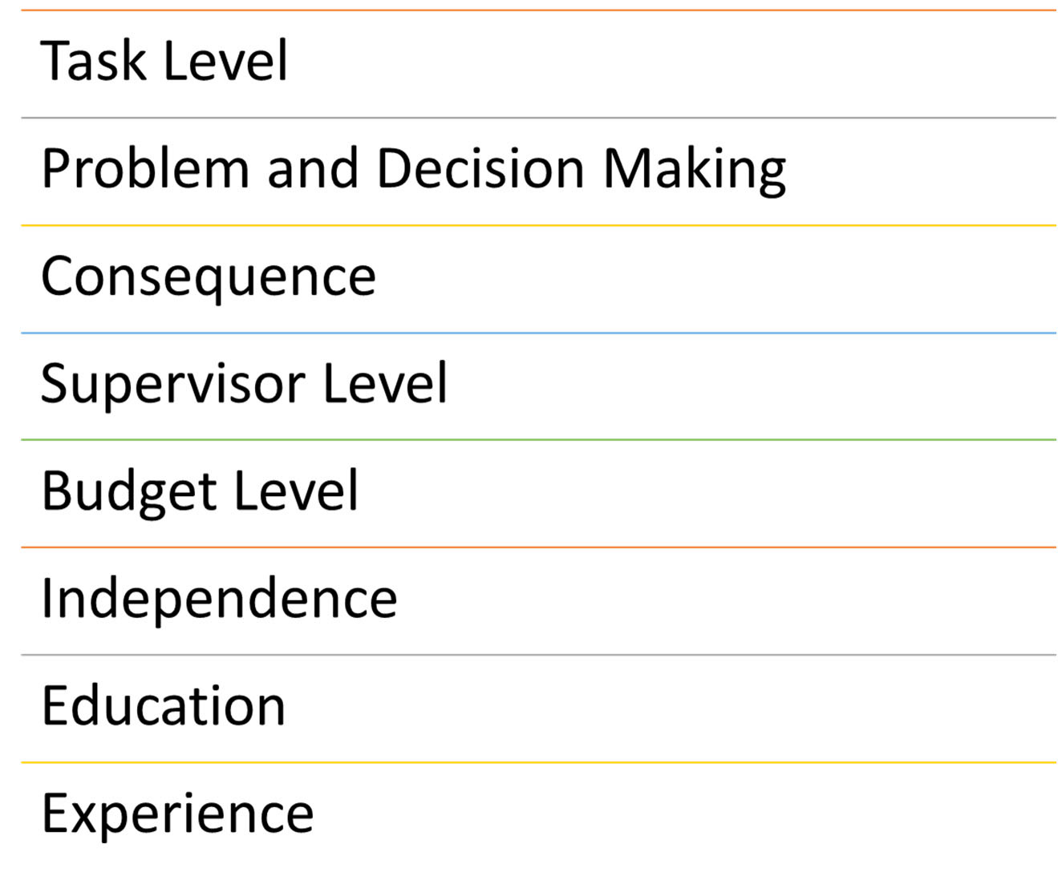
JOB ANALYSIS CRITERIA

Slide 28
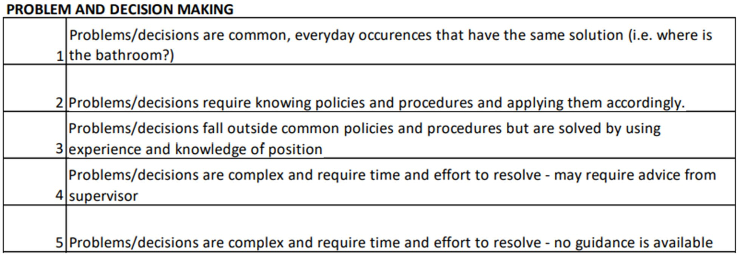
Ranking Guideline

Slide 29
POSITION | TASK LEVEL | PROBLEM AND DECISION MAKING | CONSEQUENCE RATING | SUPERVISION RATING | BUDGET AUTHORITY RATING | INDEPENDENCE | EDUCATION | EXPERIENCE | TOTAL RATING
Position 1 | 1 | 1 | 1 | 0 | 0 | 1 | 1 | 1 | 6
Position 2 | 1 | 1 | 1 | 0 | 0 | 1 | 1 | 2 | 7
Position 3 | 2 | 1 | 1 | 0 | 0 | 2 | 1 | 2 | 9
Position 4 | 3 | 2 | 1 | 0 | 0 | 2 | 1 | 1 | 10
Position 5 | 4 | 2 | 1 | 0 | 1 | 3 | 2 | 3 | 16
Position 6 | 4 | 3 | 2 | 0 | 1 | 3 | 2 | 3 | 18
Position 7 | 5 | 4 | 2 | 1 | 2 | 4 | 4 | 5 | 27
Position 8 | 5 | 5 | 2 | 2 | 3 | 5 | 5 | 8 | 35

Slide 30
Step 5 Determine Salary Structure
Developing a Salary/Pay Structure
Traditional
Broadband
Step

Slide 31

Establish the Pay Scales for each Pay Grade

Slide 32

Minimum
Represents the lowest rate on each pay grade. Typically, this is the pay that is offered at recruitment.
The employee is newly hired and in the orientation phase of their employment.
The employee just meets the minimum hiring requirements for the position.

Slide 33
Mid-Point
Considered the competitive market rate for the job.
The employee competently performs each job task associated with their role (typically 4‐8 years after hire).
The employee is typically in good standing with the organization

Slide 34
Maximum
Represents the highest rate an organization is willing to pay for the job. Reasons to pay an employee close to the maximum of the range include:
  Employee has mastered all the competencies of this position.
  The employee has been identified as a high performer or has high potential within the organization.
  The employee has long service and/or tenure with the organization

Slide 35

Range Spread
What it means
The spread or width between the range minimum (e.g., the 25th percentile) and the range maximum (e.g., the 75th percentile).
Example
Different jobs would have different spreads. For example, the spreads within an organization can look like this:
Hourly contract positions: 30%-40%
Entry to mid-level to managerial positions: 40%-60%
Executive positions: 60%-70%

Slide 36
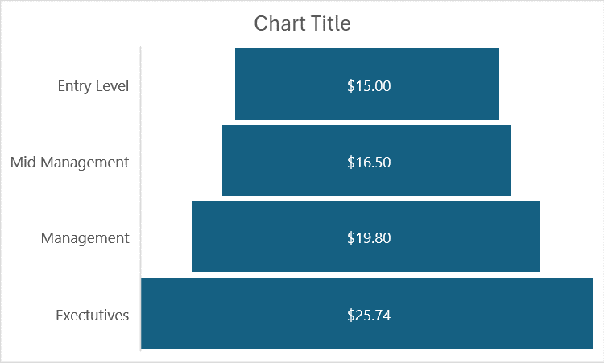
Notes:
Ranges tend to widen higher in the organization. Organizations can
have ranges with a spread of 25 percent at lower grades to 75 percent for senior roles. Wider ranges at senior roles reflect the
opportunity for individual discretionary performance, longer learning curves for the position and longer lengths of stay of incumbents in
the same position.

Slide 37
Salary Differential
What it means
This metric shows the progression from one job level to another by comparing the two ranges’ midpoints.

Slide 38
Developing a Salary/Pay Structure
Step 6
Determine the Grades
Determine the number of pay grades for each pay scale
Review the market price of benchmark jobs within the industry.
Review the rating of each position
Assign Positions to Grades
  Similar in rating
  Similar in market

Slide 39
Jobs are assigned to salary grades based on the level of responsibility, skill, and difficulty so that similar jobs are grouped together.
Salary survey data for benchmark jobs within each grade is used to establish the midpoint of the rate range for that salary grade.

Slide 40
Example
XX position has a market average midpoint of $19.50 and has a rating between 11 and 12.
XXX position has a market average of $19.25 and has a rating between 11 and 12.
These positions are now benchmarked. They are assigned a Grade 5, which has a midpoint of $19.30.
XXXX position does not have any market data and has a rating between 11 and 12. It is assigned to the same pay scale as XX and XXX positions.

Slide 41
Example

Slide 42

Questions?

Slide 43




Get in Touch
Contact us to get more info
K.Bylund@soaringbirdsiolutions.com
725-251-9909
www.soaringbirdsolutions.com

