Slide 1
28th Annual Conference
“Emerging Trend: How AI is Enhancing Career Advancement and Talent Acquisition in Tribal Gaming”
September 23-25, 2024
Durant, Oklahoma

Slide 2
AGENDA
Introduction
AI Trends Across Tribal HR
AI Technologies For Tomorrow’s HR Team
AI in HR - Real World Case Study
Legal Considerations For AI Use
Conclusions / Q&A

Slide 3
Our Speakers
Brian Ferrilla
Judy Wright
Raquel Sapigao
John Haney
CEO
IGworX, KYX Advantage
Vice President of Human Resources
Valley View Casino & Hotel
Human Resources Manager
Wilton Rancheria
Partner
Holland & Knight

Slide 4
AI Practical Definitions
Computer Vision (CV):
The ability for a device or machine to “see” images or video and interpret them as preexisting or new patterns
Machine Learning (ML):
For a specific task, automated refinement of algorithms and identified patterns as more datasets are analyzed (i.e. model), thus improving accuracy of decisions
Deep Learning / Neural Network (DL):
Subset of ML; subsequent levels of dataset analysis based on learnings from prior levels
Natural Language Processing (NLP):
Enables computers to comprehend, generate, and manipulate human language
The AI Umbrella
AI
ML
Robotics
ASR
DL
ES
NLP
CV

Slide 5
AGENDA
Introduction
AI Trends Across Tribal HR
AI Technologies For Tomorrow’s HR Team
AI in HR - Real World Case Study
Legal Considerations For AI Use
Conclusions / Q&A

Slide 6
Emerging Acceptance of AI
Industry Trends
Possible Use Cases
Implementation Considerations
Vision / plans for AI Gaming Properties, Commission, Tribal Government
Human element
Candidate skills assessment
Candidate culture fit
Employee internal career advancement
High-profile role succession planning
Candidate background vetting
Employee licensing and renewals
Candidate demographics
Hourly vs. salary
Age
Technology acceptance
Existing HRIS systems and processes
External vs. internal candidates journey

Slide 7
AGENDA
Introduction
AI Trends Across Tribal HR
AI Technologies For Tomorrow’s HR Team
AI in HR - Real World Case Study
Legal Considerations For AI Use
Conclusions / Q&A

Slide 8
AI-Based Talent Acquisition
Opportunity | AI Tech Usage
1) Identify candidates with skills that meet position requirements | No human interaction Universe intelligent search Automated “resume” profiling
2) Identify candidates that have a role-based cultural fit with the organization | No human interaction Algorithm-based culture / personality assessment
3) Rank / recommend top candidates based on best organization “fit” | No human interaction Algorithm-based “scoring” of all candidates against role skill reqts. and personality fit
ML
ML

Slide 9
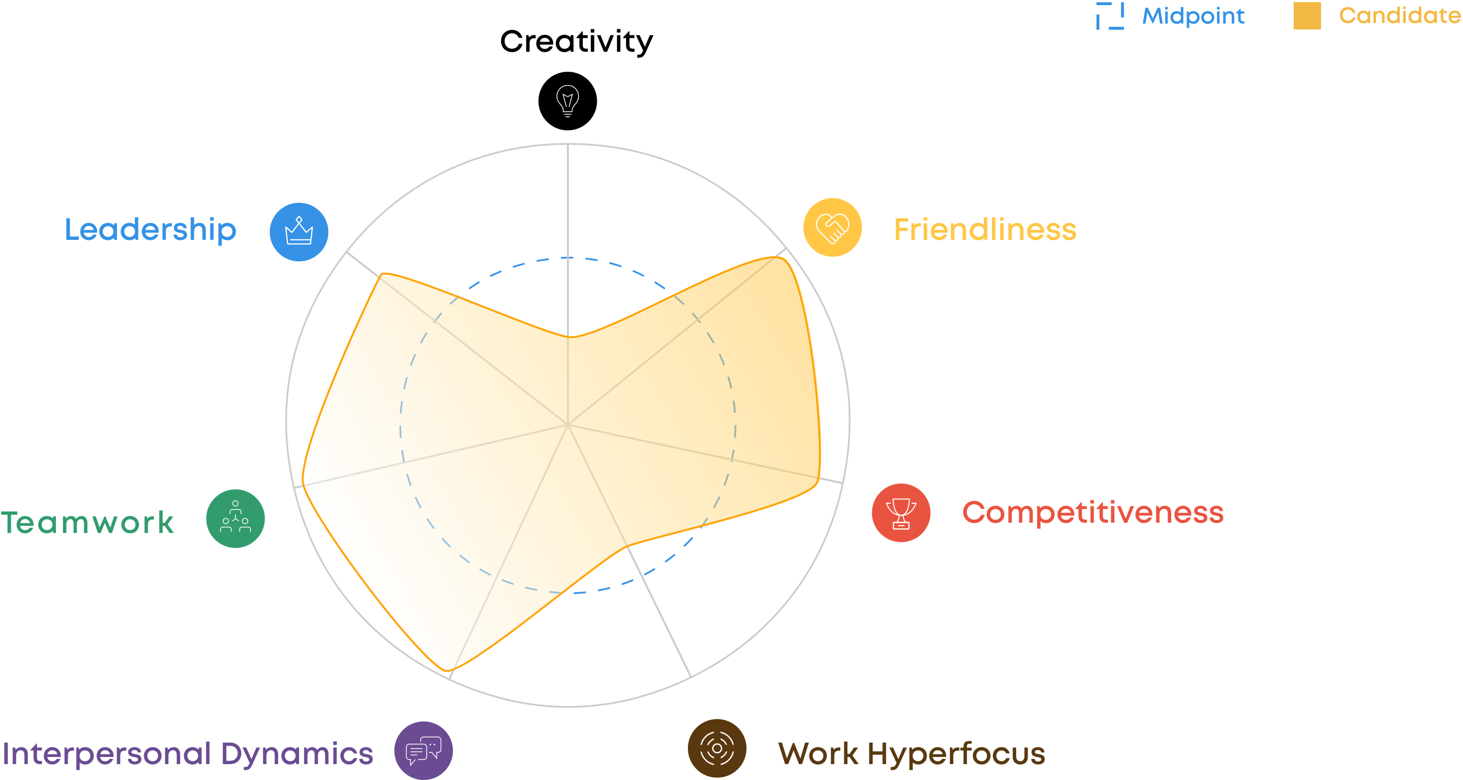
Ideal Candidate Personality Profile
Using a patented unique 7-point, 5-minute personality assessment applied by an AI engine to a job role’s ideal candidate requirements, IGworX instantly vets candidates for workplace success
IGworX eliminates the bottlenecks in hiring, yielding a better and faster understanding of the candidate-employer match much earlier in the evaluation and hiring process

Slide 10
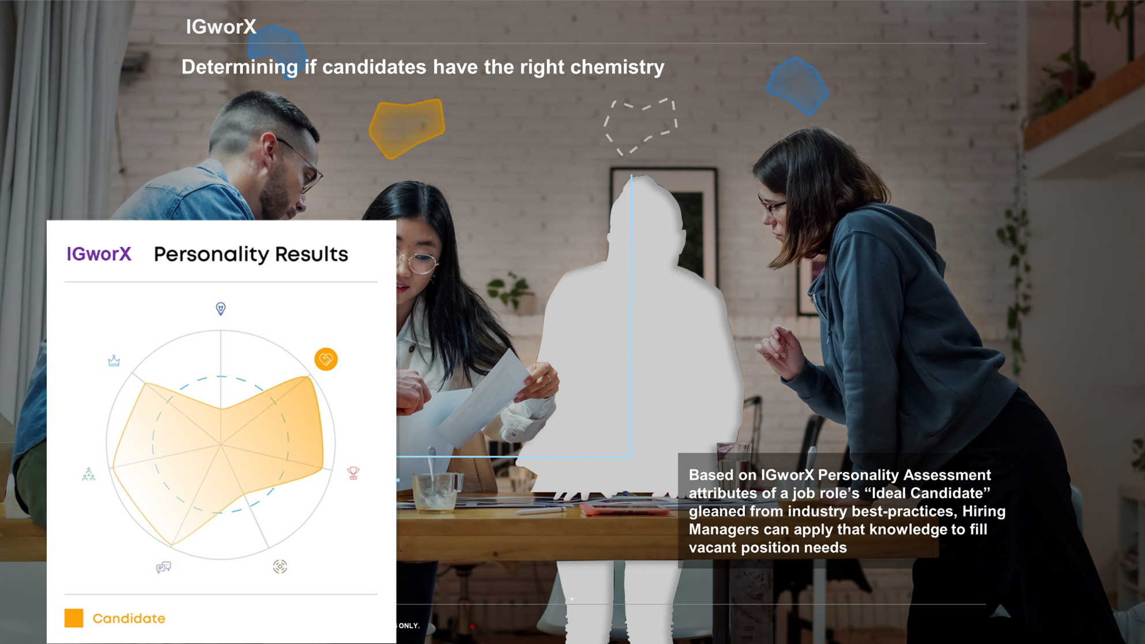

Slide 11
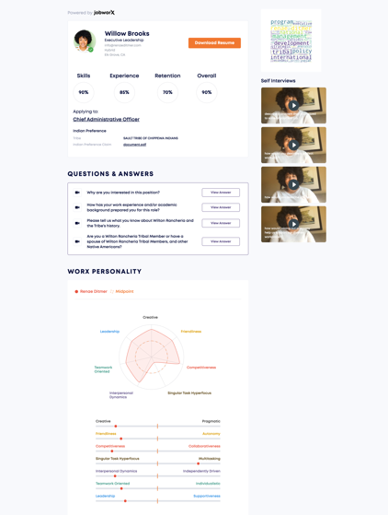
AI-Generated Candidate Profiles

Slide 12
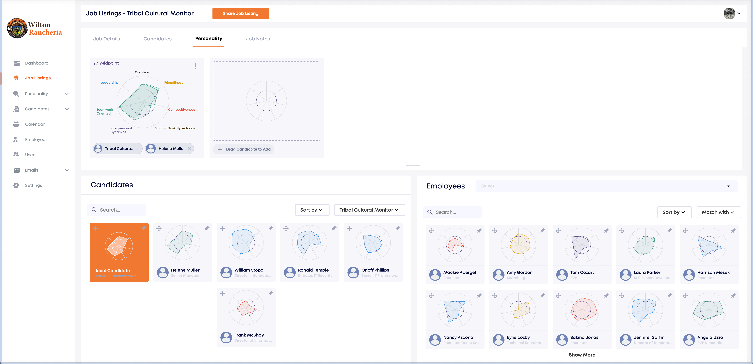
AI-Driven Ideal Candidate Analysis

Slide 13
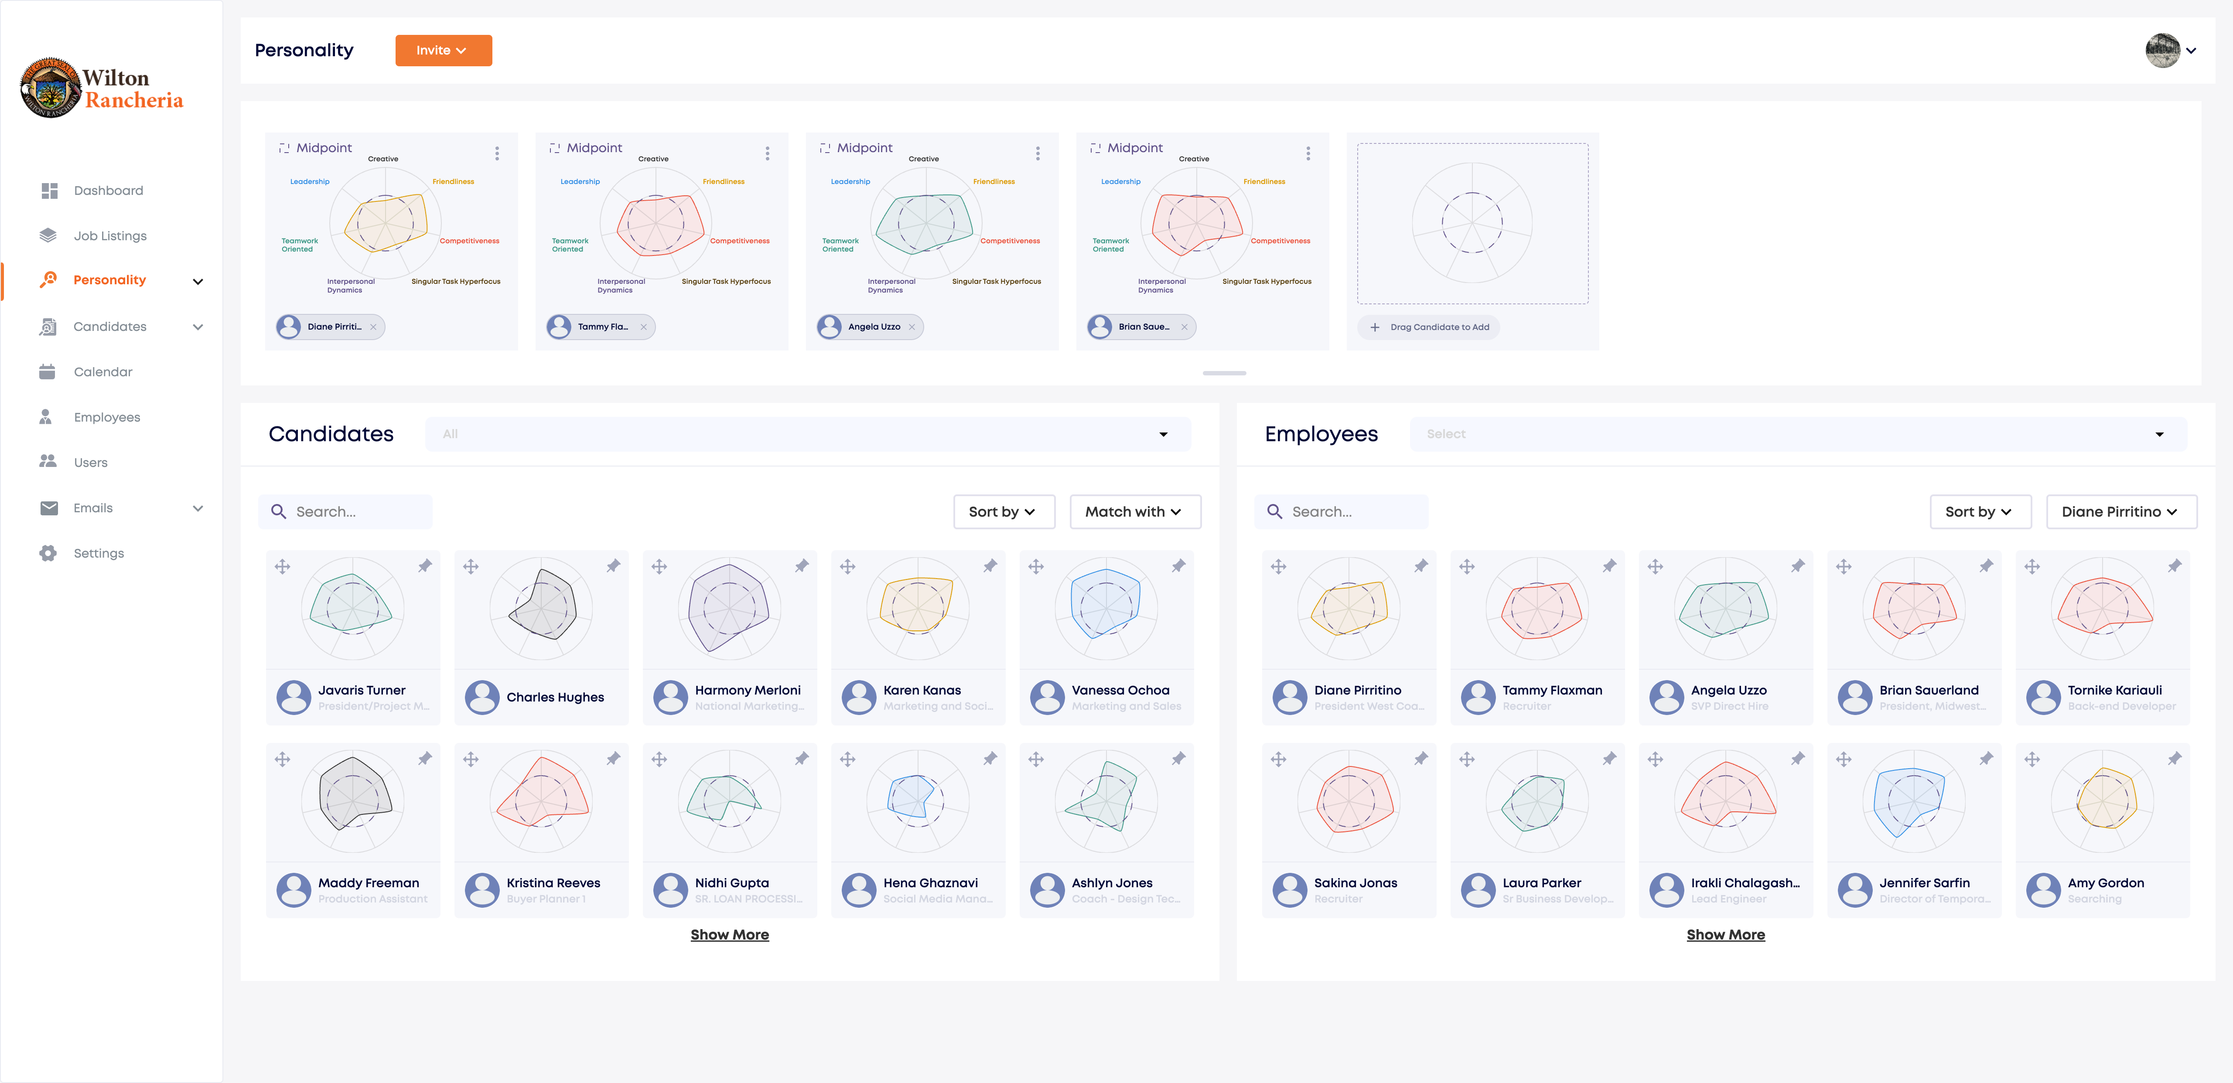
AI-Driven Staff Performance Analysis

Slide 14
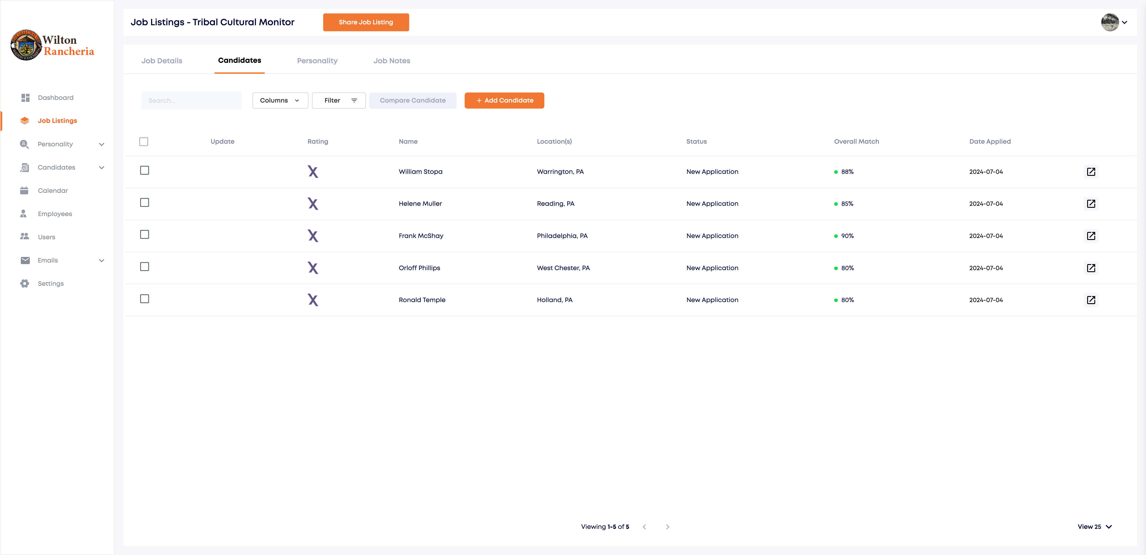
AI-Based Unbiased Candidate Ranking
450
390
375
350
345

Slide 15
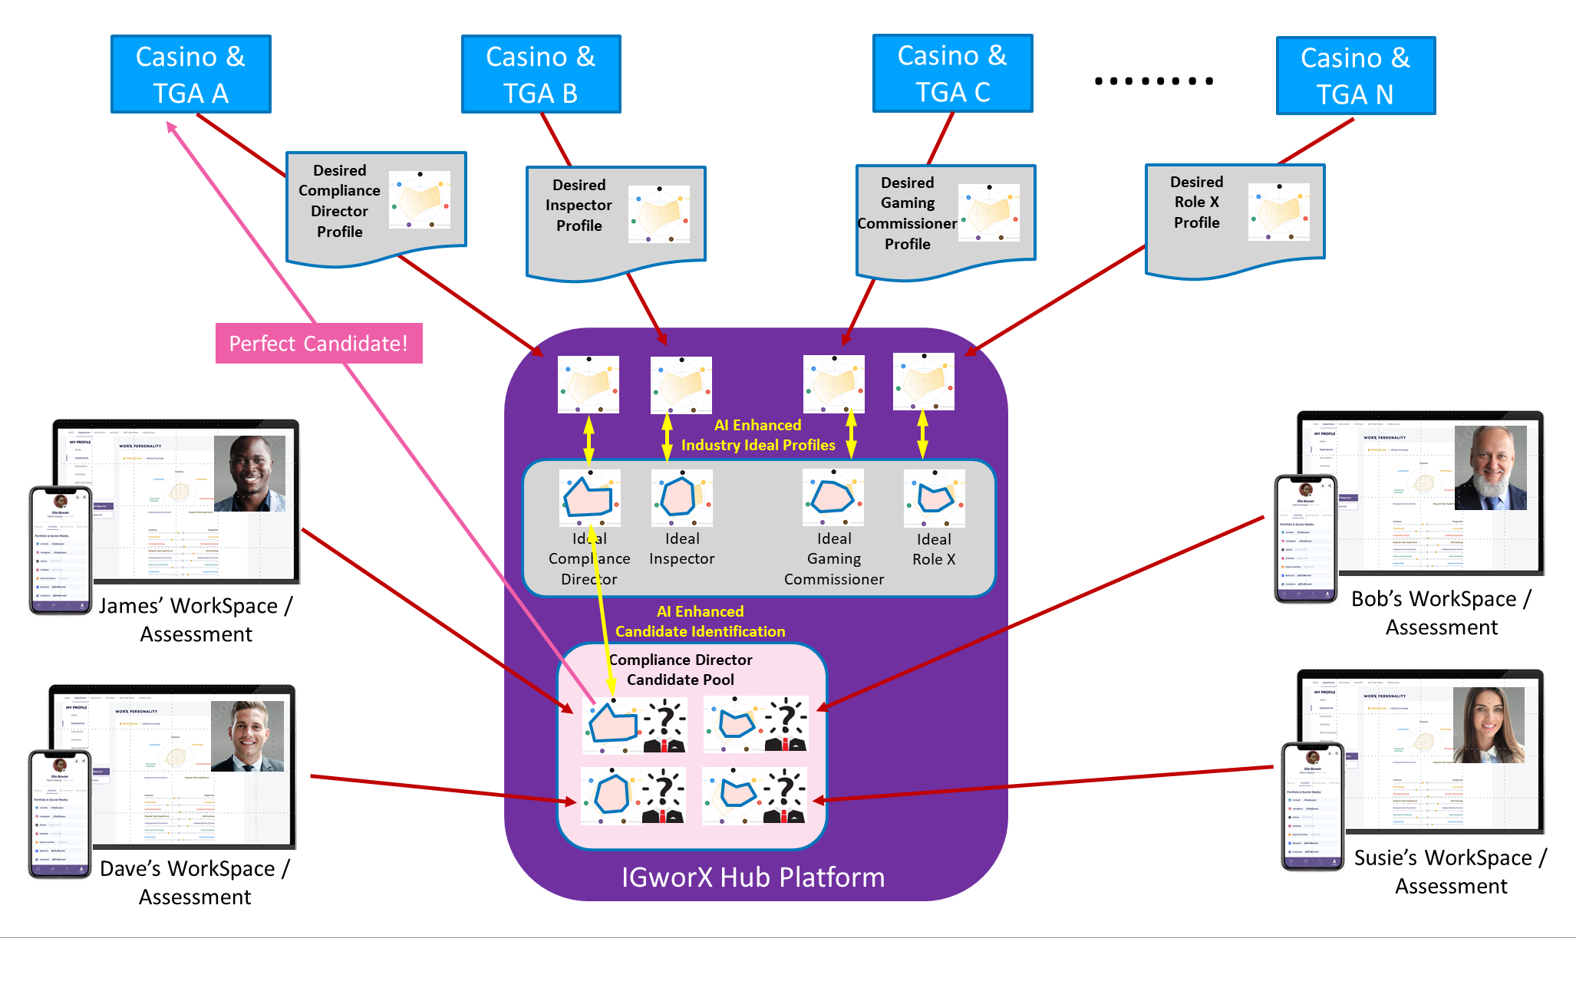
AI-Based Tribal Talent Vision

Slide 16
AI-Based Mobile Self-Service Employee Onboarding and Licensing
Opportunity | AI Tech Usage
1) Self-service identity verification | No human interaction Anti-spoofing / zero bias Age
2) Identity document authentication | No human interaction Fraud detection Learning new ID document types Reauthentication pattern recognition (selfie)
3) Background investigation | No human interaction Analyze detailed data on subject from subscribed sources, summarized snapshot
ML
CV
ML
CV
DL
NLP
ML

Slide 17
AI-Based Mobile Self-Service Employee Onboarding and Licensing (Cont.)
Opportunity | AI Tech Usage
4) Self-service mobile biometric (fingerprints) | No human interaction Liveness checking Anti-spoofing Reauthentication pattern recognition
5) User “behavior” biometrics | Movement signature definition
ML
CV
DL
ML
CV

Slide 18
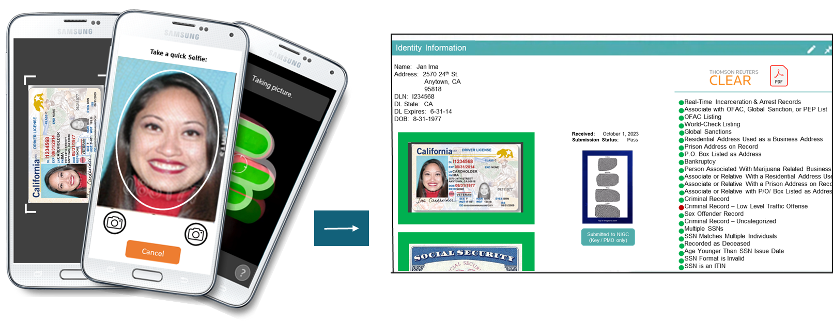
AI-Based Mobile Self-Service Employee Onboarding and Licensing

Slide 19
AGENDA
Introduction
AI Trends Across Tribal HR
AI Technologies For Tomorrow’s HR Team
AI in HR - Real World Case Study
Legal Considerations For AI Use
Conclusions / Q&A

Slide 20
AI in HR-Applicant Review Benefits Achieved
Efficiency:
Automates repetitive tasks
Speeds up the screening process
Consistency:
Standardizes applicant evaluations
May reduce bias
Data-Driven Decisions:
Utilizes large data sets for better insights
Enhances decision-making accuracy
Cost-Effective:
May reduce the need for extensive HR staff
Lowers recruitment costs over time

Slide 21
AI in HR-Applicant Review Lessons Learned
Bias in Algorithms:
Potential to perpetuate existing biases
Requires regular updates and monitoring
Doesn’t Replace Human Touch:
May overlook soft skills and cultural fit
Reduces personal interaction
Data Privacy Concerns:
Handling of sensitive applicant information
Compliance with internal and external data protection policies
Technical Issues:
Training staff- Change is hard
Dependence on technology reliability
Potential for errors in AI judgments

Slide 22
AGENDA
Introduction
AI Trends Across Tribal HR
AI Technologies For Tomorrow’s HR Team
AI in HR - Real World Case Study
Legal Considerations For AI Use
Conclusions / Q&A

Slide 23
“Artificial intelligence and algorithmic decision-making tools have great potential to improve our lives, including in the area of employment. At the same time, the EEOC is keenly aware that these tools may mask and perpetuate bias or create new discriminatory barriers to jobs. We must work to ensure that these new technologies do not become a high-tech pathway to discrimination.”
-EEOC Chair Charlotte A. Burrows (2021)

Slide 24
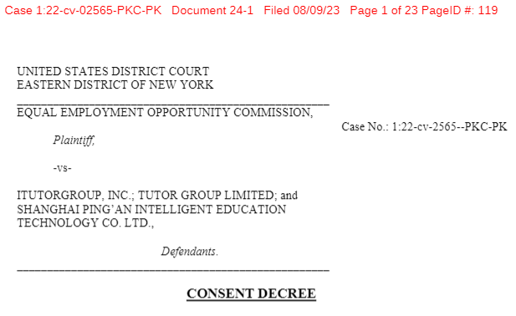
EEOC AI Settlement
August 9, 2023 – EEOC settled an AI bias case brought under the Age Discrimination in Employment Act (“ADEA”), involving alleged age discrimination in hiring decisions.
Algorithm using machine learning automatically rejected women over 55 and men over 60.
$365,000 settlement and all rejected applicants over 40 invited to reapply for 3 years.

Slide 25
Mitigating Legal Risks
Ask yourself:
What laws that implicate AI apply to my organization, if any?
If laws that implicate AI apply to my organization, am I up-to-date on legal guidance?
If my organization contracts with HR vendors that use AI, have I ensured that the vendors are up-to-date on legal guidance?

Slide 26
1. What laws that implicate AI apply to my organization, if any?
As an initial step, determine whether laws that implicate AI arguably apply to the organization’s applicants or employees, e.g., Title VII of the Civil Rights Act, Americans with Disability Act (“ADA”), Age Discrimination in Employment Act (“ADEA”), Fair Credit Reporting Act (“FCRA”).
Potential sources of applicable law:
Tribal Code
Tribal Constitution
Tribal Traditions and Customs
Tribal Court Case Law
Compacts
Tribal Employment Rights Ordinance (“TERO”)
Treaties
Federal Labor and Employment Statutes and Regulations
Federal Case Law
State Employment Laws and Regulations (which generally do not apply to tribal employers absent consent)

Slide 27
1. What laws that implicate AI apply to my organization, if any?
Applicability of Federal and State Employment Laws to Tribes and Tribal Employers:
Federal employment laws
Two main types of federal employment law statutes:
(1) federal statutes that expressly exclude Indian tribes; and
(2) federal statutes of “general application” that are silent as to Indian tribes.
Under Ninth Circuit precedent, federal employment laws of “general application” are commonly held to apply to tribes unless they fall into one of three exceptions: (i) application of the law would abrogate treaty right; (ii) Congress did not intend for the law to apply to tribes, or (iii) applying the law would interfere with the right of self-governance in purely intramural matters (e.g. self-governance exception).
Other circuits, such as the Eighth and Tenth Circuits, reject the Ninth Circuit’s presumption that generally applicable laws apply to tribes.
Even if a law is applicable, tribes may still assert tribal sovereign immunity.
State employment laws
Tribal employers are not subject to state employment laws without consent of the tribe, e.g., privacy laws such as the California Consumer Privacy Act (CCPA), the Illinois Biometric Information Privacy Act (“BIPA”).
Consider full-time remote workers who live and work outside of tribal land.

Slide 28
1. What laws that implicate AI apply to my organization, if any?
Federal Employment Law Statutes Excluding Indian Tribes:
1) Title VII of the Civil Rights Act of 1964 (Title VII)
Expressly exempts Indian tribes
2) Americans with Disabilities Act (Title I: Discrimination)
Exempts Indian tribes from anti-discrimination provisions
3) Worker Adjustment and Retraining Notification Act (WARN)
Federal Department of Labor regulations exempt Indian tribes

Slide 29
1. What laws that implicate AI apply to my organization, if any?
Federal Employment Law Statutes without Specific Exclusions:
1) Age Discrimination in Employment Act (ADEA)
2) Fair Credit Reporting Act (FCRA)
3) Occupational Safety and Health Act (OSHA)
4) National Labor Relations Act (NLRA)
5) Title III of Americans with Disabilities Act (ADA)
Specifically the public access provisions
6) Fair Labor Standards Act (FLSA)
7) Family and Medical Leave Act (FMLA)
8) Consolidated Omnibus Budget Reconciliation Act (COBRA)
9) Employee Retirement Income Security Act (ERISA)
Exempts tribal employees performing “essential” government functions, and to employees performing commercial activities
10) Immigration Reform and Control Act of 1986

Slide 30
2. If laws that implicate AI apply to my organization, am I up to date on legal guidance?
EEOC Guidance on AI & Title VII
Guidance: “Select Issues: Assessing Adverse Impact in Software, Algorithms, and Artificial Intelligence Used in Employment Selection Procedures Under Title VII of the Civil Rights Act of 1964,” EEOC, May 18, 2023, EEOC-NVTA-2023-2.
If an adverse impact results based on membership in a protected class (race, color, religion, sex, national origin, etc.) then use of the tool will violate Title VII unless such use is “job related and consistent with business necessity” pursuant to Title VII.
Employers may be responsible for adverse impacts created from third-party software vendors.
Evaluate and test for selection rate and bias.

Slide 31
2. If laws that implicate AI apply to my organization, am I up to date on legal guidance?
EEOC Guidance on AI & the ADA
Guidance: “The Americans with Disabilities Act and the Use of Software, Algorithms, and Artificial Intelligence to Assess Job Applicants and Employees,” EEOC, May 18, 2023, EEOC-NVTA-2023-2.
Indicates certain AI-based violations:
Failure to provide reasonable accommodations for an applicant, such as for a timed job fitness test, in order to be fairly rated by the algorithm.
Algorithm “screening out” individuals with disabilities, even though they could perform the essential functions of the job with reasonable accommodations.
Tools which make disability-related inquiries or constitute medical examinations.

Slide 32
2. If laws that implicate AI apply to my organization, am I up to date on legal guidance?
Consider:
Background check laws
Fair Credit Reporting Act (“FCRA”), and other background check laws, when applicable, require disclosure of summary of rights, and written authorization for background check.
Privacy laws
California Consumer Privacy Act (“CCPA”), the Illinois Biometric Information Privacy Act (“BIPA”), and similar laws.
Does the organization have a privacy policy or written employee consent forms in connection with personal information collected and/or used by an AI software?

Slide 33
3. If my organization contracts with HR vendors that use AI, have I ensured that the vendors are up-to-date on legal guidance?
EEOC takes the position that employers may be responsible for adverse impacts created from third-party software vendors that use AI.
Accordingly, it is important for organizations that contract with such vendors to ask:
1. Is the vendor knowledgeable about the current legal guidance on the use of AI in the HR space?
E.g.: Is it clear from speaking with the vendor that it has considered legal guidance when developing its software/algorithms?
2. What steps has the vendor taken to mitigate against the risk of an adverse impact against any protected classes?
E.g.: Has the vendor had an independent review conducted on its use of AI? Does the vendor offer its own applicant/employee consent forms and/or privacy policies.

Slide 34
CONCLUSIONS
Introduction
AI Trends Across Tribal HR
AI Technologies For Tomorrow’s HR Team
AI in HR - Real World Case Study
Legal Considerations For AI Use
Conclusions / Q&A

Slide 35
AI: Enhancing Careers and Talent Acquisition in Tribal Gaming - Conclusions
Recap:
Industry is moving to do more with less
Viable use of technology
Multiple use cases to consider
Changes to existing processes & systems
Legal considerations continue to be refined
Offers Valuable Benefits:
Cost savings / efficiency
Reduce risk, improve accuracy
Improve decision-making
Plans for your organization?
Select use cases; consider a pilot
Do your homework

Slide 36
28th Annual Conference
Q&A
Thank You!
September 23-25, 2024
Durant, Oklahoma

