Slide 1
Shining a Light on Mental Health Awareness and Access to Resources
September 23-25, 2024
Durant, Oklahoma

Slide 2
AGENDA
Contributing Factors of Mental Health in the Workplace
Real Life Stories and Workplace Harassment
Defining Mental Health
The Blob Tree Activity
General Factors Affecting Mental Health
Mental Health in the Workplace Statistics
Real Life Stories
The Stress Curve
The Mental Health Continuum
Supporting Your Mental Health
Recap and Touching Base
This Photo by Unknown Author is licensed under CC BY

Slide 3
Presenters
TeriLynne Kisto
Jake Aguas, Ph.D.
CEO Kisto HR Consulting
Principal Consultant & Author

Slide 4
Introduction
This session covers current trends in workplace harassment and the impact it has on an employee’s mental health and wellness
It will provide warning signs for employees struggling with their mental health and recommendations on how to handle it before it gets out of control. As well as well as how employers can develop strategies to provide mental health support for their employees whom workplace harassment has impacted their mental well-being.

Slide 5
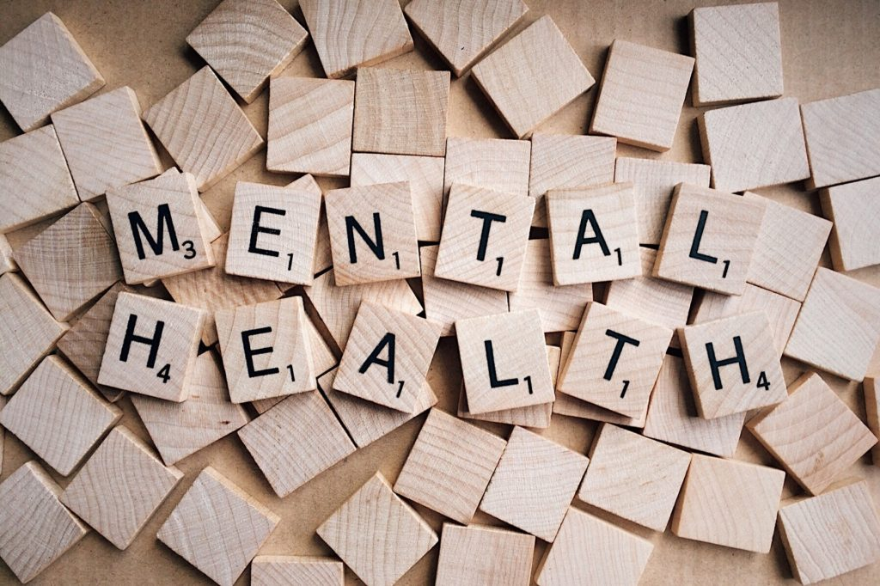
“It is increasingly being recognized that the mental health of employees is a crucial determinant in their overall health and that poor mental health and stressors at the workplace can be a contributory factor to a range of physical illnesses like hypertension, diabetes and cardiovascular conditions, amongst others. In addition, poor mental health can also lead to burn-out amongst employees, seriously affecting their ability to contribute meaningfully to both their personal and professional lives”
Source: T. Rajgopal, Vice President, Medical and Occupational Health

Slide 6
How do you define health?
The World Health Organization (WHO) defines health as “a state of complete physical, mental, and social wellbeing and not merely the absence of disease or infirmity”
How do you define mental health?
The World Health Organization (WHO) defines mental health as “a state of wellbeing in which an individual realizes his or her own abilities, can cope with the normal stresses of life, can work productively and is able to make a contribution to his or her community”

Slide 7
How do you know when you have good mental health?
How do you know when you have poor mental health?

Slide 8
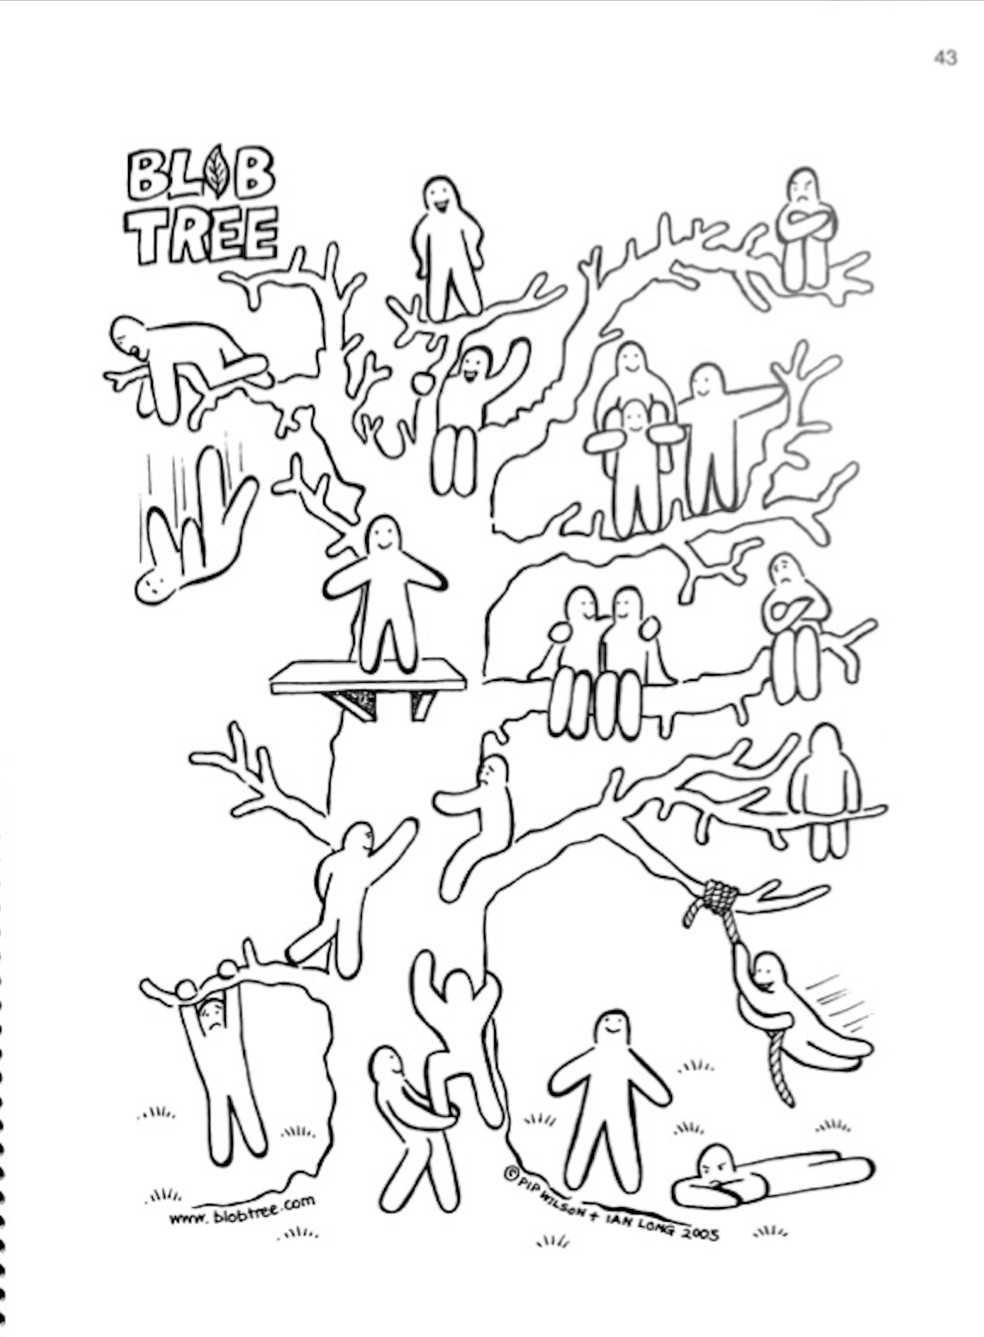

Slide 9
Contributing Factors of Mental Health Issues in the Workplace
Relationship problems with superiors
Bureaucratic constraints
Work family conflict
Relationship problems with colleagues
Performance pressure
Source: Mental Well-being at the Workplace

Slide 10
General Factors Affecting Mental Health
Trauma, childhood abuse, or neglect
Social isolation or loneliness
Social disadvantage and poverty
Bereavement
Severe or long-term stress
Genetic and physical health
Significant and shaping events
Life environments (work, home, etc.)
Finances and debt
Unemployment or losing a job
Drug and alcohol misuse
Domestic violence and/or bullying

Slide 11
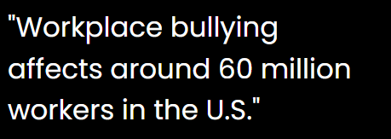
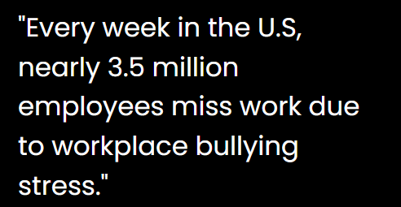
Mental Health Statistics
43% of employees say their managers have negatively impacted them by lacking an understanding of life outside or work or by treating team members unequally
https://wifitalents.com/statistic/bullying-in-the-workplace
https://organizations.headspace.com/blog/the-workforce-state-of-mind-in-2024
77% of Employees say that work stress has negatively impacted their physical health

Slide 12
Real life stories
Dr. Antionette Bonnie Candia-Bailey
18-year-old retail worker

Slide 13
Dr. Antionette Bonnie Candia-Bailey’s Story
Dr. Antionette (Bonnie) Candia-Bailey is the former Vice President of Student Affairs at Lincoln University who was only 49 years old when she died by suicide.
Dr. Candia-Bailey died on January 8, 2024, but not before leaving documents that identified she was struggling with mental health issue due to workplace bullying and harassment.
Source: krcgtv.com/news/local/emails-surface-from-lus-vp-of-student-affairs-sent-the-day-she-died-by-suicide

Slide 14
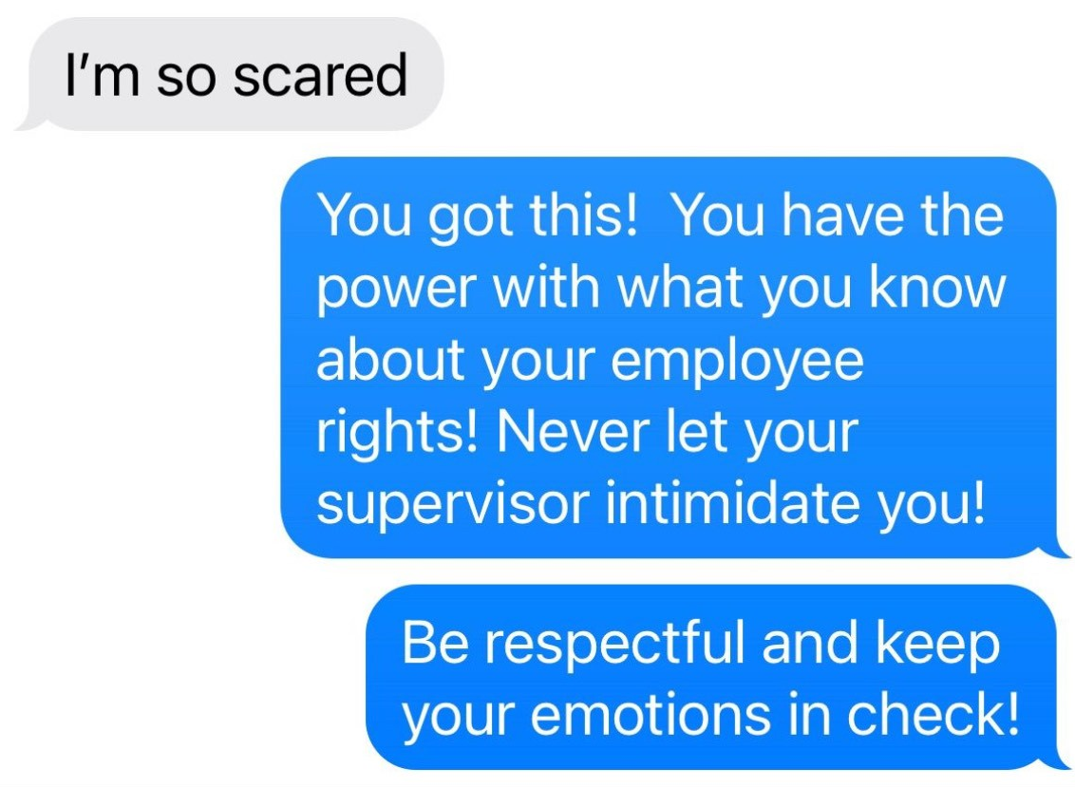
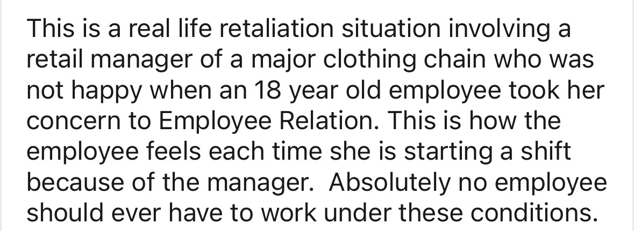
Chantelle’s story
Source: TeriLynne Kisto

Slide 15
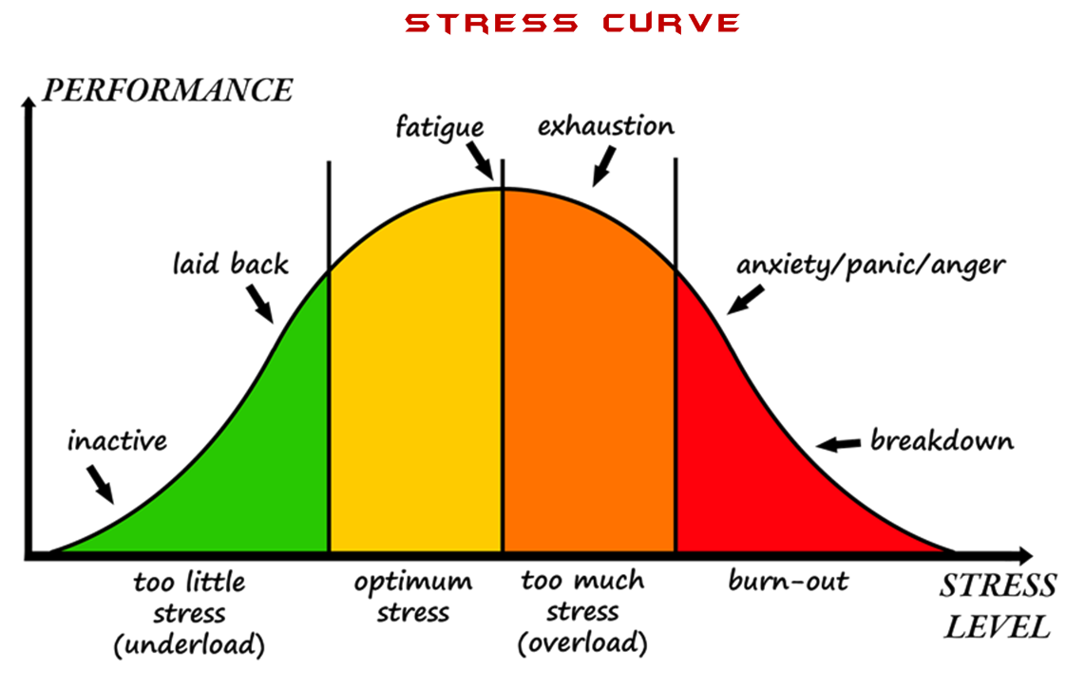
Source: Yerkes and Dodson

Slide 16
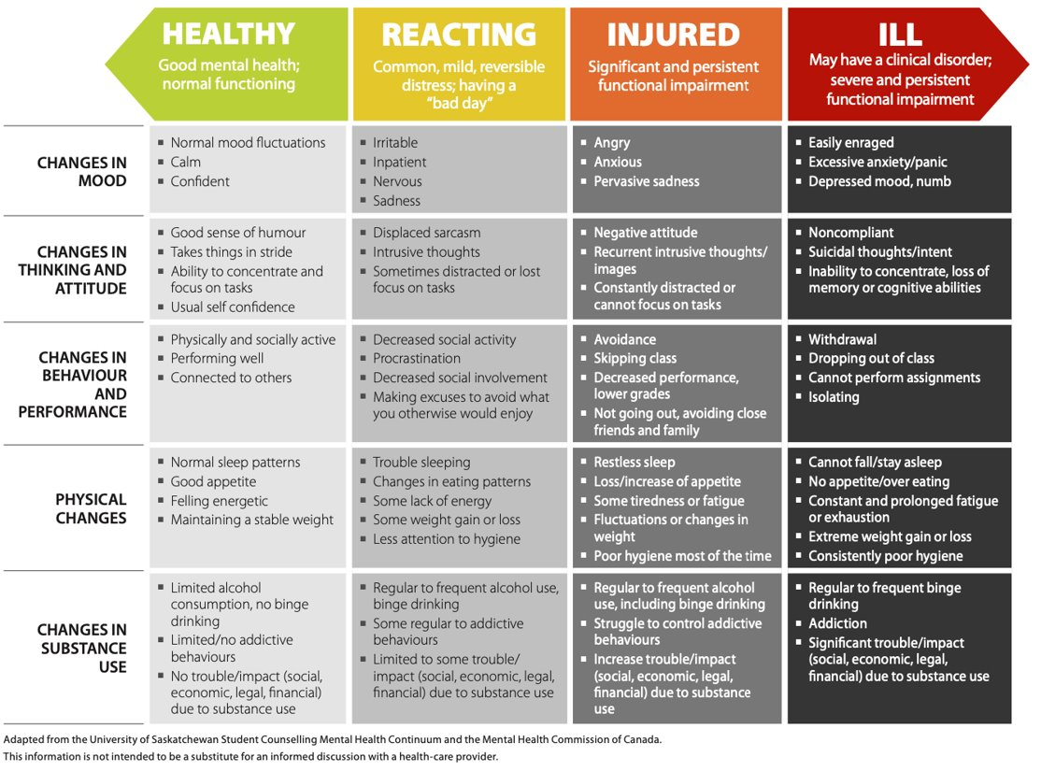
The Mental Health Continuum

Slide 17
Supporting Your Mental Health

Slide 18
The Mental Health Continuum
Physical Movement
Physical activity is what tells your brain you have successfully survived the threat and now your body is a safe place to live. Physical activity is the single most efficient strategy for completing the stress response cycle.

Slide 19
Rest
Ceasing work or movement to relax, refresh oneself, or recover strength.
Boosts your immune system
Improves concentration, memory, and productivity
Restores and energizes
Stimulates creativity
Helps maintain mental and emotionally fitness

Slide 20
Meals
When you eat highly palatable and calorie-dense food, your body releases certain hormones that suppress stress signals and emotions. This is one of the answers to “why does eating relieve stress”.
This is why foods with refined carbs and fats are often called “comfort” foods.

Slide 21
Breathing
Deep, slow breath down regulate the stress response especially when the exhalation is low and long and goes all the way to the end of the breath so that your belly contracts.

Slide 22
Creative Expression and Hobbies
The arts, including painting, sculpting, music, theater, storytelling etc. encourage an outlet for emotions.
Hobbies such as journaling, collecting, fishing, crochet, baking, calligraphy, baking, home improvement, karaoke help minimize any room for self-pity, anger and fear.
Essentially, you are getting out of your own way and taking the focus off your internal circumstances, leaning on external outlets.

Slide 23
Social Interaction
Social interaction is the first external sign that the world is a safe place.
When you share mutual trust and connection with someone, you co-create energy that renews both people. This can be true with family, friends, peers or even pets.
Connection is just as necessary as food and water; humans are built for connection.

Slide 24
Cathartic Crying
Crying helps our bodies release negative feelings and re-energize our minds, reducing the level of cortisol (a hormone that’s responsible for stress, anger, and anxiety). A reduction in this hormone can lead to feelings of relaxation and calmness.
Having a big old cry may mean you have not changed the situation that caused the stress, but you have completed the cycle.

Slide 25
Recap and Touching Base
Summary of Mental Health Awareness
Feel Free To Come To Us To Check In
Any Questions

Slide 26
THANK YOU!
TeriLynne Kisto
Kisto_hrconsulting@outlook.com
Jake Aguas
jake@morris-interactive.com

Slide 27
References
All other information has come from my research
Aguas, J. (2024). A Phenomenological Study of Leadership Preferences and Aspirations, Mental and Physical Wellbeing, and Diversity of Adult Working Members of Generation Z. https://www.proquest.com/openview/fe2cb079305c4946b7c029c63d636442/1?pq-origsite=gscholar&cbl=18750&diss=y
Aguas, J. (2021). Generation Z and the Mental Health Crisis. The Global Journal of Management, Spring, 53-76.
Aguas, J. (2024). Working across generations. [PowerPoint slides]. Morris interactive Advanced leadership Development Workshop.

