Slide 1


Shining a Light on Mental Health Awareness and Access to Resources
September 23-25, 2024
Durant, Oklahoma

Slide 2



AGENDA
Contributing Factors of Mental Health in the Workplace
Real Life Stories and Workplace Harassment
Defining Mental Health
General Factors Affecting Mental Health
Mental Health in the Workplace Statistics
Real Life Stories
Stress Curves
The Mental Health Continuum
Supporting Your Mental Health
Recap and Touching Base
This Photo by Unknown Author is licensed under CC BY

Slide 3




Presenters
TeriLynne Kisto
Jake Aguas, Ph.D.
CEO Kisto HR Consulting
Principal Consultant

Slide 4

Introduction
This session covers current trends in workplace harassment and the impact it has on an employee’s mental health and wellness
It will provide warning signs for employees struggling with their mental health and recommendations on how to handle it before it gets out of control. As well as well as how employers can develop strategies to provide mental health support for their employees whom workplace harassment has impacted their mental well-being.

Slide 5
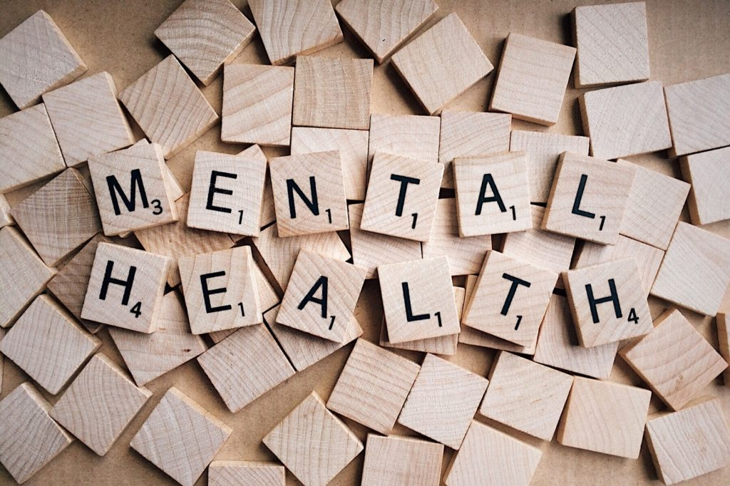
“It is increasingly being recognized that the mental health of employees is a crucial determinant in their overall health and that poor mental health and stressors at the workplace can be a contributory factor to a range of physical illnesses like hypertension, diabetes and cardiovascular conditions, amongst others. In addition, poor mental health can also lead to burn-out amongst employees, seriously affecting their ability to contribute meaningfully in both their personal and professional lives.”
Source: T. Rajgopal, Vice President, Medical and Occupational Health
This Photo by Unknown Author is licensed under CC BY

Slide 6


How would you define health?
The World Health Organization (WHO) defines health as “a state of complete physical, mental, and social wellbeing and not merely the absence of disease or infirmity”
How would you define mental health?
The World Health Organization (WHO) defines mental health as “a state of wellbeing in which an individual realizes his or her own abilities, can cope with the normal stresses of life, can work productively and is able to make a contribution to his or her community”

Slide 7


How do you know when you have good mental health?
How do you know when you have poor mental health?

Slide 8

Contributing Factors of Mental Health Issues in the Workplace
Relationship problems with superiors
Bureaucratic constraints
Work family conflict
Relationship problems with colleagues
Performance pressure
Source: Mental Well-being at the Workplace

Slide 9
General Factors Affecting Mental Health
  Trauma, childhood abuse, or neglect
  Social isolation or loneliness
  Social disadvantage and poverty
  Bereavement
  Severe or long-term stress
  Genetic and physical health
  Significant and shaping events
  Life environments (work, home, etc.)
  Finances and debt
  Unemployment or losing a job
  Drug and alcohol misuse
  Domestic violence and/or bullying

Slide 10
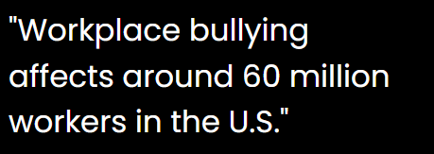
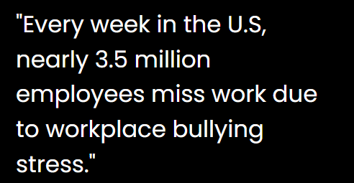
Mental Health Statistics
43% of employees say their managers have negatively impacted them by lacking an understanding of life outside or work or by treating team members unequally
https://wifitalents.com/statistic/bullying-in-the-workplace
https://organizations.headspace.com/blog/the-workforce-state-of-mind-in-2024
77% of Employees say that work stress has negatively impacted their physical health

Slide 11
Real life stories
Dr. Antionette Bonnie Candia-Bailey
18-year old retail worker

Slide 12

Dr. Antionette Bonnie Candia-Bailey’s
Story
Dr. Antionette (Bonnie) Candia-Bailey is the former Vice President of Student Affairs at Lincoln University who was only 49 years old when she died by suicide.
Dr. Candia-Bailey died on January 8, 2024, but not before leaving documents that identified she was struggling with mental health issue due to workplace bullying and harassment.
Source: krcgtv.com/news/local/emails-surface-from-lus-vp-of-student-affairs-sent-the-day-she-died-by-suicide

Slide 13
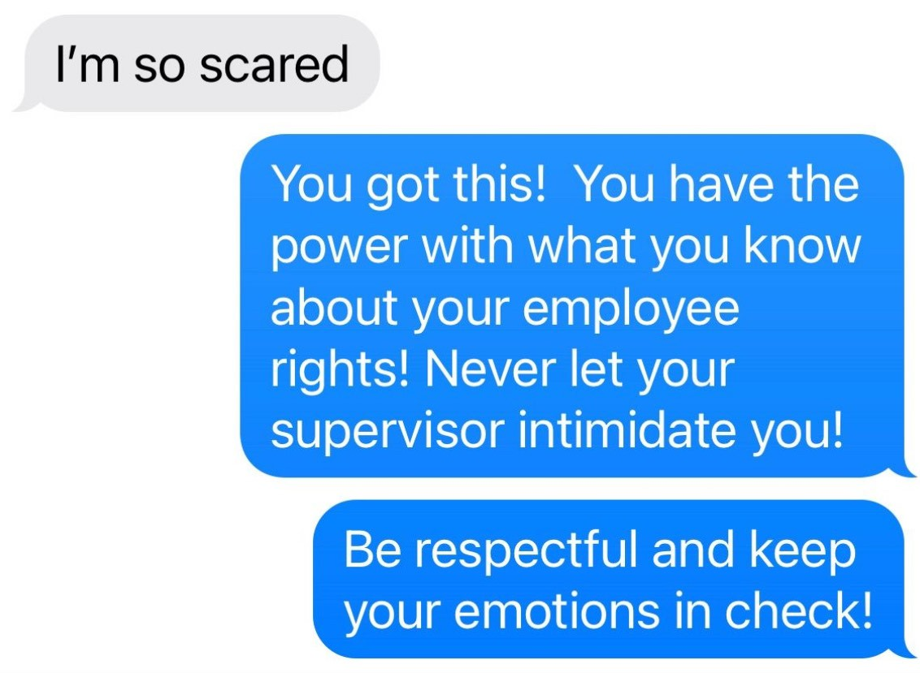
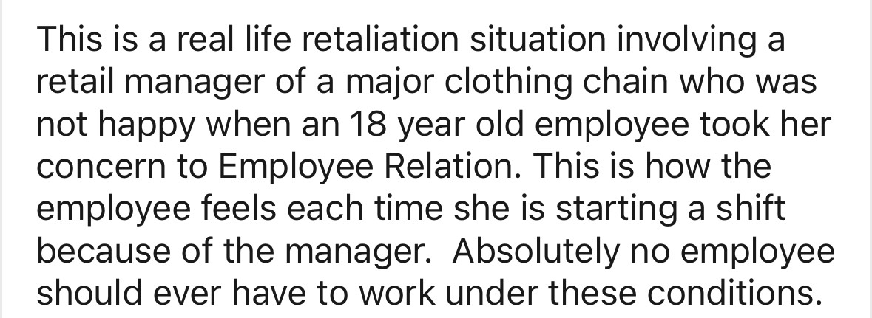
Chantelle’s story
Source: TeriLynne Kisto

Slide 14
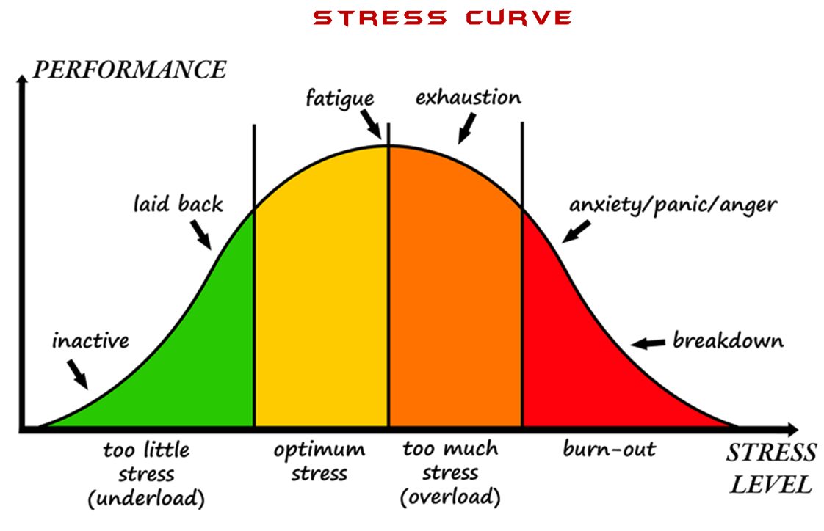
Source: Yerkes and Dodson

Slide 15
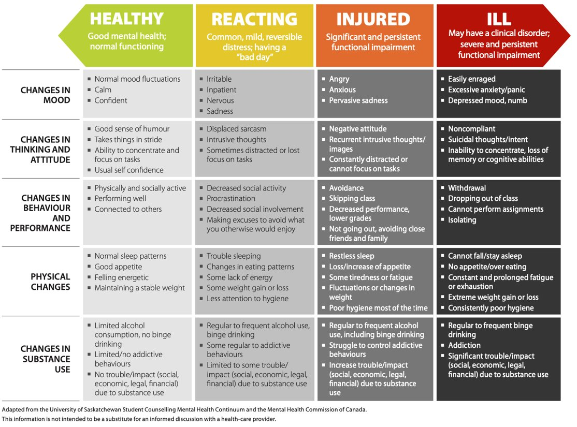
The Mental Health Continuum

Slide 16
Supporting Your Mental Health

Slide 17

The Mental Health Continuum
Physical Movement
Physical activity is what tells your brain you have successfully survived the threat and now your body is a safe place to live. Physical activity is the single most efficient strategy for completing the stress response cycle.

Slide 18

Rest
Ceasing work or movement to relax, refresh oneself, or recover strength.
Boosts your immune system
Improves concentration, memory, and productivity
Restores and energizes
Stimulates creativity
Helps maintain mental and emotionally fitness

Slide 19

Meals
When you eat highly palatable and calorie-dense food, your body releases certain hormones that suppress stress signals and emotions. This is one of the answers to “why does eating relieve stress”.
This is why foods with refined carbs and fats are often called “comfort” foods.

Slide 20

Breathing
Deep, slow breath down regulate the stress response especially when the exhalation is low and long and goes all the way to the end of the breath so that your belly contracts.

Slide 21

Creative Expression and Hobbies
The arts, including painting, sculpting, music, theater, storytelling etc. encourage an outlet for emotions.
Hobbies such as journaling, collecting, fishing, crochet, baking, calligraphy, baking, home improvement, karaoke help minimize any room for self-pity, anger and fear.
Essentially, you are getting out of your own way and taking the focus off your internal circumstances, leaning on external outlets.

Slide 22

Social Interaction
Social interaction is the first external sign that the world is a safe place.
When you share mutual trust and connection with someone, you co-create energy that renews both people. This can be true with family, friends, peers or even pets.
Connection is just as necessary as food and water; humans are built for connection.

Slide 23

Cathartic Crying
Crying helps our bodies release negative feelings and re-energize our minds, reducing the level of cortisol (a hormone that’s responsible for stress, anger, and anxiety). A reduction in this hormone can lead to feelings of relaxation and calmness.
Having a big old cry may mean you have not changed the situation that caused the stress, but you have completed the cycle.

Slide 24
Recap and Touching Base
Summary of Mental Health Awareness
Feel Free To Come To Us To Check In
Any Questions

Slide 25
THANK YOU!
TeriLynne Kisto
Kisto_hrconsulting@outlook.com
Jake Aguas
jake@morris-interactive.com

Slide 26
Reference
All other information has come from my research
Source: Aguas, J. (2024). A Study on Mental Wellness of Adult Working Members

