Slide 2
Succession Planning
Presented by:
Karla S. Bylund, MS-IOP, SHRM-SCP
CEO
www.soaringbirdsolutions.com

Slide 3
Introduction
Planning for expected departures and unexpected absences of individuals who hold key roles in an organization is a task that we as employers often avoid or engage in only in an informal manner.
Without concentrated effort on this activity, known as succession planning, a business that has been successful can quickly fail if it loses one or more of its leaders.

Slide 4
What is Succession Planning?
The process of identifying the critical positions within your organization
Developing action plans for individuals to assume those positions.
It is a structured process that requires strategic alignment with the overall business strategy.

Slide 5
The Importance of a Plan
What is Next?
Who is Next?
Notes:
Ask the leaders in any group “What’s next?” for their organization and you will likely get a litany of responses detailing business strategies, projections, and forecasts. Planning for success and the future of a business is an ongoing process and is always a top priority. Ask the same group of leaders “Who’s next?” and the responses will likely be less forthcoming and enthusiastic.
Succession planning seems to stay on the back burner for many organizations, viewed mainly as a task to be thought of, discussed, and put back. However, “who’s next” is as important a question to answer as “what’s next” for the long-term success of your company. Creating a succession process is crucial to ensuring longevity and a well-developed talent pipeline.

Slide 6
The Importance of a Plan
Avoid extended and costly vacancies in key positions
Ensure the stability of business operations.
Provide meaningful developmental opportunities for the employees
Tribal Member Development
Help develop a diverse workforce
Notes:
An effective succession plan can help an employer:
Avoid extended and costly vacancies in key positions and ensure the stability of business operations.
Provide meaningful developmental opportunities for the employees
Tribal Member Development
Help develop a diverse workforce by enabling decision-makers to look at the future makeup of the organization as a whole.

Slide 7
What You Need (at a minimum) to Develop a Succession Plan
Vision and mission for the organization
Job descriptions
Standard Operating Procedures for each key position

Slide 8
Steps Involved in Succession Planning
Identify
Select
Determine
Create
Plan
Execute and Update
Identify Diversity.
Identify Key Positions.
Select Potential Successors.
Determine Readiness of Potential Successors.
Create a Development Plan.
Plan for key positions that do not have potential successors.
Execute the plan and update it regularly.
Notes:
See next slides

Slide 9
Identify Diversity Issues
Is your organization lacking in diversity?
When positioning employees for succession, avoid “like-me” approaches.
Use assessment tools to reduce biased selection practices.
Train leadership on recognizing hidden biases.

Slide 10
Identify Key Positions
Imagine if one of your employees hits the lottery and never shows back up to work.
Which positions could be easily filled with internal or external talent?
Which ones would cripple the organization if no one was in the position?
Which positions do not even have a back up plan?

Slide 11
CEO
Admin Assistant
Program A Director
Program B Director
Finance Director
HR Director
Program Coordinator
Assistant Finance Director
HR Assistant
Program Coordinator
Finance Specialists
Clerk
Notes:
Maybe your organization looks like this

Slide 12
CEO
Admin Assistant
Program A Director
Program B Director
Finance Director
HR Director
Program Coordinator
Deputy Program Director
Assistant Finance Director
HR Assistant
Program Coordinator
Finance Specialists
Clerk
Notes:
Most likely these are your key positions
You have a potential backup plan for the Finance Director and Program Director B

Slide 13
Priority
TOP PRIORITY
Second Priority
CEO
Program Director A
HR Director
Finance Director
Program Director B

Slide 14
Select High-Potential Employees
Conduct a job analysis of key positions:
Duties
Knowledge, skills & abilities
Update the job descriptions.
Identify necessary competencies needed for the position.
Select

Slide 15
Select High-Potential Employees
Ask the incumbents in key positions to identify employees
Develop a profile of candidates from the current employee base
Selection is based on available candidates.
Some available candidates will be ready, whereas some will not meet the demands of critical positions.
Select
Notes:
Ask the incumbents in key positions to identify employees who they think are available for succession into their positions.
Develop a profile of candidates from the current employee base:
History of performance reviews
Accomplishments
Relevant experience, education and credentials.
Selection is based on available candidates.
Some available candidates will be ready, whereas some will not meet the demands of critical positions.

Slide 16
Determine Readiness In Potential Successors
Use assessment tools to determine skill deficiencies that may presently exist.
A common method used to chart the available candidates and their readiness level to succeed is a nine-box grid.
The nine-box grid helps management visualize the available successors along with the strengths/weaknesses in the plan.
Determine
Notes:
Use assessment tools to determine skill deficiencies that may presently exist.
360-degree surveys that include feedback from peers, direct reports, line management and other relevant sources, such as clients, customers, vendors and/or suppliers.
Leadership evaluations by an independent third-party consultant.
Existing performance review information and feedback from management.
A common method used to chart the available candidates and their readiness level to succeed is a nine-box grid.
The nine-box grid helps management visualize the available successors along with the strengths/weaknesses in the plan.

Slide 17
9-Box Grid
 | ​Underperformance | ​Effective Performance | ​Outstanding Performance
High Potential | Box 5: Seasoned professional capable of expanded role but may be experiencing problems that require coaching and mentoring. | Box 2: Does extremely well at current job with potential to do more. Give stretch assignments to help prepare for next level. | Box 1: Consistently performs well in a variety of assignments. A superstar employee, big-picture thinker, problem solver, self-motivated.
Medium Potential | Box 8: With coaching, could progress within level. Focus on stretch goals for this employee. | Box 6: May be considered for job enlargement at the same level, but may need coaching in several areas, including people management. | Box 3: Current role may still provide opportunity for growth/development; focused on tactical. Focus should be on helping improve strategic thinking.
​Low Potential | Box 9: May be a candidate for reassignment, reclassification to a lower level or to exit the organization. | Box 7: Effective performer but may have reached career potential. Try to coach employee on becoming more innovative, focused on lateral thinking. | Box 4: Experienced high performer but has reached limit of career potential. Still a valuable employee and can be encouraged to develop communication and delegation skills.
Notes:
When leadership performance and potential are assessed and plotted on the graph, individuals in the upper right quadrant (Box 1) are identified as high-potential candidates for succession, while those in the lower left quadrant (Box 9) may need to be reassigned or removed from the organization.
The boxes on the grid indicate where investment needs to be made to develop future leaders. Those people in box 1 should be ready for top leadership within 6 months to a year; those in boxes 2, 3, or 6 have a longer timeline but can be groomed for eventual movement to box 1.

Slide 18
Create a Development Plan
Create action plans for developing strengths and reducing weaknesses.
Leadership development programs
Skill-specific educational programs
Internal mentoring programs
Soft skills training
Create

Slide 19
Create An Employee Development Plan
Meet with the employee to discuss short- and long-term career goals
Identify skill gaps and where employees can improve to meet their goals
Create a list of resources to help the employees
Develop a detailed plan with action items and deadlines
Create

Slide 20
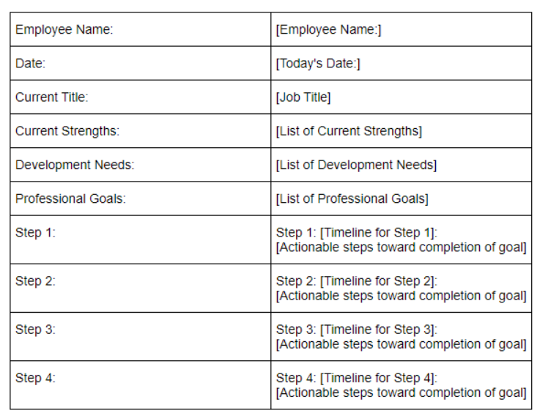
Sample Development Plan
Create

Slide 21
Plan for Key Positions Without Successors
In some cases, no identifiable candidate will be available for succession.
These become emergency positions.
Plan

Slide 22
Plan for Key Positions Without Successors
Emergency positions are critical to identify and rectify because the organizational operations may be at risk in the event of a departure.
Consider external recruitment strategies
Consider internships
In the interim, consider cross-departmental succession opportunities.
Plan

Slide 23
Plan for Unexpected Departures
Successor
Have Step-in (or Interim positions) ready.
Interim
Key Position
Plan

Slide 24
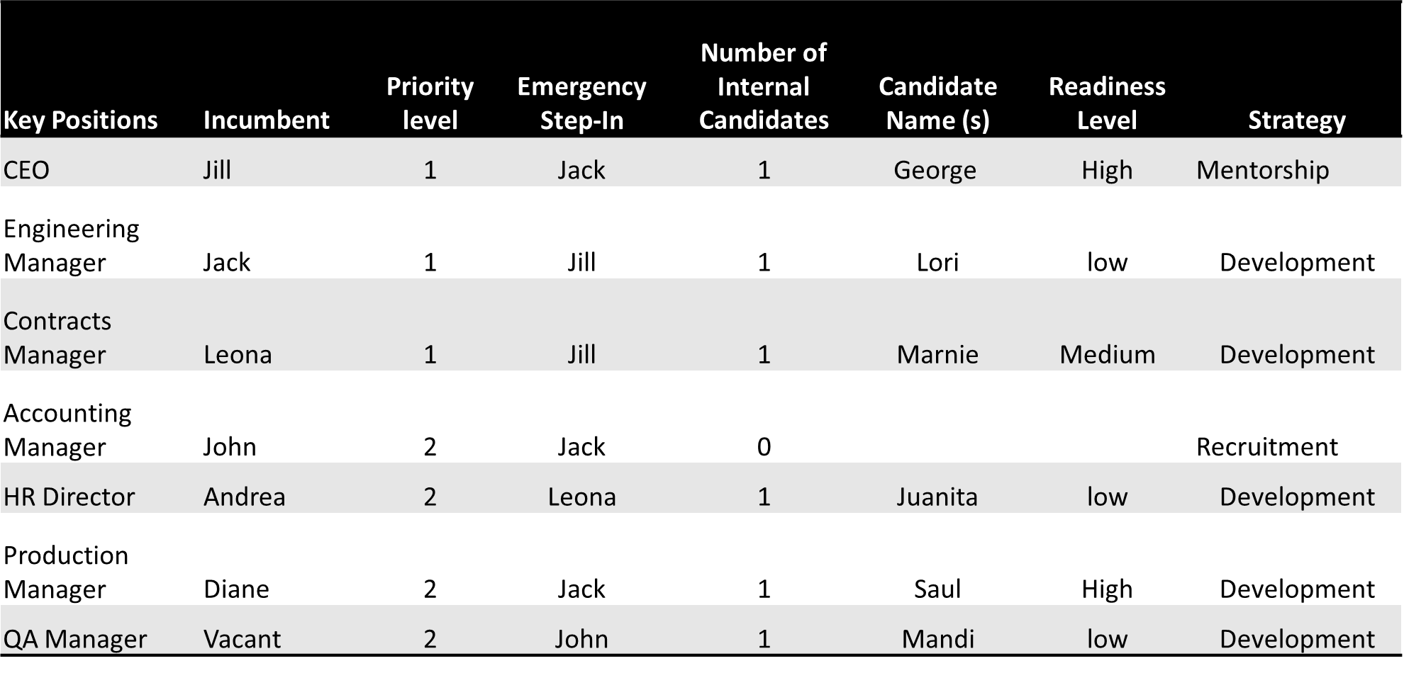
Example Planning Worksheet

Slide 25
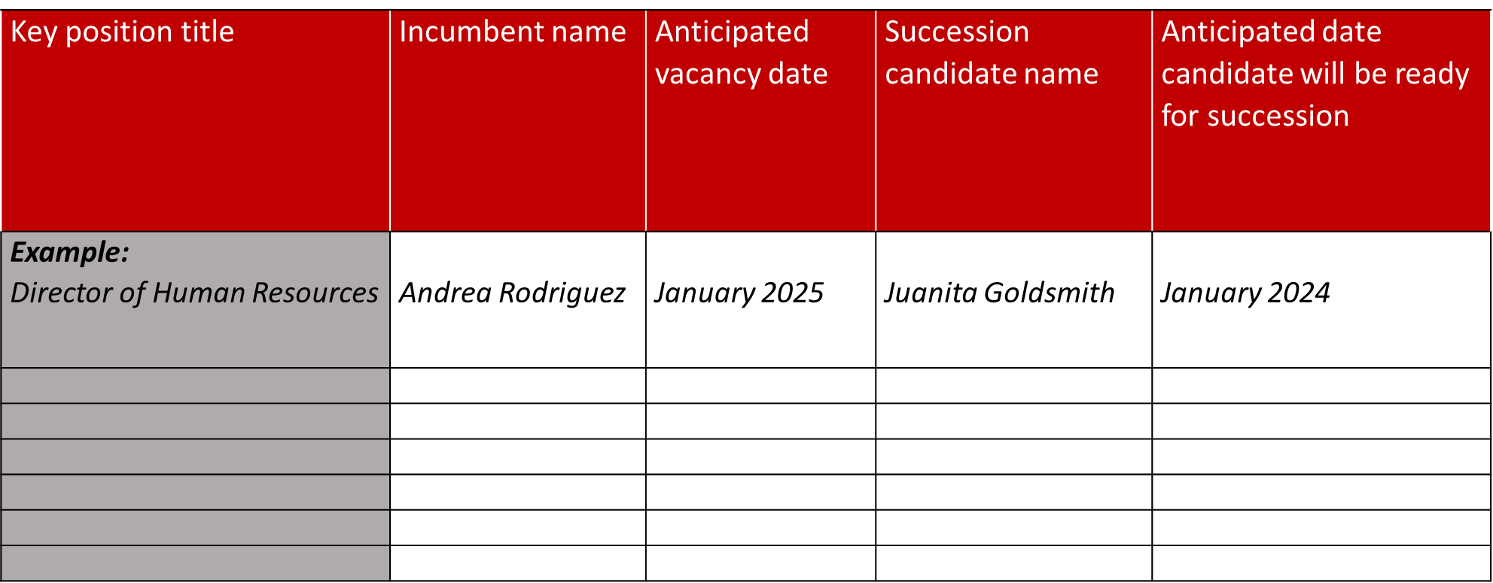
Example Readiness Level Chart
Notes:
The readiness chart helps employers to identify key positions, expected vacancy dates and potential candidates for succession.

Slide 26
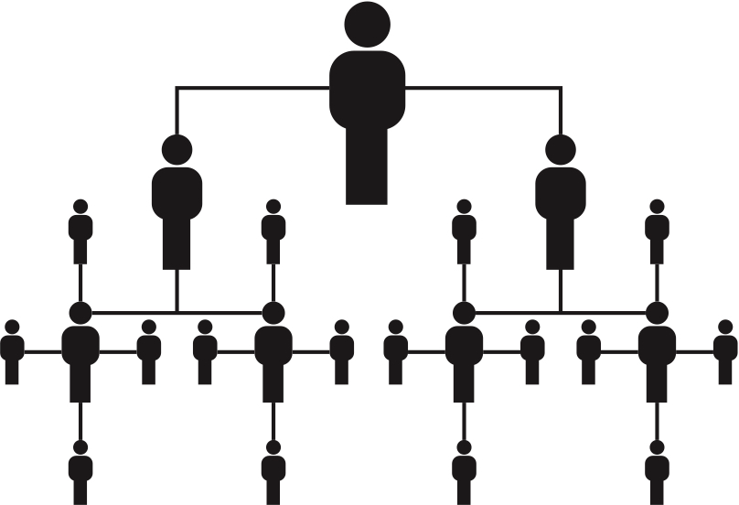
Execute the Plan
Execute Long and short-term goals
Measure the success of the plan
Keep high potentials engaged with development and support
Update the Plan
Revisit the plan every 2 to 3 years
Is development still on track?
Are the key positions still the same?
Execute & Update

Slide 27
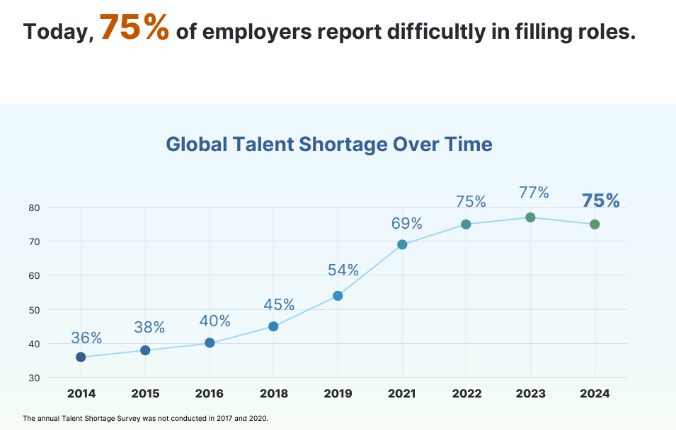
Manpower Group Survey
Wrap-Up

Slide 28
The Why
Preparation for the Future
Business Continuity
Increase Engagement
Increase Retention
Preserves Institutional Knowledge
Preserves Organizational Culture
Wrap-Up

Slide 29
Who’s Next????
Wrap-Up

Slide 30
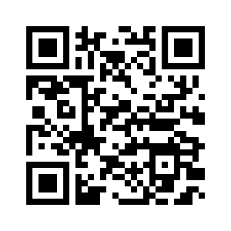
Thank You!
Karla S. Bylund, MS-IOP, SHRM-SCP
Office: 725-251-9909
kbylund@soaringbirdsolutions.com

