Slide 1


28th Annual Conference
September 23-25, 2024
Durant, Oklahoma

Slide 2



Designing Your Organizational Development Blueprint:
Strategies for Success
Presented by:
The Pascua Yaqui Tribe of Arizona
Organizational Development Team

Slide 3
Introduction
This session unravels the Pascua Yaqui Tribe Organizational Development Department's journey of halving its budget while enhancing organizational capabilities and becoming a strategic partner in growth. Through innovative strategies, this presentation offers insights into developing impactful OD programs that scale effectively without increased costs.

Slide 4

Objectives
Showcase the strategic blueprint of the Organizational Development Department’s commitment to reducing wastage by more than 50% while increasing the department’s impact throughout the organization.
Highlight the creation and impact of leadership, succession planning, mentorship, and cross-training programs.
Demonstrate the department's role in strategic planning, organizational design, policy development, and process improvement.

Slide 5
What You Can Expect
Demonstration of implemented strategies for significant cost reduction and resource optimization.
Frameworks for developing leadership and ensuring continuity through succession planning.
The benefits of mentorship and cross-training for skill development and employee engagement.
The department's pivotal role in strategic planning, enhancing organizational agility, and crafting inclusive policies.

Slide 6
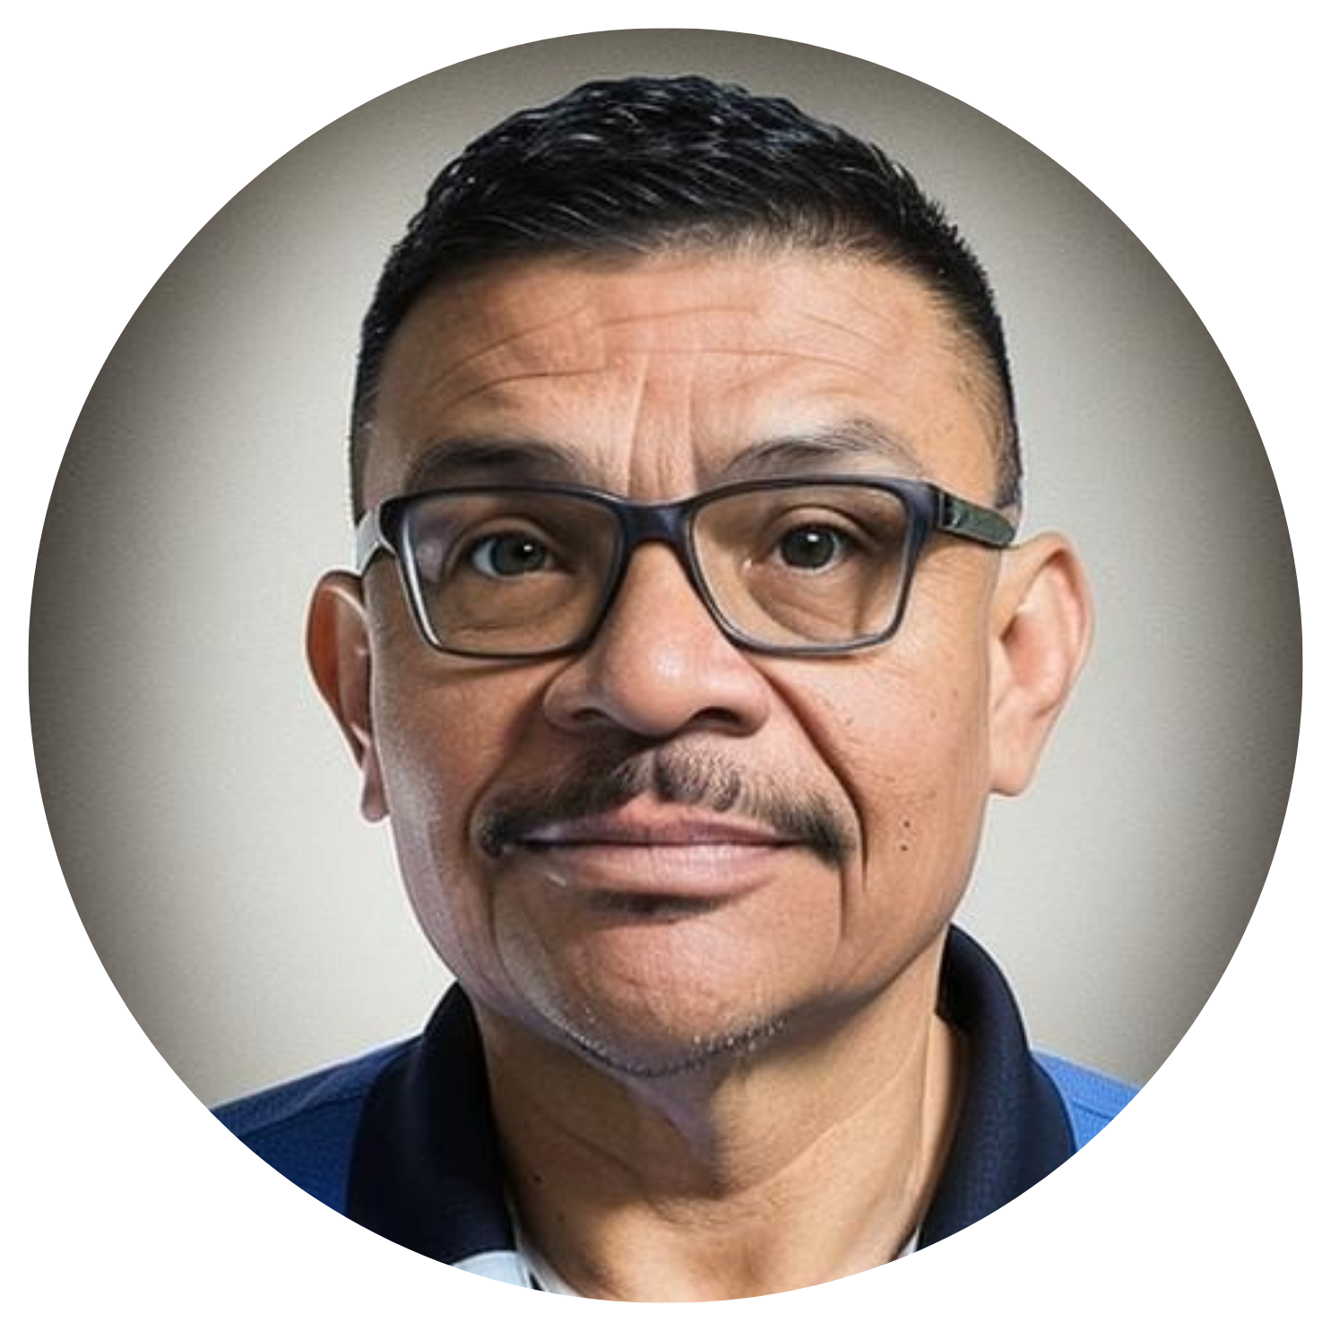
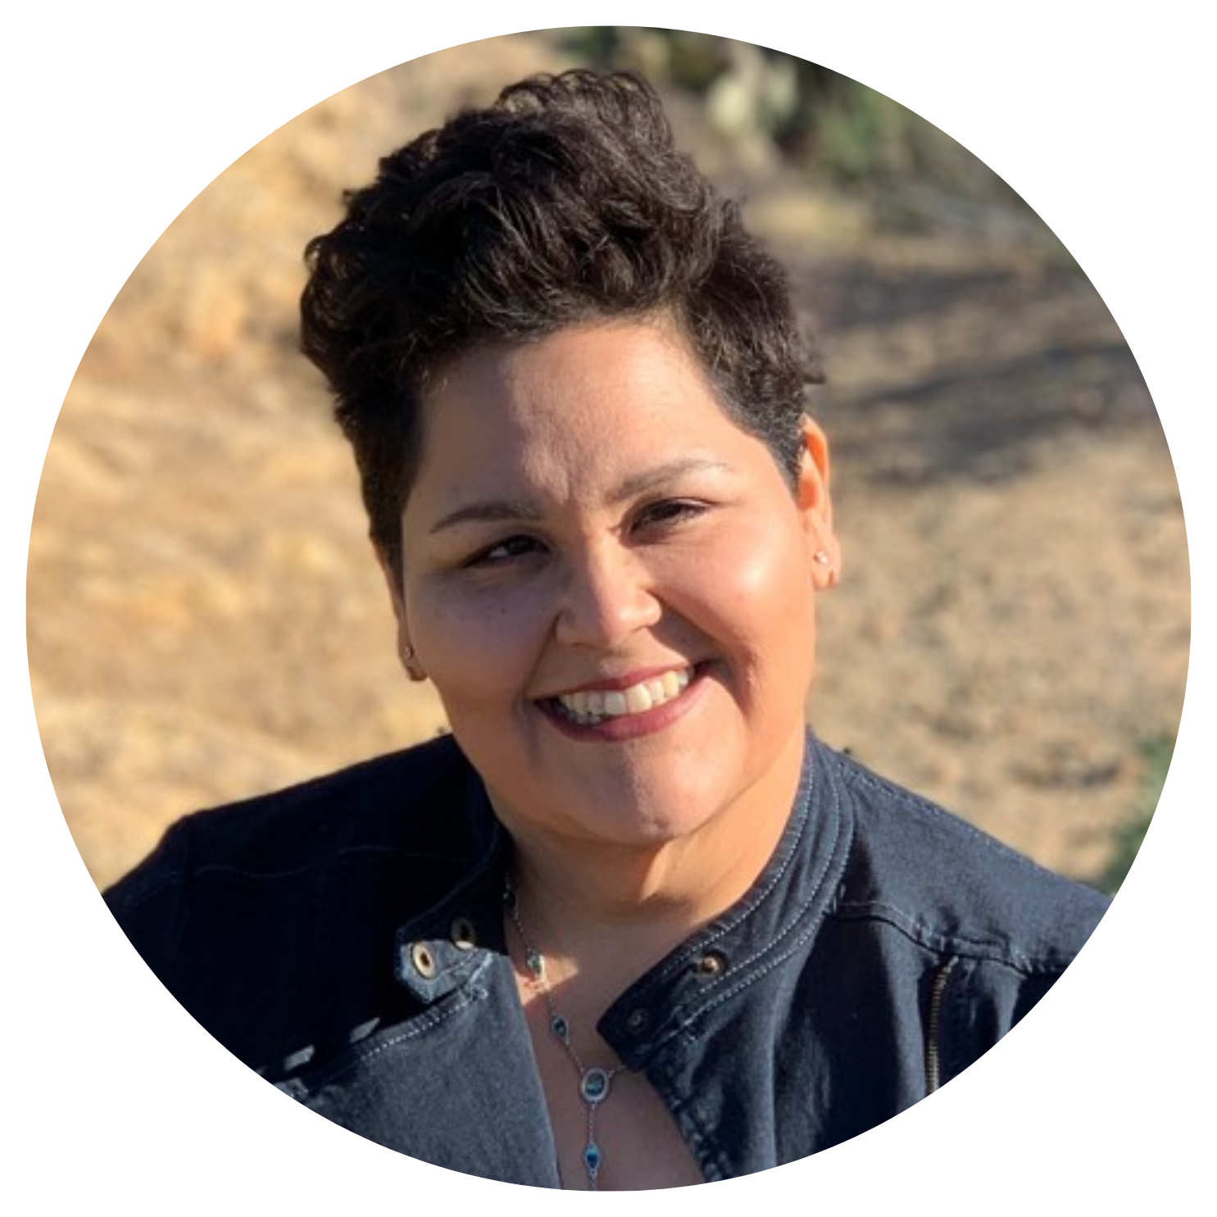
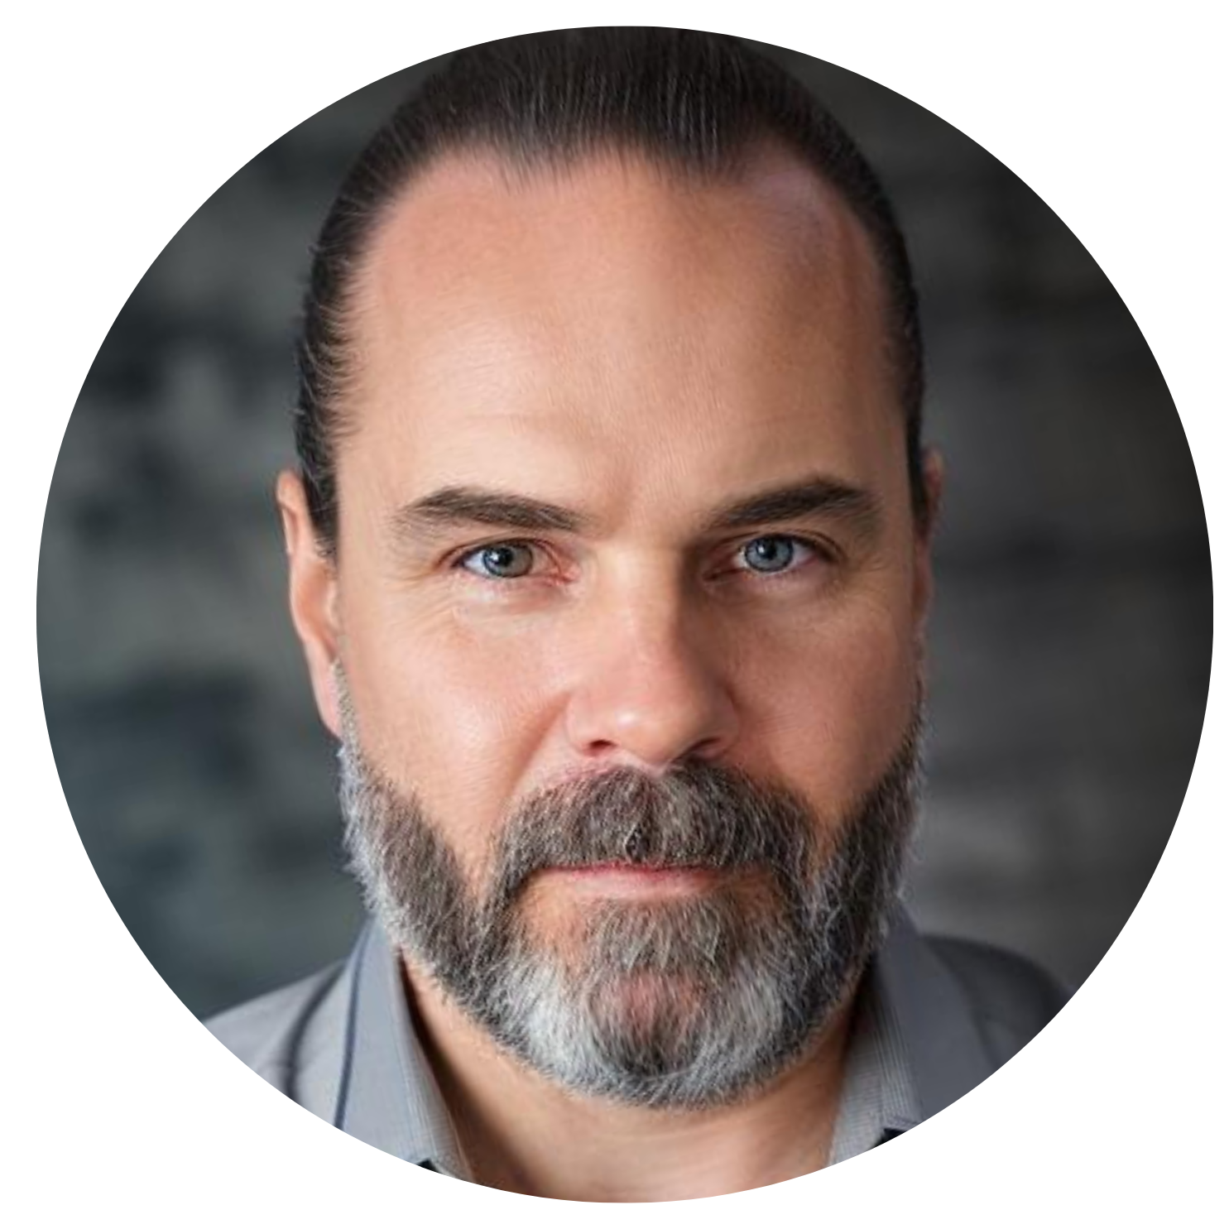
Meet Our Team
Pete C. Rodriguez
Raquel Aviles
Kenneth Pearson
Organizational Development
Learning Specialist
Executive Director
of Human Resources
Organizational Development
Manager

Slide 7
Overview of the
Pascua Yaqui Tribe of Arizona
The Pascua Yaqui Tribe, recognized federally in 1978, resides primarily in southern Arizona and parts of Sonora, Mexico. The tribe manages various economic enterprises and programs focused on health, education, social services, and cultural preservation.

Slide 8
WHAT IS THE FUNCTION OF ORGANIZATIONAL DEVELOPMENT?

Slide 9
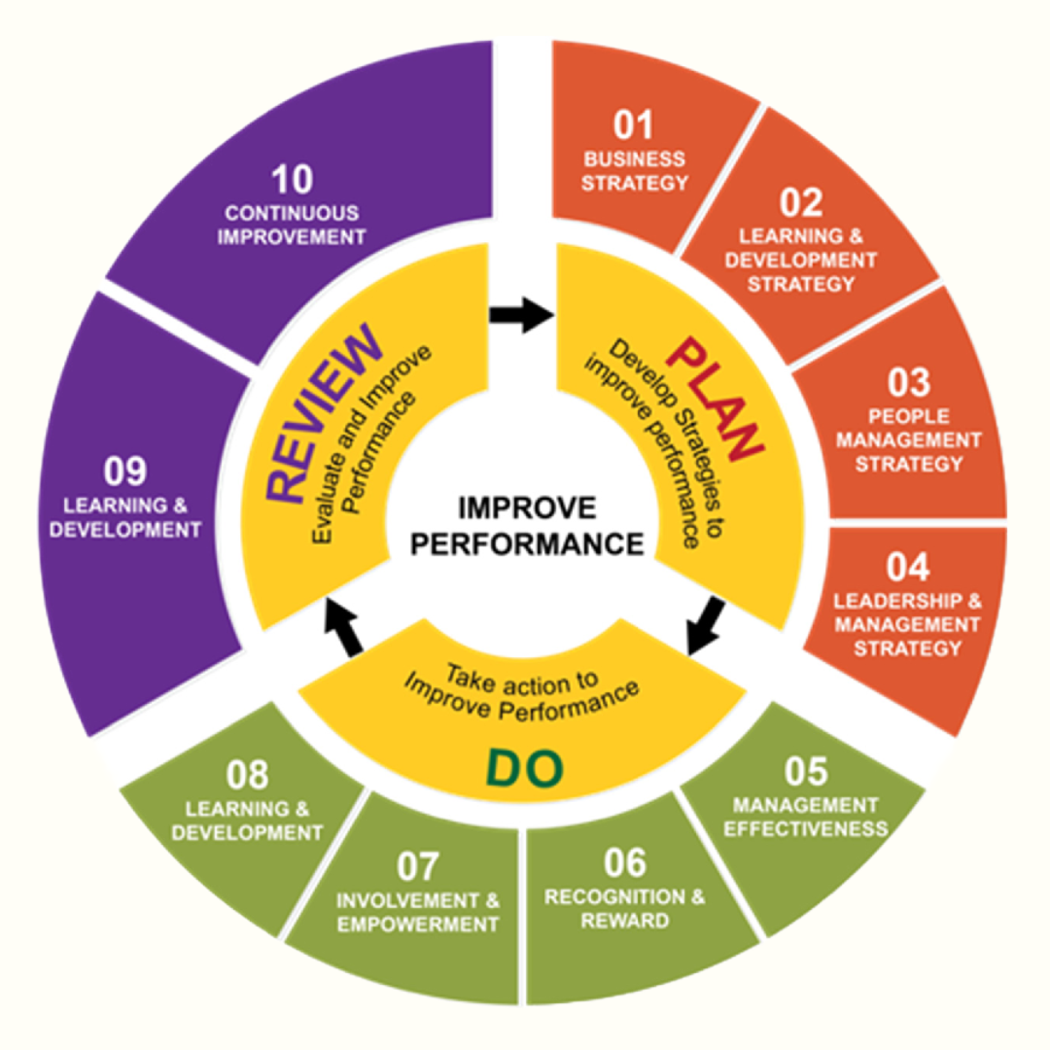

Slide 10
Agenda
Strategic Blueprint for Cost Reduction & Impact Enhancement
Development & Implementation of Core Programs
Organizational Design & Strategic Planning

Slide 11
STRATEGIC BLUEPRINT FOR COST REDUCTION & IMPACT ENHANCEMENT

Slide 12
Challenges 2021-2022
Transitioning from COVID
Considered only a Training Department
Once Monthly Onboarding – Virtual
Severely Underutilized & Expensive External Partnerships
Lacked Foundational Elements
Lacked Formal Training Direction
Lacked Appropriate Delegation of Staff Tasks
No Strategic Plan

Slide 13
2021-2022 Budgeted Expenses
(*Does Not Include Salaries)
$177,000
Notes:
Includes:
$95000 – LMS
$32000 – Supplemental LMS
$27,000 – HRIS LMS
$15000 – Leadership Consultant
$8000 – OD Consultant
$5000 – OD Career Development

Slide 14
2021-2022 Strategic Decisions
Implement a Three-Year Plan to Eliminate Wastage by 50%
Increase OD Footprint and Impact within the Organization
Solidify Foundational Elements
Develop Tailored Programs Centered Around the Needs of the Pascua Yaqui Tribe Government Workforce
Create an Annual Calendar of Events
Develop a Five-Year OD Strategic Plan

Slide 15
Timeline
Late 2021
Conduct an in-depth Program Evaluation and SWOT/C Analysis to identify strengths, areas of waste, and opportunities for growth
2022
Strengthen Foundational Elements:
2023
Maintain Foundational Elements:
2024
Officially Launch the Leadership Development Program,
2025 & Beyond
Expand Employee Wellness Initiatives,
Day 1 New Hire Orientation,
Annual Employee Handbook Review,
Expand Program Policies,
Increase LMS Utilization,
Increase Training Attendance
Revise Performance Evaluation Process,
Develop & Pilot a Leadership Development Program,
Develop & Pilot a Mentorship & Cross-Training Program,
Develop & Pilot a Succession Planning Program,
Expand Program Policies,
Increase Content Creation
Mentorship & Cross-Training Program, Succession Planning Program,
Introduce Employee Wellness Initiatives,
Increase Departmental Organizational Structure & Design Consultations,
Revise the Tribal Pathways Program
Increase Departmental Strategic Planning Consultations,
Implement Leadership Programs for Youth,
Develop a Job Shadowing Program,
Develop a PYT Credentialing Program,
Develop an Upskilling Program tied to Performance Evaluations

Slide 16
Implementation Strategies
2022: Increase LMS Utilization; Day 1 NHO; Annual Employee Handbook Review; Strengthen Policy & Procedures; Calendar of Training Events (up to 150 annually)
2023: Develop Leadership Program; Mentorship Program; Succession Planning Program; Increase Video Content Creation
2024: Implement Leadership Program; Mentorship Program; Succession Planning Program

Slide 17
Measures to Achieve Cost Reduction
Reduced LMS Contract from $95,000 annually to $35,000 annually by September 2024
Remove LMS Extension from HRIS Platform, Eliminating $27,000 Annually in Unutilized Platform
Reduced Supplemental LMS from $32,000 annually to $4,600 annually by June 2022, eventually to $0 by June 2025
Reduced Leadership Training Contractor from $15,000 annually to $0 by June 2023

Slide 18
Measures to Increase Impact
Reallocated funding to partner with an established local leadership program in Tucson
Increased OD Professional Development Initiatives
Developed a Feedback System for Continuous Improvement
Ensure OD Staff Working Primarily within their Strengths

Slide 19
Results 2024-2025
Established Foundational Elements
Established PYT Specific Leadership Development Program
Established Mentorship & Cross-Training Program
Established Succession Planning Program
Established Monthly Training Programs & Video Content Specific to PYT Government Employee Needs
Established OD as Organizational Structure & Design Consultants
Established OD as Strategic Planning & Program Evaluation Consultants

Slide 20
2024-2025 Budgeted Expenses
(*Does Not Include Salaries)
$65,000
Notes:
Includes:
$35000 – LMS
$5000 – Supplemental LMS
$10000 – External Leadership Partnership
$7000 – OD Career Development
$3000 – Content Creation Platforms & Tools
$3000 – Other Training Expenses

Slide 21
DEVELOPMENT & IMPLEMENTATION OF CORE PROGRAMS

Slide 22
Implementation of Foundational Elements
Year 1: 2021-2022
  Establish Day 1: New Hire Orientation
  Establish Annual Employee Handbook Policy Review
  Refined Annual Performance Evaluation Cycle

Slide 23
Development of Core Programs
Year 2: 2022-2023
  Revise Policy & Procedure
  Develop Foundation for the Leadership Program
  Develop Foundation for the Mentorship Program
  Develop Foundation for the Succession Planning Program

Slide 24
Executive Leadership Development Program
2023-2024: 14 Leaders from 4 Departments Completed the Pilot Program
Seven (7) Month Program
  Covers 36 Topics through Videos, Textbook, and Tests
  In-Person Exercises & Networking Groups
  Executive Leadership Panel Discussions

Slide 25
Feedback:
“Through this program, my goal was to assess my strengths and develop my leadership style. I can say with confidence that this program was all of that, and more! The Executive Leadership Development Program has been a remarkable outlet for advice, support, and peer relationship building.”
- HRIS MANAGER

Slide 26
Feedback:
“Having participated in the executive leadership development program the HR Organizational Development Team offers, I can attest to its immense value. It offers a comprehensive curriculum tailored to formal and informal leaders, covering essential topics and providing invaluable networking opportunities. I highly recommend it to anyone looking to enhance their leadership skills and positively impact their organization and community.”
- FIRE CHIEF

Slide 27
Mentorship & Cross-Training Program
Purpose & Goals
  Empowerment & Development
  Alignment
Program Structure
  Duration
  Participation
  Support
Notes:
Purpose & Goals
Empowerment and Development: Enhance skills and foster a skilled, motivated workforce aligned with organizational objectives.
Alignment: Integrates with Leadership Development, Succession Planning, and Training & Development.
Program Structure
Duration: 6-7 months, with bi-monthly meetings.
Participation: Voluntary for all levels, matching based on needs and expertise.
Support: Backed by Human Resources and Organizational Development.

Slide 28
Mentorship & Cross-Training Program
Defining Roles & Responsibilities
Developing Policies & Communicating Benefits
Establishing Ethical Foundations
Notes:
Roles and Responsibilities
Mentors: Act as teachers, advisors, and role models.
Mentees: Focus on learning, leadership, and growth.
Policies & Benefits
Key Policies: Includes eligibility, training resources, evaluation, confidentiality, and exit strategies.
Benefits: Enhances engagement, retention, knowledge transfer, and talent development.
Ethical Foundations
Trust and Ethics: Emphasizes confidentiality, ethical conduct, and cultural sensitivity.

Slide 29
Succession Planning Program
Identify Key Positions within each Department
Develop Core Competencies based on Job Description and Incumbent Feedback
Readiness Criteria and Score Created for Potential Successors
Director | OD Department Assess the Importance of the Position and Develop an Importance Score

Slide 30
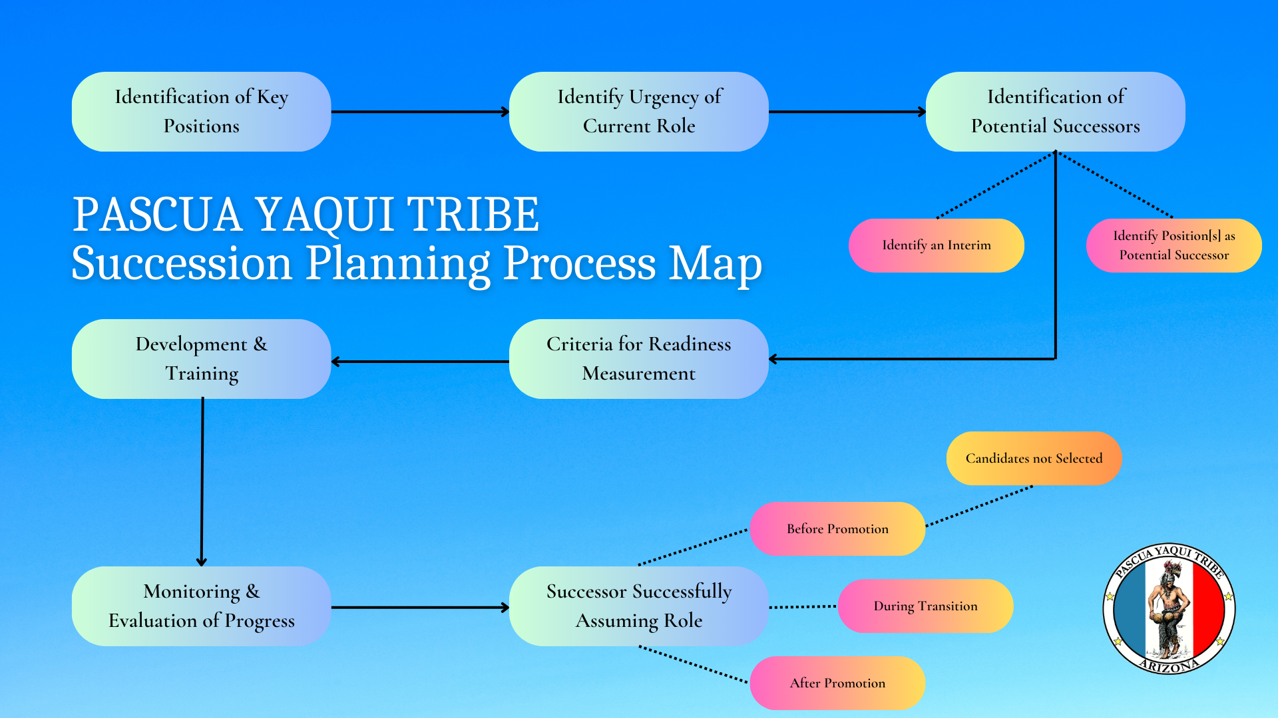
Succession Planning Program

Slide 31
Goal & Purpose of the Programs
Growth & Development Opportunities for Employees
Uniform Messaging & Development of Leaders
Foster Long-Term Sustainability
Preserve Institutional & Cultural Knowledge

Slide 32
ORGANIZATIONAL DESIGN & STRATEGIC PLANNING

Slide 33
Organizational Design
Assist in Departmental & Program Development of their Internal Policies & Procedures
Assess Workflow Analysis & Program Evaluation
Assist in the Development of Team Charters

Slide 34
Strategic Planning
Actualize the Vision of Tribal Council Initiatives
Assist in Organizing & Supporting Long-Term Initiatives
Provide Project Management Training & Assistance
Develop Phases & an Accountability Structure

Slide 35
Other Key Internal OD Policies & Programs Developed or Revised
Tribal Pathways Program
Educational Leave Policy
Employee Career Development Planning
Volunteer & Externship Policy
Internship Policy
Employee Wellness Program & Incentives

Slide 36
KEY TAKEAWAYS

Slide 37
CREATING YOUR OD BLUEPRINT
UNDERSTAND THE STRENGTHS OF YOUR TEAM!
Conduct a SWOT/C Analysis
Define the Long-Term Vision & Create a Strategic Plan
Focus on the Foundational Elements: Define Your Short- and Long-Term “Must Haves”
Shift from a “Training Only” Mindset to a Comprehensive OD Approach
Develop Employee Programs that Encourage Long-Term Sustainability of the Organization

Slide 38
QUESTIONS?

Slide 39
THANK YOU!
Raquel Aviles
Raquel.Aviles@pascuayaqui-nsn.gov
Pete C. Rodriguez
Pete.C.Rodriguez@pascuayaqui-nsn.gov
Kenneth Pearson
Kenneth.Pearson@pascuayaqui-nsn.gov
www.pascuayaqui-nsn.gov

