Slide 2
FUELING ENGAGEMENT
UNLEASHING THE POWER OF MISSIONS & VALUES
RUTH TIDMORE MBA, SPHR, SHRM-SCP, THRP

Slide 3
AGENDA
RAISE YOUR HAND
IGNITE YOUR TEAM
CAN’T START A FIRE
HOW TO IGNITE YOUR TEAM
WHAT WE LEARNED

Slide 4
RAISE YOUR HAND

Slide 5
TURN TO YOUR NEIGHBOR

Slide 6
TURN TO YOUR NEIGHBOR

Slide 7
IGNITE YOUR TEAM

Slide 8
SENSE OF PURPOSE
SHARED VISION
GET EVERYONE INVOLVED
GUIDE TO MAKE DECISIONS
CONNECTION WITH THE CUSTOMER

Slide 10
CAN’T START A FIRE

Slide 11
HOW TO IGNITE YOUR TEAM

Slide 12
ASSEMBLE YOUR TEAM
DISCUSS YOUR PURPOSE
DEFINE THE “WHAT” & “WHY”
CRAFT THE MISSION STATEMENT
DEVELOP YOUR CORE VALUES
GATHER FEEDBACK & REFINE
FINALIZE AND COMMUNICATE

Slide 13
ABUNDANCE
ACCONTABLE
AMBITION
COMMITTED
COMMUNICATION
COMPASSON
CONSTENCY
CREATIVE
DEPENDABILITY
DETERMINATION
DISCIPLINE
EXCELLENCE
FAIR
FAMILY
FOCUS
FUN
GIVING
GRATITUDE
GROWTH
HONESTY
IMAGINATIVE
INNOVATION
INSIGHTFUL
LEADERSHIP
PATIENCE
QUALITY
QUALITY FOCUSED
RESPECT
SELF-RESPECT
SUPPORT
THANKFUL
TRANSPARENT
TRUSTWORTHY
UNIQUENESS
VISIONARY
WISE
LIST OF VALUES

Slide 14
HOW WE LIT OUR EMPLOYEES

Slide 15
CREATE A UNIQUE AND GUEST FOCUSED ENTERTAINMENT ESCAPE.
CREATE A CHALLENGING, YET ENJOYABLE WORK ENVIRONMENT FOR OUR TEAM MEMBERS.
BE AN ACTIVE PARTNER THAT SUPPORTS THE BETTERMENT OF OUR COMMUNITY AND THE MUSCOGEE NATION.

Slide 16
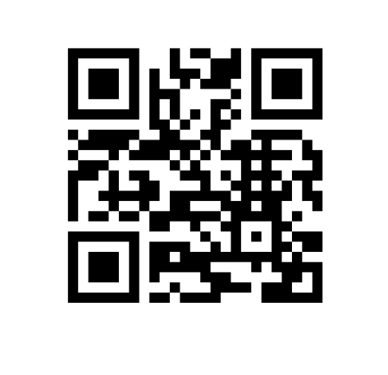

Slide 17
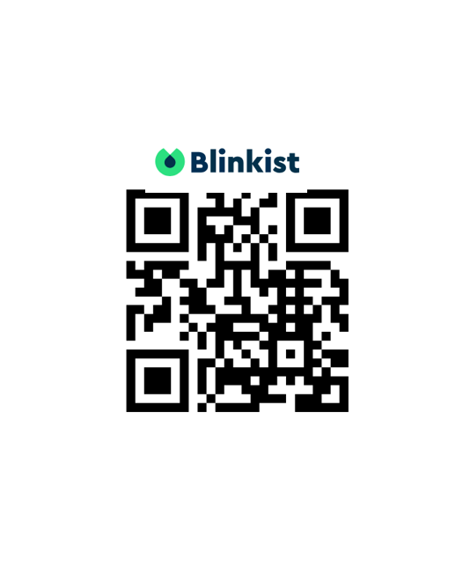
TRUST
RESPECT
ACCOUNTABILITY
CUSTOMER FOCUS
KNOWLEDGE

Slide 18
HOW WE FUELED ENGAGEMENT

Slide 19
MONTHLY TRAINING AT ALL PROPERTIES
FLAGSHIP PROPERTY:
FRONTLINE: BALLROOM TRAINING
(12 SESSIONS a week )
MANAGERS: CLASSROOM TRAINING
(15 SESSIONS a week )
TIMES VARY FROM 5AM-6PM
OTHER PROPERTIES:
FRONTLINE & MANAGERS: BOH TRAINING
(3-6 SESSIONS a day)
TIMES VARY FROM 5AM-3PM

Slide 20
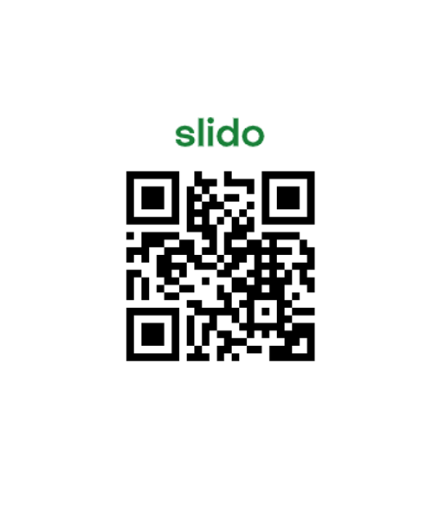

Slide 21
HOW WE LIVE OUR VALUES

Slide 23
WHAT WE LEARNED

Slide 24
QUESTIONS
MVTO

