Slide 1


28th Annual Conference
September 23-25, 2024
Durant, Oklahoma

Slide 2


Is the Whole Thing Broken or Are We Just Going Broke?
Managing Rx Costs and HR

Slide 3

AGENDA
How does this all work?
What should I worry about?
Where is my money going?
Are doctors part of the problem?
What can I do about it?
Is my solution working?
A NNAHRA Exclusive
  PBM Landscape
  Rx Hot Topics
  Rx Cost Drivers
  America’s PCP Shortage
  Employer Solutions
  Why Data Matters
  Life Insurance Opportunities

Slide 4
PBM Landscape

Slide 5
How PBMs Work -
Beyond the Basics
Rebates
Wholesaler Payment For Product – Uses AMP Pricing
Rebates Aggregators
Drug Manufacturer
PBMs Have The Highest ROA in the Pharma industry
Drugs
Formulary Placement
PBM
Negotiated Rates
Wholesaler
Drugs
Pharmacy Payment for Product – Uses WAC pricing
Such As:
AWP-16% + $1 Disp. Fee
Admin. Services
Share of Rebates; Per Brand Guarantees;
Admin Credit.
Pharmacy
Claims Payment
Drugs
Copayment/ Co-Insurance
Employer/
Insurers
Benefit Coverage
Member
Premium/Contributions
Financial Flow
Contract Relationship
Product Movement
5
Notes:
The reality of the PBM business is that its very complex from a contractual stand point, but its not very capital intensive business and is very profitable. So its not surprising there are currently are over 70 PBMs operating in the US, and that PBMs on average have the highest Return on Assets (around 12%) in the drug supply business. For a comparison – ROA for Retail pharmacy is only 3%.
Example of contractual complexity – different pricing methodologies used in transactions between Drug Manuf. and Wholesalers (Average Manufacturer Price (AMP)); Wholesaler and Pharmacy (Wholesaler Acquisition Cost (WAC)); PBM and Pharmacy (Average Wholesaler Price(AWP) or Maximum Allowable Cost (MAC)) and PBM and Employer (AWP/MAC); the last two transactions create a spread for a PBM since its “buys low from pharmacy and sells high to health plan”.
The end result – Complexity creates inefficiency at the consumers and payers expense. They are faced with lack of transparency and inconsistent pricing.
Pop quiz – can you spot another entity that is important to this diagram but is omitted? Rebates aggregators (OptumRx and Gateway health partners are examples of those).

Slide 6


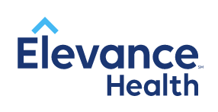




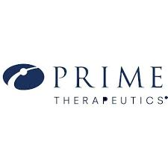



























Marketplace landscape
Vertically Integrated Large Players
And others
Mid-sized PBMs
Potential Disruptors
(Standalone PBMs)
And
many
more!
Potential Disruptors
(Rx Point Solutions)

Slide 7
Hot Topics

Slide 8
Healthcare costs
indexing at
2x CPI and
Rx costs are 5x
~30%
of healthcare spending may be considered waste
Specialty drugs
expected to increase 21-25%
YOY for the next 5 years, encroaching on 50% of total benefit spend.
By 2035, 16.2% of total healthcare spend is expected to be driven by RX
Pre-set animation
(just 1 click)
Today, ~42.5% of Americans are obese
By 2030, it’s expected to be 50%
11 FDA approved gene therapies Cost can be as high as $3-$4 Million
US healthcare system has a shortage of over 100,000 providers
75% of health insurers anticipate higher or significantly higher medical trend over the next 3 years
Inappropriate care or over-utilization of healthcare accounts for a quarter of total annual US healthcare spend ($765 billion)
Healthcare costs approaching 18% of GDP
Notes:
Our current environment is rife with waste which costs employers and their people untold billions every year. In many cases they simply aren’t aware of the problem, or how to avoid it. It’s difficult to do, and if you look at the investments in healthcare tech (Transition)

Slide 9

Why does
Pharmacy matter?
Frequency
Most utilized employee benefit
30%
Pharmacy represents 30% of healthcare spend
60%
Specialty represents approximately 60% of drug spend
Fastest
Fastest growing benefit in healthcare

Slide 10


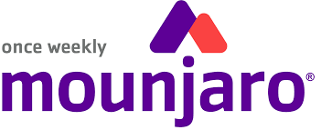








Pharmacy industry landscape
HUMIRA BIOSIMILARS
INSURGENCE OF GLP-1s
Entry of first biosimilar under pharmacy benefit - Humira
How will PBMs cover, prefer and price?
Will reference products be less expensive with rebate?
Will biosimilars receive rebates or manufacturer discount program?
Physician willingness to prescribe
Continued growth of utilization and cost for diabetes and weight loss
Extensive drug pipeline for weight loss drugs
Ensuring right utilization and lifestyle management programs are in place to prevent off label use and maximize results
POTENTIAL DISRUPTORS
RETAIL PHARMACY BURNOUT
Continued emergence of new PBMs and point solution vendors
Will anyone build a better mousetrap?
Employer fatigue of market over saturation
Reduction of pharmacy staffing at major chains leads to pharmacy staff burnout
Strikes at CVS and Walgreens
Bankruptcy of RiteAid and closures of other pharmacies
REGULATORY LANDSCAPE
EXTENSIVE DRUG PIPELINE
Increasing anti-PBM laws focused on:
  Elimination of spread pricing
  Prevention of steerage to one pharmacy over another
  J&J lawsuit : Fiduciary responsibilities
Exploding drug pipeline for 2023-2025
Includes gene therapies and multiple specialty drugs, including new drug for Alzheimer's
Non-specialty continued focus on weight loss drugs, RSV vaccines and many more

Slide 11
Cost Drivers

Slide 12

Health Status Declining
11.2% of U.S. adults, had three or more of the following chronic health conditions: arthritis, asthma, chronic kidney disease (CKD), chronic obstructive pulmonary disease (COPD), cardiovascular diseases (CVDs), cancer (excluding non-melanoma skin), depression and diabetes.
A recent Blue Cross Blue Shield Association (BCBSA) survey found that millennials had substantially higher diagnoses for eight of the top 10 health conditions than Generation X, and based on their current health status, millennials are more likely to be less healthy when they’re older, compared to Gen Xers. ¹
It’s estimated that about 66% of the U.S. population takes one or more prescription drugs. Of those that who take prescription medications, the average number of medications taken is four. 50% are non-compliant with medications.
Notes:
chrome-extension://efaidnbmnnnibpcajpcglclefindmkaj/https://assets.americashealthrankings.org/app/uploads/ahr_2023annual_comprehensivereport_final2-web.pdf?utm_source=internal&utm_medium=website&utm_campaign=2023annual&utm_content=report
https://www.singlecare.com/blog/news/prescription-drug-statistics/

Slide 13
Gene Therapy
There are 7,000 “special conditions” that had no cure 15 years ago.
Gene therapy drugs inject viruses into the body to correct the genes causing the condition.
FDA has approved 18 gene/cell therapy drugs for 26 conditions.
The most expensive gene therapy drug is currently $2.1 million per patient.
There are 109 clinical trials underway.
By 2035 there will be over 1 million people taking one of these drugs.
Cost will be over $7 billion.

Slide 14
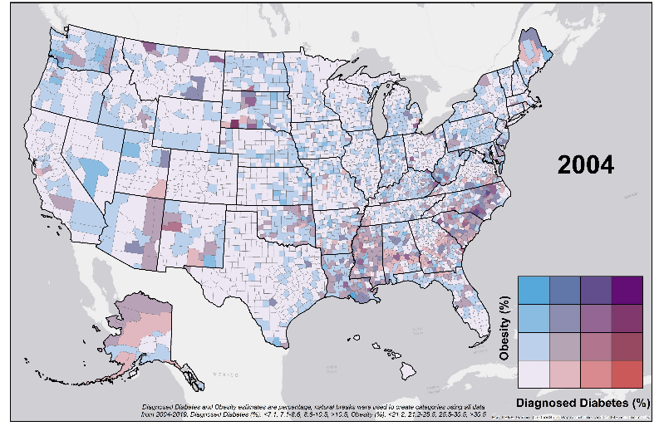
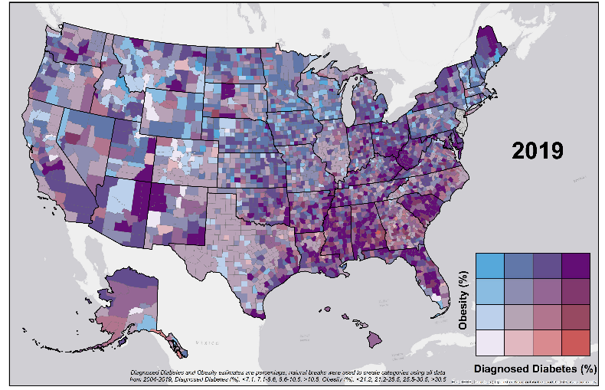
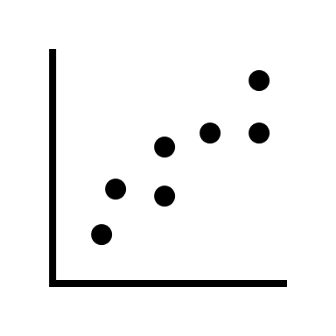
The State of Obesity
2004
The U.S. obesity prevalence in adults is now 42.5%
The percent of the population noted as morbidly obese as nearly doubled over the past 20 years
Three-quarters of every dollar spent on medical costs in the U.S. are used to treat and manage chronic conditions associated with obesity
Obesity is associated with numerous comorbidities including cancer, diabetes, high blood pressure, osteoarthritis and mental heath issues
Research shows obesity will continue to be a population-wide issue
2019
4
Notes:
From 1999 –2000 through 2017 – March 2020, U.S. obesity prevalence increased from 30.5% to 41.9%. During the same time, the prevalence of severe obesity increased from 4.7% to 9.2%.
2014 CDC established research and focus on this through the national diabetes prevention program
Obesity alone increases the risk of an individual actually contracting COVID-19 and dying from the disease. Studies reported the following:
Patients, who had both COVID-19 and obesity had a higher risk of death at days 21 and 45
Higher rates of obesity were reported in COVID-19 patients who were critically ill and required intubation
There are 236 other diseases (e.g. type 2 diabetes, high blood pressure and cholesterol, depression, etc.) impacted by obesity, 13 of which are cancers (breast, colon and rectum, esophageal, kidney, etc.). In addition, obesity can decrease an individual’s lifespan by eight years.
Obesity is associated with lower productivity at work; estimated to cost about $506 per obese worker per year
Obese individuals are up to 48% more likely than their normal weight counterparts to sustain injury and disability, including sprains, strains, lower extremity
fractures, and joint dislocations. Risk of injury is believed to be higher in the morbidly obese than obese
Sources:
https://www.cdc.gov/obesity/data/adult.html
Centers for Disease Control and Prevention. The Health Effects of Overweight and Obesity. 2015.

Slide 15

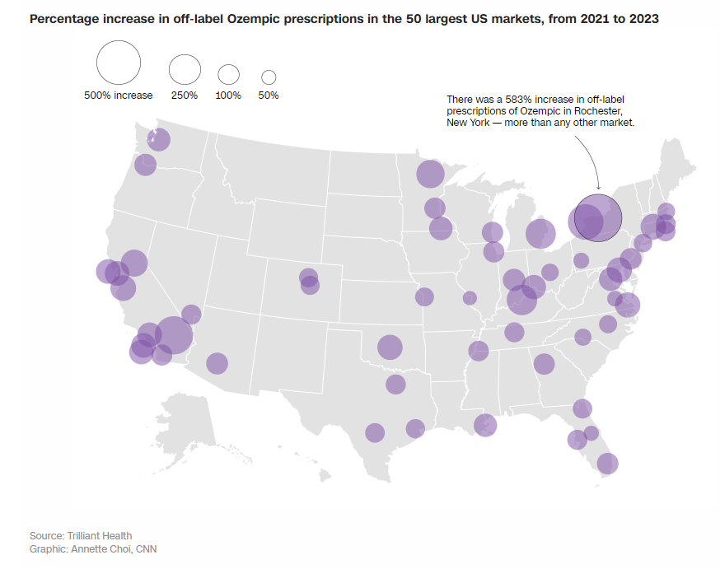


GLP-1’s
  What Is Happening In The Market Today?
Pharma Marketing
Prescriptions have gone up 40x in 5 years.
In 2020, 90% of scripts were for type 2 diabetics.
In 2023, 58% of scripts were for type 2 diabetics.
Retail price for Ozempic is $1,200 to $1,500 per month
$4.7 T
Market
How has GLP-1 usage changed?
Notes:
We wanted your presentation to focus on the perspective of clinical and provider concerns. How is the provider feeling today? Managing patient demands and the pressure of lack of providers crating shortened visits and RX as a means to manage a practice, etc. We are hopeful the stats and issues are what you feel comfortable talking to and will get you slides ASAP to adjust if need be.
Healthcare delivery from the PCP perspective
Shortage of Docs
Creates limited pcp visit time
Consolidation of practices/hospital system control
Drives higher specialist utilization
Job dissatisfaction at an all time high
(rx becomes quick fix)

Slide 16
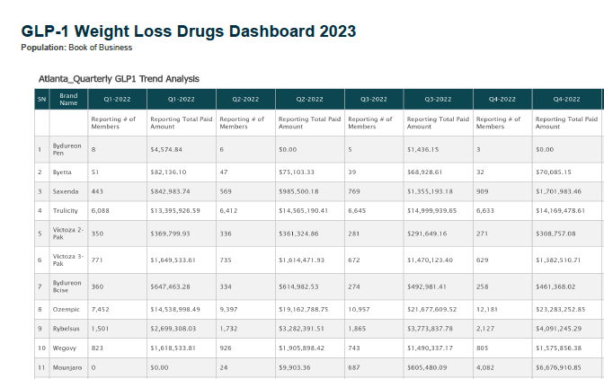
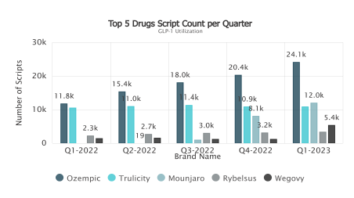


Watch GLP-1
Utilization
Trends

Slide 17
Best practices in managing GLP-1s
For Diabetes
e.g., Mounjaro, Ozempic
For Weight Loss
e.g., Saxenda, Wegovy
All plans must cover
Ensure you have utilization management (UM) on these products
    Can include step therapy, prior authorization (PA), and/or quantity limits​
Require PA to include documentation of diagnosis of diabetes
Confirm approvals are not granted indefinitely
Place 30-day supply
If you do not cover:
  Do not add coverage at this time​
  Eliminate pathway to cover through medical necessity to align with intent
If you do cover:
  Consider excluding
  Ensure you have PA ​
  Ask your PBM if they offer “enhanced” or more stringent PA criteria
  Require PA to include engagement in a lifestyle management program
  Limit to a 30-day supply
While medication is extremely important for managing diabetes and weight loss, a cornerstone of success for both is
long term lifestyle management
We can help you determine which PBM or third-party programs might be a good fit for you​
We’re here to help!

Slide 18
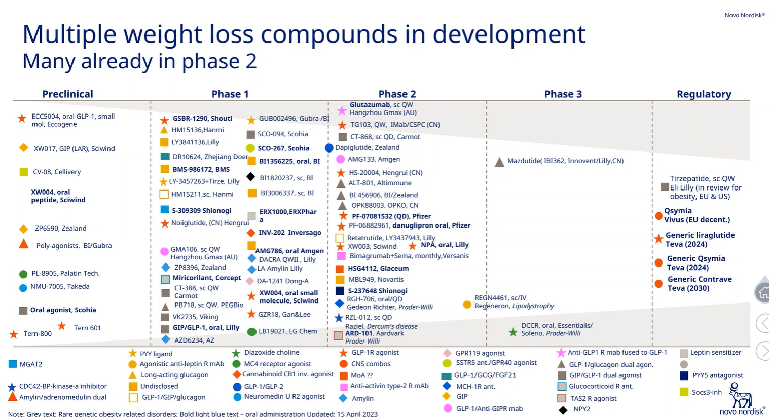
2023-2025 GLP 1 Pipeline

Slide 19
The Doctor’s Role

Slide 20
Doctor Shortages
Covid has created severe burn out
Currently only 27% of a PCP’s day is spent with patients.
The average time a PCP spends with patients is about 12-16 minutes.
Predicted shortage of PCP’s will be over 125K in the next 10 years.
20% of current PCP’s are over 65 and another 22% are between 55-64.

Slide 21
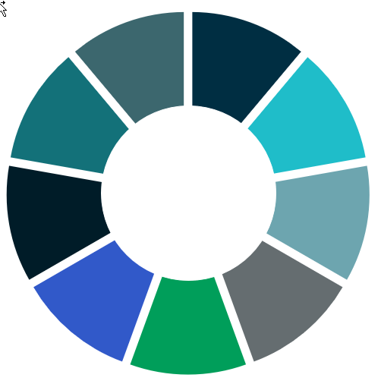









Factors Influencing Provider Prescribing
$4.7 T
Market
Pharma Marketing
Media Influence
Complacency
Data Overload
Patient Satisfaction
Clinical
Social
Behavioral
Financial
Operational
Organizational
70% Employed
Lack of Time
Interests Misaligned
Notes:
$4.7T Market – Massive financial inertia, like a 4.7 T ton locomotive. Everybody wants a piece, and those that have a piece want to keep it the way it is. Lobbying, politics, PE funding ($200B/year) – make money quickly
Pharma Marketing – the adds pop up everywhere, and are geared to create awareness and a feeling of “I need that to be happy, active, healthy”. It impacts consumers of health care, and it also impacts the physicians prescribing medication and treatments. There’s also direct marketing to physicians as well. Used to be gifts, fancy trips/dinners etc.

Slide 22







Sponsoring Primary Care to Get More Value
  Patients engaged in independent, high-quality primary care
  cost 5-10% less (total medical and pharmacy)
$4.7 T
Market
Pharma Marketing
Why is this important?
Healthcare costs continue to grow
Point solutions alone aren’t solving the problem
Community primary care is broken and getting worse
The U.S. has underinvested in primary care
60% of large employers said they were implementing an advanced primary care model in 2023
(Business Group On Health Survey)
Value to Employees
ü High satisfaction
ü Lower out-of-pocket cost
ü Convenient access to high-quality providers
Value to Employer
ü Access to higher-quality medical services
ü Lower total cost of care
ü Increased prevention
ü Increased productivity and lower turnover
ü Improved worker-well-being & health equity
Quality
Value =
Cost
Quality =
Access
Outcomes
Appropriateness
Experience
Primary care model options for every employer
Onsite
Near-site
Retail
Home
Mobile
Virtual
Marketplace
Notes:
We wanted your presentation to focus on the perspective of clinical and provider concerns. How is the provider feeling today? Managing patient demands and the pressure of lack of providers crating shortened visits and RX as a means to manage a practice, etc. We are hopeful the stats and issues are what you feel comfortable talking to and will get you slides ASAP to adjust if need be.
Healthcare delivery from the PCP perspective
Shortage of Docs
Creates limited pcp visit time
Consolidation of practices/hospital system control
Drives higher specialist utilization
Job dissatisfaction at an all time high
(rx becomes quick fix)

Slide 23
Employer Strategies

Slide 24

Pharmacy benefit management approach
Due Diligence
Performance guarantees
Market checks and audits
Concierge member support for issues or escalations
Continuous Rx Plan Monitoring
Ongoing plan review and team meetings
Close monitoring of drug pipelines & high cost claimants
Deliver Channel and Plan Design
Medial and Rx data integration
Retail/Mail and Rx/Medical programs
Pros and cons of R90 and Mail
Clinical/Formulary Management
Suite of UM, PA, QL, Step Therapy Options
Focus on medication adherence/outcomes
PBM Pricing/Contracting
Transparency
Maximal rebate and discount guarantees
Includes provisions for biosimilars
Total Cost Profile = Unit Cost* Utilization* Mix/Intensity
35%-45% of spend
55%-65% of spend

Slide 25




Finding the best fit: PBM configuration options
Direct
Carve-In
Group Purchasing
Carve-Out
Direct
Carve-Out
Multi-Vendor Custom Solution
Fully Integrated Employee Benefits Program
Ultimate Goal: Ensure the Right Fit for Client
Leverage organizations that focus on one particular area, such as carve out specialty and lifestyle management vendors
Increased administration efforts
Potential of greater savings/results
Best for large market clients
Benefit from better pricing and focus on Rx than carve in, but single employer contract requires individual maintenance
Ability to leverage better pricing and rebates from larger group of employers
Leverage best in class group contract
Pharmacy strategy as key focus
Greater ease of administration
Less insight into pharmacy nuances
Less favorable pricing

Slide 26

Having a good sense of your employee population can lead to stronger health and welfare strategies.
Creating a culture that supports satisfaction in one’s work, along with using data to drive employee engagement are the building blocks to happy and healthy employees.
Organizations that have employees who love their job and work hard to grow within it are more likely to be just as engaged in their health as they are in their jobs. Data-driven strategies can help employers focus on people and profits simultaneously.
Notes:
As we prepare to dig into the details, we will share a high level overview and some highlights. In order from lowest to highest and a benchmark of 50% this is each category. To be over 50%, the organization needs to be doing most of the things identified in the surveys as drivers and influencing factors of strong program. The difference between offering one financial well-being program versus 3 or more is what shows up in these scores.
< Review the Assessment Highlights >
Use examples if needed.

Slide 27








Fastest Growing Well-Being Initiatives for 2024
Mental Health
Physical Health
Mental Health Champions
Newer EAP models
Pediatric-focused support
Digestive health programs
Cancer programs
Musculoskeletal programs
Financial Well-being
Work/Life Balance
Programs to enable emergency savings
Student loan repayment
Caregiver leave
Updated PTO policies
Parental journey support
Business Group on Health’s Well-being’s Path Forward
Community Initiatives
Social Connectedness
Programs and tools to support social needs of employees
Time off to volunteer
Programs to help with loneliness/isolation
Support networks
Employers are also looking to add Lifestyle Savings Accounts, to
allow employees
to reimburse a
wide variety of
well-being
expenses
43%
of employers
are planning to
expand incentives
over the next
3-5 years
73%
of U.S. employers are using incentives
2023
2024
14% increase over the previous year

Slide 28

H&P Ecosystem
H&P Communications
Social Determinants of Health
Alliant’s
H&P Ecosystem
High-Cost Claimants
Health Risk Assessments
Biometrics / Labs
Health Education
Global Well-Being
Data Analytics
Population Health
Provider Quality
Informatics
Cost Containment
Digital Health

Slide 29






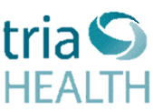



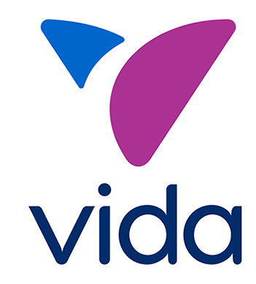
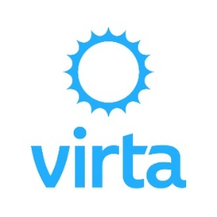
Vendor Management Continuum
Vendor Solution Continuum
Major
Obesity Management Solution Considerations
For the purposes of this continuum, clinical intervention is described as the level of clinical team engagement in the participant’s journey
Minor clinical intervention reflects vendors that utilize Certified Health Coaches as the participant's health coach. These vendors may also focus on digitally delivered education to the participant – including AI technology.
Vendors in the moderate clinical intervention category also leverage Certified Health Coaches as the participant’s health coach. These solutions also integrate remote monitoring devices and app engagement in the participant’s health journey. Many of these vendors also offer virtual care teams who work alongside the health coach. Care teams can consist of clinicians, including RNs, Medical Doctors, Pharmacists and Behavioral Therapists.
Vendors that offer major clinical interventions lead with a clinician as the health coach or main point of contact for the participant. The clinicians also develop the participants treatment plan.
  These vendors also work to prescribe/deprescribe GLP-1s
  These vendors are driving research and sharing results to help solve the broader population health issues.
Clinical Intervention
Moderate
Minor
$
$$
Program Fees
$$$

Slide 30
The Importance of Data

Slide 31
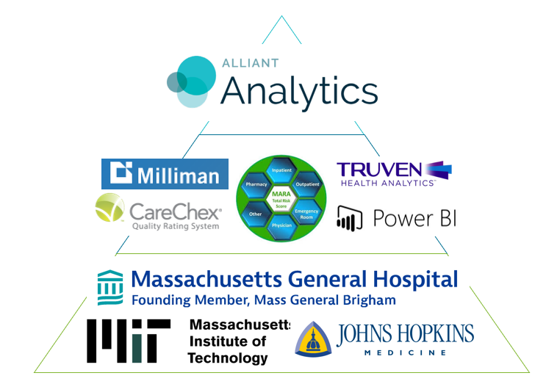

Robust Analytics Platform

Slide 32
Case study 1 – Multi vitamin
    Challenge
      Alliant drug report identifies Xyzbac
      16 users at $932 per month
      $76k in spend
Understanding the Challenge
    Solution:
      Xyzbac is a multi-vitamin!
      Many alternatives available
      Alliant identifies single provider and pharmacy
Applying a Solution
Achieving Results
    Results:
      Alert PBM to change formulary
      Provider was fired

Slide 33
Case study 2–Watchdog Program/Fiduciary Responsibility
    Challenge
      J&J lawsuit names Teriflunomide
      Alliant routine monthly audit
      1 client identified
      Cost from $94 to $7,800 per month
Understanding the Challenge
    Solution:
      Alliant contacts PBM
      PBM confirms pricing
      Makes correction
Applying a Solution
Achieving Results
    Results:
      Alliant demands refund
      PBM cuts check to client for cost difference

Slide 34
Carve-in vs. Carve-out PBM
    Challenge
      When to carve out PBM?
      Many groups are told of massive savings
      Many factors are left unstated
Understanding the Challenge
    Solution:
      Alliant uses detailed cost analysis
      Pros & Cons are thoroughly discussed
      Multi-faceted approach is used
Applying a Solution
Achieving Results
    Results:
      Case 1: Over $2M in savings
      Case 2: PBM boasted $1.7M, Alliant provided $150k
      Case 3: Carve-in strategy saved $300k with no disruption (added programs)

Slide 35
Client A: Initial Rx Marketing Results (Our Take)
Carrier 1
PBM 8
Carrier 1
Carrier 1” $
Carrier 1” %

Slide 36
A NNAHRA Exclusive

Slide 37

Unique Opportunity
Trusted purchasing source via NNAHRA
Exclusive Insurance Program
Products
  Employer-Paid group Life/AD&D
  Member-Paid Life Insurance (Vol. Benefit)
  Burial Benefits

Slide 38



Group Purchasing Organization (GPO)
Growth
Today’s focus is on Life Insurance Only.
Future Years – NNAHRA may expand to include STD/LTD & Voluntary Benefits.
Flexibility
Not An Association
All Tribes will maintain their own risk and their own plan design
No shared risk between Tribes

Slide 39

What’s the Value?
Upon Participation
  Estimated 10% savings
  Contract enhancements and high Guarantee Issue
  Simple process and implementation
Upon Submission of Data
  Full Contract Analysis
  Tribal Benchmark

Slide 40

Tribes Send to Alliant
Company Information Document
Census Data
Current Contracts & Rates
  Under 1,000 lives - last 3-5 years of renewal rates
Plan Experience (if applicable)
  Over 1,000 lives - last 5 years

Slide 41
AFLAC Tier One
A NNAHRA First!
We are making AFLAC products available to all Tribal Members
Purchased 100% through a “Amazon-type” website
Tribal members choose plans they want
Direct credit card payment

Slide 42
Your Workload is NOT Increased
HR simply sends information to your membership
No payroll deductions
No HR billings
No claims support (AFLAC provides all of this)

Slide 43

An Added Bonus!
HHAHRA Endorsed Employee Program
Low Rates
Better Contractual Provisions
Complimentary comparison with all voluntary benefit plans you offer your team members
** You can offer Tribal member plan without the group plan

Slide 44





THANK YOU!
Contact us to get more info
Mark.patrick@alliant.com
Spokane, WA
(509) 343-9506
www.alliant.com

