Slide 1
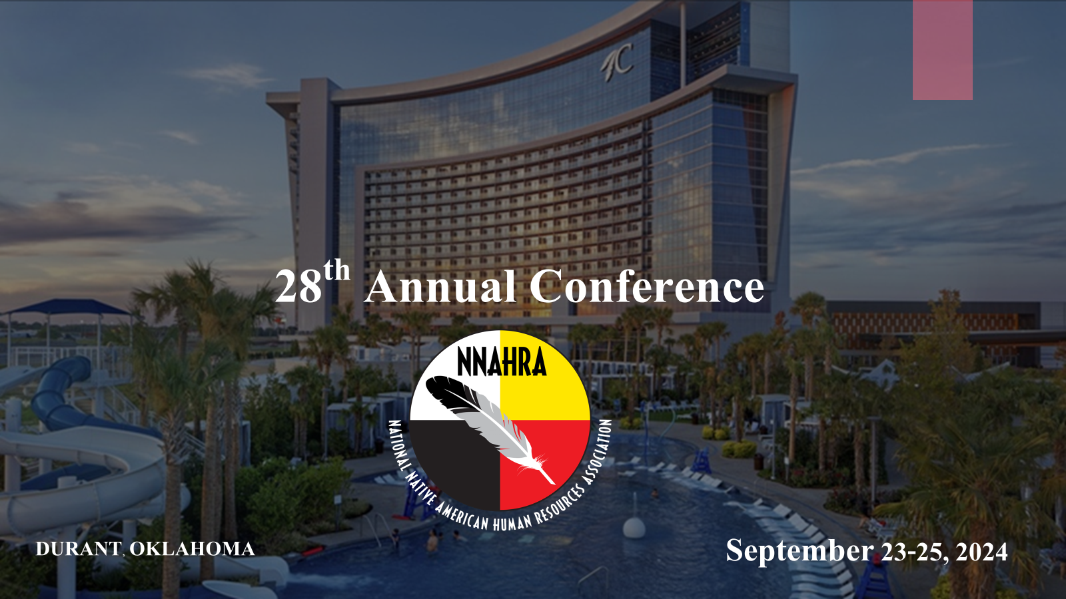

Slide 2
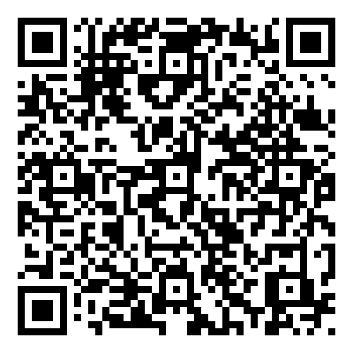
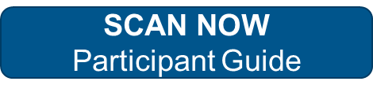
Human Trafficking

Slide 3

Human Trafficking Definition
“Human Trafficking is a crime that involves exploiting a person for labor, services, or commercial sex.”
Sex trafficking in which a commercial sex act is induced by force, fraud, or coercion, or in which the person induced to perform such act has not attained 18 years of age;
“The recruitment, harboring, transportation, provision, or obtaining of a person for labor or services, through the use of force, fraud, or coercion for the purpose of subjection to involuntary servitude, peonage, debt bondage, or slavery.”

Slide 4
NIGC Authorities and Human Trafficking
1. What authority does the NIGC have in regard to Human Trafficking?
  IGRA and NIGC regulations require Tribes to operate gaming facilities in a manner that adequately protects public health and safety.
2. What may NIGC do in regard to individuals involved in Human Trafficking?
  The Chair may issue a notice of violation to any person for violations of any provision of IGRA.
3. How does the NIGC monitor public health and safety at gaming operations?
  NIGC Compliance Officers visit gaming operations, conducting compliance reviews; receive information from tribal gaming commissioners, officials, employees, and witnesses; and request documents or other evidence.

Slide 5
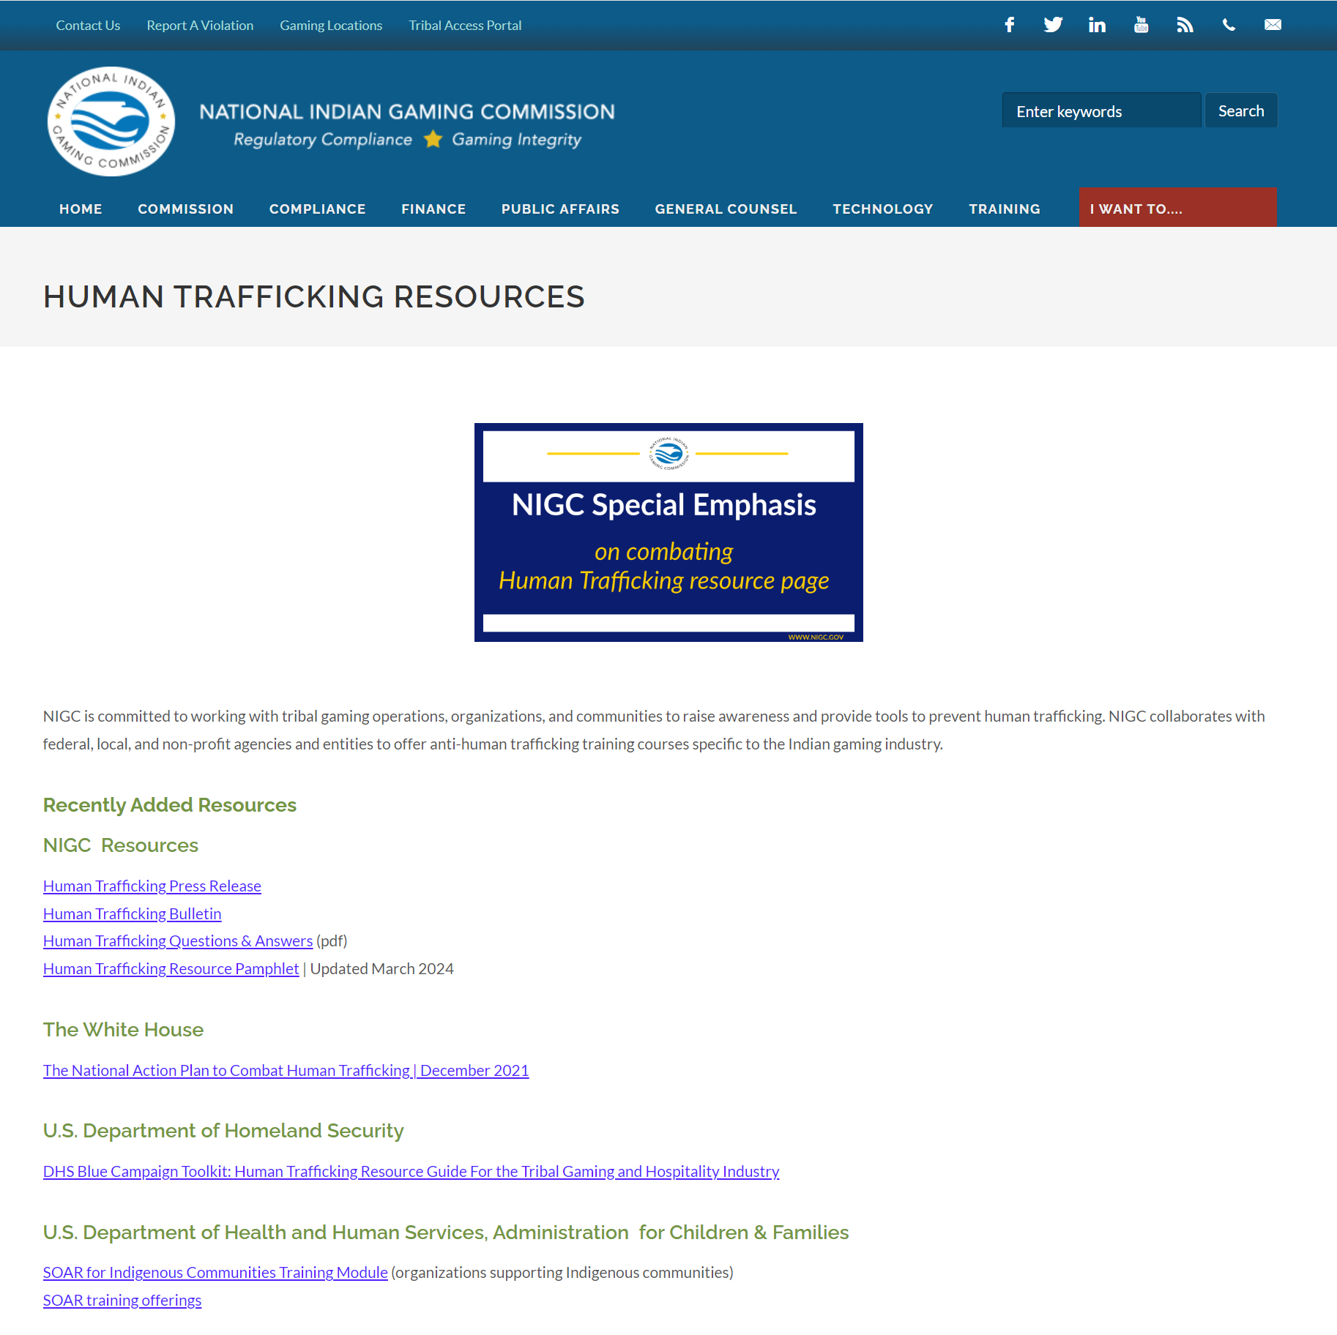

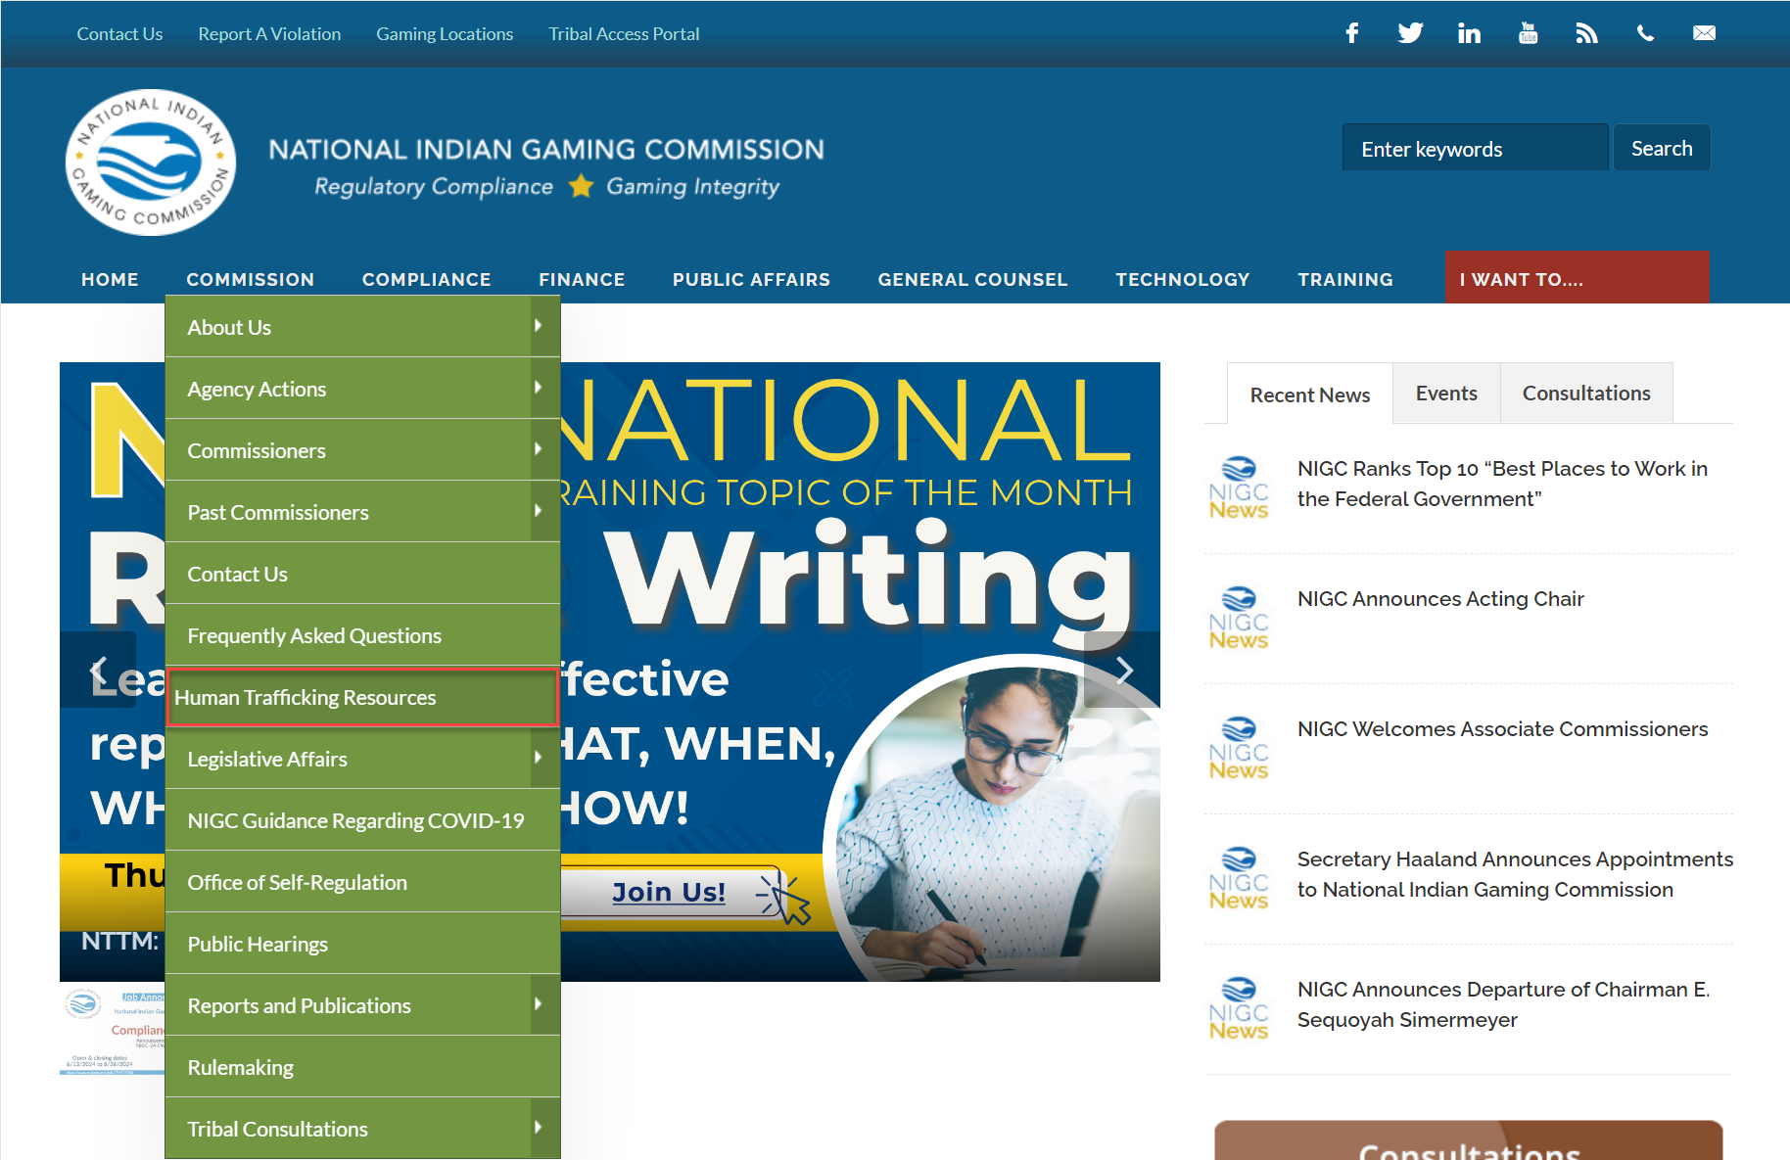
NIGC and Human Trafficking Activities Resources
Notes:
HIGHLIGHT TRIBES HOSTING TRAINING

Slide 6
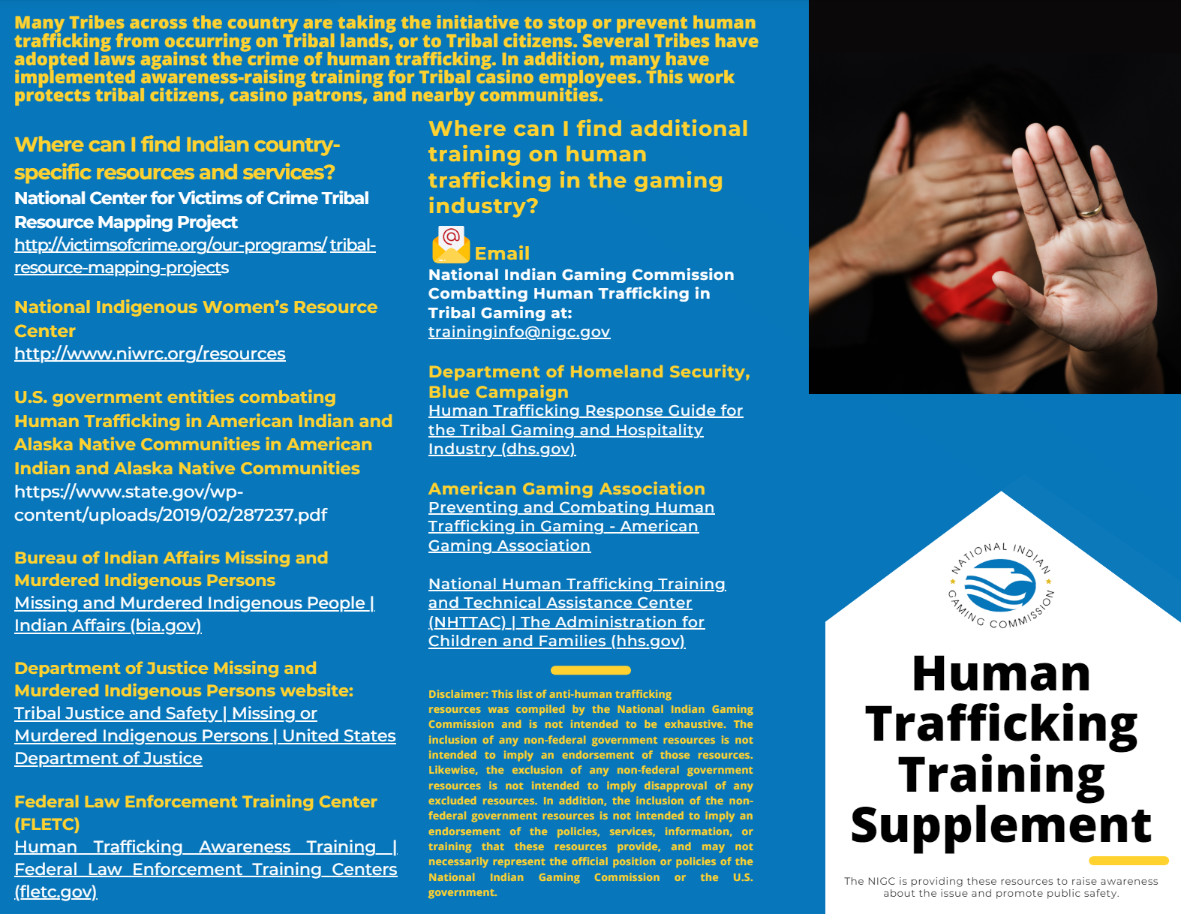
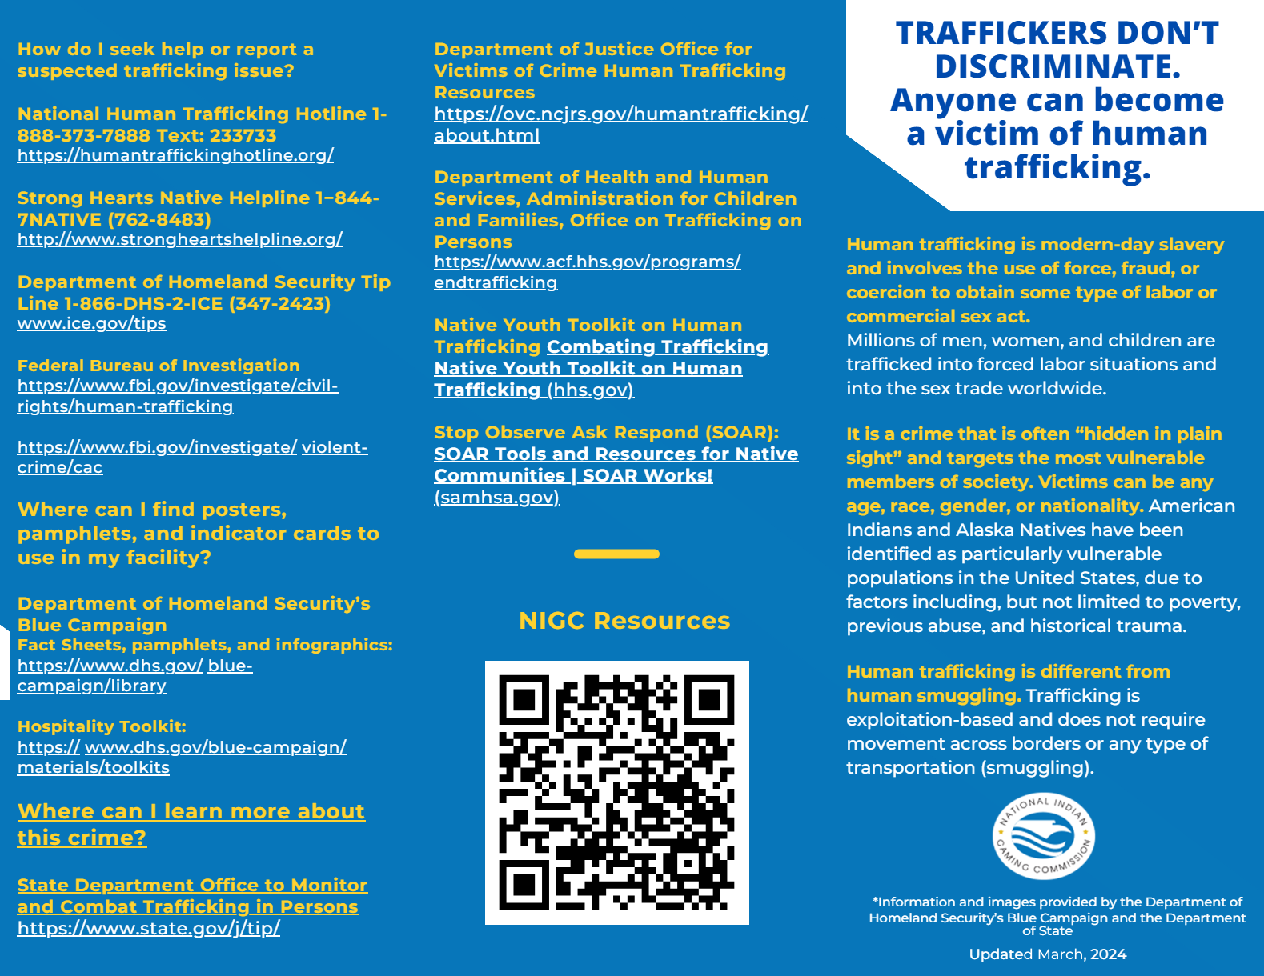
NIGC and Human Trafficking Activities Resources
Notes:
HIGHLIGHT TRIBES HOSTING TRAINING

Slide 7
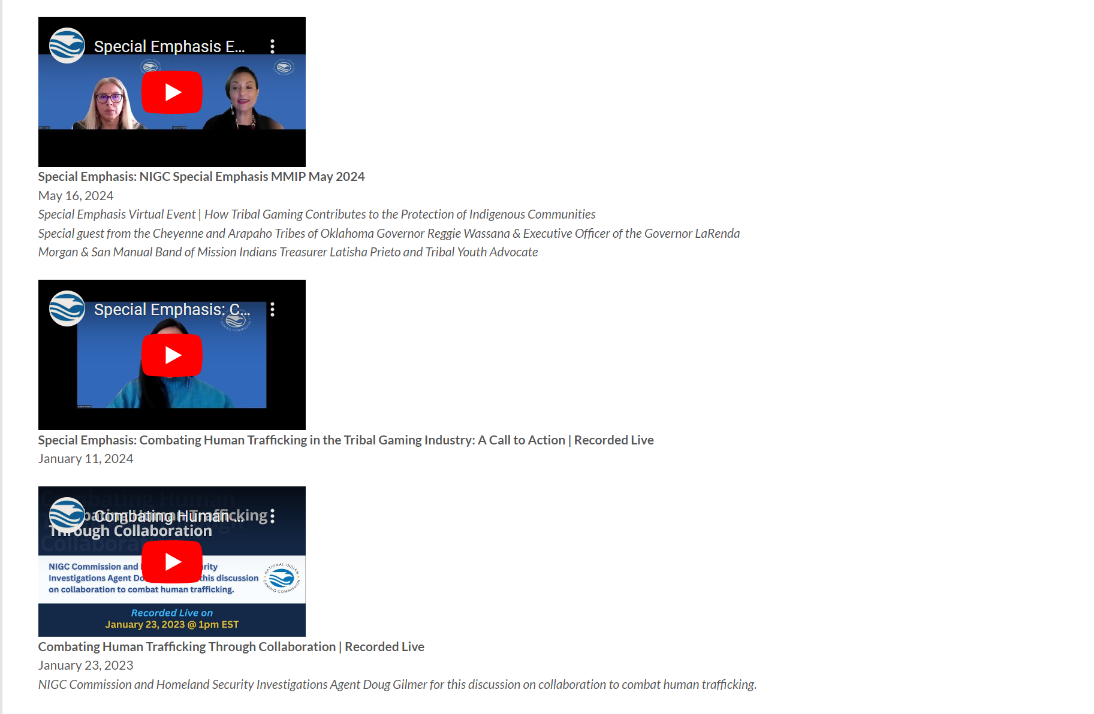
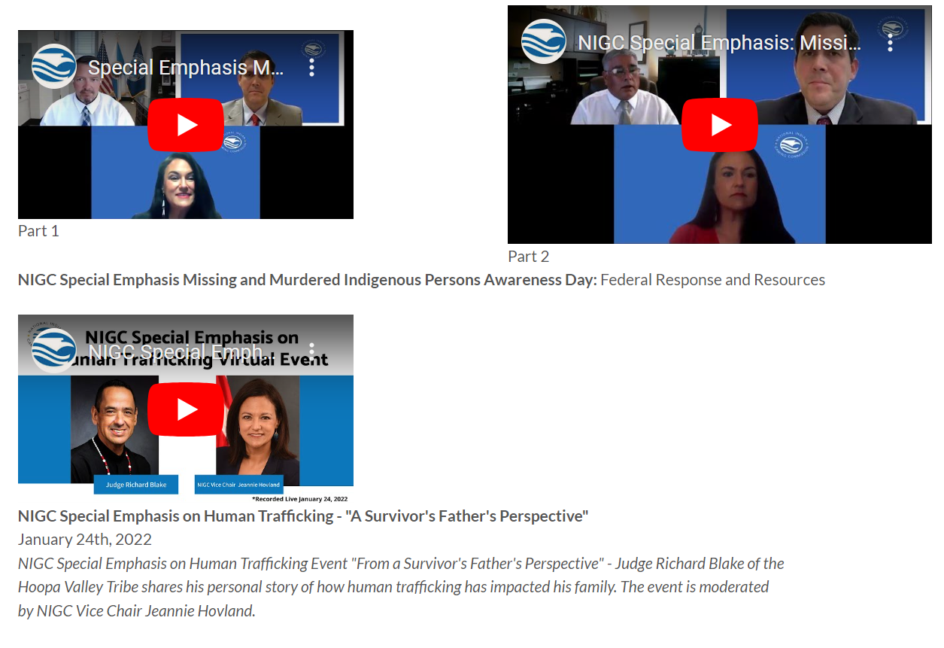
NIGC and Human Trafficking Activities Resources
Notes:
HIGHLIGHT TRIBES HOSTING TRAINING

Slide 8

Responding to Human Trafficking Activities:
Gaming Employees
Provide Human Trafficking training during new employee orientation/onboarding & annual Human Trafficking training for all employees.
Prepare employees for large events and remind employees to watch for human trafficking indicators.
Make sure your employees feel safe , security especially may be targeted and/or harassed.
Develop employee support programs for those directly affected by human trafficking or MMIP.
Display throughout the casino and in employee break rooms, human trafficking posters that include indicators and the help line contact information.

Slide 9
Responding to Human Trafficking Activities:
Policy and Collaboration
Develop Human Trafficking policy and procedures and include it in your emergency preparedness and response plans.
Collaborate with your tribe, local law enforcement, and taskforce/organizations addressing human trafficking in your community.
Require all vendors to sign a “Responsible Vendor” statement on human trafficking.
Wear Blue across Casino floor on Human Trafficking Awareness Day.

Slide 10
Responding to Human Trafficking Activities:
Potential Victims
Know how to assess situation and respond appropriately.
Designate a safe, quiet, room for victims recovered from gaming floor.
Be alert to important details, what wearing, height, license plates, etc.
Select security guards who have a kinder, empathetic approach, good listeners, be at their level.
Establish a POC with local law enforcement and Victim Services that can respond immediately.

Slide 11
Responding to Human Trafficking Activities:
Potential Victims
Do not attempt to confront a suspected trafficker or alert a victim to your suspicions.
Follow your organization’s reporting protocol, or call 911 or local law enforcement authorities if someone is in immediate danger.
You can report suspected human trafficking to: Homeland Security Investigations (HSI) Tip Line at 1-866-347-2423, or submit an HSI Tip Form online at https://humantraffickinghotline.org/chat.
To obtain victim support, contact the National Human Trafficking Hotline at 1-888-373-7888.

Slide 12



Anti-Human Trafficking

Slide 13

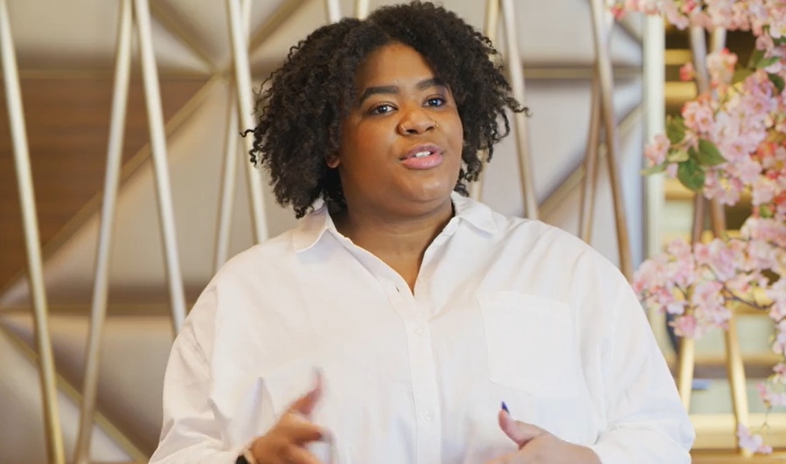
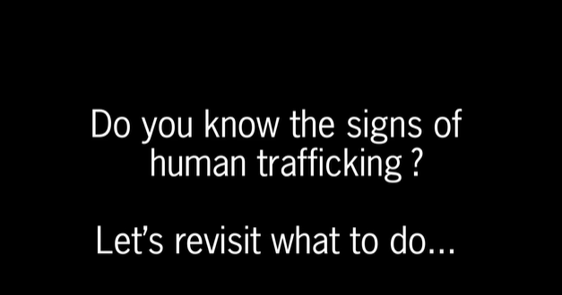



OPERATIONS
TRAINING
 | Hard Rock is Signatory 1. Policy and procedures 2. Team member training 3. Contract language to prevent exploitation 4. Guest information 5. Community Partnerships 6. Annual reporting
ECPAT Tourism
Child Protection
Melanie - Trafficking Survivor
Code of Conduct
Donate electronic devices that are lost and unclaimed by guests
1,733 given to trafficking survivors who need phone

Slide 14
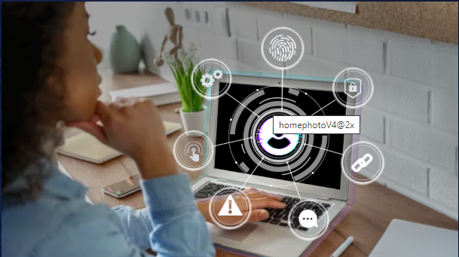

PREVENTION
Public Education
1.2 million students
educated & engaged
59,054 educators
teaching the curriculum
22% increase
in attitudes toward healthy online choices
Quest game designed to help prevent risk of teenagers being lured online by increasing their literacy of online safety habits
www.socialidentityquest.com

Slide 15

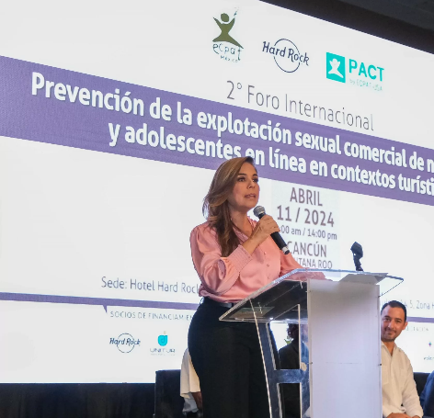
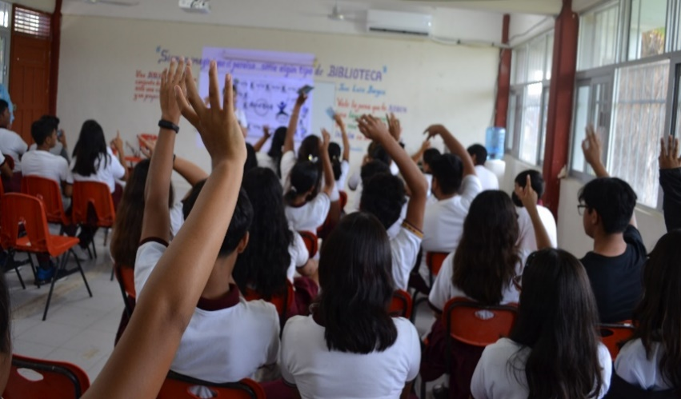
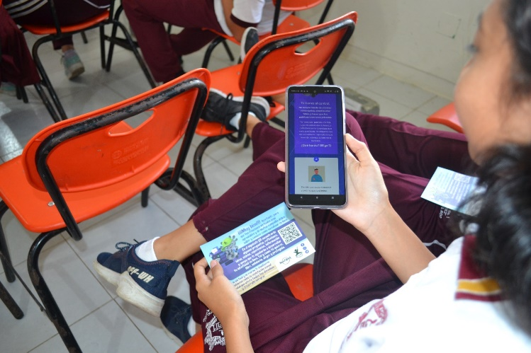
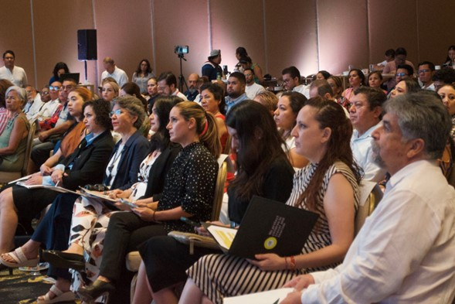
PREVENTION Public Education
Adapted Quest with ECPAT-Mexico
Governor mandated program for schools
42,000+ students completed in state of Quintana Roo
Hard Rock Hotel Cancun hosted conference
www.socialidentityquest.com/mx

Slide 16
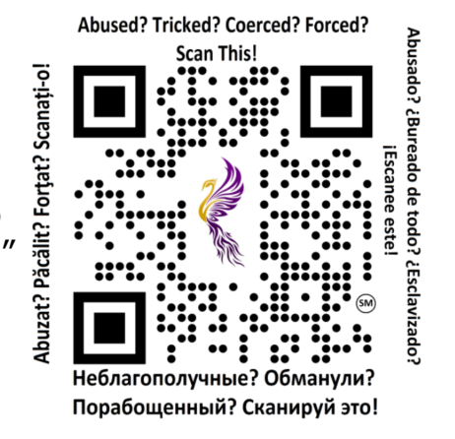
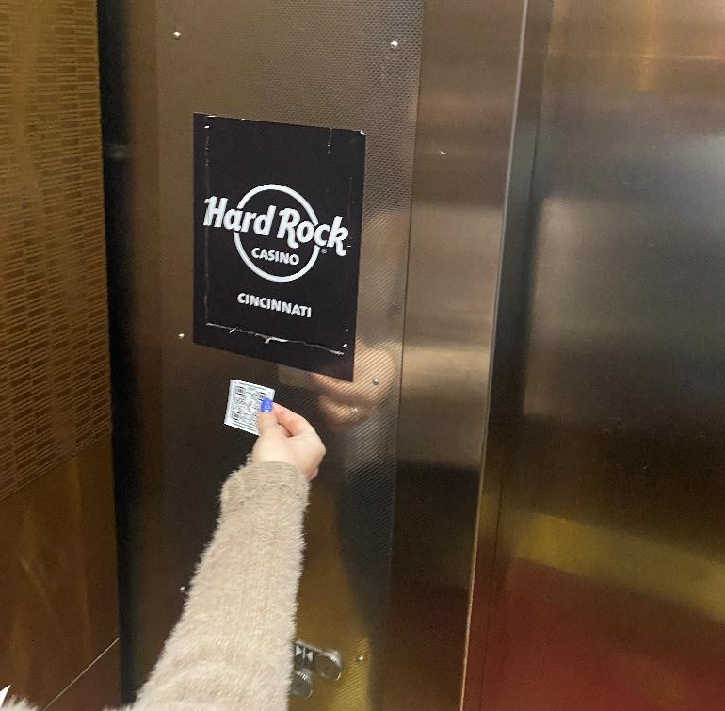
SUPPORTNG VICTIMS
QR CODE FOH
Hard Rock first hospitality company to introduce 24-Seven Inc. are survivors helping victims
Mitigates human trafficking at properties
Effective method to connect victim directly to help
All information goes directly to law enforcement
96 reports filed to law enforcement leading to:
Victims being identified and located
Trafficking rings being interrupted
Information shared across agencies
Notes:
Issue that affects all our businesses – hotel and casino
It is global and everywhere
We have to be careful how we talk about it – branding
Our role:
Knowing what to do on property
Victims
Survivors
Prevention
Communities of operation
Training: enhancements
SIQ: prevention, US, Mexico, indigenous
QR code: pilot, reports and expansion
QR

Slide 17

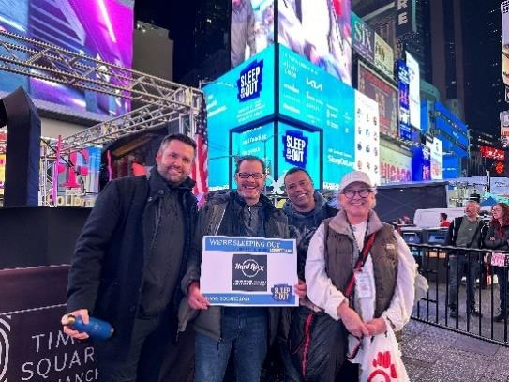

Workforce Development Program
Provide homeless youth access to careers in hospitality
Partner with Covenant House New York City and Fort Lauderdale, and FLITE Center Broward
Participants employed at Cafe Times Square, New York hotel, Hollywood, Coconut Creek
Enable youth to overcome systemic barriers, achieve independence, and break free from cycles of poverty and homelessness
SUPPORTING
SURVIVORS

Slide 18

2022 GOALS
2024 RESULTS
2025 GOALS
1
QR Code for Victims FOH:
38 hotel and casino properties implemented
96 reports by victims to law enforcement
2024 GOALS:
Apply insights from data
GUEST
IMPACT
GOALS: Support victims who may be on property
2
78,689 completed session 30 min online training
GOALS:
New gaming & class training
TEAM MEMBER IMPACT
3
1,473 TM completed the Social ID Quest voluntarily to learn about online safety literacy for their children
GOALS: To educate TM to respond to red-flags
4
Vulnerable Youth Employment Transition: launched, first employees with Covenant House NY and FLITE Center Broward
GOALS:
Expand to other cities
BRAND IMPACT
5
Social ID Quest Mexico: Launched Quintana Roo state, 42,000+ students completed, mandated part of curriculum
GOALS:
To enhance brand reputation in support of expanding business
GOALS:
Expand to other states
500 million media impressions for press release
Freedom Award for Chair Osceola and CW Mariann Biullie
1
Notes:
DEI Goals 2022
People: 20% of Team Members at all U.S. Properties attending The Look Workshop, including all Directors and above – 21, 443 20% - 4289
People: Launch Advancing Black Leaders (ABL) and Tribal Career Development (TCD) – ECC Programs and TCD Complete
Culture: TMRG Membership at 8% of total population (increased from 3% in 2021) – 21,443 8% - 1716
Culture: 15% Team Member Engagement in our TMRGs 15% - 260
Stakeholders: Develop Corporate SOP (standard operating procedure) for Philanthropic efforts and develop SOP for Publics Relations on delivering Diversity Statements on the behalf of the Company.
Stakeholders: Sponsor and partner with nationally recognized organization that increase our status with in the DE&I i.e. BPN, HRC
DEI GOALS NOTES
People: our learning focus of getting 20% of team members at properties through the Look Workshop, including at many properties managers and above and at all properties, directors in above, is about shifting perspective and changing assumptions about inclusion. Our goal is to increase this number every year and add additional learning paths to build on this initial immersive experience with level sets ALL team members and focuses on dropping assumptions, being kind, and showing up with compassion.
Measurement: Pie chart two data points: total population with a sample completion segment i.e. 25,000 total population and 43% completion
Measure effectiveness of Training: EOS, Increase in Diverse Hiring Promotions, Reduced Turnover by Women of Color and Underrepresented Groups.
People: This pillar focuses on the launch of two pipelines for developing talent that we KNOW are needed in our organization: first, Advancing Black Leaders, for Directors who identify as Black or African American, and second, Tribal Team Members in our TCD Program. These programs, through learning and development opportunities, professional development opportunities, mentoring, and customized skills-building, will prep these populations for leadership roles across the organization.
Measurement: Two Pie Charts 1. Total number of V.I.B.E. membership (make up a number) and a % of promotions (make up a number). 2. TCD pie chart 11 TTMs and 3 graduates as the data points for pie charts.
Measurement of effectives: DE&I progress Report: Hiring., Development, Retention.
Culture: This goal, along with the goal above, is at the core of our Culture Pillar, and this increases our TMRG membership to 2,000 team members (8% of the TM population.) As we continue to shift our culture to a culture of engagement in the inclusion space, this goal will help shift individuals, leaders and teams to be more engaged in their professional development and growth through the TMRGs and create excitement and engagement throughout the TM population so we can continue to grow these pipelines for talent development.
Measurement: Total population against a sample % of membership i.e. 25,000 total population and 12% membership.
Measure Effectiveness: TMRG Comms Plan Evaluation, surveys, recruiting strategy
Culture: Our TMRGs are the core development of the Culture Pillar, serving as conduits for cultural awareness, engaging in community outreach and development, spearheading professional development, focusing on business impact, and supporting recruiting strategies to attain, retain, and develop diverse candidates. This goal doesn’t just tie to TMRG membership, but in active engagement in the resource groups team members are signed up for, including engaging in meetings, events, and leadership development opportunities, and more, as well as engaging on our virtual platform with one another as they interact with media and one another on diversity and inclusion issues that matter to them.
Measurement: Pie Chart two data points: Total TMRG population against a sample % of membership i.e. 1300 total population and 12% engagement.
Measure Effectiveness of Efforts: Igloo Enrollment/Participation, events and meeting participation.
Stakeholders: In order to move with intentionality through our Philanthropic Efforts and Public Relations, we will develop Corporate SOP (standard operating procedure) for Philanthropic efforts and develop SOP for Publics Relations on delivering Diversity Statements on the behalf of the Company.
Measurement: Company adoption. no pie chart
Stakeholders: Our intentionality in the inclusion space must continue both within the walls of our buildings but also among our communities where we live and serve. We will Sponsor and partner with nationally recognized organizations that increase our status with in the DE&I (i.e. BPN, HRC) to enhance recruitment and retention and build a reputation of inclusivity where diverse talent is valued and given investment to flourish.
Measurement: Engage in their Reputation Surveys, Recruiting Conversation Rates. No pie chart.

Slide 19
THANK YOU

Slide 20

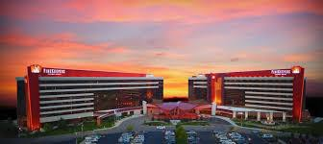
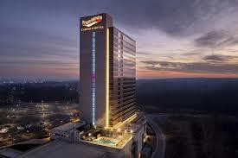


Casino Operator Perspective
George Jenkot – Firekeepers Casino

Slide 21

Sex Trafficking in the U.S.
Sex Trafficking
Children
Women & Girls
Labor
300,000 new sex trafficked victims each year in the U.S.

Slide 22
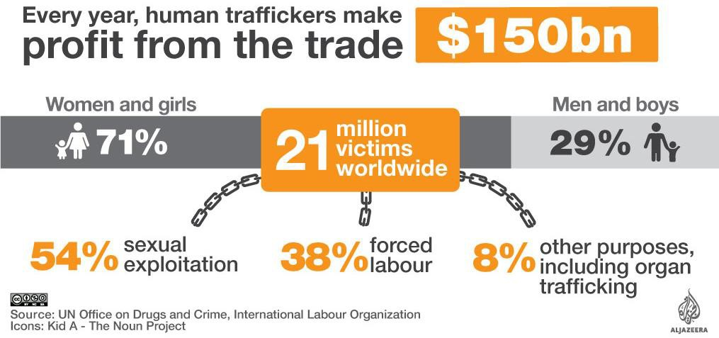
Cost of Human Trafficking

Slide 23
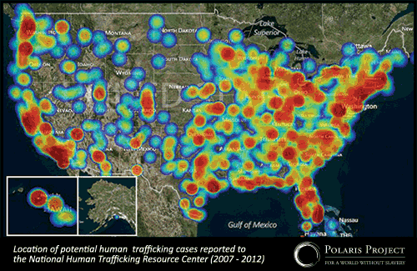

Slide 24






Trafficker handles victims documents, identification, travel documents- Restricts freedom of movement
RED FLAGS & WARNING SIGNS OF HUMAN TRAFFICKING
Victim lack of knowledge of what city they are in,their whereabouts
Trafficker handles victims money
Victim inability to clarify where they live, address
Victim defers to another person to on their behalf
Victim shows signs of physical abuse, deprived of food,water, sleep,medical care

Slide 25
Extends stay on a day to day basis
Pays for room in cash, pre- paid card (someone else pays for them)
HOTEL & CASINO RED FLAGS
Request for room overlooking parking lot or next to stairs
Multiple cell
phones
Frequent request of a new linens and or towels
Presence of
drugs
No knowledge of current or previous whereabouts

Slide 26
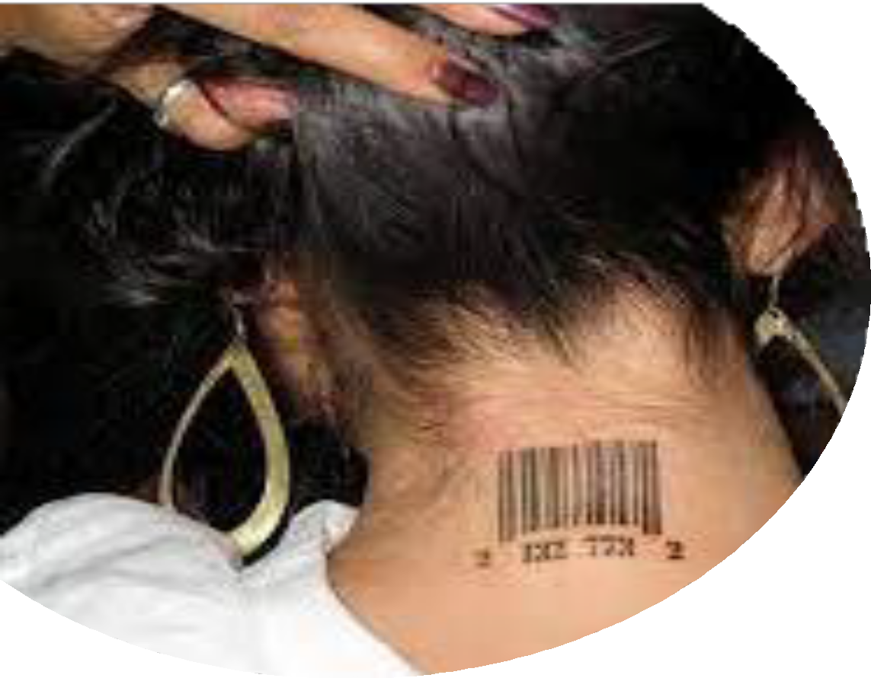
It could be trafficking if…..
Is unable to leave location (anywhere) unaccompanied
Are not in control of their own money or have very limited access to any kind of money, even though working
Are not allowed to speak for themselves; a third party interprets or person may be watched or followed;
Has innumerable inconsistencies in his/her stories
If a foreign national, does not have papers in their
possession
Has symptoms of physical or psychological abuse
Has no ability to name friends, relationships and is isolated from other people
Clothing and attire not appropriate for weather
conditions
IF WHAT YOU SEE DOES NOT MAKE SENSE!

Slide 27
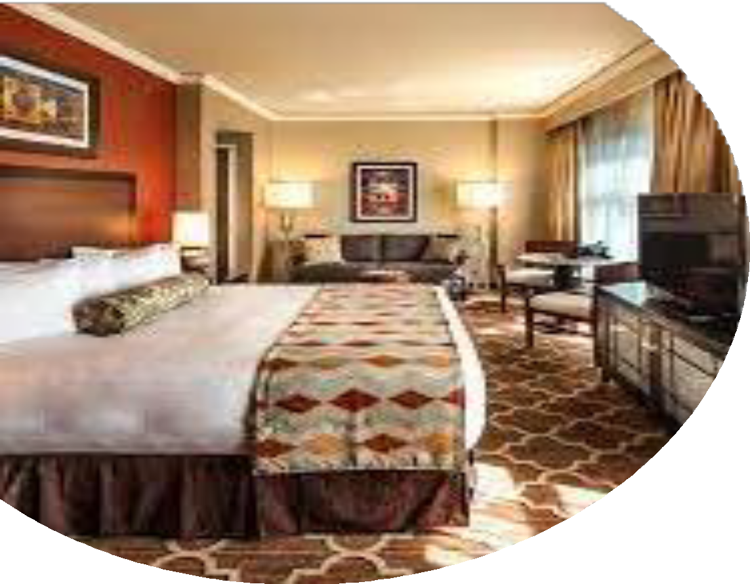
Indicators for Housekeeping, Maintenance, and Room Service Staff
Occupants insists on little or no housekeeping.
Requests room or housekeeping services (additional towels, new linens, etc.), but denies staff entry into room.
Presence of multiple computers, cell phones, pagers, credit card swipers, or other technology.
Extended stay with few or no personal possessions.
Excessive amounts of sex paraphernalia in rooms (condoms, lubricant, lotion, etc.).
Excessive amount of cash in the room.

Slide 28
Human Trafficking Initiatives – Nottawaseppi Band of the Potawatomi
Presentations to Firekeepers Employees.
Virtual presentation available through FKCH training website.
Human Trafficking Toolkit.
Human Trafficking (HT) Response in Casino Emergency Action Plan.
Community Human Trafficking Presentations.
Partnership with:
  NHBP Tribal Police Department.
  Michigan Human Trafficking Task Force.
  AGA.
Law Enforcement HT Operations.
Participation in Inter-Tribal Coalition Against Violence.

Slide 29

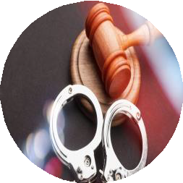
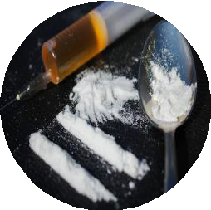
Trends: Nottawaseppi Band of the Pottawatomi
On April 13, 2024, the NHBP Tribal Police Department conducted a
Human/Sex Trafficking Operation at the Quality Inn Motor Lodge,
Battle Creek, MI
3 people were detained
(1 female and 2 males)
2 arrested facing warrants in state court. 80 unique cell phone numbers captured.
1 female confessed and is receiving victim services from NHBP

Slide 30
Trends: Nottawaseppi Band of the Pottawatomi
On July 30, 2024, the NHBP Tribal Police Department conducted a
second Human/Sex Trafficking Operation at the Quality Inn Motor Lodge,
Battle Creek, MI.
7 detained
(5 males 2 females)
2 women diverted
2 charged with felony warrants and distribution of meth
5 charged with prostitution

Slide 31
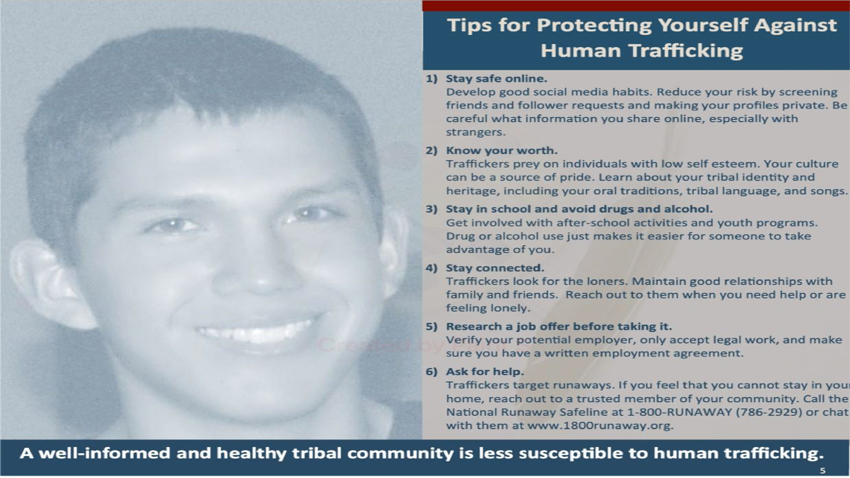

Slide 32
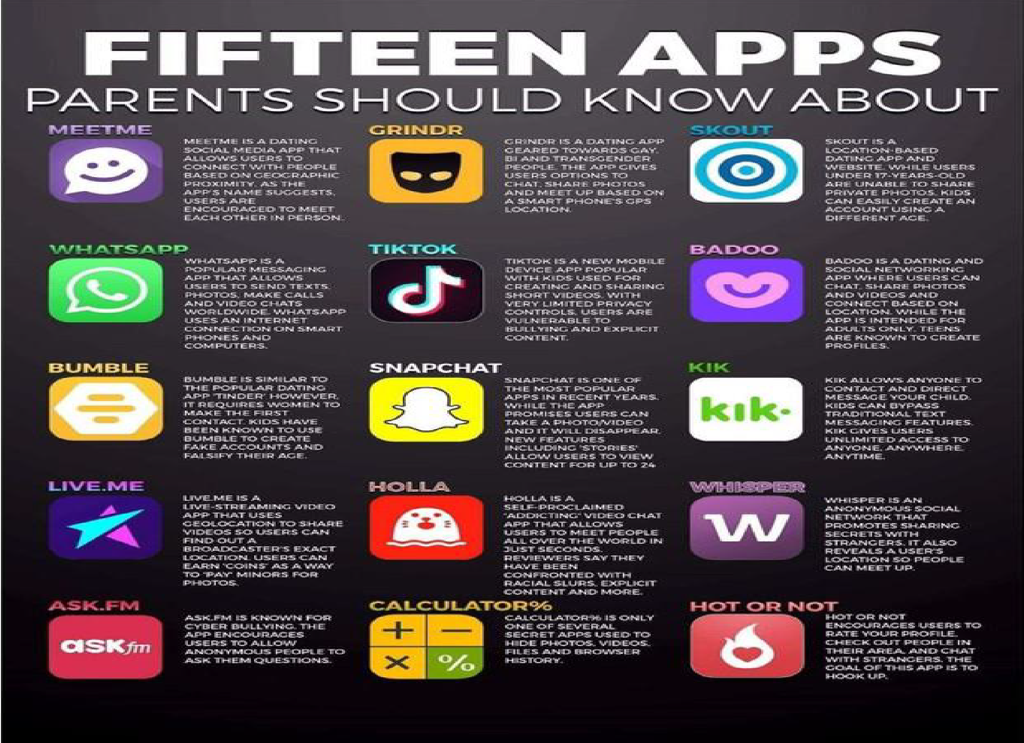

Slide 33
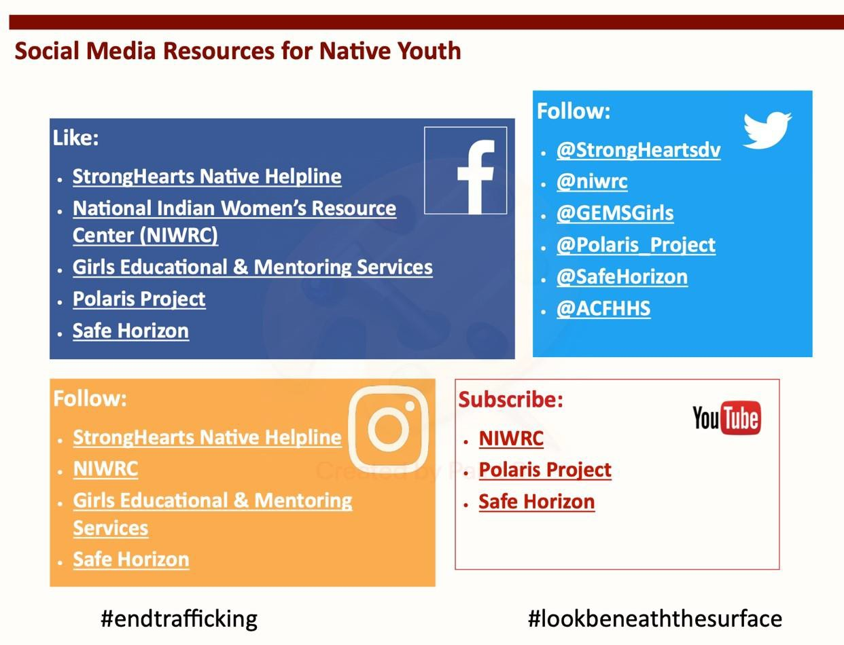

Slide 34
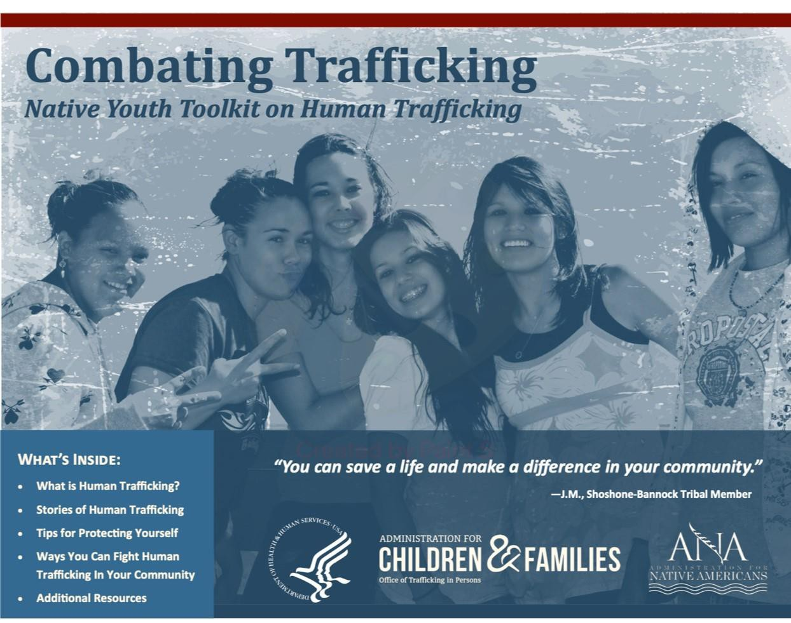







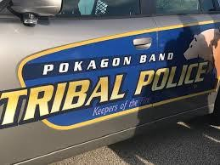


Thank you!
RESOURCE NUMBERS
•
•
•
NIGC.gov

