Slide 1
28th Annual Conference
September 23-25, 2024
Durant, Oklahoma

Slide 2
Mastering Financial Wellness: Strategies for a Healthy Financial Future
Presented by: Tina Herndon

Slide 3
How does personal finance affect an employer?

Slide 4
PwC 2023 Employee Wellness Survey
49% say it is hard to meet monthly expenses (up 44%)
44% say they struggle to pay minimum payments
28% of employees run out of money between paydays
15% who make $100k run out of money
39% retail workers said they run out of money
Source: PricewaterhouseCoopers, International’s 2023 Employee Financial Wellness Survey

Slide 5
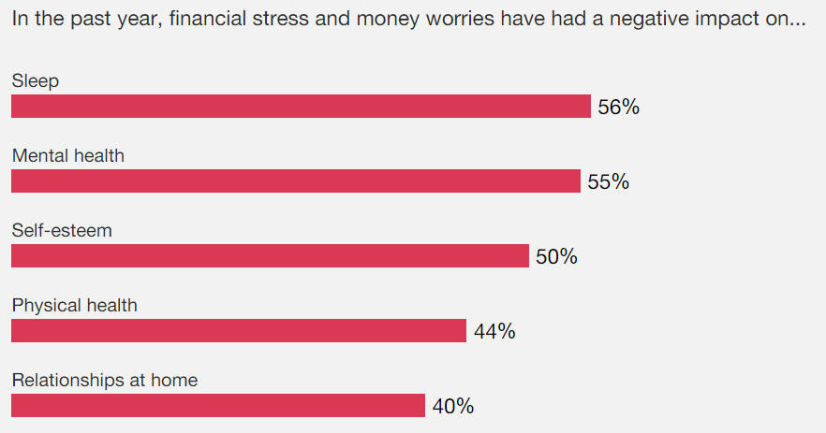
PwC 2023 Employee Wellness Survey
Source: PricewaterhouseCoopers, International’s 2023 Employee Financial Wellness Survey

Slide 6
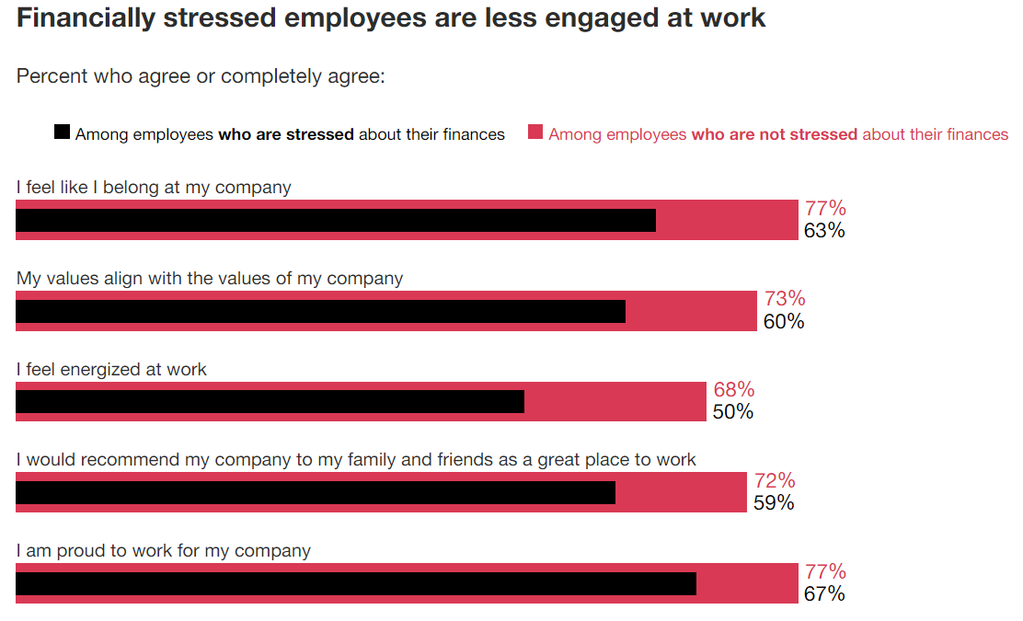
PwC 2023 Employee Wellness Survey
Source: PricewaterhouseCoopers, International’s 2023 Employee Financial Wellness Survey

Slide 7
How does personal finance affect employee wellness?

Slide 8
What does wellness mean?

Slide 9
What is a Healthy Financial Future?
Good Credit
Low Expenses
Sufficient Income
High cost of education
Lack of opportunity
Income stagnation
High inflation
Lack of financial education
Limited physical access
Lack of transportation
Cultural

Slide 10
Psychology and Money
Shame and Guilt
Fear
Euphoria
Procrastination
Bigger than lazy
Overwhelmed
Goal seems too big
Where to start
Money mistakes
Lack of knowledge
Lack of direction
Imposter Syndrome
Consequences
Societal demands
Façade will fade
Limited knowledge
Neurodivergence
Financial windfall
Change of income

Slide 11
Meet Alice
ALICE is
A L IC E
= Asset Limited
= Income Constrained
= Employed
Making Tough Choices

Slide 12
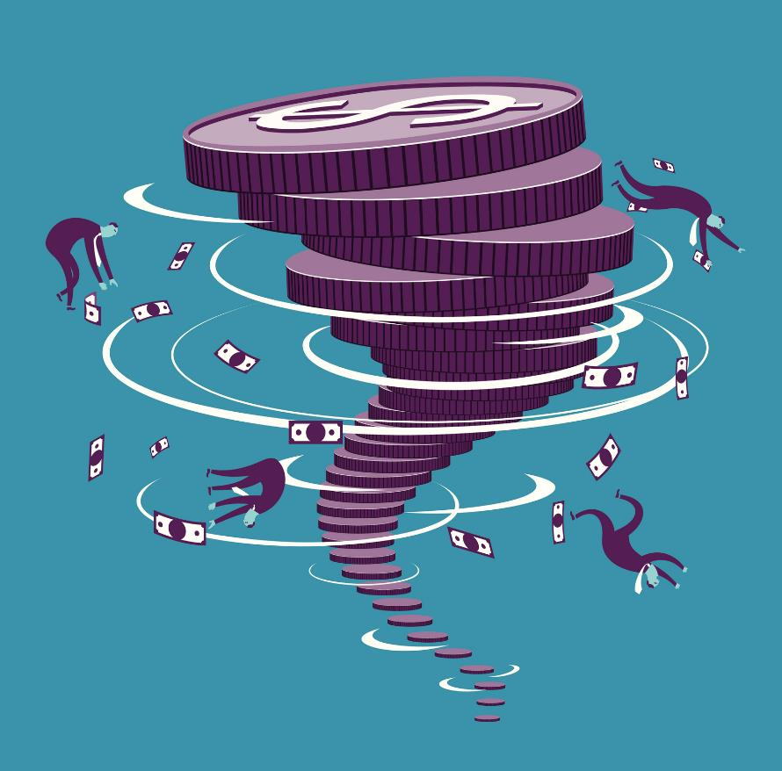
What’s up with ALICE
Their life is a secret tornado
Time is ambiguous
Limited vocabulary = anger
Trust & respect is earned
Judgement is expected
Look for differences not similarities
Better budgets are not always the solution
Societal sabotage is real
Financial resources and good support can change their entire life

Slide 13
How can a financial institution help employers serve their employees?

Slide 14
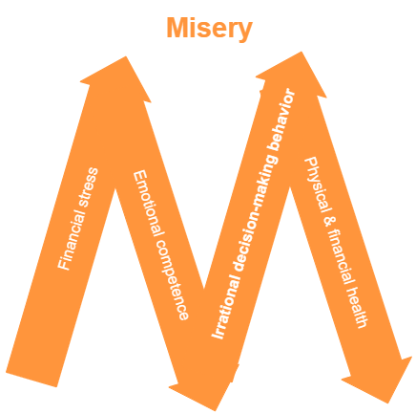
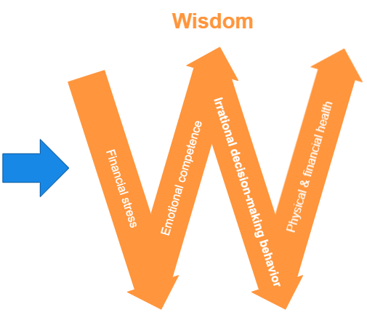
Source: Think2Perform Behavioral Financial Advice

Slide 15
Partnering with a Financial Institution
.
Financial Education
.
Financial Counseling
.
Financial Planning
Employee Lending
.

Slide 16
.
Financial Education
Group presentations
Multifaceted learning
Questions answered
Online resources
Confidential
Convenient
Newsletters and articles
Easily shared
Timely topics

Slide 17
.
Financial Coaching
Confidential 1:1 conversations
Help create improvement strategies
Questions are answered privately
Accountability partner
Ongoing development support
Uncovers resources

Slide 18
Financial Advisors
.
Retirement strategies
Investment guidance
401k, IRAs
Avoid large losses and mistakes
Ensures sufficient insurance
Life insurance
Other insurance
Estate planning
End of life planning
Survivor’s benefits

Slide 19
Employee Lending
.
Good interest rates
Resource for building credit
Reports to all three credit bureaus?
Nonpredatory small-dollar lending
Outsource employee loans
Building banking relationship
Refer struggling employees
Can help with resources

Slide 20
WIIFM…What’s in it for me?
Financial Institutions
Brand exposure
Field of membership
Better borrowers
Employee morale
Security of larger accounts
Community giveback
Employer
Lower financial stress for employees
Sponsorship available
Referral resource for financial conversations
Free workplace culture investment

Slide 21
Is financial education something my employees will want to do?

Slide 22
Let’s have some educational fun?

Slide 23
Financial Facts and Money Myths

Slide 24
I can stop saving for an emergency someday.

Slide 25
I can stop saving for an emergency someday.
Recommended savings = 3-6 mos. of essential living expenses
Households may choose to invest after they have “enough” savings
Start saving again immediately if emergency funds are used.

Slide 26
I can use rent and utility payments to increase my credit score.
&

Slide 27
Experian Boost allows you to build a nontraditional credit score.
Only Experian offers this option
This doesn’t always increase scores
Not every lender will pull Experian
Can work for credit with TFCU

Slide 28
I can pull a free credit report from AnnualCreditReport.com yearly.

Slide 29
I can pull a free credit report at AnnualCreditReport.com yearly.
You can now pull your credit reports weekly
Direct access to credit bureaus
May pull all three credit reports
May dispute errors on website
Pulling credit reports can help with fraud detection and money motivation.

Slide 30
Julie’s Credit Journey

Slide 31
Psychology of Money
Presented by Tina Herndon TFCU Financial Educator

Slide 32
Freeze Exercise
What am I…
Thinking
Feeling
Doing
What should I be…
Practice = Emotional Intelligence
Source: Think2Perform Behavioral Financial Advice

Slide 33
To schedule a virtual or in-person workshop for your school or organization, please contact us at
405.319.2185
or
FinancialEducationDept@TinkerFCU.org

Slide 35
BALANCE is a financial education and counseling service. Services include money management counseling, debt repayment options, credit report review and more.
Call toll-free 888.456.2227 or visit TinkerFCU.balancepro.org
/BALANCEPro
@BAL_Pro
findyourbalanceblog.org

Slide 36
Business Partner Perks
Employees qualify for TFCU membership
Live or virtual Business Development Officer meetings to discuss TFCU accounts and services
Free financial education opportunities
Sponsorships & giveaways are possible
405-319-2180 silversg@tinkerfcu.org

Slide 37
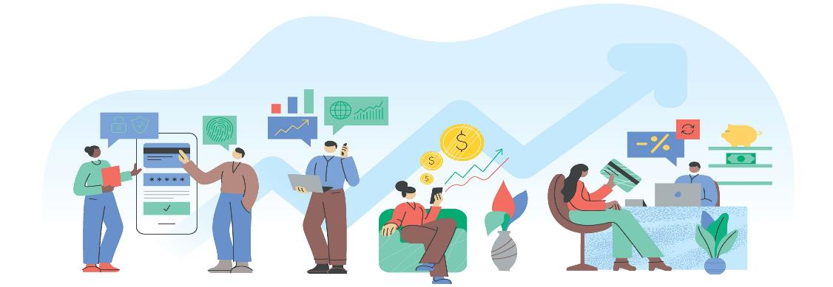
TFCU Accounts
Does it cost you to not have a bank account?
$25 + $25 New Member Perk
Free Checking & Savings Accounts
No Monthly Service Fees or Minimum Balances
Free Online Banking
Direct Deposit / Payroll Deduction
Surcharge-free ATM network
Co-Op Shared Branching
Free Financial Counseling
TFCU Member Givebacks

Slide 38
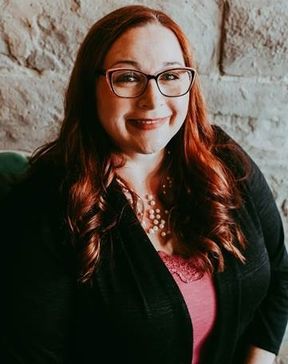
THANK YOU!
Tina Herndon
Financial Educator Tinker Federal Credit Union
Email: herndont@tinkerfcu.org
LinkedIn: @TinaHerndon
To schedule a workshop call or email: 405-319-2185 or FinancialEducationDept@tinkerfcu.org

