Slide 1
28th Annual Conference
Engage Your Leaders
Strategies for Retention & Growth
- Diane Ristau & Carrie Beaudette, ROI, Inc
Durant, Oklahoma
September 23-25, 2024

Slide 2
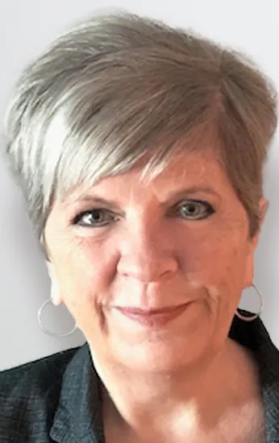
Carrie Beaudette
Diane Ristau
Vice President of Organizational Development
Vice President of Learning & Development
www.ROIsolutionsInc.com
612-360-9923

Slide 3
Let’s See Who’s Here!
In Human Resources/ Training
In a Leadership Position
Not in Human Resources/ Training
In Gaming
In a Non-Gaming Business
In Tribal Government
Other
www.ROIsolutionsInc.com

Slide 4
Develop a Leader Engagement Strategy by…
Removing common frustrations and barriers that exist
Providing robust, on-going development opportunities
Creating a culture of empowerment and accountability
Gaining buy-in and building HR’s credibility throughout the organization
www.ROIsolutionsInc.com

Slide 5
First, let’s define:
Employee Engagement is based on…
Behavior — the effort that an employee is willing to invest in their job
Attitude — the commitment a worker feels toward the company
Blink (co-worker connection app)
www.ROIsolutionsInc.com

Slide 6
Why Focus on LEADER Engagement?
Managers account for an astounding 70% in team engagement.
The SUPERVISOR
has the #1 impact
on an employee’s
decision to stay
www.ROIsolutionsInc.com

Slide 7
LEADER Engagement
Only 30% of employees are engaged
WHERE
DO YOUR EMPLOYEES
STAND?
ENGAGED
SATISFIED
DISENGAGED
www.ROIsolutionsInc.com
Notes:
In any company, engagement comes from the top. Employees look to their organization's executives and leadership team to set a tone and expectations. They know that company leadership determines whether engagement is important, or even if it matters at all.
…engagement at the top cascades down the line.
- Gallup

Slide 8
How Engagement is Measured – Gallup Q^{12 ®}
I know what is expected of me at work.
I have the materials and equipment to do my work right.
At work, I have the opportunity to do what I do best every day.
In the last seven days, I have received recognition or praise for doing good work.
My supervisor, or someone at work seems to care about me as a person.
Someone at work who encourages my development.
At work, my opinions seem to count.
The mission/purpose of my company makes me feel my job is important.
My co-workers are committed to doing quality work.
I have a best friend at work.
In the last six months, someone at work has talked to me about my progress.
In the last year, I have had opportunities to learn and grow.
www.ROIsolutionsInc.com

Slide 9
How Engagement is Measured – Gallup Q^{12®}
Manager Enablement Index – To measure their needs and challenges
Job authority and trust from senior leaders
Effective collaboration
How managers are consulted about changes that directly affect them
Growth opportunities and development
Performance management
Gallup, Inc.
www.ROIsolutionsInc.com

Slide 10
Or what would you like to be doing?
What is working well to engage your leaders?
www.ROIsolutionsInc.com

Slide 11
Removing Common Frustrations & Barriers
Unclear goals/expectations ➡ Clear & inspiring goals/expectations
Micro-managed ➡ Trusted
Overworked ➡ Work balance
Lack of skills & training ➡ Robust development opportunities
On an island ➡ Strong leadership community
Lack of vision/purpose ➡ Goals & meaning
Missing/outdated tools ➡ Automated & seamless
Promoted for job performance ➡ Promoted for leadership
www.ROIsolutionsInc.com

Slide 12
What barriers need to be removed for your leaders?
www.ROIsolutionsInc.com

Slide 13
Purpose & Expectations
Purpose: Your Vision, Mission & Core Values matter!
Expectations: Leaders need to know what’s clearly expected of them
When the two align and are understood, leaders are set up for success!
www.ROIsolutionsInc.com

Slide 14
Purpose & Expectations:
Redefine their Role
Boss:
Managing people and tasks
Coach:
Helping others WIN!
www.ROIsolutionsInc.com

Slide 15
Purpose & Expectations:
Redefine their Role
Coaching is:
Letting people know that what they do matters
- The Practical Coach
www.ROIsolutionsInc.com

Slide 16
Purpose & Expectations
Expectations:
Do you have a set of leader expectations?
Does it align with your leader competencies?
Purpose: Vision, Mission & Core Values
Are they known?
Are they a part of daily decision-making?
Are successes measured and celebrated?
www.ROIsolutionsInc.com

Slide 17
Purpose & Expectations
Competencies:
Technical job knowledge
Leadership
Self-Awareness/EQ
Management
www.ROIsolutionsInc.com

Slide 18
Identify the Gap & Strengths
Utilize Assessments
Core Competencies – Completed by Self and Superior
360 Surveys
DiSC® – Communication Style
Strengths-based Assessments
www.ROIsolutionsInc.com

Slide 19
What would you like to implement?
What assessments have been effective for you and why?
www.ROIsolutionsInc.com

Slide 20
Gallup has found that employees who receive
STRENGTHS-BASED development have….
Learn their strengths and then help them develop to use their
strengths intentionally.
7-23%
Higher Engagement
8-18% Increased Performance
20-73% Lower Attrition
www.ROIsolutionsInc.com

Slide 21
Provide Opportunities to LEARN & GROW
Development
Matters
Opportunities to learn and grow are the #1 reason younger generations of employees are attracted to an organization.
Lack of opportunities for development and advancement is the #1 reason employees of all ages leave an organization.
www.ROIsolutionsInc.com

Slide 22
Provide Opportunities to LEARN & GROW
Are top leaders having meaningful conversations with supervisors about how they’re doing now and about their future?
Are they sharing their advice and best practices with them?
36% of managers do not fully believe they have the skills they need to do their best work.
www.ROIsolutionsInc.com

Slide 23
Provide Opportunities to LEARN & GROW
Provide clear career paths, with frequent, incremental steps. (trend alert!)
Provide a mix of learning methods:
Classroom training
Discussion groups & Book clubs
On-the-job training
Job shadow
Stretch assignments
On-line learning/ apps
Mentorship
Identify development opportunities for all employees, including Tribal Member Development programs.
Provide mentorship programs.
www.ROIsolutionsInc.com

Slide 24
Provide Opportunities to LEARN & GROW
Leader Training
Start with your Mission/Expectations
Then move to Core Leadership Development:
Supervisor Orientation
Self-Awareness/EQ
Coaching Effectiveness
Providing Constructive Feedback
Building Strong Teams
Conflict Resolution
RETENTION:
30-50% higher when strong development programs are in place
- John Maxwell Leadership
www.ROIsolutionsInc.com

Slide 25
Provide Opportunities to LEARN & GROW
Qualification Criteria
Career Assessments
Individual Development Plans (w/ more hands-on mentorship & coaching)
Training & Awareness for Other Leaders
Honor & Recognize their Commitment
Develop Your Tribal Members
www.ROIsolutionsInc.com

Slide 26
What leadership training made a big impact on you or your leaders?
www.ROIsolutionsInc.com

Slide 27
You’ve Equipped Them! Now What?
___________________________________
Creating Ownership
Review job descriptions with leaders
Have conversations
Where are you currently not able to make a decision?
What do you need to feel fully informed?
How do you like to be lead/managed?
Give control over job
Make it safe to fail
www.ROIsolutionsInc.com

Slide 28
“Psychological safety is about creating an environment where ideas can be tested, risks can be taken, and mistakes can be learned from.”
-re:Work
www.ROIsolutionsInc.com

Slide 29
Gaining Buy-in & Building HR’s Credibility
________________________________________________________________________________
It starts with Executive Leadership
Align as a Strategic Partner, helping to identify performance needs
Partner executive leadership to lead People Reviews with each department
Open positions
Turnover
Training completion
Exit interviews
Conduct Internal Service Reviews
Celebrate successes – Leadership Recognition
www.ROIsolutionsInc.com

Slide 30
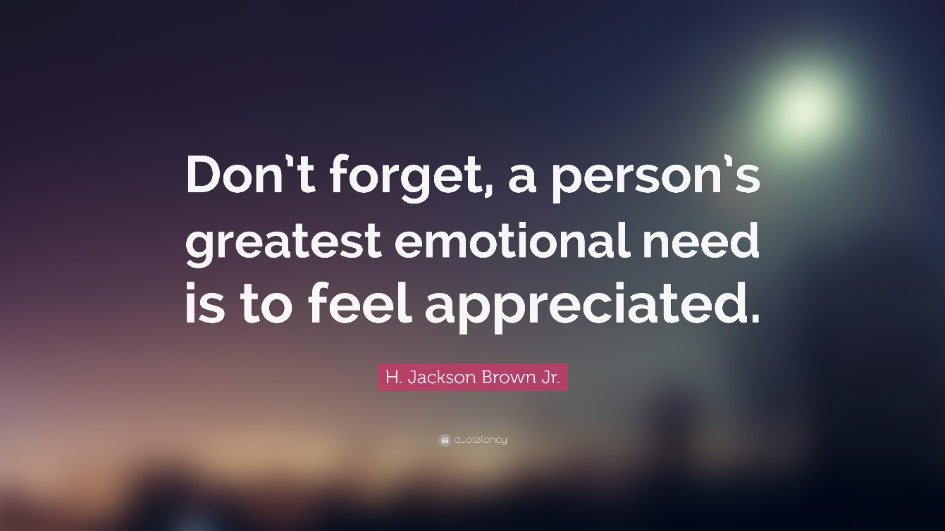
Notice & Celebrate Successes!
Link incentives to business and people results
Provide meaningful forms of recognition
Create memorable moments
www.ROIsolutionsInc.com

Slide 31
What is your #1 suggestion for positioning HR as a Strategic Partner?
www.ROIsolutionsInc.com

Slide 32
Thank You!
Leadership Development
Employee & Customer Experience Evaluation
Comprehensive Customer Service Programs
Training Design & Development
(Click on Talent Management Portfolio for a full list of services)
www.ROIsolutionsInc.com
612-360-9923

Slide 33
Foundation for
Service Success
Langevin
www.ROIsolutionsInc.com

