Slide 1


Back-to-back world champion head coach
Dominic Bramante
presents
The
champions mindset

Slide 2
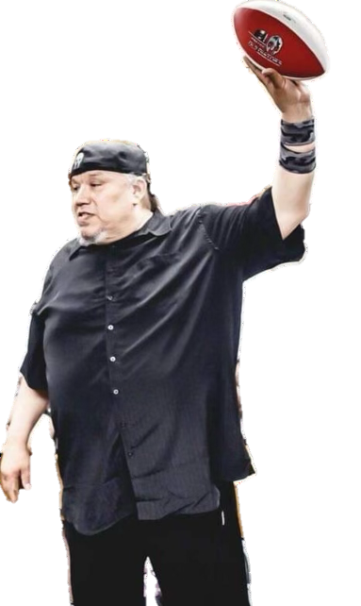

pace
the
We will set
P
Passion
A strong and barely controllable emotion
Dominic Bramante
champions mindset
The

Slide 3
pace
the
We will set
a
accountability
Required or expected to justify actions or decisions;
responsible
Dominic Bramante
champions mindset
The

Slide 4
pace
the
We will set
C
committed
Bound or obligated
As under a pledge to a particular cause, action, or attitude
Dominic Bramante
champions mindset
The

Slide 5
pace
the
We will set
e
excellence
The quality of being outstanding or extremely good.
The state, quality or condition of excelling;
superiority
Dominic Bramante
champions mindset
The

Slide 6
3
rules
Team
1
Always protect the team
The Team, the team, the team
Dominic Bramante
champions mindset
The

Slide 7
3
rules
Team
2
No whining
No complaining
No excuses
Believe in the power of intentions and want everybody to speak in the affirmative.
A negative mentality attracts negative thoughts.
A positive approach creates the power of possibilities.
Dominic Bramante
champions mindset
The

Slide 8
3
rules
Team
3
Be ready
Be early
Be disciplined
Be organized and show respect.
Expect an uncommon level of performance in every aspect of your life.
Dominic Bramante
champions mindset
The

Slide 9
3
Ingredients of
culture
1. trust
Given or earned?
2. toughness
Must have a relentless drive to get better every day
3. teamwork
This will always
be about us
Dominic Bramante
champions mindset
The

Slide 10
3 leadership
principles
1. Values provide the moral authority for skillful leadership
2. Proper planning is the most effective way for a leader to approach the future
3. self-discipline is the bedrock foundation on which
successful leadership is built
Dominic Bramante
champions mindset
The

Slide 11
4
H
the
‘s
history
heartbreak
Hero
hopes
Dominic Bramante
champions mindset
The

Slide 12
“a very great vision is needed, and the man who has it must follow it as the eagle seeks the deepest blue of the sky.”
- Crazy horse
Dominic Bramante
champions mindset
The

Slide 13
“Stay away from negative people; they have a problem for every solution.”
- Albert einstein
Dominic Bramante
champions mindset
The

Slide 14
“I don’t think much of a man who is not wiser today than he was yesterday.”
- Abraham Lincoln
Dominic Bramante
champions mindset
The

Slide 15
“greed is good. Greed clarifies, crystallizes, and purifies!!! What he meant was passion.”
- Gordon gekko
Dominic Bramante
champions mindset
The

Slide 16
loyalty
Within the workplace, loyalty from leadership sends a very positive message to employees.
It enhances the employee’s sense of self-worth.
In turn, such loyalty tends to stimulate the employee’s own feelings of loyalty to leadership and the organization.
Dominic Bramante
champions mindset
The

Slide 17
Back-to-back world champion head coach
Dominic Bramante

