Slide 2
Generational Differences and the Impact of Artificial Intelligence (AI)
Presented by Jake Aguas, Ph.D.
Principal Consultant, Morris Interactive

Slide 3
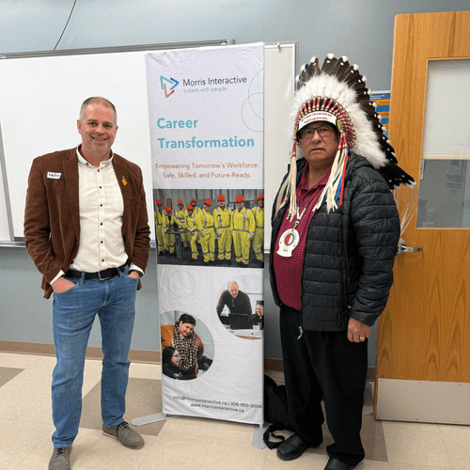
Morris Interactive
Work with over 180 Native American Indian, First Nations, & Metis Tribes
Learning and Development Training
Human Resource and Organizational Development
Leadership Development
Succession Planning
Performance Management
Productive Conflict Training
Generations
Emotional and Social Intelligence
Team Building

Slide 4
Learning Objectives
Define a Generation
Understand what constitutes a generation and why differences
matter in the workplace
Highlight Current Challenges
Identify the key generational challenges affecting today's workplace
environment and team productivity
Discuss AI-Driven Tensions
Explore how artificial intelligence (AI) adoption creates new sources of
Intergenerational conflict in the workplace
Present Strategies
Learn practical approaches to bridge generational gaps and foster collaboration
in a technology-driven workplace

Slide 5
Presentation Summary

Slide 6
The Multi-Generational Workplace
Unprecedented Diversity
More generations working together than ever before
Technological Revolution
AI is reshaping workplace dynamics and creating workplace friction
Communication Challenges
Different styles across generations

Slide 7
What this Means
Today's workplace is experiencing a unique convergence of generations, each shaped by different formative experiences and technological exposures
This diversity brings both rich perspectives and potential conflicts, particularly as artificial intelligence transforms work processes at an unprecedented pace
Organizations that successfully navigate these generational differences can leverage the complementary strengths of each cohort—combining the technological fluency of younger generations with the deep experience and institutional knowledge of older workers

Slide 8
What is a Generation?
A group of people of similar age (born within a narrow span of years), located in the same sphere of influence (physical and/or virtual), experiencing the same events, environments, and social situations, during the formative and critical development stages of their lives—technology is the most influential factor impacting the shaping of a generation

Slide 9
Generation Groups
Generation Groups
Birth Years
The Silent Generation
1928-1945
Baby Boomers
1946-1964
Generation X
1965-1980
Millennials
1981-1995
Generation Z
1996-2009/2012
Generation Alpha
2013-2024/2029

Slide 10
Shifting Workplace Demographics
Baby Boomers are retiring at a rate of 10,000 per day in the United States—
that's 3,650,000 annually
Generation X is reaching its career maturity
Millennials are continuing to navigate diverse career paths
Generation Z is emerging as a critical component of a generational succession
plan, particularly for Baby Boomers
Differences in generational identity and perceptions of technology, particularly AI, contribute to workplace tensions that can impact productivity, communication, and organizational culture

Slide 11
Baby Boomers (1946-1964)
Defining Characteristics
Workplace Values
Aging workforce, increasingly health conscious
Perks, praise, and competitive compensation
Fitness-focused lifestyle orientation
Long working hours – "live to work" mentality
Confident, competitive, and disciplined
"Earn the right" approach to advancement
Goal-centric approach to work and life
Emphasis on high-quality, thorough work
"Dress for success" professional standards
Value physical presence and "face time" at the office
Baby Boomers represent a significant portion of current organizational leadership, bringing decades of experience and institutional knowledge. They foster a strong work ethic and organizational loyalty that continues to influence workplace culture.

Slide 12
Generation X (1965-1980)
Defining Characteristics
Workplace Values
Independent and highly adaptable
Personalized rewards and relationship-based
recognition
Self-reliant, entrepreneurial self-starters
Autonomous approach to work and problem-solving
"Work to live" mentality, valuing remote
work options
Skeptical of institutional authority
Loyalty to people rather than organizations
Strong self-trust and decision-making confidence
Preference for informality and casual professional
attire
Digital Immigrants who adapted to technological
change
Appreciation for clearly defined goals
and expectations
Advocates for work-life balance
Generation X combines traditional work values with digital adaptability. Their independent nature and pragmatic approach to leadership make them valuable change agents in organizations navigating technological transformation

Slide 13
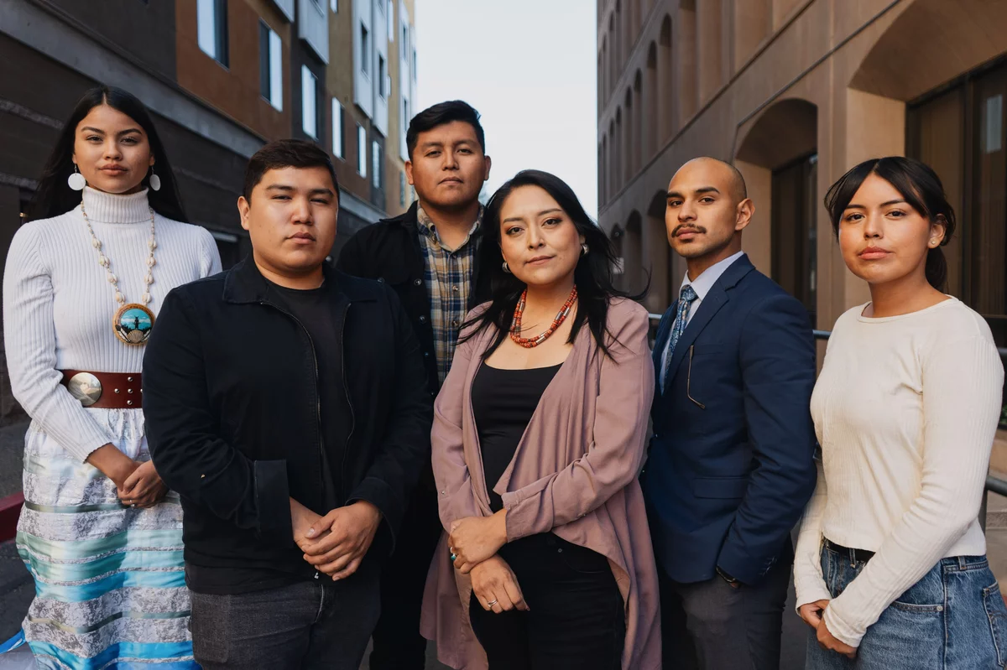
Millennials (1981- 1995)
Team-Oriented
Value collaborative environments and shared success
Feedback-Oriented
Crave input and regular performance discussions
Purpose-Driven
Curious about the "why" behind tasks and decisions
Meaning-Focused
Millennials bring technological proficiency, collaborative mindsets, and a desire for transparency. Their defining characteristics include hopeful optimism, exceptional talent, and civic-mindedness balanced with pragmatic approaches to career advancement. Millennials value loyalty to effective leadership rather than institutions, structured environments with clear expectations, and ample opportunities for work-life integration.
Seek meaningful work aligned
with personal values

Slide 14
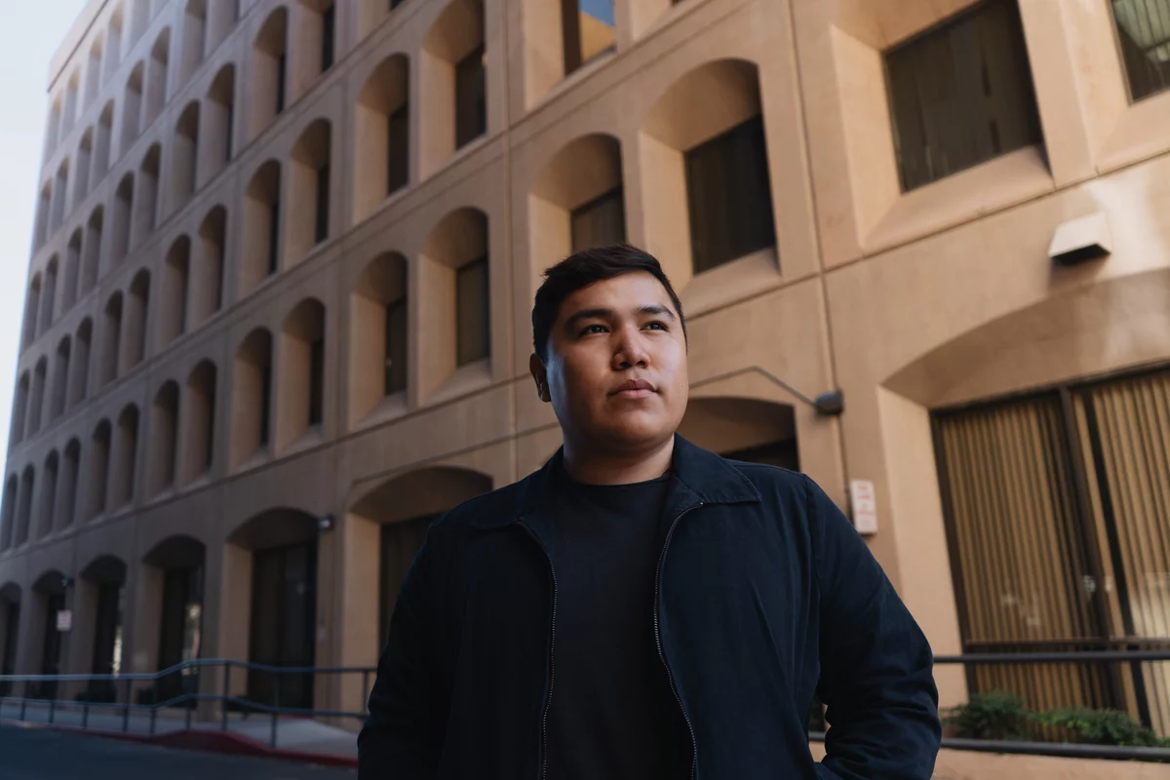
Generation Z (1996-2009/2012)
Defining Characteristics
Workplace Values
Tech-savvy (digital natives) and hyperconnected
“Work smarter not harder”
mindset
Appreciate both autonomy and collaboration
Meaning, significance, and relationships
Environmentally and ecologically conscious
Entrepreneurial and market-savvy
Financially conservative (compared to predecessors)
Safety-focused
Expect on-demand
Social responsibility
Career pathing and development
DIY problem-solving
Multitasking
Generation Z navigates technology seamlessly and integrates digital tools into all aspects of work and life, prioritizing safety
and security (mental wellness). Gen Z is more realistic and financially conservative compared to its Millennial peers and likes to move fast,
having no problem job hopping.

Slide 15
Top 5 Generational Challenges in The Workplace
1
2
Communication Clashes
Work Ethic Expectations
Differing communication preferences create friction—from Baby Boomers' preference for face-to-face meetings to Gen Z's comfort with instant messaging
Conflicting views on productivity, with older generations valuing office presence and younger ones prioritizing efficiency and results regardless of location
3
4
Leadership Approaches
Cultural Misalignment
Leadership style and feedback frequency expectations vary dramatically across generations, leading to satisfaction gaps
Fundamental differences in company culture expectations and core workplace values create ongoing tension

Slide 16
5. Technological Adoption
Generational Digital Divide
Rapid technological evolution has created a significant gap in digital fluency and comfort between generations
in the workplace
Digital Natives vs. Immigrants
Younger generations adapt quickly to new apps and platforms while older colleagues often struggle with constant technological change
Measurable Impact
Only 12% of workers over 50 use AI tools frequently, compared to much higher rates among younger generations
Workplace Consequences
90% of workplace teams report conflict over digital tool choices, with 60% claiming tech disputes hinder productivity
67% of employees concerned that emerging technologies like AI will further widen generational divisions at work, addressing
this gap becomes crucial for maintaining organizational cohesion

Slide 17
AI-Driven Tensions in the Workplace
AI Adoption Differences
Job Security Concerns
Varying comfort levels and usage patterns with AI technology
Different perceptions of AI's threat to employment
Digital Upskilling Gaps
Productivity Expectations
Unequal access to AI skill development
Contrasting views on AI's role in work efficiency
In modern workplaces, artificial intelligence has emerged as a new flashpoint between generations. Millennials and Generation Z approach AI technologies more aggressively and optimistically, while older generations tend to be more cautious and sometimes resistant.
These different approaches to AI create tensions across multiple dimensions, affecting everything from day-to-day collaboration to long-term strategic planning. Understanding these specific areas of conflict is essential for developing effective mitigation strategies.

Slide 18
Adoption Usage Differences
Research reveals significant generational differences in AI adoption
Approximately one-third of Generation Z (34%) and one-quarter of Millennials report frequent AI use for work tasks, while the majority of Generation X and Baby Boomers say they never use AI applications
Half of Generation Z and Millennials express eagerness to incorporate AI into their workflows, compared to only 34% of Baby Boomers. Millennials have developed particularly strong AI proficiency, surpassing other age groups in their comfort with these tools
The hesitation among older generations often stems from feeling overwhelmed by rapid technological changes, leading to resistance that can create team friction and leave veteran team members feeling alienated by tech-first approaches

Slide 19
Workplace Impact
Productivity Bottlenecks
Informal Support Burden
Failed Innovation Initiatives
When older managers or team members avoid leveraging AI, younger employees often feel their efficiency and innovation potential are artificially constrained, leading to frustration and suboptimal production outcomes.
Digitally savvy workers frequently end up serving as unofficial "tech support" for older colleagues, creating an additional workload that can dampen overall team output and create resentment.
In worst-case scenarios, promising AI initiatives fail completely due to a lack of buy-in from veteran team members, creating significant workflow divisions that impact organizational performance.
These impacts create a cycle of frustration that can significantly reduce team cohesion and organizational effectiveness.
When technology becomes a dividing line rather than a unifying tool, both individual and collective performance suffer, creating unnecessary friction in workplace relationships.

Slide 20
Job Security Concerns and AI Disruption
Generation Z & Millennials
Generation X & Baby Boomers
Younger generations express significant anxiety about AI’s
potential to disrupt their career trajectories:
Older generations typically demonstrate greater
confidence in their job security:
59% believe AI will eliminate jobs in their industry
Only 15% of Baby Boomers fear AI will replace their
positions
40% of Millennials fear AI could replace their current position
Entry-level workers see traditional starting roles increasingly automated
Longer career histories provide perspective on
previous automation waves
New graduates worry about finding viable opportunities as traditional pathways evolve
Established roles often feel less vulnerable to
immediate disruption
Greater emphasis on interpersonal skills that AI
cannot easily replicate

Slide 21
Workplace Impact
Eroded Team Morale
Generational Rifts
When employees—particularly younger ones—fear that AI may eventually make their roles obsolete, they may develop ambivalence or resistance toward AI-driven changes
Discussions about using AI can expose deep divisions between generations. Younger workers perceive older colleagues as blocking progress, and older employees view younger ones as naively undermining job security.
Trust Degradation
Implementation Delays
Different perceptions of AI's threats can lead to skepticism about leadership motives, especially when executives fail to address job security concerns transparently
Divergent perspectives on AI's impact can slow a team's progress and frustrate both ambitious AI adopters and more cautious skeptics, creating a cycle of tension

Slide 22
Productivity and Culture Clashes
Younger Generations' Perspective
Older Generations' Perspective
Younger workers approach productivity through an efficiency lens:
Veteran employees often define productivity differently:
Value thoroughness and established processes
"Work smarter, not harder" mentality
Concern that AI "shortcuts" may compromise
quality
Eager to leverage AI for automation and workflow streamlining
Worry about younger generations missing
important learning experiences
Measure productivity by output quality and efficiency gains
Technology-enabled efficiency connects to broader values of work-life balance
Associate productivity with visible effort and
time investment
Equate physical presence with engagement
and commitment
View traditional processes as unnecessarily time-consuming
Older generations may perceive younger colleagues as taking shortcuts and not putting in sufficient effort, while younger generations
view older colleagues as stuck in inefficient habits that waste time and resources. Both sides feel misunderstood and undervalued when
their approach to productivity is criticized.

Slide 23
Workplace Impact
37%
30%
65%
Gen Z Productivity Loss
Millennial Impact
Manager Misperception
Percentage of Generation Z reporting reduced productivity attributed to generational differences in work approach
Percentage of Millennials experiencing productivity challenges due to generational misalignment
Percentage of older managers who judge productivity by traditional metrics like desk time rather than output
This disconnect demoralizes team members, stifles innovation, and creates friction that hurts organizational
outcomes. Recent research increasingly links productivity slumps and persistent workplace conflicts to these fundamental generational misunderstandings about what constitutes effective work.

Slide 24
AI Digital Upskilling Between Generations
The rapid integration of AI into workplace processes has exposed a significant generation gap in digital skills development. Millennials and Generation Z typically approach new technologies proactively, seeking out AI-related skills through online courses and self-directed learning. In contrast, Generation X and Baby Boomers, despite possessing deep industry knowledge, often have fewer formal opportunities to develop advanced digital skills.
Research shows that older workers receive significantly fewer digital upskilling opportunities, creating a widening proficiency gap as younger team members continue advancing their technological capabilities. This disparity creates both practical workflow challenges and potential sources of intergenerational tension.

Slide 25
Workplace Impact
Negative Employee Experience
1
Unequal upskilling leads to diminished morale and higher turnover
Workflow Inconsistencies
2
Teams develop parallel systems using different technological approaches
Task-Based Age Segregation
3
Work divides along generational lines based on digital comfort
Younger generations often feel that older colleagues slow down innovation, while veteran employees may feel embarrassed or defensive
about keeping pace with technological change. This dynamic frequently leads to an unintended "division of labor" where technical tasks are
assigned based on age rather than expertise or interest. If left unaddressed, these skills disparities widen both practical workflow divisions
and cultural rifts between generational groups.

Slide 26
Strategies
Transparent Communication
Commit to openness about AI plans, clearly explaining the strategic reasoning and human roles
Upskilling Commitment
Robust upskilling and reskilling programs transform perceived job threats into career growth opportunities—77% of workers across generations express willingness to learn new skills to enhance future employability
Human-AI Collaboration Focus
Emphasize how AI augments rather than replaces human work to help alleviate anxiety
Educate on AI Capabilities
Training programs targeted at experienced managers help debunk misconceptions about AI-driven work, demonstrating that faster doesn't necessarily mean lower quality

Slide 27
Strategies
Establish AI Usage Guidelines
Setting clear parameters for when, where, and how to use AI creates shared expectations that both younger and older workers can trust and follow
Modernize Performance Metrics
Leading organizations update evaluation criteria to focus on outcomes rather than inputs, creating clear guidelines that acknowledge efficiency and quality
Foster Mutual Respect
Creating a culture that explicitly values both hard-earned knowledge and digital efficiency helps bridge generational divides and reduce productivity frictions
Multi-Format Training
Providing diverse learning options—including self-paced e-learning, instructor-led workshops, and individualized coaching—ensures that employees of all learning styles and technical comfort levels can develop AI skills effectively

Slide 28
Thank You!
Dr. Jake Aguas
Jake@morris-interactive.com

