Slide 2
SELECTING THE RIGHT HR TECHNOLOGY FOR YOUR ORGANIZATION
A Practical Guide
Moderator: Sunshine Brown
Customer: Wildhorse Resort and Casino, Paskenta Band of Nomlaki Indians
Notes:
Welcome to:
We are scheduled for x amount of time.

Slide 3
SUNSHINE
BROWN
SUZANNE
CLEM
JANINE
SAM
Ascend Sr Sales Executive
Wildhorse Resort & Casino Director of Human Resources
Paskenta Band of Nomlaki Indians Director of Human Resources
16 years of HCM Consulting
Operations Leader of a Great Place to Work company for 7 years
Specialty in Process Improvements and Professional Services
THRP Certified
34 years facilitator of Leadership and Employee Development
24 years of HR at Wildhorse Resort and Casino, owned by Confederated Tribes of the Umatilla Indian Reservation
19 years NNAHRA Member
16 years NNAHRA Board of Directors
14 years Little River Band of Ottawa Indians Tribal Council; 4 Years Board of Directors
7 years with Tribal Citizen/ Youth Development Programs
Over a decade of HR Leadership serving 3 Tribal Governments
Specialty in incorporating Traditional Knowledge and Values into HR practices
Notes:
Intro the team and share their experience with HR Technology Software selection and implementation

Slide 4
A Practical Guide
Setting the
Stage​
Defining your
Why
Clarifying
Requirements​
Avoiding
Pitfalls​
​
Why selecting the right HR Tech matters now​
What’s driving your organization to explore new technology
What you need – and what you don’t
What to look out for and how to ensure success
Timing is
Everything​
Putting it All Together​
Closing
Thoughts
When to act
How to align strategy, needs, and timing
Lessons learned, Q&A

Slide 5
Why Selecting the Right HR
Technology Matters

Slide 6
Let’s ask AI
Notes:
Why do we need technology in HR? So we can focus on the people.

Slide 7
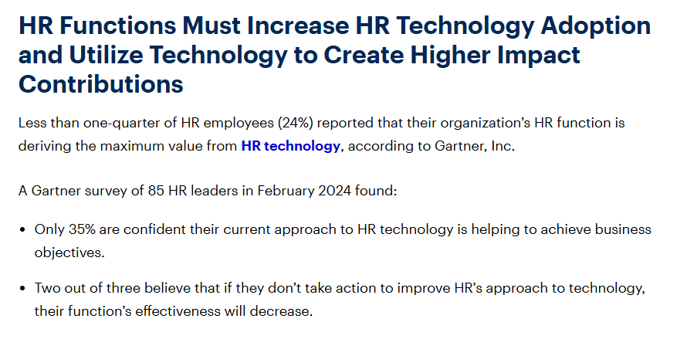
2024 Gartner Report

Slide 8
Defining your Why?
Why are we looking for new tech?
What pain points are we having with current technology and processes?
What problems are we trying to solve for?
Are the problems functionality, strategic or experience related?
Are we trying to align with the organization’s vision? If yes, how?
Notes:
So, now that we all agree having the right tech is super important to our job and the success of our organization, what’s our first step if we’ve decided to evaluate HR technology for the tribe or enterprise we represent.
Bullets: elaborate
Suzanne and Janine – what were their whys

Slide 9
Clarifying Requirements
Priorities vs
Nice-to-Have
What
Who
What are our Functional vs Technical requirements?
What do these things drive?
What goals do these align to?
What could we accomplish if these requirements met?
What are we using today and why is it not working? What is reason for change?
What does our current technology offer that we are not using? Why?
What does success look like?
Who are the organizational leaders that will own this project?
Who will be the key resources who will lead this project internally?
Who will be involved in this implementation and for what purposes?
Do we need external resources to assist with this project?
Who will be our biggest champion and biggest obstacle to this change?
What are the priorities?
When are they needed?
Why are they the priorities?
Are these something we have today?
Do we have competing priorities? Do they change over time?
What are our nice-to-haves?
How do we know the difference between priorities and nice-to-haves?
How can we track our priorities and nice-to-haves?
Notes:
Key items to consider when requirements gathering:
What, who, priorities vs nice to haves

Slide 10
Don’t confuse features with outcomes
Avoid overloading on “nice to haves”
Do not skip internal alignment
Avoid relying on vendor promises alone
Do not ignore end-user input
Do not over-engineer requirements
Consider the flexibility or inflexibility of the product
AVOID PITFALLS
Do your homework and research
Avoid rushing the process
Consider resource involvement to implement
Ask meaningful questions
Ask for help if you need it
Seek out insight from others
Consider professional services and external support when selecting new technology
Notes:
After you’ve identified the Why , what and who you’d be ready to start the actual process for evaluating vendors. However, this is where we should stop and discuss risks/ pitfalls to avoid.
In my experience, these are things you should ask if you’re doing along the way. Consider them guardrails to keep you on the right track…

Slide 11
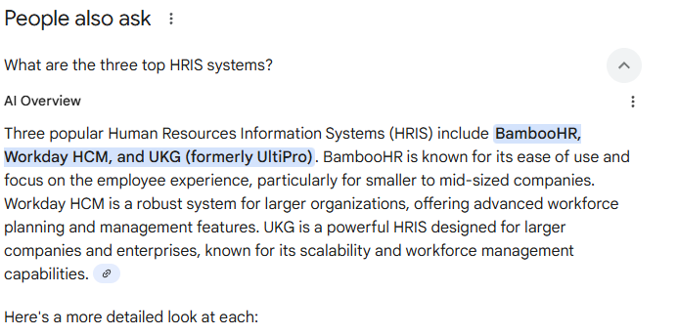
Resources to Research Vendors
Gartner Report
Forbes 10 Best HR Software Companies
SHRM White Paper: HR Software Pricing and Trends 2025
AI Overview

Slide 12
Resources to Compare Software and Services
Review Sites:
G2 Crowd - since 2013
Software Advice - since 2014
TrustRadius – since 2012
Capterra (owned by Gartner) – since 1998

Slide 13
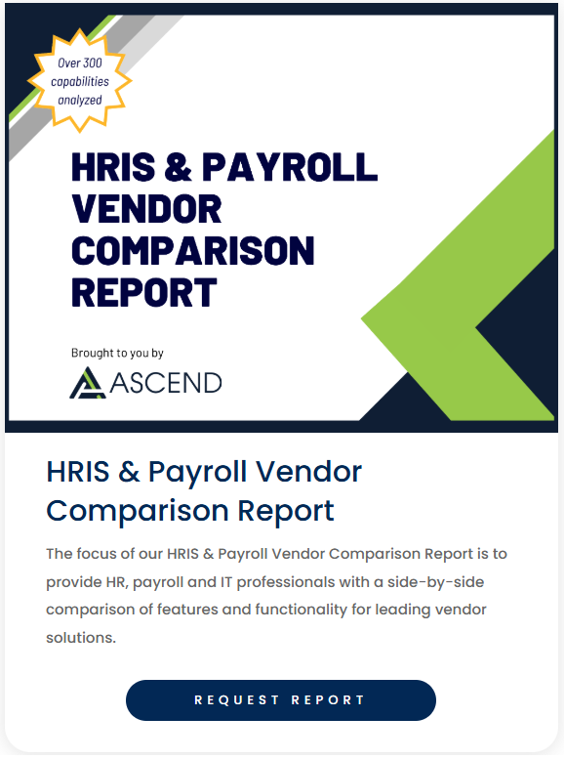
Vendor Comparison Resources
Notes:
Good opportunity to talk about getting help from external firms (not part of the vendor or the client team)
Janine and Suzanne’s input

Slide 14
RFP vs Evaluation
RFP
Evaluation
RFP
What is it: A Request for Proposal
A document used to announce a new project and solicit bids from vendors
PROS:
Documents the vendors responses
Allows the company to have a full list of items they are requesting from the vendor
CONS:
Lengthy, non-interactive process
Cannot be included in the contract; not a legally binding document
What is it: Process of evaluating vendors through product demos, and detailed vendor meetings discussing company, culture, services and methodology
PROS:
Allows the buyer to ‘see’ functionality
Allows interactive process between vendor and buyer
CONS:
Scheduling conflicts
Functionality between vendor solutions can begin to run together
Can be difficult to sort through multiple opinions
Notes:
Once you’ve researched the vendors you need to consider the RFP or Evaluation

Slide 15
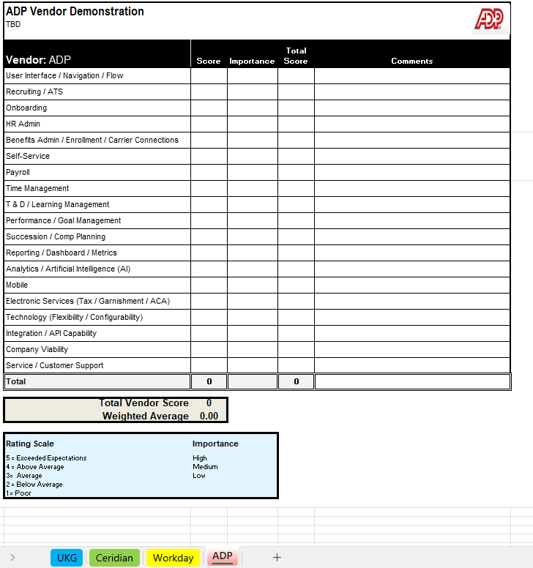
Examples of Scorecard
Notes:
Which ever direction you go, RFP or straight to evaluation with scripted or unscripted demos, you’ll want your team to score them. This helps take the emotion out of the process. For example, we have seen vendors who have scored lowest on the scorecard get selected because the client liked the salesperson – and all too often the opposite being true.

Slide 16
When you take a leap, timing is everything
When will my team and organization be ready for this change?
When does it make sense from a budget perspective?
When can our company afford to make the change? (Time, Resource and Cost)
When can the vendor start the project and take us live?
Notes:
When is the right time?
Internal readiness: change management, bandwidth, budgeting
External timing: vendor market, fiscal cycles
Building a realistic timeline with change management, training, phases
Suzanne and Janine – their feedback

Slide 17
Putting it All Together
STRATEGIC GOALS
REQUIREMENTS
PROCESS: EVALUATE & RESEARCH
TIMING & CAPACITY
STAKEHOLDER ALIGNMENT + LEADERSHIP SUPPORT
WHY: BUSINESS CASE
SUCCESS
Notes:
Starting with strategic goals that promote having the right HR technology – or rather identifying that your org needs HR technology is key.
Then the process starts with why we need it; why the investment of time, resources and money are important
Defining what and who is needed from the technology (feature, functionality, support)
Process of evaluating the HR technology options: Research and Process itself: RFP and evals
When is the right time
Having leadership and organization support for ties it up – critical to success

Slide 18
TAKE AWAYS & QUESTIONS
?
Q&A

Slide 19
THANK YOU!
Ascend is one of the largest exclusive UKG partners in North America.
We offer comprehensive implementation services catering to both mid-market and enterprise organizations with vast experience with tribal entities, healthcare, public sector and non-profit organizations.
With a focus on personalized service and a deep understanding of digital transformation, Ascend empowers businesses to fully leverage their technological investment.
Our talented team is dedicated to delivering exceptional value and ensuring a smooth and valuable experience for every customer.
Sunshine Brown
(909) 993-2576
sbrown@ascendps.com

