Slide 2
AI IN HR: MANAGING LEGAL RISKS & ADAPTING HR POLICIES

Slide 3
Agenda
What is Generative AI and Why is it Relevant?
Demonstration
Legal Landscape of AI in HR
Futureproofing my Organization’s Use of AI in HR

Slide 4
Poll
Have you used Gen. AI personally?
YES
NO
Discussion: How?

Slide 5
Poll
Have you used Gen. AI professionally?
YES
NO
Discussion: How?

Slide 6
What is Generative AI and why is it relevant?

Slide 7
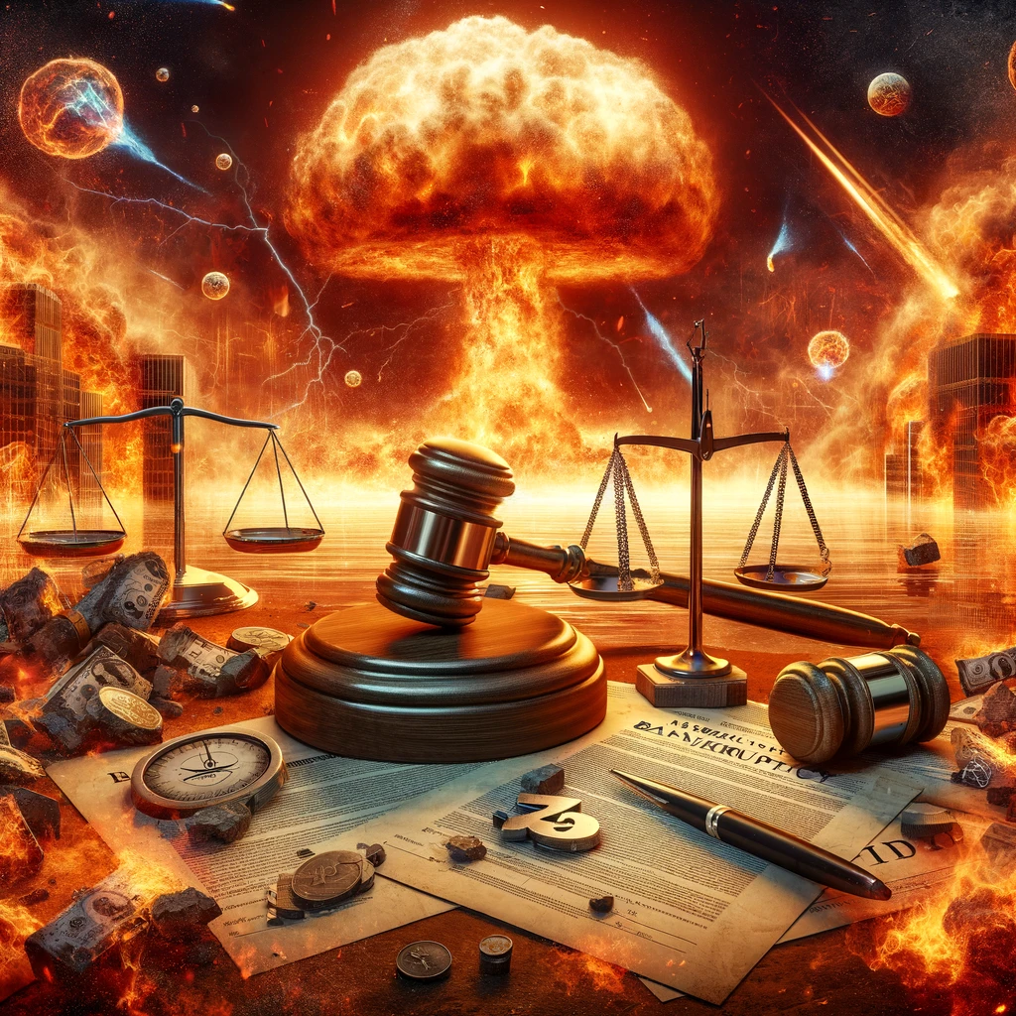
It will be the death of HR and our careers
Image created by DALL-E

Slide 8
It will usher in an Edenlike future for HR and Tribes
Image created by DALL-E

Slide 9
It is just another technological change
Image created by ChatGPT image generator

Slide 10
Demonstration
So how do these services work, anyway?

Slide 11
Sample Prompts
Document Drafting: I am a Tribal HR Director. Prepare an equal employment opportunity policy for my Tribe’s employee handbook.
General Research: Do federal employment laws apply to employees of Native American Tribes when the employee lives and works outside of tribal land?
Ideation: Help me think of ways to strengthen employee retention, honor tribal values, and support career development pathways for both tribal and non-tribal employees. Generate a list of creative initiatives, policies, or programs that the HR team could pilot over the next year.
Hiring/Application Assessment (Document Review): Analyze the attached 3 attached resumes and send me the top candidate based on relevant educational and work experience.
Editor/Tone Check: Review and improve the wording of the following email: “Hey Justin, just a reminder that you have a meeting with John next week, try to wear something other than your normal t-shirt and flipflops. We meet is 5/15 at 2pm. Don’t miss it.”

Slide 12
Human language and the patterns of thinking behind it are somehow simpler and more “law like” in their structure than we thought. ChatGPT has implicitly discovered it.
–Stephen Wolfram
Source: Stephen Wolfram Blog

Slide 13
Definitions
Artificial Intelligence – Computer systems that can perform tasks typically associated with human intelligence (visual perception, speech recognition, translation, decision making).
Machine Learning – Computer systems that can learn to do things from data without explicit programming.
Neural Networks – Computer systems modeled on the human brain, composed of artificial neurons.
Deep Learning – Neural networks with a large number of layers of neurons.
Language Models - Computer systems that can predict the next word or word order of a sentence.
Large Language Models - Language models trained on extremely large datasets.

Slide 14
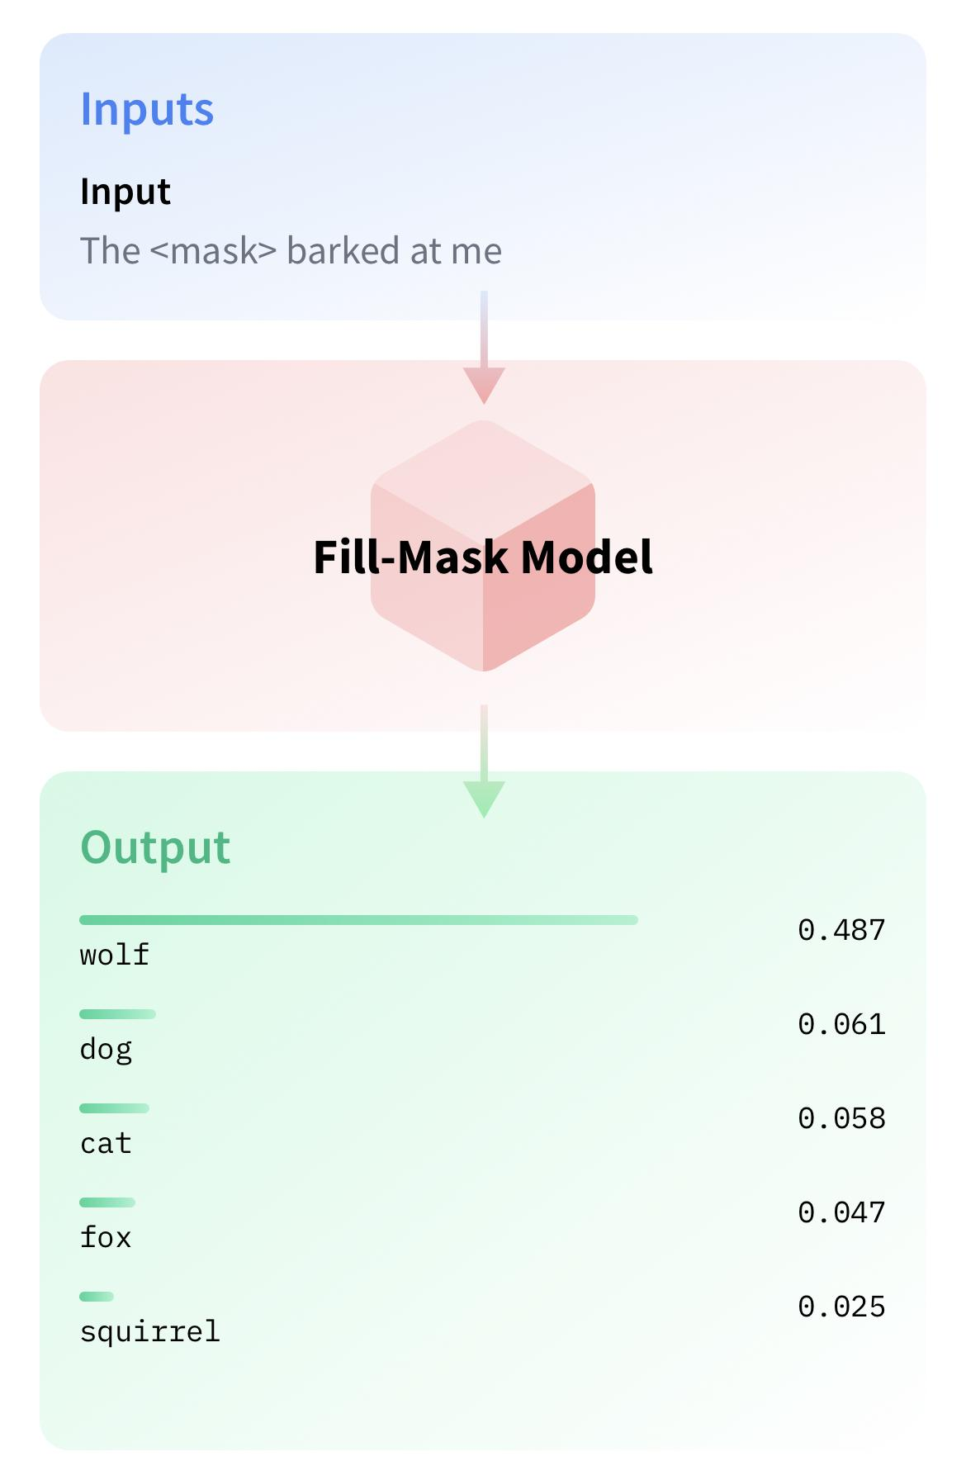
Generative
AI details
Generative vs. Extractive AI
Language Models
It’s expensive to label data
Unlabeled text data is common
“Masking” words in a sentence
Predicting the next word
“Advanced Autocomplete”?
Source: Hugging Face

Slide 15
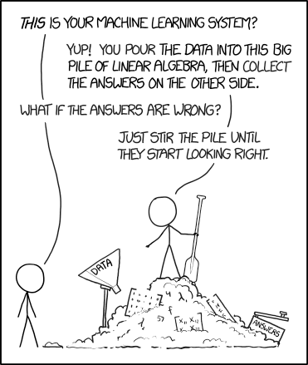
Training Data
Data Sources
Common Crawl, WebText, Books, Wikipedia, GitHub
Public legal documents
ChatGPT data volume:
570GB, 500B tokens
Biases (gender, race, . . .)
Knowledge cutoffs (2023)
“Grounding”
Internal Legal Databases (and as related to APIs)

Slide 16
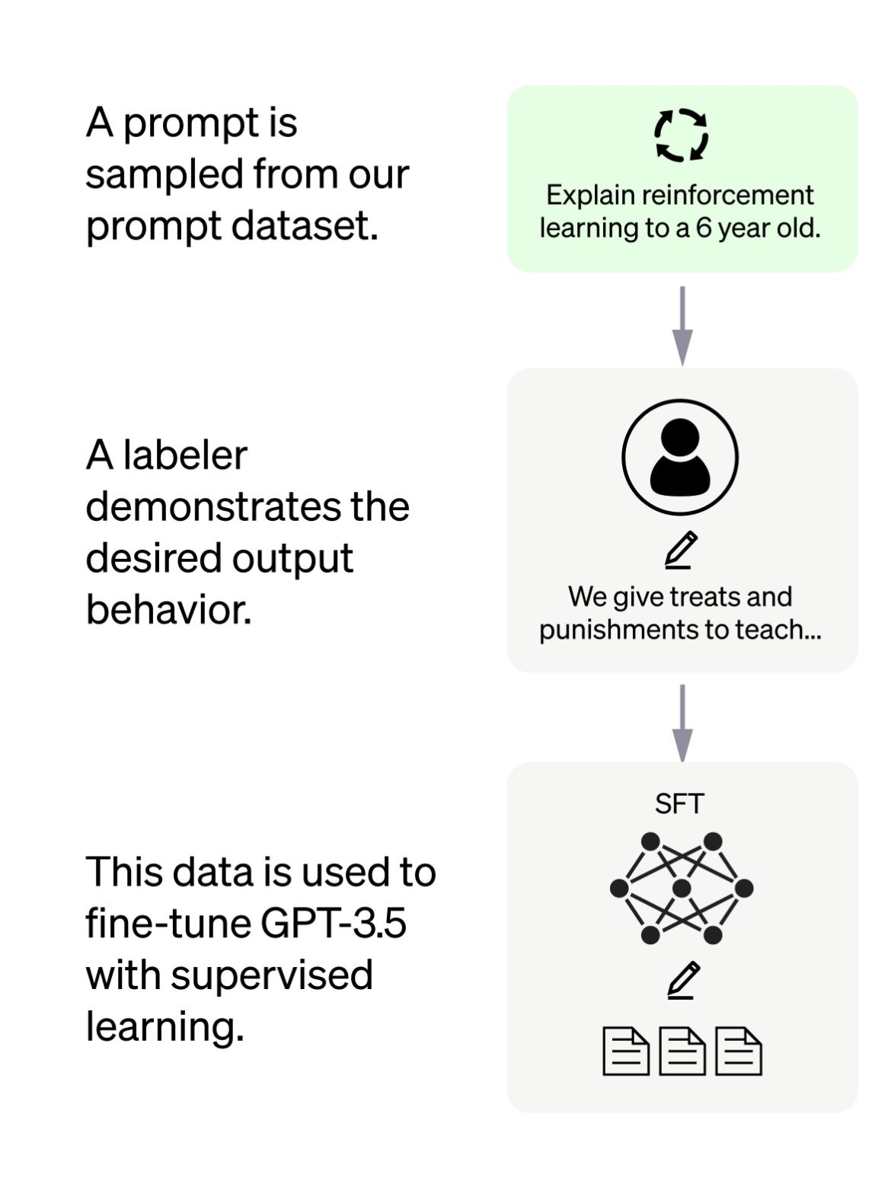
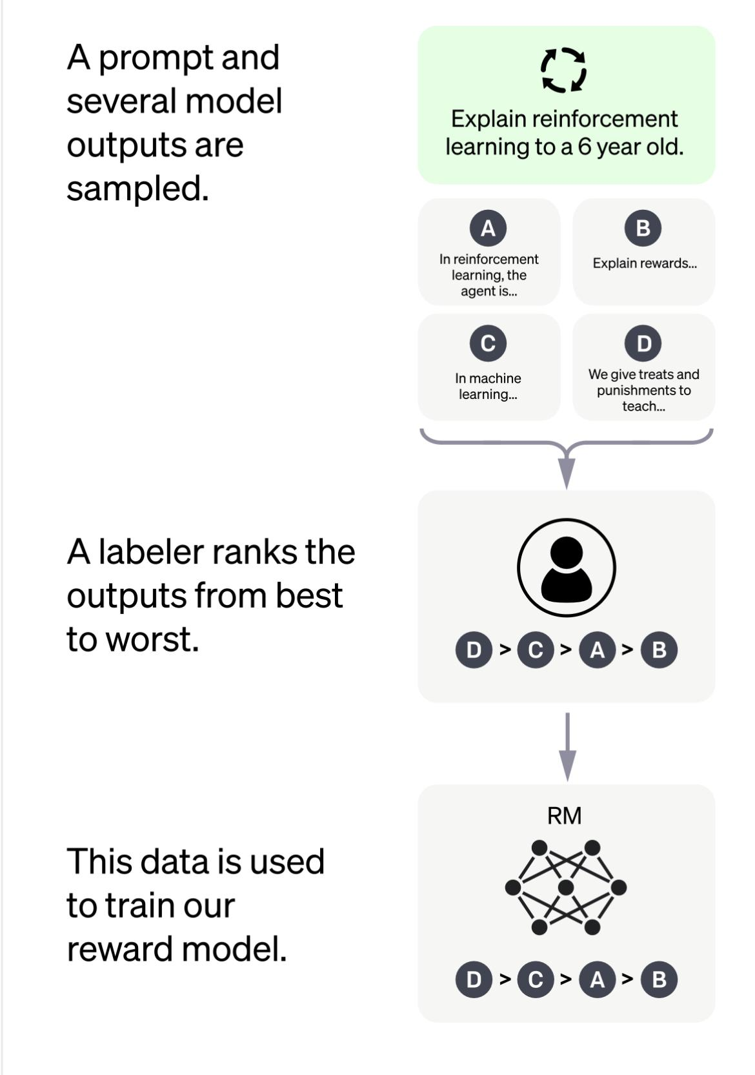
Fine Tuning
Motivation:
Better quality
Reduce harm
Specialization
LawGPT
Source: OpenAI

Slide 17
Legal Landscape of AI in HR

Slide 18
“Artificial intelligence and algorithmic decision-making tools have great potential to improve our lives, including in the area of employment. At the same time, the EEOC is keenly aware that these tools may mask and perpetuate bias or create new discriminatory barriers to jobs. We must work to ensure that these new technologies do not become a high-tech pathway to discrimination.”
- Former EEOC Chair Charlotte A. Burrows

Slide 19
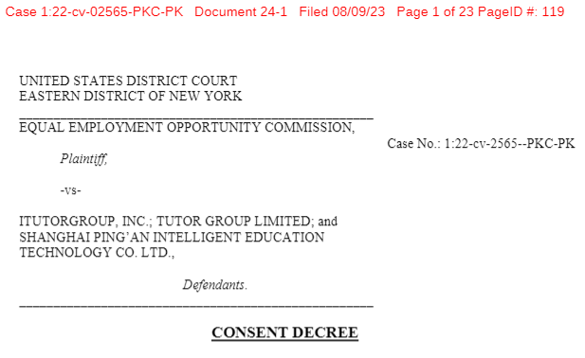
EEOC AI Settlement
August 9, 2023 – EEOC settled an AI bias case brought under the Age Discrimination in Employment Act (“ADEA”), involving alleged age discrimination in hiring decisions.
Algorithm using machine learning automatically rejected women over 55 and men over 60.
$365,000 settlement and all rejected applicants over 40 invited to reapply for 3 years.

Slide 20
Mitigating Legal Risks
Ask yourself:
What laws that implicate AI apply to my organization, if any?
If laws that implicate AI apply to my organization, am I up-to-date on legal guidance?
If my organization contracts with HR vendors that use AI, have I ensured that the vendors are up-to-date on legal guidance?

Slide 21
1. What laws that implicate AI apply to my organization, if any?
As an initial step, determine whether laws that implicate AI arguably apply to the organization’s applicants or employees, e.g., Title VII of the Civil Rights Act, Americans with Disability Act (“ADA”), Age Discrimination in Employment Act (“ADEA”), Fair Credit Reporting Act (“FCRA”).

Slide 22
1. What laws that implicate AI apply to my organization, if any?
Potential sources of applicable law:
Tribal Code
Tribal Constitution
Tribal Traditions and Customs
Tribal Court Case Law
Compacts
Tribal Employment Rights Ordinance (“TERO”)
Treaties
Federal Labor and Employment Statutes and Regulations
Federal Case Law
State Employment Laws and Regulations (which generally do not apply to tribal employers absent consent)

Slide 23
1. What laws that implicate AI apply to my organization, if any?
Applicability of Federal and State Employment Laws to Tribes and Tribal Employers:
Federal employment laws
Two main types of federal employment law statutes:
(1) federal statutes that expressly exclude Indian tribes; and
(2) federal statutes of “general application” that are silent as to Indian tribes.
Under Ninth Circuit precedent, federal employment laws of “general application” are commonly held to apply to tribes unless they fall into one of three exceptions: (i) application of the law would abrogate treaty right; (ii) Congress did not intend for the law to apply to tribes, or (iii) applying the law would interfere with the right of self-governance in purely intramural matters (e.g. self-governance exception).
Other circuits, such as the Eighth and Tenth Circuits, reject the Ninth Circuit’s presumption that generally applicable laws apply to tribes.
Even if a law is applicable, tribes may still assert tribal sovereign immunity.

Slide 24
1. What laws that implicate AI apply to my organization, if any?
State employment laws
Tribal employers are not subject to state employment laws without consent of the tribe, e.g., privacy laws such as the California Consumer Privacy Act (CCPA), the Illinois Biometric Information Privacy Act (“BIPA”).
Consider full-time remote workers who live and work outside of tribal land.
Federal Employment Law Statutes Excluding Indian Tribes:
1) Title VII of the Civil Rights Act of 1964 (Title VII)
Expressly exempts Indian tribes
2) Americans with Disabilities Act (Title I: Discrimination)
Exempts Indian tribes from anti-discrimination provisions
3) Worker Adjustment and Retraining Notification Act (WARN)
Federal Department of Labor regulations exempt Indian tribes

Slide 25
1. What laws that implicate AI apply to my organization, if any?
Federal Employment Law Statutes without Specific Exclusions:
1) Age Discrimination in Employment Act (ADEA)
2) Fair Credit Reporting Act (FCRA)
3) Occupational Safety and Health Act (OSHA)
4) National Labor Relations Act (NLRA)
5) Title III of Americans with Disabilities Act (ADA)
Specifically the public access provisions
6) Fair Labor Standards Act (FLSA)
7) Family and Medical Leave Act (FMLA)
8) Consolidated Omnibus Budget Reconciliation Act (COBRA)
9) Employee Retirement Income Security Act (ERISA)
Exempts tribal employees performing “essential” government functions, and to employees performing commercial activities
10) Immigration Reform and Control Act of 1986

Slide 26
2. If laws that implicate AI apply to my organization, am I up to date on legal guidance?
On Jan. 23, 2025, the President signed Executive Order 14179, “Removing Barriers to American Leadership in Artificial Intelligence”, which requires federal agencies to review and roll back existing AI policies and regulations.
Shortly thereafter, the EEOC removed from its website previous guidance on potential legal liability under Title VII and the ADA:
“Select Issues: Assessing Adverse Impact in Software, Algorithms, and Artificial Intelligence Used in Employment Selection Procedures Under Title VII of the Civil Rights Act of 1964,” EEOC, May 18, 2023, EEOC-NVTA-2023-2.”
The Americans with Disabilities Act and the Use of Software, Algorithms, and Artificial Intelligence to Assess Job Applicants and Employees,” EEOC, May 18, 2023, EEOC-NVTA-2023-2

Slide 27
2. If laws that implicate AI apply to my organization, am I up to date on legal guidance?
Despite anticipated deregulation at the federal level, state and local legislatures across the United States have enacted or proposed restrictions on the use of AI in HR. For example:
California: Assembly Bill 2930 (Proposed)
Colorado: Senate Bill 24-205 (Effective Feb. 1, 2026)
Connecticut: Senate Bill 1484 (Proposed)
Illinois:
The Artificial Intelligence Video Interview Act (820 ILCS 42/1) (In Effect)
House Bill 3773 (Effective Jan. 1, 2026)
Maryland: House Bill 1202 (In Effect)
New Jersey: Attorney General Guidance (In Effect)
New York City: Local Law 144 (In Effect)
New York State: Senate Bill 1169 and Assembly Bill 768 (Proposed)
Texas: House Bill 1709 (Proposed)
Virginia: House Bill 2094 (Passed but Vetoed by Governor)

Slide 28
2. If laws that implicate AI apply to my organization, am I up to date on legal guidance?
Also consider:
Background check laws
Fair Credit Reporting Act (“FCRA”), and other background check laws, when applicable, require disclosure of summary of rights, and written authorization for background check.
Privacy laws
California Consumer Privacy Act (“CCPA”), the Illinois Biometric Information Privacy Act (“BIPA”), and similar laws.

Slide 29
3. If my organization contracts with HR vendors that use AI, have I ensured that the vendors are up-to-date on legal guidance?
The EEOC has previously taken the position that employers may be responsible for adverse impacts created from third-party software vendors that use AI.
Accordingly, it is important for organizations that contract with such vendors to ask:
1. Is the vendor knowledgeable about the current legal guidance on the use of AI in the HR space?
E.g.: Is it clear from speaking with the vendor that it has considered legal guidance when developing its software/algorithms?
2. What steps has the vendor taken to mitigate against the risk of an adverse impact against any protected classes?
E.g.: Has the vendor had an independent review conducted on its use of AI? Does the vendor offer its own applicant/employee consent forms and/or privacy policies.

Slide 30
So, what to do about employee AI use?
Option 2: Unlimited use of AI within Policy Frameworks
Option 1: No use of AI
Option 3: Regulated Use
Objective: Prioritize traditional methods, eschewing AI-based approaches
Implications:
Avoids ethical, legal, and privacy concerns associated with AI.
Might miss out on potential efficiencies, insights, and competitive advantages offered by AI.
Some employees may (likely will) use the technology despite the prohibition.
Relies solely on human decision-making processes and may disadvantage employees by limiting their use of a technology that may become necessary to know how to use well in the future.
Need policy of clear prohibition.
Objective: Embrace AI fully in all aspects without restrictions.
Implications:
Maximizes potential for innovation, efficiency, and data-driven insights.
Risks regarding data privacy, ethical concerns, and biases can emerge.
Less significant check on employee responsible/ethical use and potentially significant issues with cheating/plagiarism.
May miss opportunity to use GAI as additional opportunity to educate.
Employees may express concerns about transparency, job displacement, or decision-making processes.
Recommend you clarify permission.
Objective: Utilize AI within a defined set of ethical, legal, and operational guidelines.
Implications:
Balances the benefits of AI with responsible use, mitigating risks.
Requires regular audits and updates to ensure policies remain relevant.
Requires employee training and oversight.
Combines the strengths of AI with the insight and oversight of human intervention.
Requires a more detailed policy or set of policies.

Slide 31
Policy Drafting Tips; Consider Including…
Option 2: Unlimited use of AI within Policy Frameworks
Approved Tools Only – Employees may only use firm-approved generative AI platforms; all others require prior authorization from Tech Support.
Confidentiality is Paramount – Never input client, firm, or personal sensitive information into GAI tools.
Legal and Ethical Compliance – Use must comply with all applicable laws, professional conduct rules, and firm policies, including confidentiality, privacy, and diligence.
Not a Substitute for Judgment – GAI may assist with tasks but cannot replace professional expertise, legal analysis, or responsibility.
Accuracy Must Be Verified – All outputs must be reviewed for correctness and appropriateness before use in legal documents or client-facing work.
No Use in Hiring – Generative AI may not be used to evaluate or make decisions in the hiring process.
Manager Approval Required – Employees must notify and obtain approval from a manager or supervising attorney before using GAI in their work.
Allowed Uses Defined – Only the specified uses (e.g., research, drafting, proofreading) are permitted unless expressly approved by the Chief Privacy Officer.
Training is Required – Users must complete appropriate training on GAI’s ethical use, limitations, and evolving best practices.
Policy Violations Have Consequences – Misuse of GAI may lead to disciplinary action, including termination, and GAI use is subject to firm monitoring policies.
Option 3: Regulated Use

Slide 32
What should I do today to futureproof my Organization use of AI in HR?
1. Have a written policy
2. Train employees
3. Look out for agentic AI
4. Understand what information you cannot share and that which you are already sharing.

