Slide 1
April 19 - 21
25th Annual Conference
Honolulu, Hawaii

Slide 2
How Digital Advertising is Reshaping the Recruitment Landscape
Lynn Maurer
Director of Digital Strategy & Technology

Slide 3
AGENDA
What Is Out There for HR
What Other HR Execs Look For
Digital Products
HR Case Study

Slide 4
OUR BRAND POSITION
InnoVision refutes the “traditional agency” stigma by putting service and value first and believing that a “Just Say Yes” attitude will lead not only to guaranteed client satisfaction, but to more creative thinking, new innovations and complex ideation. Years of experience coupled with passion for the profession and a client-first approach have encouraged the rapid growth of InnoVision with a highly positive, passionate and diverse culture that serves as the foundation for the development of proven strategies. We prioritize precision and always ensure that our clients’ expectations are not only met, but exceeded by achieving their objectives accurately, meeting all deadlines and staying within all determined budgets.
Headquartered in sunny San Diego, InnoVision encompasses the best of both coasts with clients based throughout the United States including Washington, Florida, Arizona, New York and throughout California.
InnoVision Marketing Group is a brand-centric agency dedicated to providing the highest level of service. Plus, our 24/7 availability, accessibility and flexibility coupled with outstanding work are what make us the country’s only anti-agency® with results that continually exceed client expectations. Modeled after a New York agency in style, scope and intensity, InnoVision is defined by its unique culture of free-flowing ideas, transparency and positivity.
Our team’s personal interest in Huey Magoo’s success combined with a
hands-on, sales-oriented approach has garnered the brand huge results.

Slide 5
Team HERE AT NNAHRA
Ric Militi
Lynn Maurer
Alanna Markey
Bianca Kasawdish
CEO/Executive Creative Director
Director of Digital Strategy & Technology
Sr. Vice President/
General Manager
Director of Public Relations & Digital Content

Slide 6
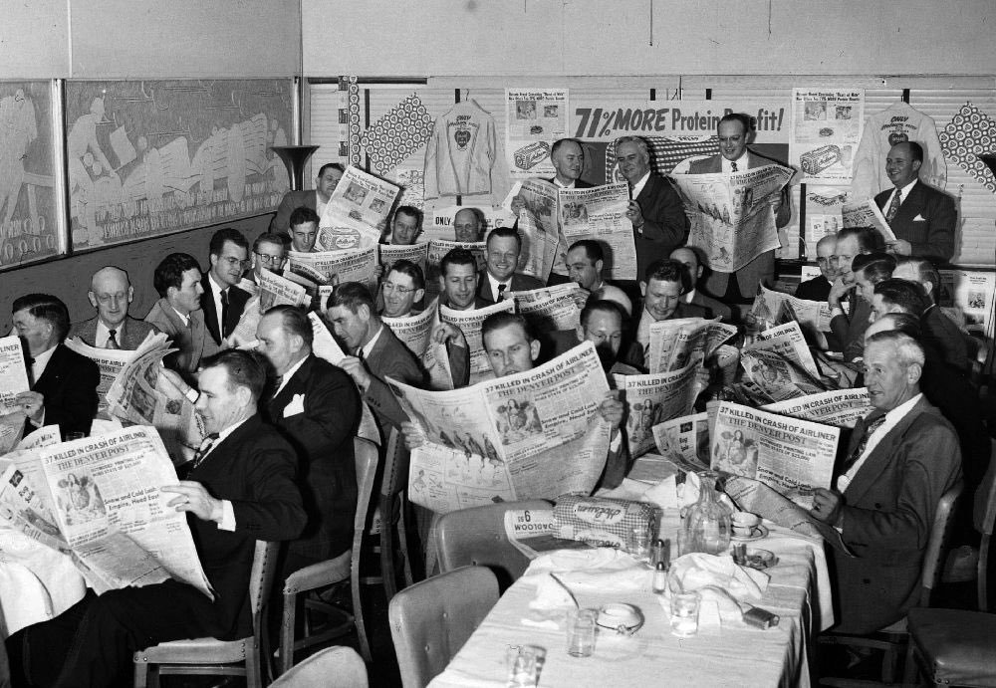
Memories...

Slide 7
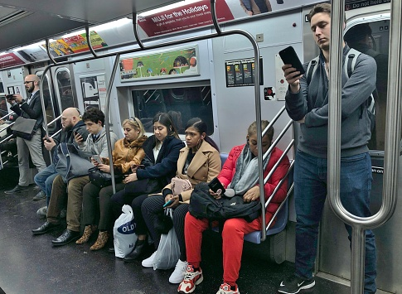
TODAY'S reality

Slide 8
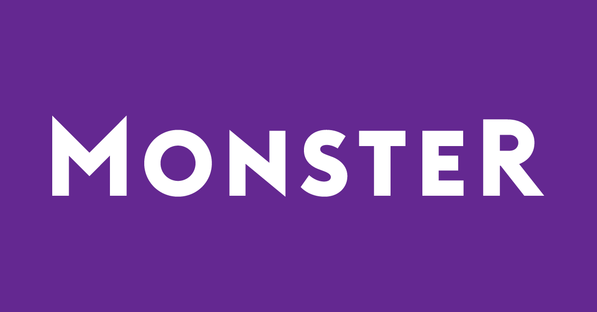
Social media / Job boards

Slide 9
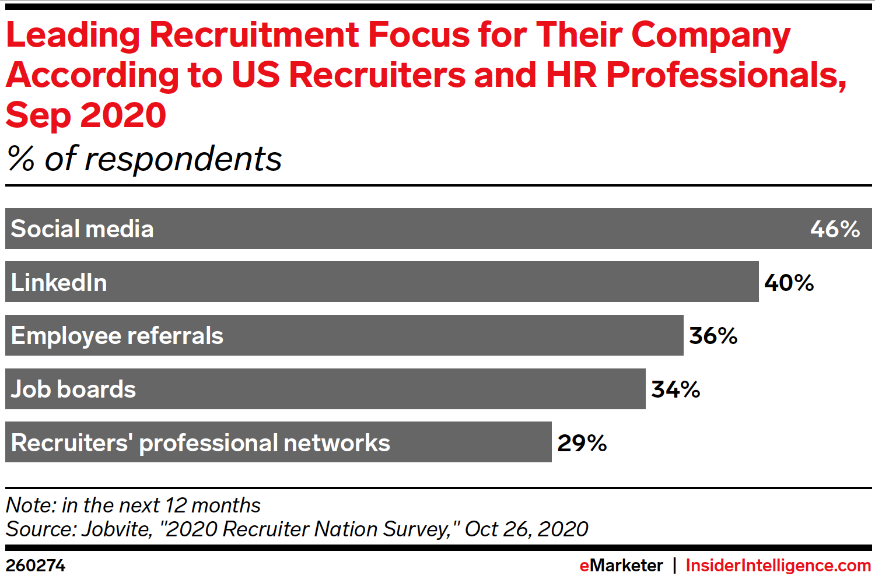
How are others recruiting

Slide 10
TikTok

Slide 11
Yes, This is real

Slide 12
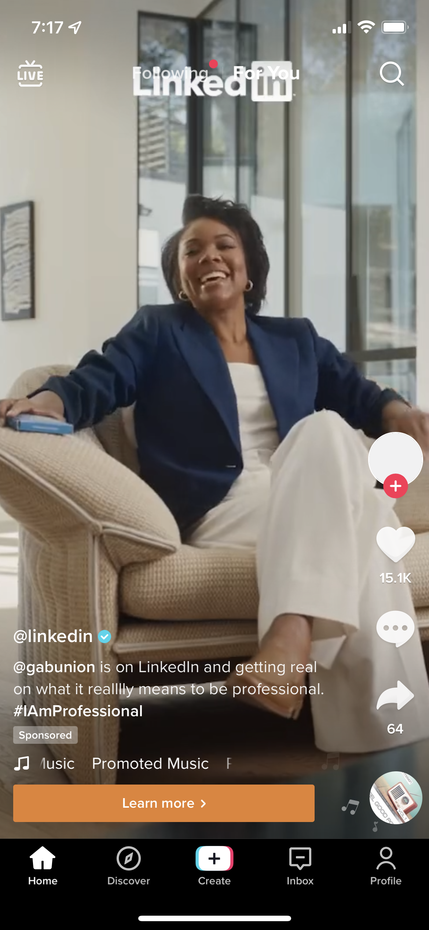
Even Linkedin jumped onboard

Slide 13
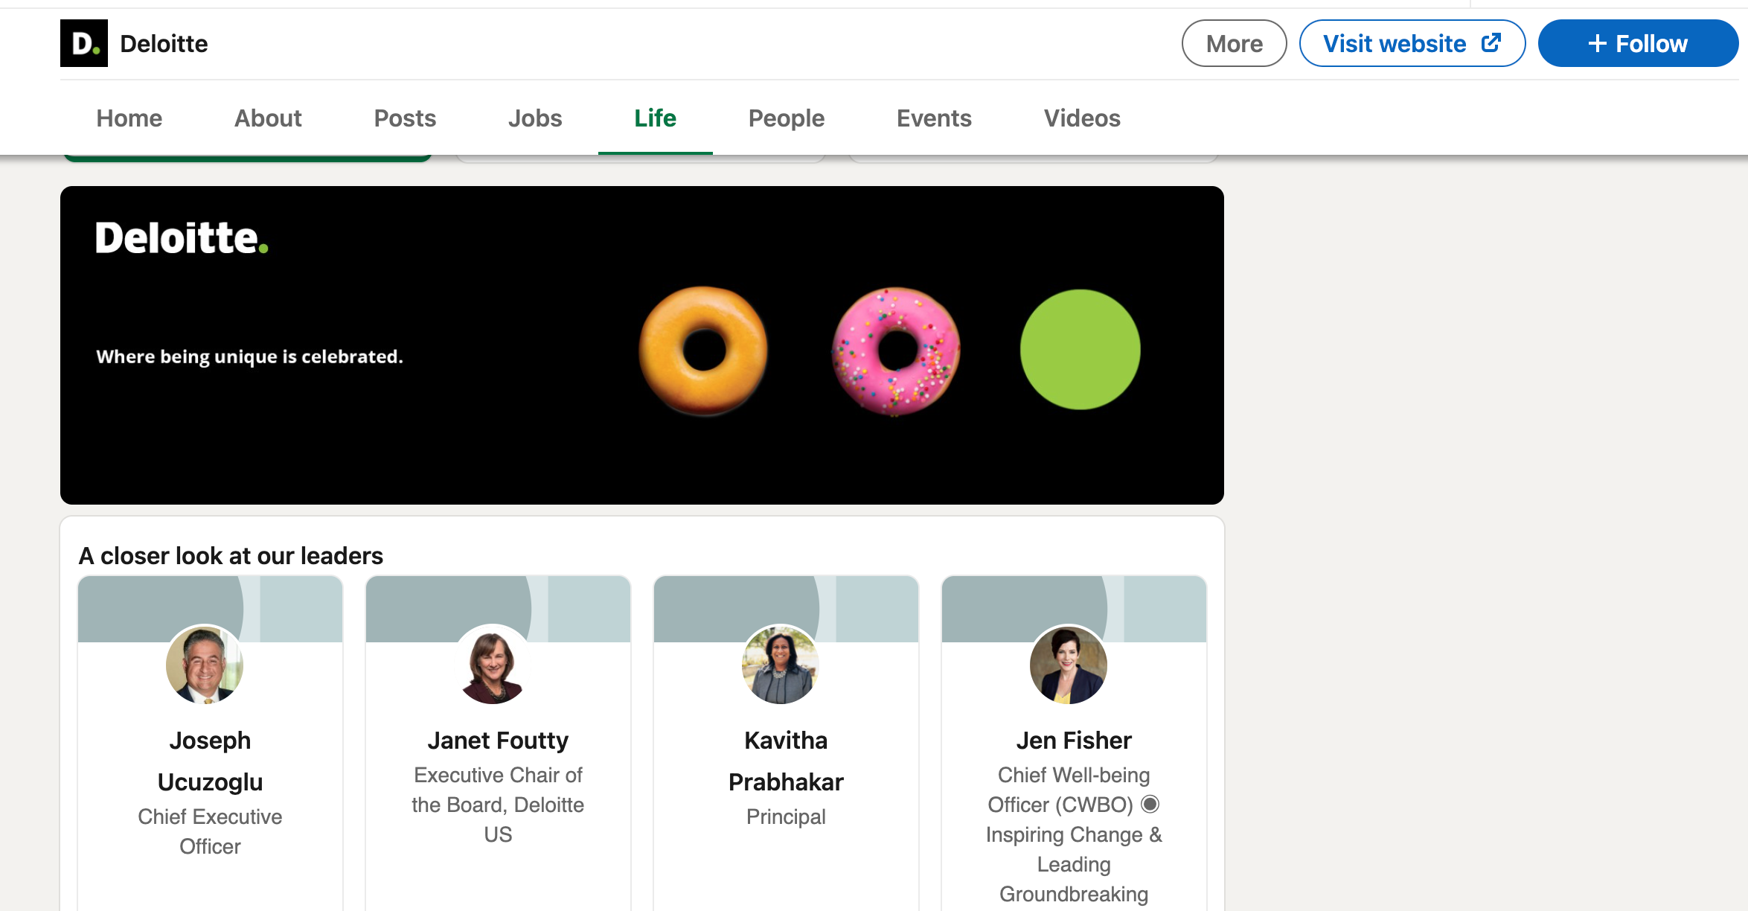
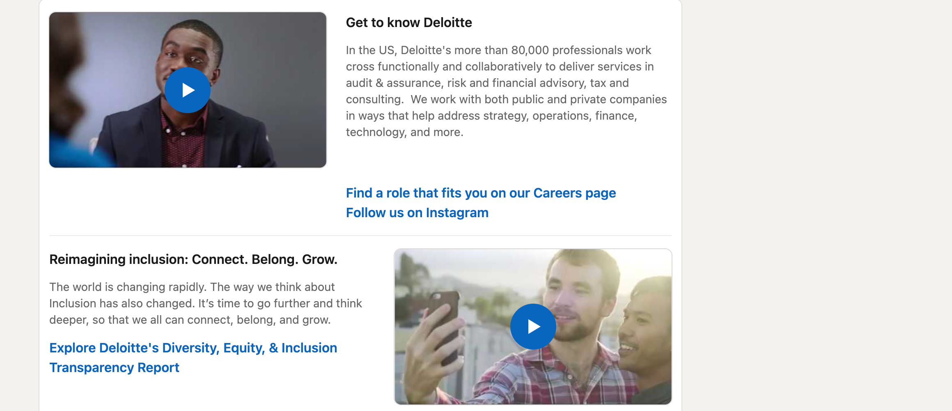
Linkedin
Be mindful and up-to-date on your company LinkedIn page

Slide 14
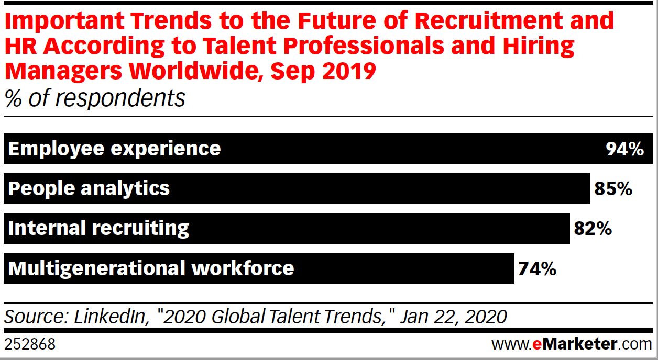
What to post

Slide 15
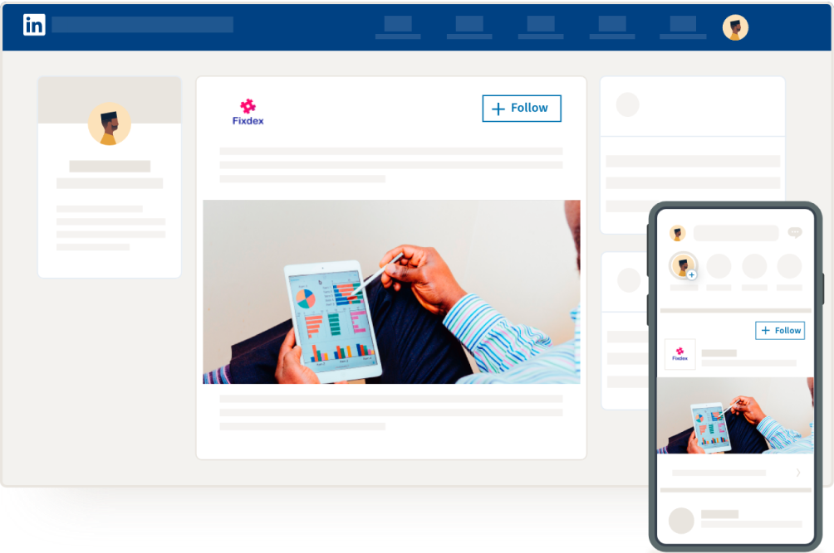
Linkedin targeting options
Can Include:
Location
Company Name
Company Size
Job Title
Job Experience
Skill Sets

Slide 16
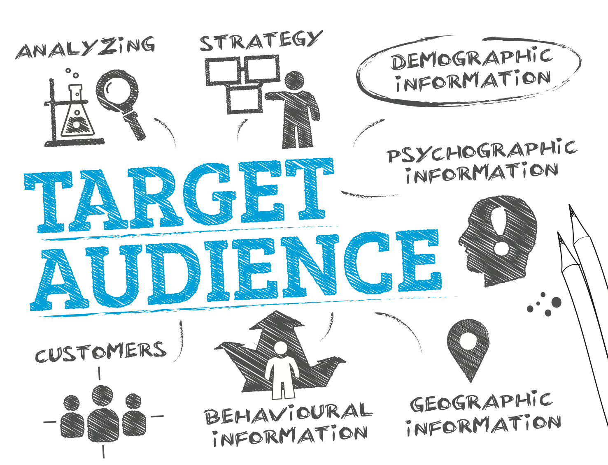
Digital targeting

Slide 17
Build the target
Who are we looking to reach?
Where are they?
How do we want to speak to them?

Slide 18
DISPLAY AD EXAMPLE

Slide 19
Display placement

Slide 20
Location targeting

Slide 21
Location targeting: How does it work?
We build an invisible fence around a specific location, or multiple locations
We decide what dates we want to pull mobile devices from – was it a one-day job fair? Or devices that are going to a specific school?
We gather the devices and build our audience from those devices which can then be served ads to their phone across multiple platforms!
Their device gives us lots of information as well – think demographics, psychographics, household information
Let’s see that info!

Slide 22
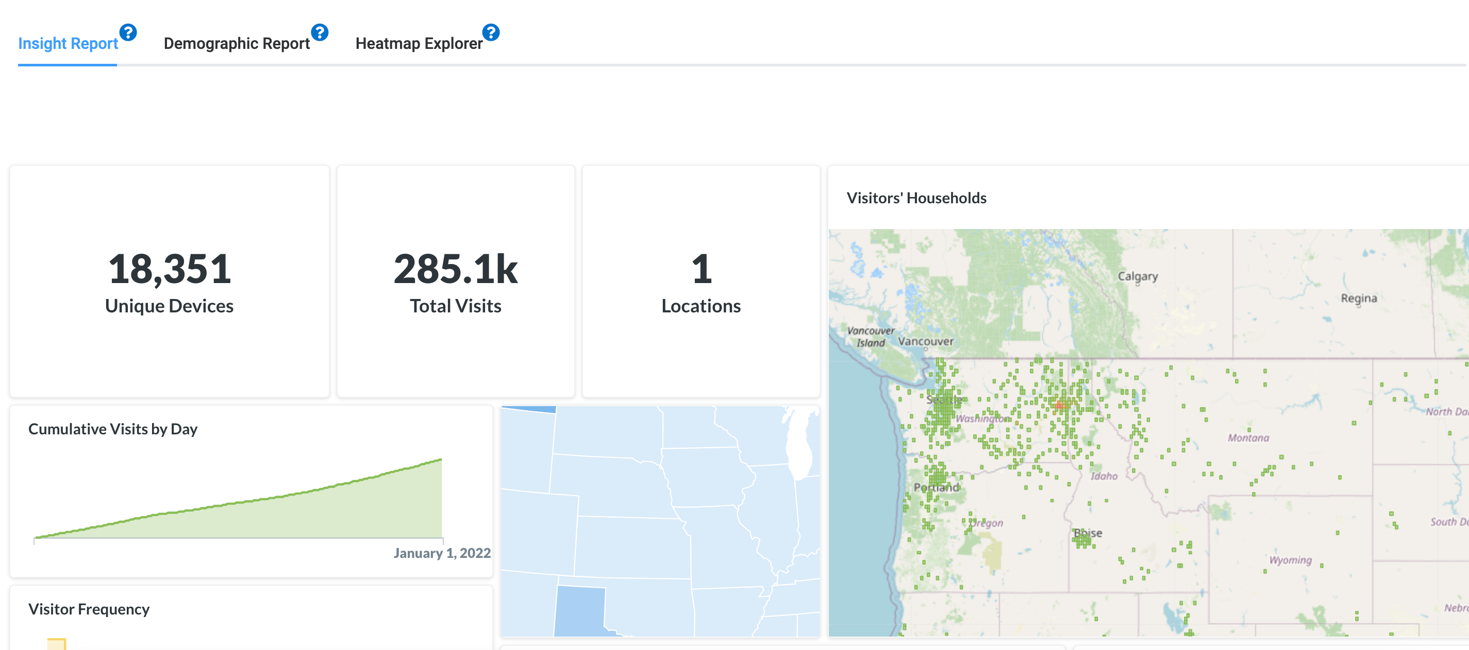
Polygonal targeting and attribution

Slide 23
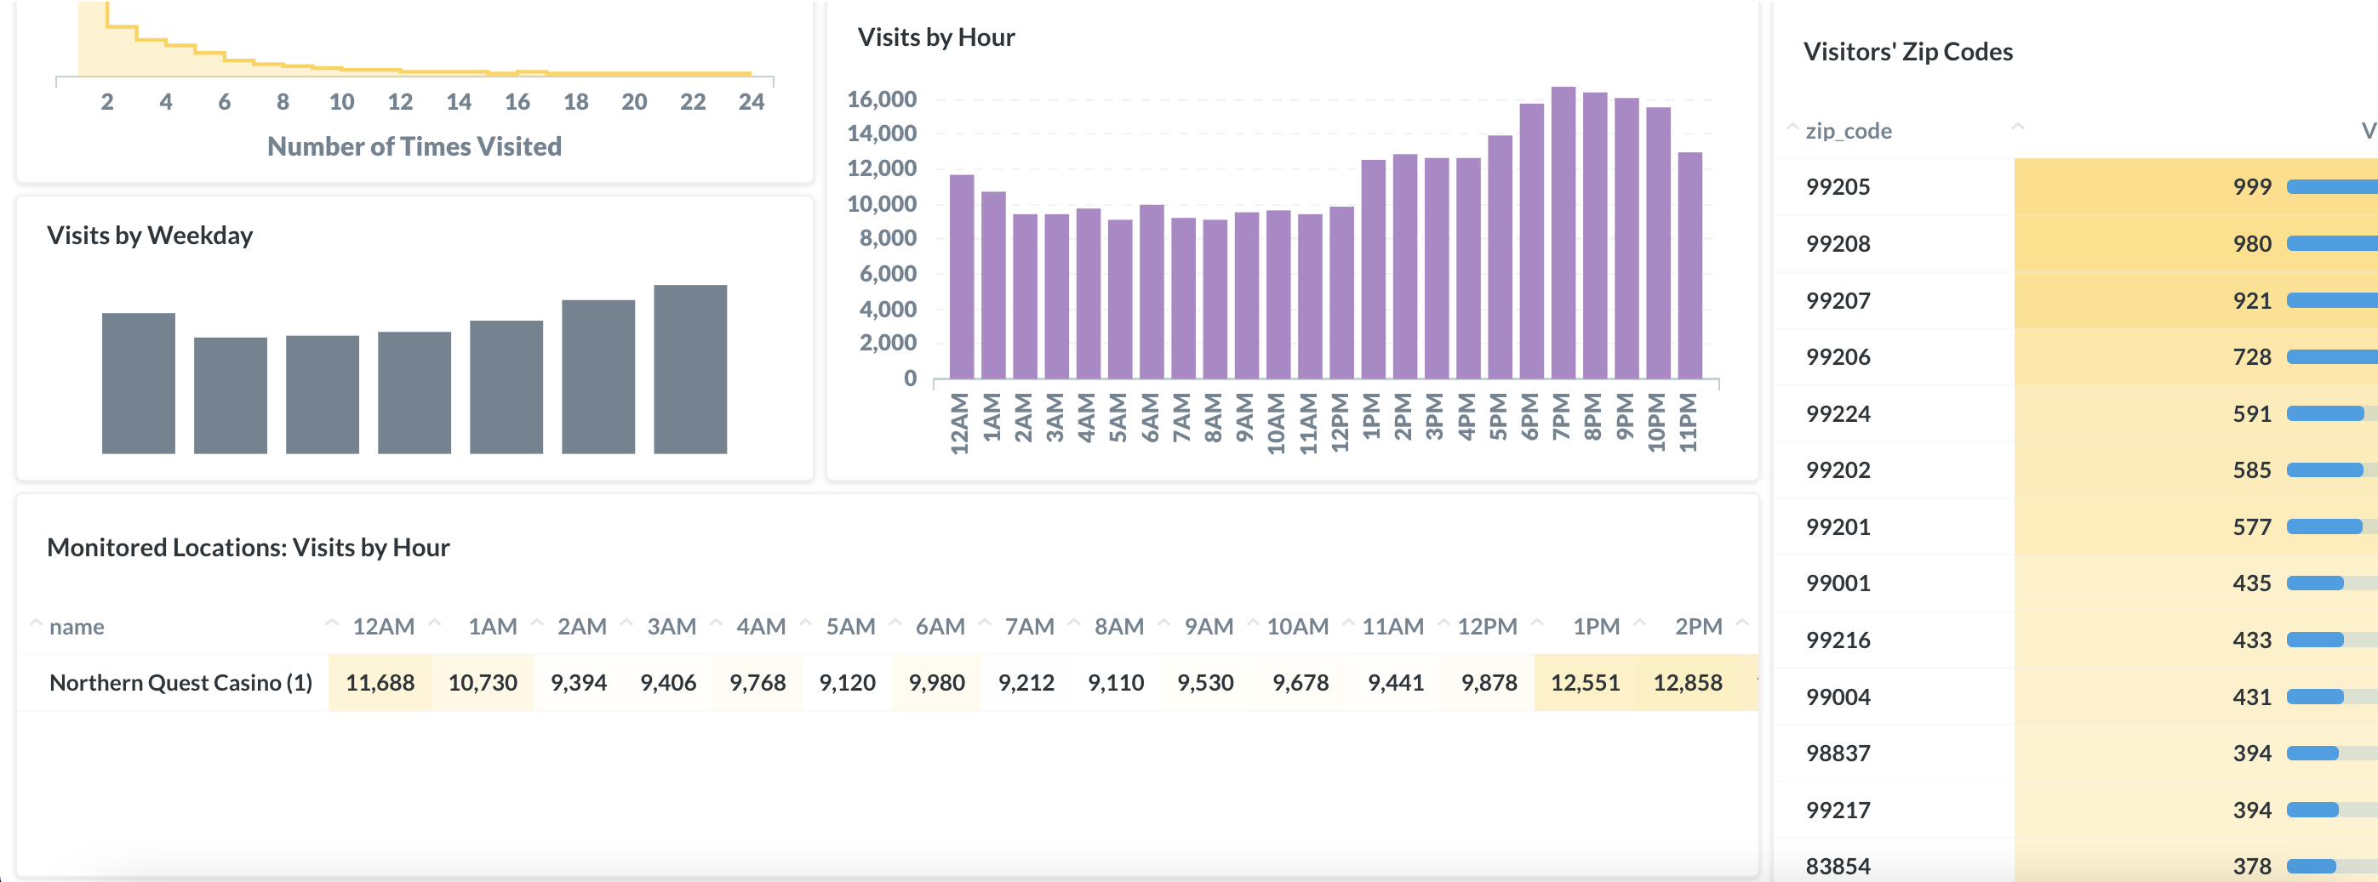
Polygonal targeting and attribution

Slide 24
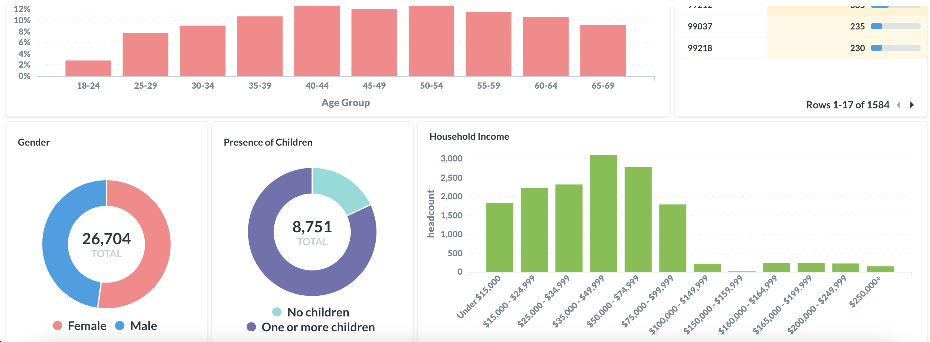
Polygonal targeting and attribution

Slide 25
Case study – valley view casino and hotel
Valley View Casino and Hotel needed to drive more applications for all position types including:
Kitchen
Janitorial
Dealers
Restaurant Staff
VVCH was open to different options to reach their prospects, including running Spanish language advertising

Slide 26
VVCH Strategy
Target specific job titles, keywords, those looking for employment
Target Spanish-language users that are looking for employment
Utilize paid Facebook options for placement to specific targets and job titles

Slide 27
VVCH RESULTS
Campaign-Specific Results
Double industry standard click-thru rates
Three times industry standard on social ads
High engagement on social including shares, comments and clicks
Our client saw an increase of 50% Spanish applicants and close to 50% for English applicants!
While other companies were struggling to find workers, VVCH was receiving consistent applications for all levels of jobs.

Slide 28
TAKEAWAYS
PLATFORMS
technology
CREative
One platform won’t do it all – be everywhere!
Update and post consistently.
Fill out the “Life” portion on LinkedIn and make sure it has personality!
Location-based targeting allows you to find people based on where they have been up to a year in the past.
Always look for new options to tell your company’s story!
Drive interest with what sets you apart.
Talk about benefits, employee success and job title openings.

Slide 29
THANK YOU
Lynn Maurer
lynnm@teaminnovision.com
TeamInnoVision.com

